Slide 1
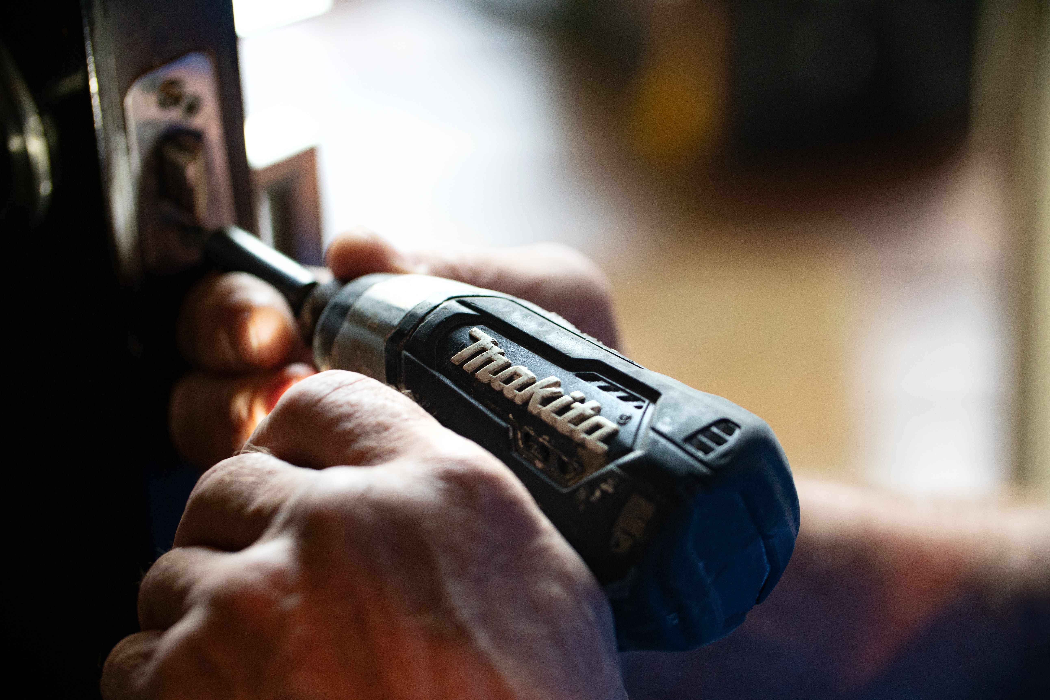
Howdy Neighbour! An app to share tools and equipment
By: Benson Coelho
Notes:
Introduction: Project 3!

Slide 2

Motivation
I bought a house!
Home and garden upkeep needs a fair bit of equipment – some used only a few times a year.
Own or hire?
Cost concerns
Storage space concerns
Get to know your neighbours!
Howdy Neighbour!
Notes:
I came up with the Idea for the app when I bought a house. And I quickly realized that the tools and equipment required for upkeep is an ever growing list. I also started to think about cost and storage space constraints. That made me think about this web application. It’s a way for neighbours to share tools and equipment that they own with others near them and rent from THEIR neighbors when they need it. It also doesn’t hurt to get to know your neighbours. I call it ‘Howdy Neighbour’.

Slide 3







Technologies used
MongoDB geoJSON
….and a number of packages
Notes:
Mongo – database
Express – maikng the connections
Front-end built with react and styled with react-bootstrap, mature package
Google maps APIs were useful to find exact address matches and store coordinates in the DB
Worked for the first time with MongoDB geoJSON schema. Great way to store location data and query it quickly. Reduces 3rd party api calls and cost.
Number of packages including moment for the time aspects, react-dates for calendar and other

Slide 4
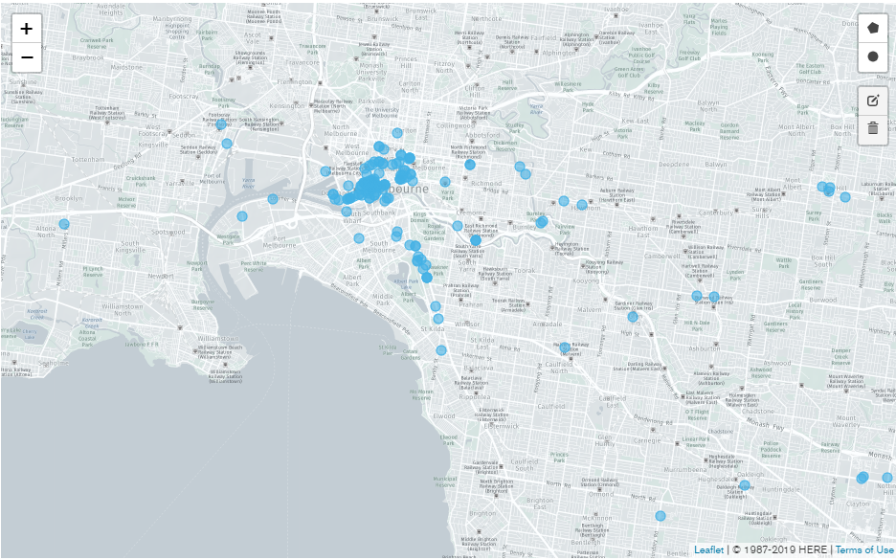
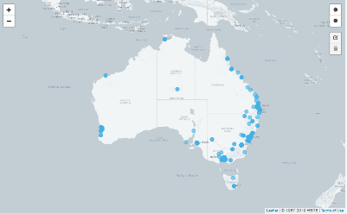
Database – Users & Assets
Approximately 3000 demo users and 15000 assets distributed near the capital cities…
Notes:
Used a publicly available address database
Built JSON seed, randomly assigning assets to each user
About 3000 users in the database for this demo with a total of about 15000 assets

Slide 5
Demonstration
Notes:
Advantage of AUTOJARE:This set is ideal for effortless screw driving and screw removal as well as for drilling in wood, metal and plastic, for the fastening and loosening of bolts, nuts and various threaded fasteners.
ERGONOMIC DESIGN: Lightweight tools designed to fit the users' needs, Soft grip handle for added comfort and total control without heavy fatigue while using
Power Tool Type: Cordless , with variable speed dial to adjust speed, with collet locking sleeve of quick change mechanism for convenient usage
Powered by the 20 voltage,1.5AH Lithium-ion battery for strong and steady power and endurable run time, which is supplied with the battery charger, simple and convenient to charge
LED Lights for providing increased visibility in dark or confined spaces

Slide 6
Future Paths
Interactive map – see who is near you and what’s on offer
In app messaging
Earning and spending tracker
Rating system?

Slide 7
Questions?

Slide 8
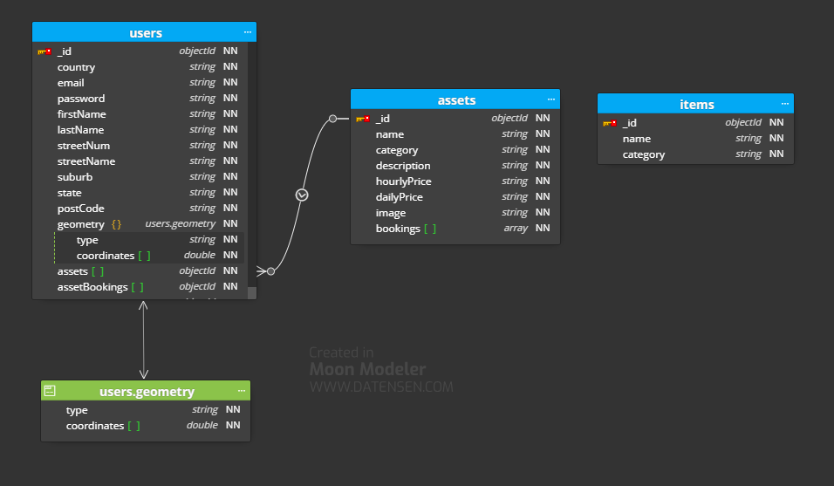
Database – Schema
Notes:
Users table contains all the location and signup data
The user geometry is the geoJSON schema that stores lat/long and the indexing methodology
It also contains the assets the user owns, and bookings that the user has made
Bookings of individual assets are stored at the asset level

