Slide 1

Project 3 Howdy Neighbour!
By: Benson Coelho
Notes:
Introduction: Project 3!

Slide 2
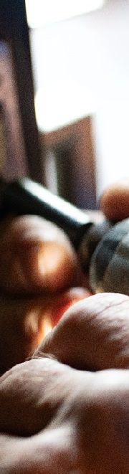
Overall Concept
Create a project building on the skills gained during the bootcamp with emphasis on the MERN stack/MVC design paradigm.
Demonstrate application of both front end and back end technologies to create a product with market applicability
Design a web-application with a market opportunity in keeping with current trends e.g. Sharing economy, in the vein of Uber, AirBNB, Car Next Door …
Notes:
Market opportunity, success stories of similar businesses
Builds on bootcamp skills
Complete application – front-end and back-end

Slide 3
Motivation
I bought a house!
Home and garden upkeep needs a fair bit of equipment – some used only a few times a year.
Own or hire?
Cost concerns
Storage space concerns
Get to know your neighbours!
Howdy Neighbour!
Notes:
Bought a house
Required lots of tools for upkeep
Cost can be an issue
Storage was an issue
Doesn’t hurt to meet your neighbours
EXPLAIN THE GENERAL IDEA OF THE APP!!!!!!!!

Slide 4
Design Process
MERN Stack
Mongo DB - Database
Express - Web server framework
React - Client-side JS framework
Node - Server-side JS runtime environment
MVC Design Paradigm
Modular and Organized codebase
Custom and third-party APIs
Google - Places and Geocoding APIs
Axios - Custom APIs
Notes:
Builds on skills gained during the bootcamp
Mongo storing the data model
Express communicating between front end and back end
React rendering the front end
Node handling server side logic and communicating with he database.

Slide 5







Technologies used
MongoDB geoJSON
….and a number of packages
Notes:
Mongo – database
Express – maing the connections
Front-end built with react and styled with react-bootstrap, mature package
Google maps APIs were useful to find exact address matches and store coordinates in the DB
Worked for the first time with MongoDB geoJSON schema. Great way to store location data and query it quickly. Reduces 3rd party api calls and cost.
Number of packages including moment for the time aspects, react-dates for calendar and other

Slide 6
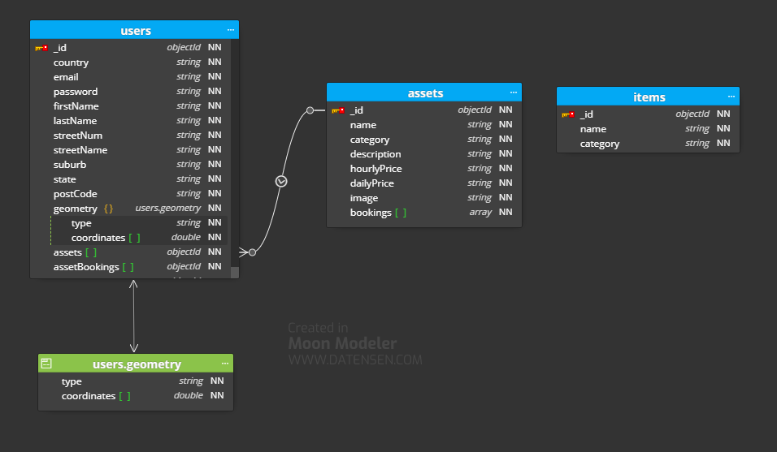
Database – Schema
Notes:
Users table contains all the location and signup data
The user geometry is the geoJSON schema that stores lat/long and the indexing methodology
It also contains the assets the user owns, and bookings that the user has made
Bookings of individual assets are stored at the asset level

Slide 7
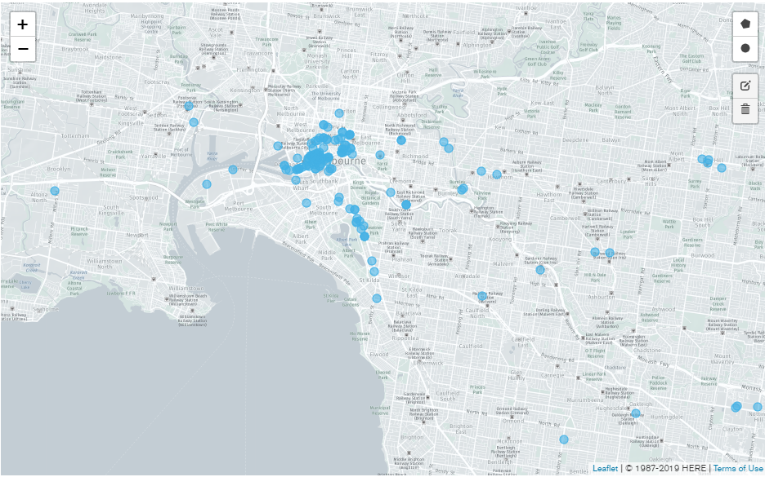
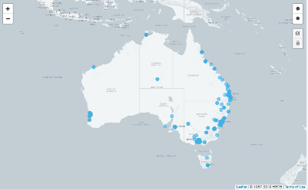
Database – Users & Assets
Approximately 3000 demo users and 15000 assets distributed near the capital cities…
Notes:
Used a publicly available address database
Built JSON seed, randomly assigning assets to each user
About 3000 users in the database for this demo with a total of about 15000 assets

Slide 8
Demonstration

Slide 9
Future Paths
Interactive map – see who is near you and what’s on offer
In app messaging
Earning and spending tracker
Rating system?

Slide 10
Questions?

