Slide 1

Predicting Chicago Taxi Behavior
Team: Cab-ish
Blake DeBenon
Ryan Rudd
Notes:
To change the image on this slide, select the picture and delete it. Then click the Pictures icon in the placeholder to insert your own image.

Slide 2
Executive Overview
Objective: Model Change in the Chicago Taxi Industry
Employed Google Cloud Tools
Utilized Predictive Indicators
Applied Linear Regression Model
Derived Predictive Results

Slide 3
Data Management

Slide 4
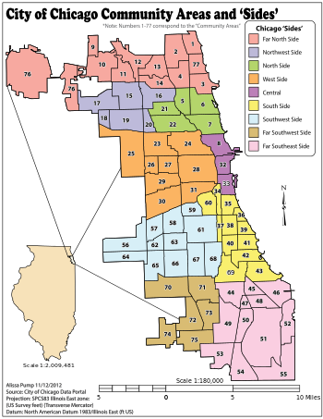
Division of Data by Community
Data Management
Indicators
Methodology
Results
The Chicago area consists of 77 communities
Data within communities have correlation

Slide 5


Google Tools
Data Management
Indicators
Methodology
Results

Slide 6
Indicators

Slide 7
Target Variable
Data Management
Indicators
Methodology
Results
Taxi Rides Per Day
Community level
Aggregate Chicago level

Slide 8
Predictive Indicators
Data Management
Indicators
Methodology
Results
Exponential Moving Average
Taxi rides per day
Widely used in the financial industry
Polynomial Average
Taxi rides per day
Average of 2nd and 4th degree
Revenue per day
High occurrence of obvious outliers

Slide 9
Predictive Indicators
Data Management
Indicators
Methodology
Results
Exponential Moving Average
Taxi rides per day
Widely used in the financial industry
Polynomial Average
Taxi rides per day
Average of 2nd and 4th degree
Revenue per day
High occurrence of obvious outliers

Slide 10
Predictive Indicators
Data Management
Indicators
Methodology
Results
Exponential Moving Average
Taxi rides per day
Widely used in the financial industry
Polynomial Average
Taxi rides per day
Average of 2nd and 4th degree
Revenue per day
High occurrence of obvious outliers

Slide 11
Predictive Indicators
Data Management
Indicators
Methodology
Results
Exponential Moving Average
Taxi rides per day
Widely used in the financial industry
Polynomial Average
Taxi rides per day
Average of 2nd and 4th degree
Revenue per day
High occurrence of obvious outliers

Slide 12
Methodology

Slide 13
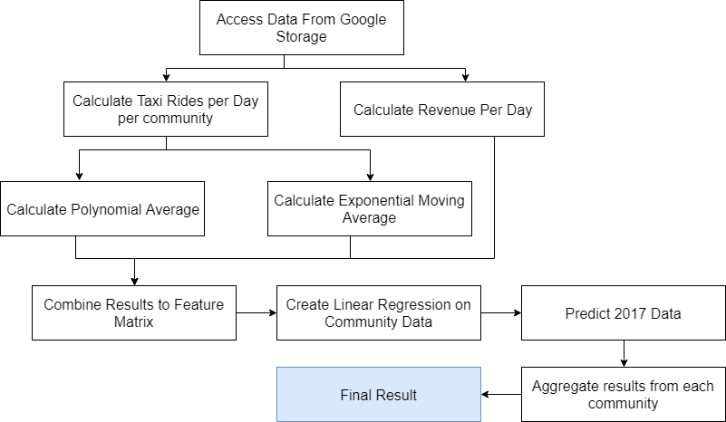
Flow of Methodology
Data Management
Indicators
Methodology
Results

Slide 14
Linear Regression
Data Management
Indicators
Methodology
Results
Train Model
Exponential Moving Average
Polynomial Average
Revenue (Deprecated)
Make Predictions
Number of taxis per day per community

Slide 15
Results

Slide 16
Revenue vs No Revenue Results
Data Management
Indicators
Methodology
Results

Slide 17
Final Results
Data Management
Indicators
Methodology
Results

Slide 18
Conclusions
Data Management
Indicators
Methodology
Results
Decreasing rate of rides per day
Actual 2017 rate of decline of 11.6%
Predicted 2017 rate of decline of 32.1%

