Slide 1
Integrating OpenShift into the Development Process
Bill DeCoste
JBoss Solutions Architect
wdecoste@redhat.com

Slide 2
Agenda
OpenShift Overview
Demo – OpenShift Basics
Demo – Local Git Pushes to OSE via Git Hook
Demo – GitHub Pull Requests to OSE via Jenkins
Demo – Maven Deployments
Demo – Binary Deployments

Slide 3
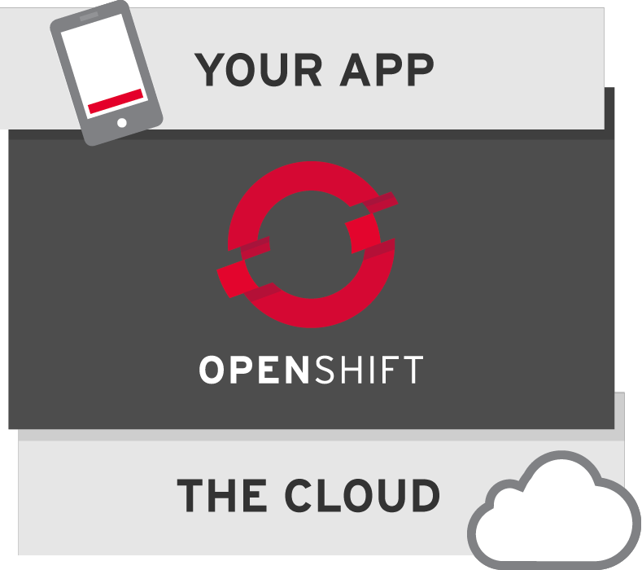
What is OpenShift?
Red Hat’s free platform as a service for applications in the cloud.

Slide 4

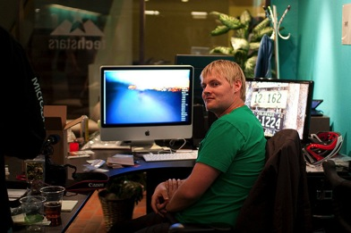


DEVOPS IMPLEMENTED MAKES LIFE BETTER
ACCELERATED APP DELIVERY FOR THE BUSINESS
SELF-SERVICE ACCESS TO THE LATEST TOOLS FOR DEVS
STANDARDIZED AND CONTROLLED ENVIRONMENTS FOR OPS

Slide 5
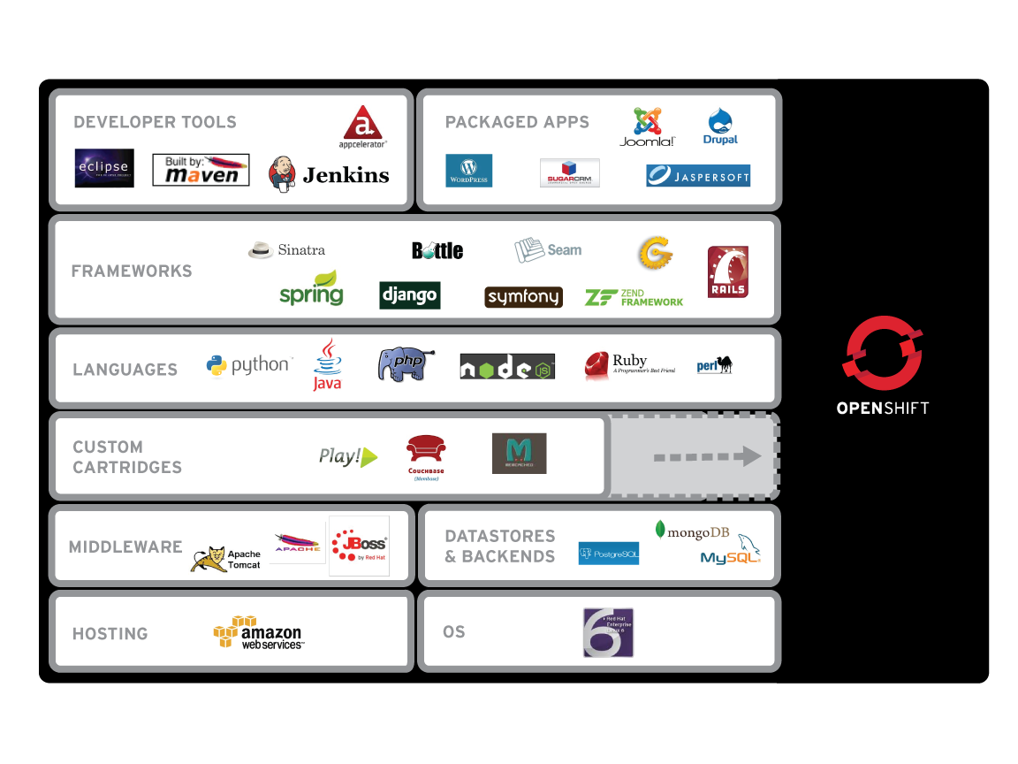
What’s supported?

Slide 6



Flavors
Open Source Project
origin
Public Cloud Service
On-premise or Private Cloud Software

Slide 7
Terminology
Broker – Management host, orchestration of Nodes
Node – Compute host containing Gears
Gear – Allocation of fixed memory, compute, and storage resources for running applications
Cartridge – A technology/framework (PHP, Perl, Java/JEE, Ruby, Python, MySQL, etc.) to build applications
Application – Instantiation of a Cartridge
Client Tools – CLI, Eclipse Plugin, Web Console, Java API, REST API for creating and managing applications

Slide 8
Topics
Git
  Mechanism for pushing code, triggering builds & deployments
  NOT SOURCE CONTROL!!!
  Use Jenkins and/or Git Hooks to integrate w/source control
OpenShift in Stage & Production
  No builds. Deploy pre-built binary artifacts
  Use binary deployment feature or Maven

Slide 9
Enough Slides!!!
Time for the Demo

Slide 10
xPaaS/iPaaS
xPaaS
  Cartridges for Entire JBoss & Fuse Portfolio
  EAP and EWS Enterprise Cartridges Today
  Several Community Cartridges Available Today
iPaaS
  Integration PaaS
  Fuse/Fabric Cartridge

Slide 11

RUNS ON IaaS
OpenShift Origin is a PaaS that runs on top of..... Infrastructure
Amazon EC2
Rackspace
Bare Metal
OpenStack
RHEV
VMWare

Slide 12
BROKER
An OpenShift Broker can manage multiple node hosts.
Nodes are where User Applications live.
Fedora/RHEL
Fedora/RHEL
Fedora/RHEL
Brokers
Node
Node

Slide 13
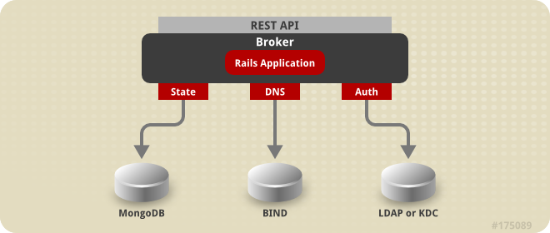
BROKER
The Broker is responsible for state, DNS, and authentication.

Slide 14
SELINUX
SELinux Policies securely subdivide
the Node instances.
Fedora/RHEL
Fedora/RHEL
Brokers
Node
Node

Slide 15
GEARS
OpenShift GEARS represent secure containers in RHEL
Fedora/RHEL
Fedora/RHEL
Brokers
Node
Node

Slide 16

CARTRIDGES
Web Console
Eclipse IDE
Cmd Line
MYSQL
JBOSS
Fedora/RHEL
Fedora/RHEL
Brokers
Node
Node

Slide 17
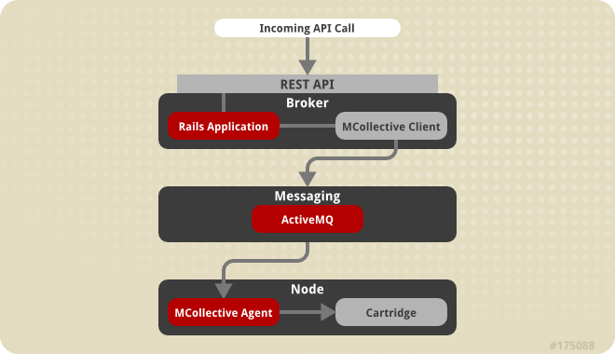
COMMUNICATION
Communication from external clients occurs through the REST API
The Broker then communicates through the messaging service to nodes

Slide 18
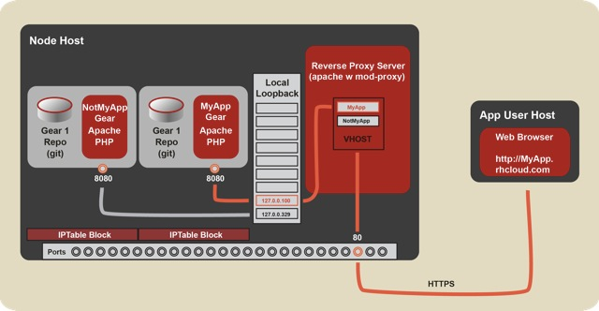
HTTP FLOW
Notes:
OpenShift Origin - Port Proxy
Linux handles the loopback interface's 127.0.0.0/8 address block specially: A request from an address in this block can only go to an address in the same block (put another way, a connection on the loopback interface is confined to the loopback interface). OpenShift uses this fact to contain hosted applications: a gear is prohibited by iptables from listening on an external network interface, and so a given gear can only respond to connections that come from processes on the same node.
For the common case of Web connections, the system Apache instance acts as a reverse proxy, forwarding requests that come in on the external interface to the appropriate 127.x.y.z address; see the documentation on the node component.
However, sometimes gears need to accept other types of connections. The two most common such scenarios are the following:
A gear needs to connect to another gear (which may be on the same node or another node).
A gear needs to listen for connections on a public interface besides HTTP connections to port 80.
For example, a game server needs to expose a port to receive incoming connections from clients, and a database needs to expost a port so that other gears can connect to it.
To meet these needs, OpenShift uses haproxy to proxy TCP connections between an external-facing network interface and the loopback interface. Each gear is assigned five exposable ports, and the gear may establish a forwarding rule for each of these ports to forward connections on the the port on the external interface to an arbitrary port on the gear's assigned loopback address.
To provide haproxy with adequate ports, we shift the ephemeral port range down to 15000-35530, so that Linux will not use ports outside of this range for connections for which no port is given explicitly. This means that ports 35531-65535 will be available for haproxy's exclusive use.
Note: Given that each gear is assigned 5 ports, this imposes a limit of 6000 gears per node.
The interaction with haproxy is implemented on the cartridge side in cartridges/openshift-origin-cartridge-abstract/abstract/info/lib/network
and:
OpenShift Origin - Node Component
Hosted applications are run in containers called "gears." These gears are run on hosts (which can be physical hosts or virtual machines) called "nodes."
Each node runs a system Apache instance with mod_proxy that listens on port 80 on a public-facing network interface. Each gear is assigned an address in the 127.0.0.0/8 block, and a hosted Web application listens on port 8080 on its assigned private 127.x.y.z address.
When a Web client requests a URL for a hosted Web application, the request goes to the node's system Apache instance. The system Apache instance examines the virtual-host header (the "Host:" HTTP header) and dispatches the request to the 127.x.y.z:8080 private address of the appropriate gear.
For an explanation of how connections other than regular HTTP connections are handled, see the documentation on the port-proxy.

Slide 19
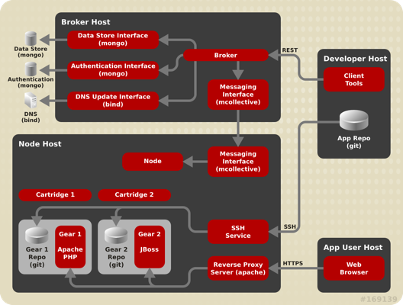
Architecture

Slide 20
SCALING
HA-Proxy
Code
Code
Code
Java
Java
Java
RHEL
MySQL
Notes:
And, once the application is launched within the OpenShift PaaS, OpenShift provides the elasticity expected in a Cloud Application Platform by automatically scaling the application as needed to meet demand.
When created, applications can be flagged as “Scalable” (some apps may not want to be scaled). When OpenShift sees this flag, it creates an additional Gear and places an HA-Proxy software load-balancer in front of the application. The HA-Proxy then monitors the incoming traffic to the application. When the number of connections to the application crosses a certain pre-defined threshold, OpenShift will then horizontally scale the application by replicating the application code tier of the application across multiple Gears.
For JBoss applications, OpenShift will scale the application using JBoss Clustering which allows stateful or stateless applications to be scaled gracefully. For Ruby, PHP, Python, and other script-oriented languages, the application will need to be designed for stateless scaling where the application container is replicated across multiple gears. The Database tier is not scaled in OpenShift today.
Automatic application scaling is a feature that is unique to OpenShift among the popular PaaS offerings that are out there.
Automatic scaling of production applications is another example of how OpenShift applies automation technologies and a cloud architecture to make life better for both IT Operations and Development.
<next slide>

Slide 21
Environmental Variables
Provided by Nodes & Cartridges for Cartridge & Application Use
  UUIDs
  URLs, Hosts, Ports
  Directories (e.g. gear home, tmp, data, log)
  Credentials
http://openshift.github.io/documentation/oo_cartridge_developers_guide.html#environment-variables

Slide 22
Minimal Cartridge
+- bin
| +- setup
| +- control
+- env
+- metadata
| +- manifest.yml
*Assumes packaged software already installed on system
*Most cartridges will have more files

Slide 23
Downloadable Cartridges
Implement your own cartridges (e.g. as github project)
No need for RPMs, installation
ZIP, tarball also supported
rhc app create app-name url-to-raw-manifest
https://raw.github.com/bdecoste/openshift-origin-cartridge-infinispan/master/metadata/manifest.yml
End of “When will OpenShift support … ???”
https://www.openshift.com/developers/download-cartridges

Slide 24
Channels
G+ Community
https://plus.google.com/communities/114361859072744017486
E-Mail
  OpenShift Users: users@lists.openshift.redhat.com
  Origin Developers: dev@lists.openshift.redhat.com
IRC: irc.freenode.net
  OpenShift Users: #openshift
  Origin Developers: #openshift-dev
  Node/Cartridge Developers: #openshift-dev-node

Slide 25
Channels
Forums
http://openshift.redhat.com/community/forums/openshift
Blogs
  https://openshift.redhat.com/community/blogs/
  http://mattoncloud.org/
  http://www.billdecoste.net
  http://www.krishnaraman.net
  http://cloud-mechanic.blogspot.com

Slide 26
Channels
Forums
http://openshift.redhat.com/community/forums/openshift
Blogs
  https://openshift.redhat.com/community/blogs/
  http://mattoncloud.org/
  http://www.billdecoste.net
  http://www.krishnaraman.net
  http://cloud-mechanic.blogspot.com

Slide 27
OpenSource
GitHub: https://github.com/openshift
  Origin: origin-server
  Quickstarts, Examples
  Watch, Star, Contribute!!!

