Slide 1
COAL-FO Alpha Release Progress Report
Bryce Egley, Kenny Thompson

Slide 2
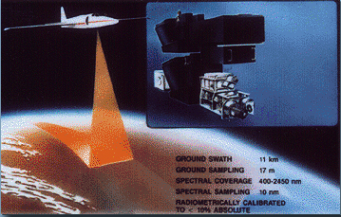
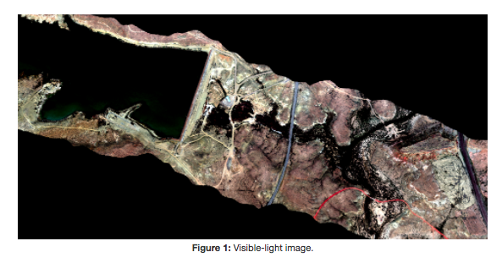
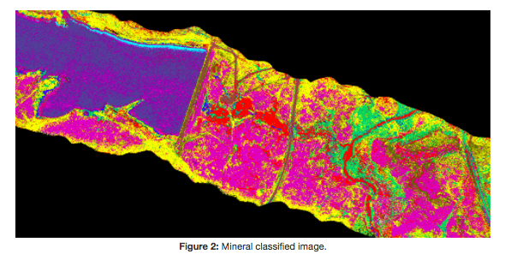
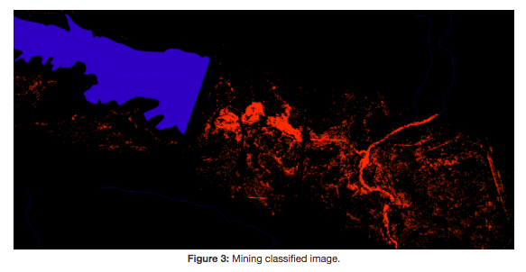
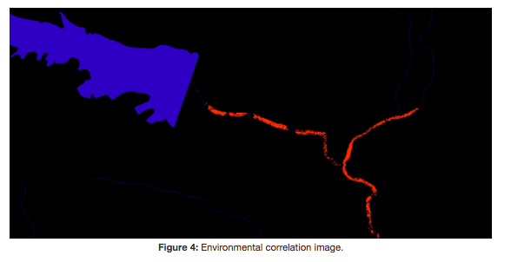
Project Overview-Group Intro
Presenter: Bryce Egley

Slide 3
What I have been working on
Fall Quarter - Week 2 Winter Quarter(Start - Jan 16)
Getting examples running and fixing bugs I found in the examples
Week 2 - Week 4 (Jan 19-Jan 30)
Update Docker Image to include Python 3
Week 4 - Week 4 (Jan 30 - Feb 1)
Update Docker Image to force install apache2
Week 2 - Week 5 (Jan 19 - Feb 7)
Updating QGIS and GDAL installation instructions
Week 5 - Week 6 (Feb 8 - Feb 15)
Create CLI
All of this is reflected on GitHub and my weekly OneNotes
Presenter: Bryce Egley

Slide 4
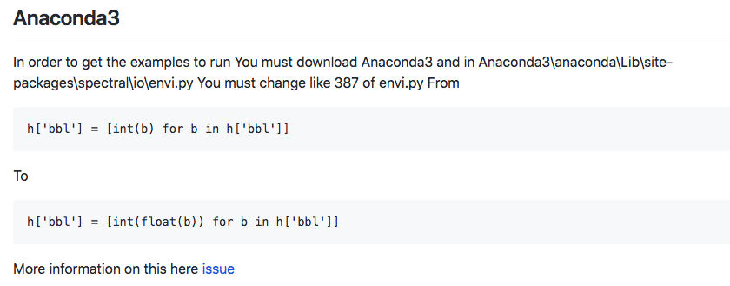
Getting Examples working and fixing bugs with examples
We didn’t want the bbl value to be just 0 or 1. They could be ints or floats
There were a lot of errors with how the old examples were passing files since the location they told us to put files in were in the wrong place based on the code.
Presenter: Bryce Egley

Slide 5
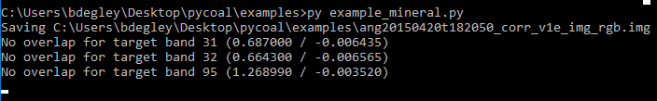
Running Example Scripts
The mineral classification can take hours to days. So, I won’t run that one but I will show you the files that it creates.
The mining classification and environmental classification take a few minutes so I will run those and then skip the video to the end to make the presentation fit into a ten minute window.
This is what the example_mineral script looks like when it runs. As you can see it saved the corr_v1e_img_rgb.img the mineral classification will be the other image generated.
Presenter: Bryce Egley

Slide 6
Updating QGIS/GDAL
QGIS is how we view the mineral, mining and environment classification images.
GDAL is used with QGIS to read and write raster and vector geospatial data formats.
I upgraded QGIS and GDAL installation instructions on capstone-coal.github.io so that users could get the most up to date version and have it work on all systems. The old way used Debian which was mainly for GNU/Linux systems.
I now will demo QGIS displaying a few of these images
Presenter: Bryce Egley

Slide 7
CLI Command Line Interface
The command line interface will allow us to automate the process of running AVIRIS and AVIRIS-NG images through pycoal to generate mineral, mining and environmental images.
Instead of changing the code in the example scripts we will just pass the file names as arguments
You can simply run pycoal-mineral -h, pycoal-mining -h, pycoal-environment-h or for pycoal-mining -mi ang20150420t182050_corr_v1e_img_class.hdr -mo ang20150420t182050_corr_v1e_img_class_mining.hdr which would generate a mining classification image
I will now demo this
Presenter: Bryce Egley

Slide 8
CLI commands
pycoal-mineral -i ang20150420t182050_corr_v1e_img.hdr -s s06av95a_envi.hdr -r ang20150420t182050_corr_v1e_img_rgb.hdr -c ang20150420t182050_corr_v1e_img_class.hdr
pycoal-mining -mi ang20150420t182050_corr_v1e_img_class.hdr -mo ang20150420t182050_corr_v1e_img_class_mining.hdr
pycoal-environment -m ang20150420t182050_corr_v1e_img_class_mining.hdr -hy Shape/NHDFlowline.shp -e ang20150420t182050_corr_v1e_img_class_mining_NHDFlowline_correlation.hdr
Presenter: Bryce Egley

Slide 9
My plans for the future
Enable use of EcoSIS Spectral Library
This will improve our classifications
2) Upgrade to use USGS Spectral Library Version 7
Clearer imager
3) Get more Data
Our current data is focused on San Juan Mine Case study. This data does not include USGS Spectral Library Version 7. Other data might
More info on these issues here: https://github.com/capstone-coal/pycoal/issues
Presenter: Bryce Egley

Slide 10
Coal-SDS
-The goal for this aspect of the project is development of tools we can use to process massive amounts of data
-Most of the work up tell now has been preparing everything to start processing the data
-We finally have everything prepared to run, and have begun the process of powering through the data we want to feed into it
Presenter: Kenny Thompson

Slide 11
XSEDE vs Amazon Web Services
-Initially the project had a grant to use XSEDE services
-We began testing initially on AWS because of the ease of use, but the process for making the XSEDE build is very similar to the AWS, and the plan is still to use that grant
-Amazon web services does give a free student tier that has been useful in processing data, and giving us comporable results to our eventual goal of XSEDE
Presenter: Kenny Thompson

Slide 12
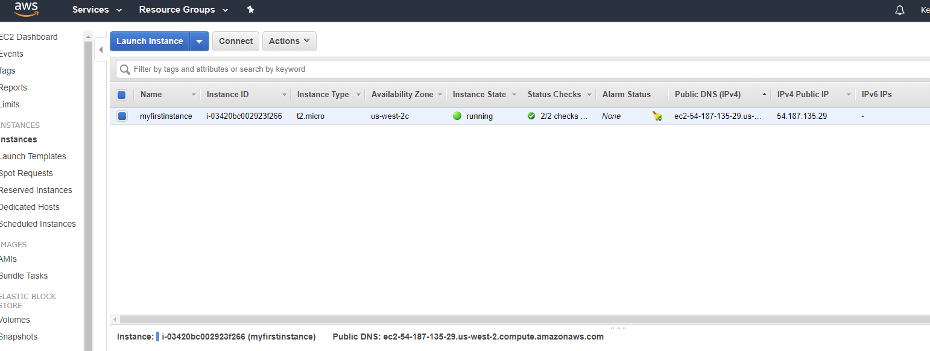
Current AWS Instance running File Manager
Presenter: Kenny Thompson

Slide 13
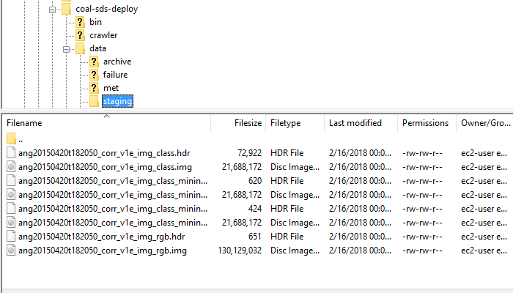
Current File Manager Staging
Presenter: Kenny Thompson

Slide 14
Demonstration of functionality
-The now functioning build on AWS of Apache OODT with Coal-sds integration
-The ability to stage files, and process data
Presenter: Kenny Thompson

Slide 15
Future
Alpha goal was to show a working deployment of coal-sds on the AWS, and we have indeed done that.
Beta goal is to start using the resource from the grant we were intially given
As well as make small continuous improvements to the COAL-SDS framework and implementation
Address any issues that come from porting to XSEDE
Presenter: Kenny Thompson

