Slide 1
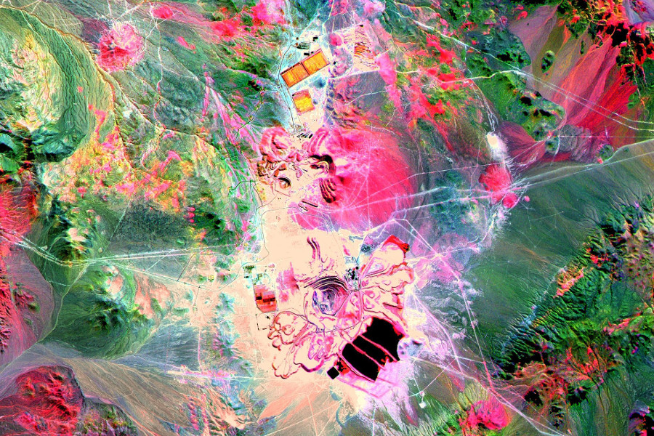
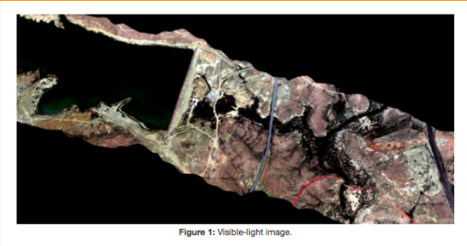
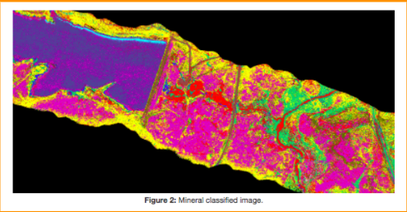

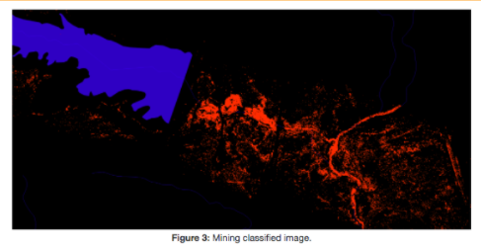
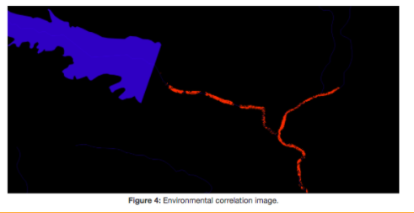

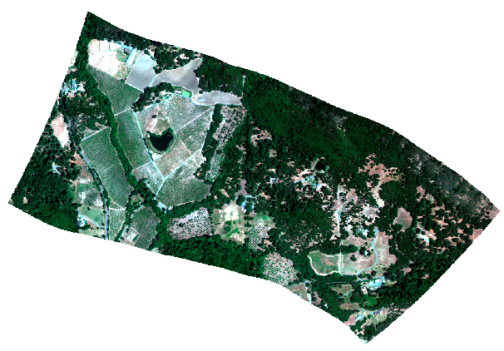
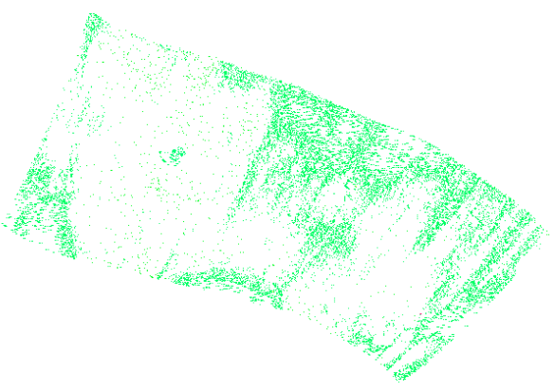
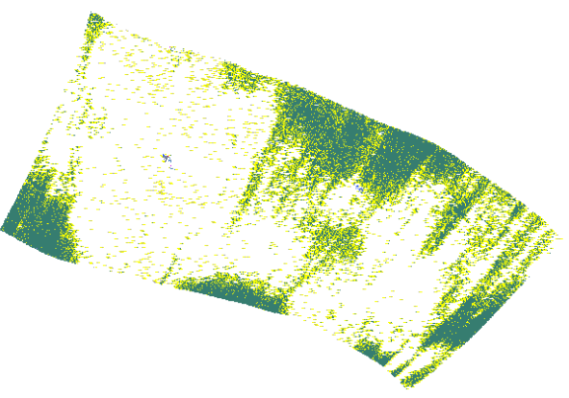


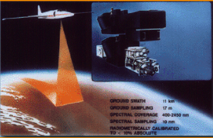
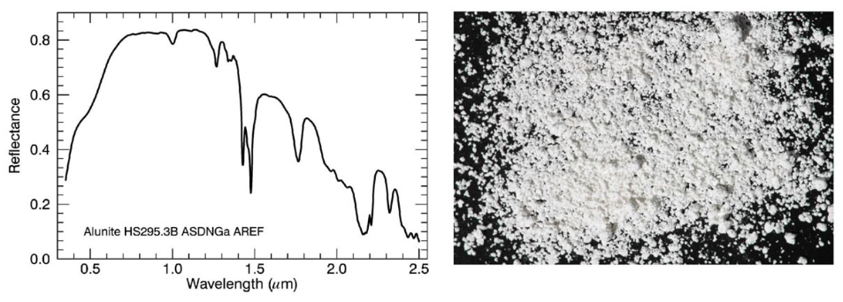
CS 28
COAL-FO:
COAL and Open-pit surface mining impacts on American Lands Follow-On
COAL-FO will allow researchers to analyze the mineral, mining and environmental impacts to American lands from Open-pit surface mining.
PROJECT BACKGROUND
Coal and Open-pit surface mining impacts on American Lands Follow-On (COAL-FO) is the successor project to the 2016-2017 COAL project. COAL initially aimed to deliver a suite of algorithms to identify, classify, characterize, and quantify (by reporting a number of key metrics) the direct and indirect impacts of mining operations and related destructive surface mining activities across the continental U.S (and further afield). COAL successfully delivered a Python library for processing hyperspectral imagery from remote sensing devices such as the Airborne Visible/InfraRed Imaging Spectrometer (AVIRIS) and a Science Data System for running COAL pipelines.
Project Description: The COAL-FO is a continuation of a previous project completed in the 2016-2017 capstone COAL project. The COAL project was a stable python toolkit providing examples, tests, packages, stable release and stable API that identified, classified, and quantified the effects of open-pit mining on the surrounding environment. The COAL-FO project improved the existing algorithms and general functionality as well as enabled the toolkit to work with more spectral libraries.
THE TEAM:
-Lewis John Mcgibbney -Client lewis.mcgibbney@gmail.com
The Mineral Classification API provides methods for generating visible-light (Figure 1)
The Mineral Classification API provides methods for mineral classified (Figure 2) images.
-Kenneth Thompson
-Student
thomkenn@oregonstate.edu
The Mining Identification API filters mineral classified images to identify specific classes of interest (figure 3)
The Environmental Correlation API finds pixels in a mining classified image that are within a certain number of meters from features in a vector layer (Figure 4)
AVIRIS: Airborne Visible / Infrared Imaging Spectrometer
USGS Spectral Library Version 7
-Bryce Egley -Student egleyb@oregonstate.edu
Figure 7: RGB Visible Light Image
Figure 8: USGS Spectral Library Version 6 Mineral Classification
Figure 9: USGS Spectral Library Version 7 Mineral Classification
Figure 5: AVIRIS Flight
The COAL project used USGS Spectral Library Version 6. The COAL-FO capstone project has designed a method for convolving USGS Spectral Library Version 7 into envi file format. This allows pycoal to classify more spectra, improving the classification images. USGS Spectral Library Version 7 is the most up to date Spectral Library by USGS and contains more spectra than any other current spectral library.
AVIRIS has been flown on four aircraft platforms: NASA's ER-2 jet, Twin Otter International's turboprop, Scaled Composites' Proteus, and NASA's WB-57.
Spectra: Wavelength values that vary over a range of reflectance.
Conclusion & Results
Bryce has improved QGIS/GDAL installation instructions to work with more systems, created a Command Line Interface(CLI), upgraded pycoal to use USGS Spectral Library Version 7 and found more data for pycoal to classify. Kenny has worked on exporting product imagery to AWS and creating a classifier callback.
Figure 6: Example Spectra

