Slide 1
Recommender Algorithm Methods
Bethany DeMerchant
CS 432 A. Nwala
25 April 2019

Slide 2

Baseline Predictors (biases)
Ratings are affected by inherent traits of items and users
Some items receive higher ratings, some users give lower ratings
We can try to account for this using baseline predictors
$b_{ui}$ is the baseline prediction of a given user’s rating of a given item

Slide 3


$$b_{ui}=μ+b_{i}+b_{u}$$
$b_{ui}$is a generic prediction based solely on external traits
$μ$ is the average rating of all movies
$b_{i}$ is the bias of a specific movie (independent of reviewer)
$b_{u}$is the bias of a specific user (independent of movie)

Slide 4
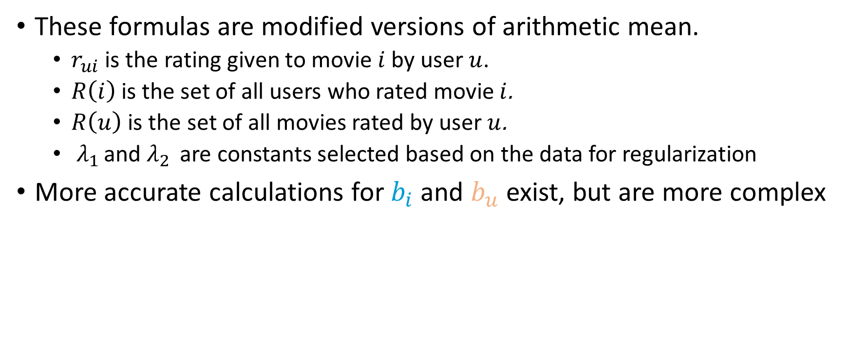
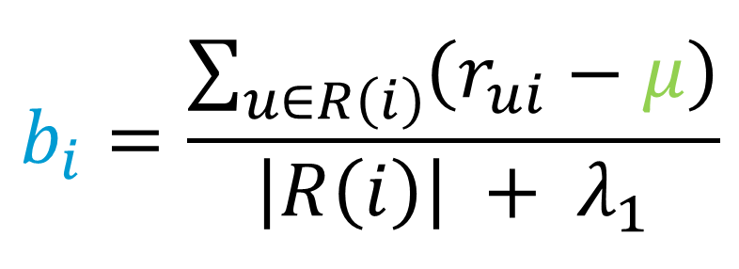
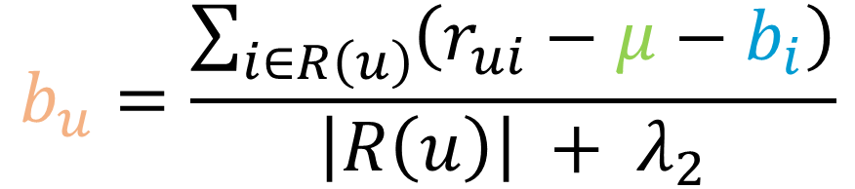
$$b_{i}=\frac{\sum_{u∈R\left(ⅈ\right)}{\left(r_{ui}−μ\right)}}{\left|R\left(ⅈ\right)\right| + λ_{1}}$$
$$b_{u}=\frac{\sum_{i∈R\left(u\right)}{\left(r_{ui}−μ−b_{i}\right)}}{\left|R\left(u\right)\right| + λ_{2}}$$
These formulas are modified versions of arithmetic mean.
$r_{ui}$ is the rating given to movie $ⅈ$by user $u$.
$R\left(ⅈ\right)$ is the set of all users who rated movie $ⅈ$.
$R\left(u\right)$ is the set of all movies rated by user $u$.
$λ_{1 }$and $λ_{2 }$ are constants selected based on the data for regularization
More accurate calculations for $b_{i}$ and $b_{u}$ exist, but are more complex

Slide 5
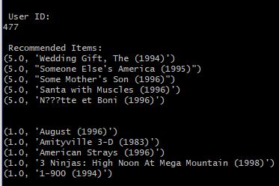
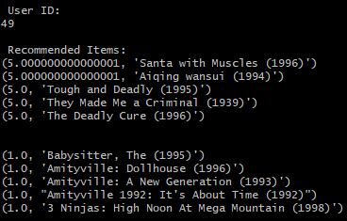
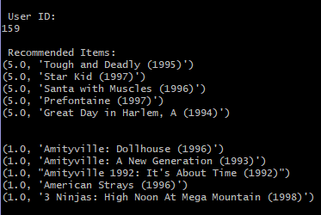
The ‘Santa with Muscles’ Problem
All three users receive extremely similar results.
What’s more, all projected ratings are either 5.0 or 1.0.
This points to something odd in the results…

Slide 6
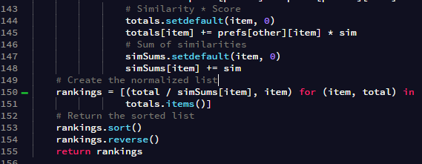
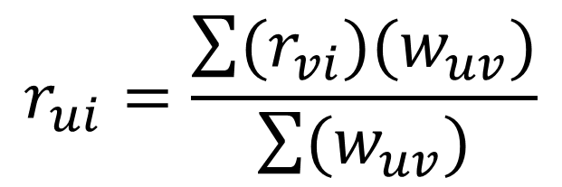
The getRecommendations() function
$$r_{ui}=\frac{\sum{(r_{vi})(w_{uv})}}{\sum{(w_{uv})}}$$
The code on the left performs the operations of this equation.

Slide 7
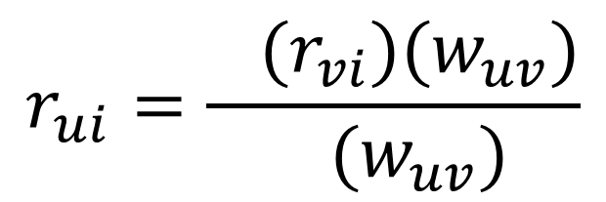
The getRecommendations() function
$$r_{ui}=\frac{\sum{(r_{vi})(w_{uv})}}{\sum{(w_{uv})}}$$
When there’s only one item to consider, no addition is done.
The similarity terms now cancel each other out.
This returns the original rating!

Slide 8
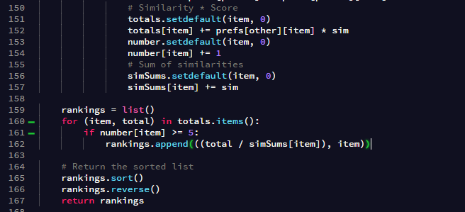
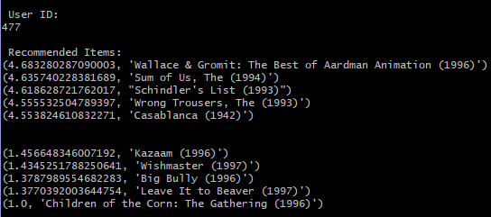
A crude solution
Code has been added to count the number of ratings an item has.
Movies with less than five ratings are not considered it the ratings.
This prevents movies with one high rating from overwhelming the results.

Slide 9
Ricci, Francesco, et al. Recommender Systems Handbook. 2nd ed., Springer, 2015.

