Slide 1

Little Bird Gardens Nursery
Administrators
and Users
The First Level Administrator will have all privileges to access the database but the pricing will be the one field unique to the first level of Administrator.
The Second Level Administrator will have Update, insert, and delete privileges to keep the inventory up to date. Price will be the only field Second Level Administrator will not have privileges for.
The general public will be able to use the site to order trees, shrubs, and perennials.

Slide 2
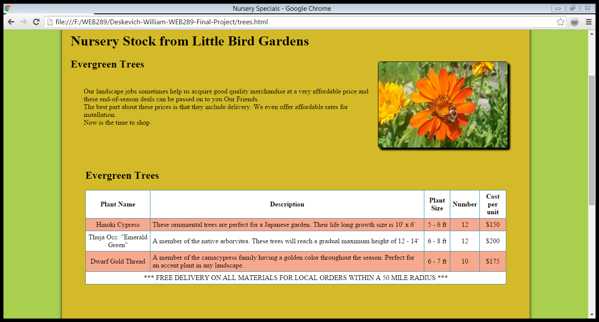

Slide 3
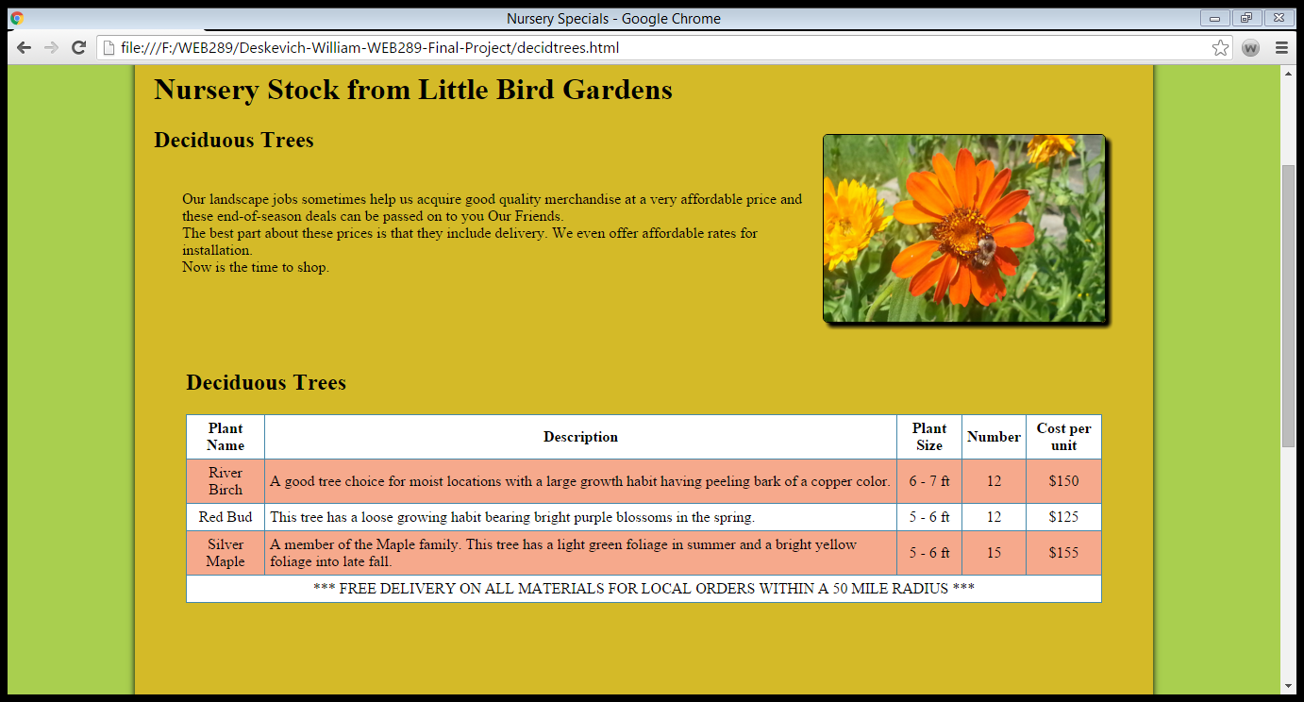

Slide 4
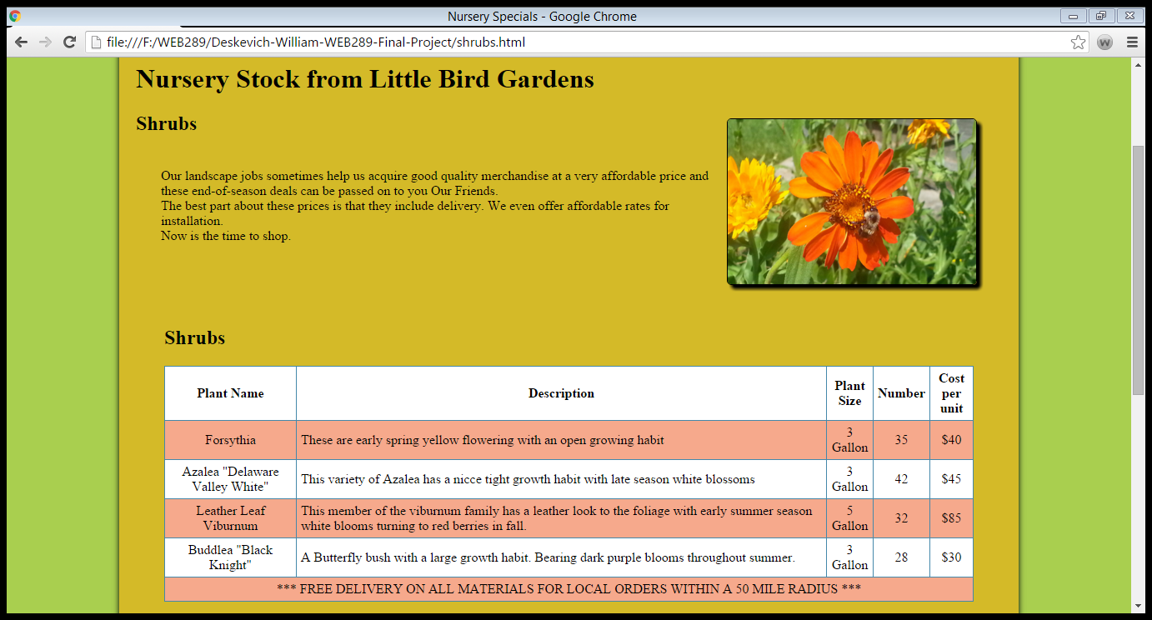

Slide 5
