Slide 1
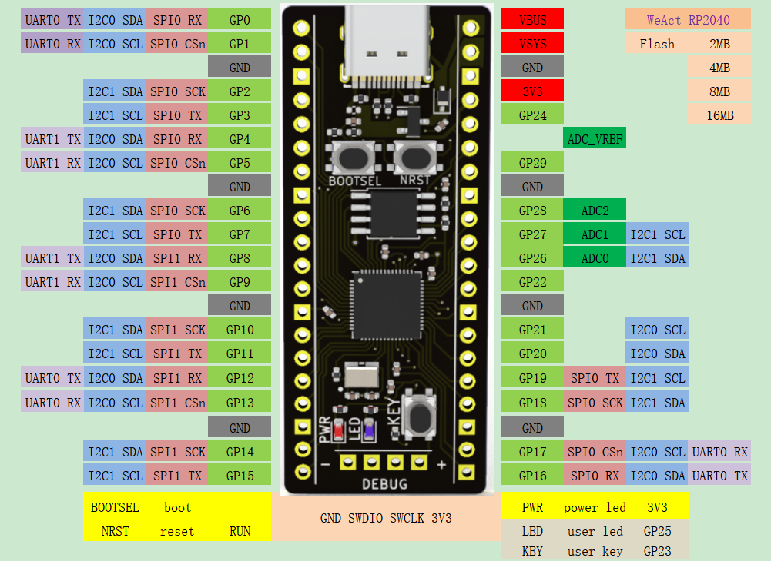
GP00 | TeleI0
GP01 | TeleI1
GND
GP02 |
GP03 |
GP04 | UART1-TX
GP05 | UART1-RX
GND
GP06 | TeleI2
GP07 | TeleI3
GP08 | TeleI4
GP09 | TeleI5
GND
GP10 |
GP11 |
GP12 | UART0-TX
GP13 | UART0-RX
GND
GP14 | TeleI6
GP15 | TeleI7
VBUS
VSYS
GND
3V3
GP24
ADC_VREF
GP29
GND
GP28
GP27
GP26 | LED0
GP22 | LED1
GND
GP21 | LED2
GP20 | LED3
GP19 | LED4
GP18 | LED5
GND
GP17 | LED6
GP16 | LED7

Slide 2
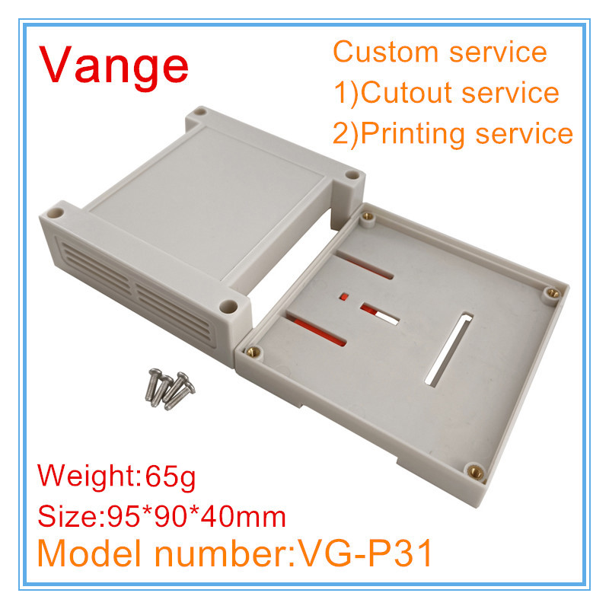

Slide 3
JACK 24V
Bornier 2p 24V
Bornier 2p 5V
Bornier 3p UART1
Bornier 3p UART2
LED0
LED1
LED2
LED3
LED4
LED5
LED6
LED7
VBUS
VSYS
GND
3V3
GP24
ADC_VREF
GP29
GND
GP28
GP27
GP26 | LED0
GP22 | LED1
GND
GP21 | LED2
GP20 | LED3
GP19 | LED4
GP18 | LED5
GND
GP17 | LED6
GP16 | LED7
GP00 | TeleI0
GP01 | TeleI1
GND
GP02 |
GP03 |
GP04 | UART1-TX
GP05 | UART1-RX
GND
GP06 | TeleI2
GP07 | TeleI3
GP08 | TeleI4
GP09 | TeleI5
GND
GP10 |
GP11 |
GP12 | UART0-TX
GP13 | UART0-RX
GND
GP14 | TeleI6
GP15 | TeleI7
Bornier 2p TeleI0
Bornier 2p TeleI1
Bornier 2p TeleI2
Bornier 2p TeleI3
Bornier 2p TeleI4
Bornier 2p TeleI5
Bornier 2p TeleI6
Bornier 2p TeleI7

