Slide 1
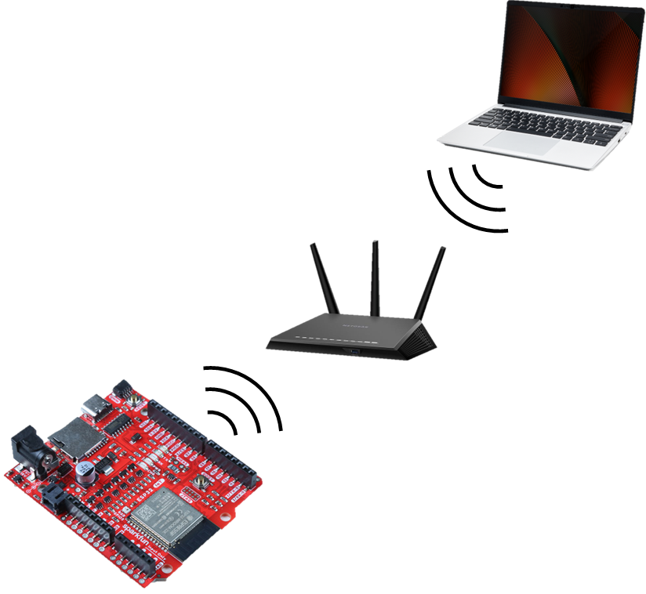
Emulating a TCP-Over-UDP Connection Using an ESP32 Dev Board
CS 5283-50 Computer Networks
Brian Goldsmith & Damon Raynor
December 6th, 2022
Notes:
Line spacing + Page numbers

Slide 2
Agenda
01 Project Goals
02 Project Description
03 Application Code Architecture
04 Project Demonstration

Slide 3
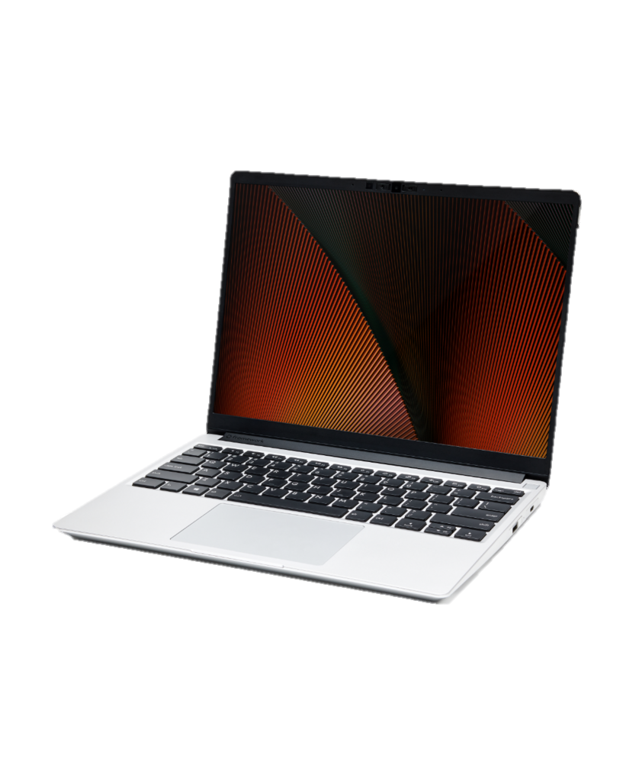
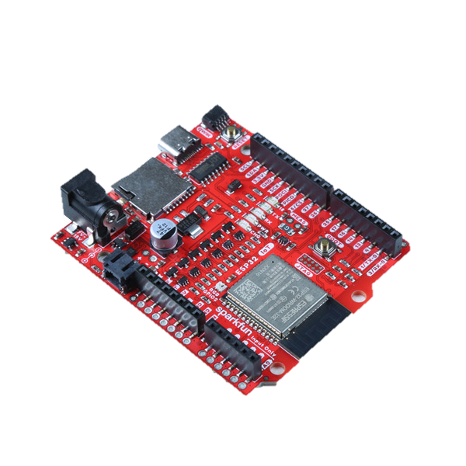
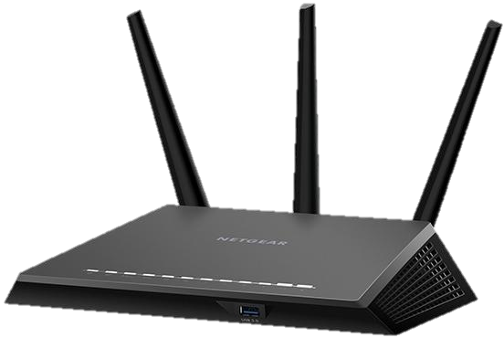
Project Goals
01
Visually demonstrate the TCP-over-UDP Handshake protocol.
Successfully send messages from one physical device to another over Wi-Fi.
Observe and capture the traceroute of relevant network traffic between the physical devices.

Slide 4
Project Description
02
Listen
Listen
NETWORK PROTOCOL SUITE
Network Layer | Protocol
Application | Custom (TCP-Like)
Transport | UDP
Network | IP
Link | Wi-Fi
SYNSENT
SYN RCVD
TCP HANDSHAKE
PROTOCOL
ESTAB
ESTAB
…
…
TCP CLOSING
PROTOCOL
CLOSED
CLOSED

Slide 5
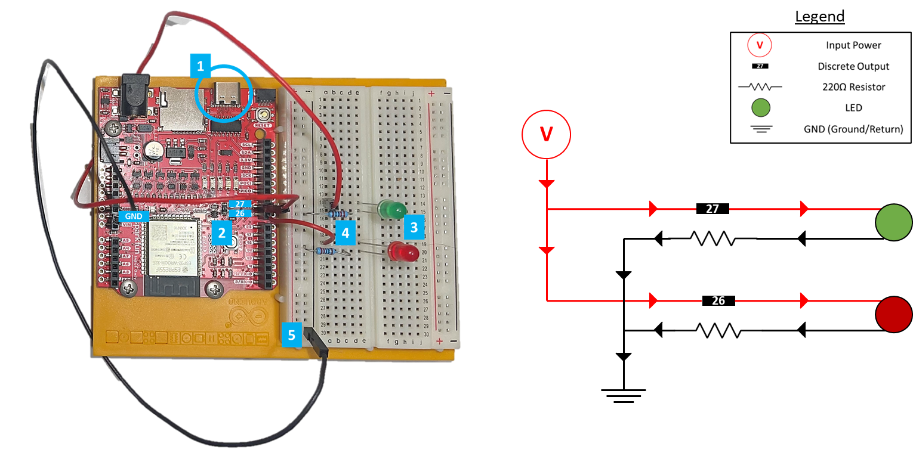
Project Description
LED STATE REPRESENTATION
Step | Connection State | LED 1 State | LED 2 State
0 | No Connection | OFF | OFF
1 | LISTEN | Blinking | OFF
2 | SYN RCVD | Steady | OFF
3 | ESTAB | Steady | Steady
4 | SEND MSG | Steady | OFF
5 | CLOSE WAIT | OFF | Steady
6 | CLOSED | OFF | OFF

Slide 6
Application Code Architecture
03
Considerations
Arduino Programming Language
Coding Structure
Controlling LEDs through Discrete Outputs
Intentional Delays
Coding Structure
void setup( ) {
// Setup code that will run once
}
void loop( ) {
// Main code that will run repeatedly
}

Slide 7
Project Demonstration
04
https://youtu.be/MNvfIGfZXhM

