Slide 1
Criminal Justice Data Analysis: Recidivism Study
Notes:
Welcome to this presentation on Criminal Justice Data Analysis. Our focus today will be on recidivism and the factors that influence it.

Slide 2
Research Question
Does the length of incarceration influence the likelihood of recidivism?
Notes:
This is the core question of our analysis. We are investigating whether the duration of incarceration has a significant impact on whether an individual reoffends after release.

Slide 3
Dataset Overview
Data from NIJ Recidivism Challenge
Sample size: 500 records
Key Variables: Recidivism, Incarceration Length, Age, Prior Arrests, Education
Notes:
The dataset used for this study is sourced from the National Institute of Justice's Recidivism Challenge. It includes 500 randomly sampled records containing information on individuals released from prison, tracking their recidivism outcomes.

Slide 4
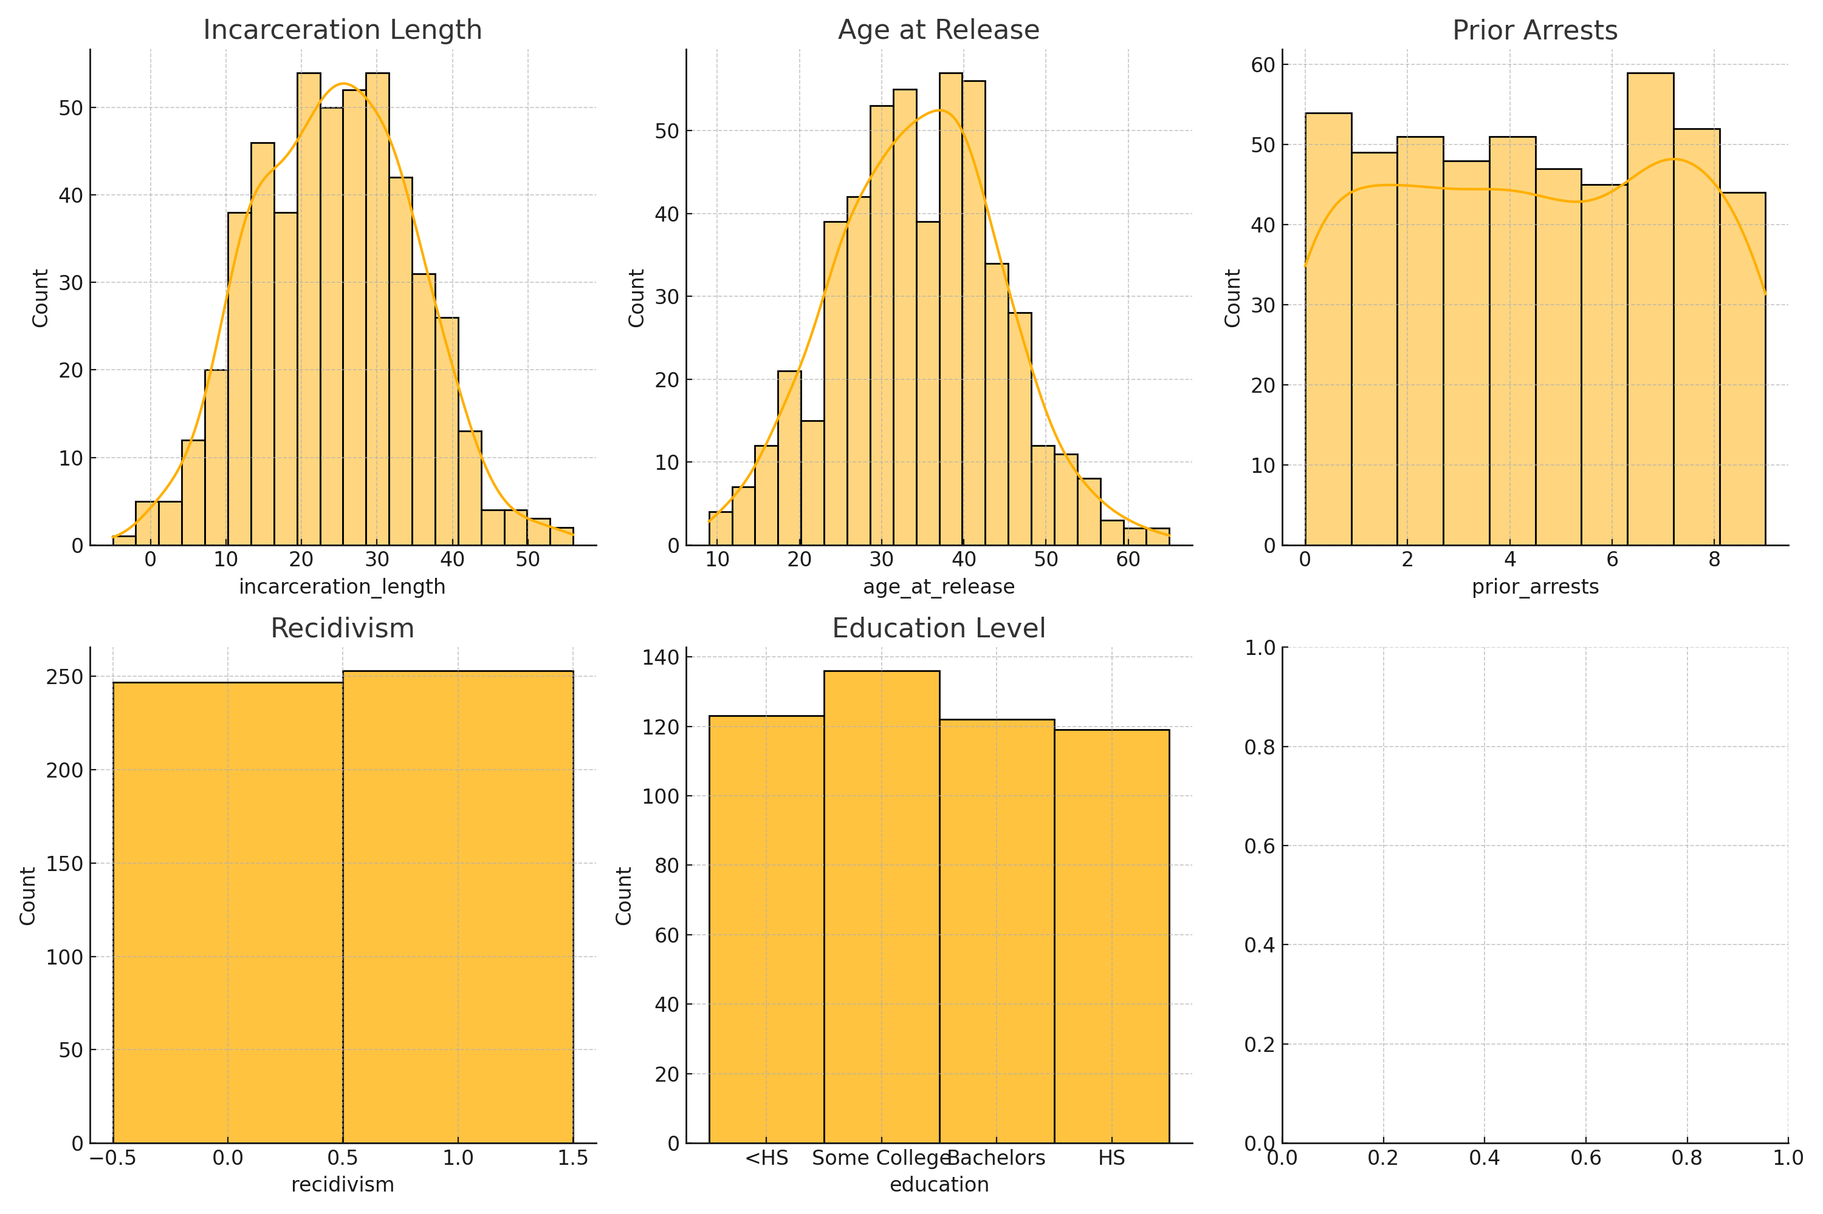
Histograms
Notes:
Here, we can see the distribution of key variables in our dataset. These histograms allow us to identify trends, patterns, and potential outliers in the data. For example, we can analyze the spread of incarceration lengths and the age of individuals at release.

Slide 5
Summary Statistics
Summary statistics provide insights into the central tendency and spread of our data:
- Mean and Median show the average values.
- Standard Deviation indicates variability.
- Mode helps identify the most frequently occurring data points.
Notes:
This slide presents key summary statistics, including mean, median, and standard deviation. These statistics help us understand the distribution and variability of our variables, which is essential for drawing meaningful conclusions.

