Slide 1
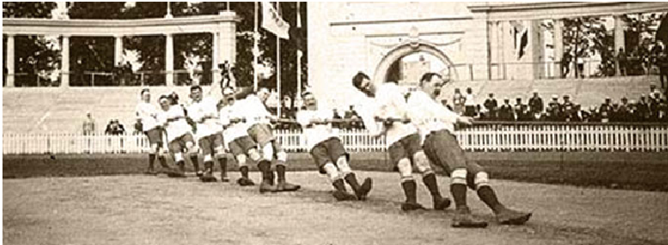
Tug of war
120210064

Slide 2


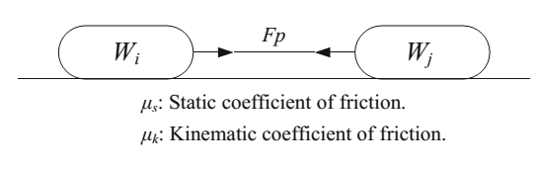

Introduction
population-based metaheuristic algorithm inspired by the game tug of war
the lightest team accelerates toward the heaviest team according to Newton’s second law with a calculable displacement rate based on the constant acceleration movement equation
TWO also added randomness to the formulation extracted from the Newtonian laws of mechanics.
each candidate solution as a team
The teams exert pulling forces on each other based
The competing teams move to their new positions

Slide 3
Introduction
TWO is applicable to global optimization of :
discontinuous,
multimodal,
non-smooth,
non-convex functions.
TWO has a very simple structure
TWO starts from a set of randomly generated initial candidate solutions

Slide 4
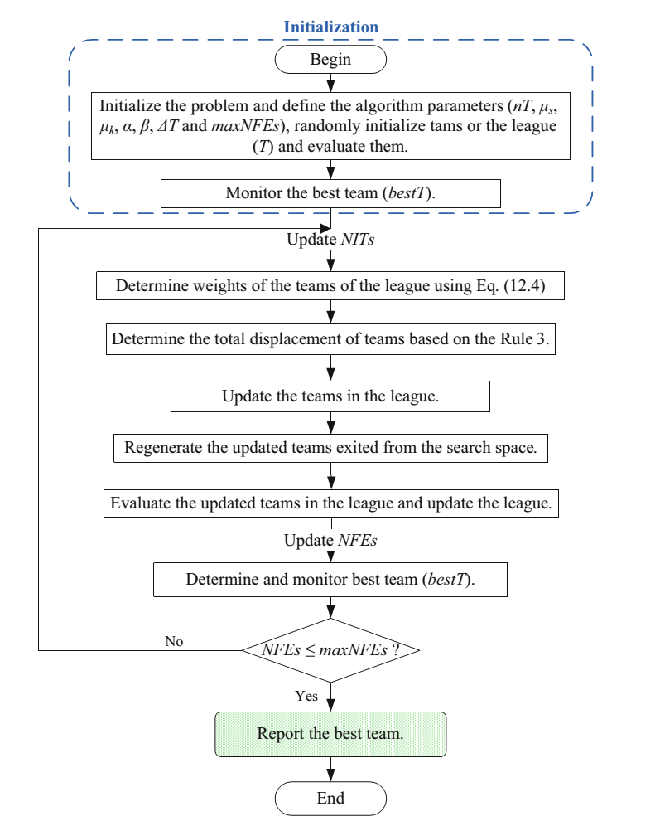
Algorithm flowchart
NFEs : number of objective function evaluations
BTS : best team strategy
maxNFEs: maximum number of objective function evaluations
maxNITs: maximum number of algorithm iterations
Pfit: penalized objective function
Fit: objective function
α: constant chosen from the interval [0.9, 0.99]
β: a scaling factor chosen from the interval (0,1)
ΔT: the time step
μs: static coefficient
μk: kinematic coefficient
nT:Number of Teams

Slide 5

Weight Assignment
Pfit: penalized objective function
The weights of the teams range between 1 and 2

Slide 6

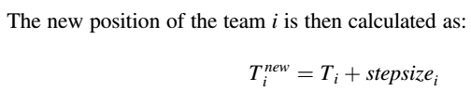

Displacement
α: constant chosen from the interval [0.9, 0.99]
β: a scaling factor chosen from the interval (0,1)
ΔT: time step
Lb and Ub : vectors containing the lower and upper bounds of the permissible ranges of the design variables
randn : vector of random numbersS

Slide 7

Handling the Side Constraints
TWO uses a new strategy incorporating the best-so-far solution (bestT)
This strategy is utilized with a certain probability (0.5).
There is a very slight possibility for the newly generated variable to still be outside the search space. In such cases, a fly back strategy is used.

Slide 8
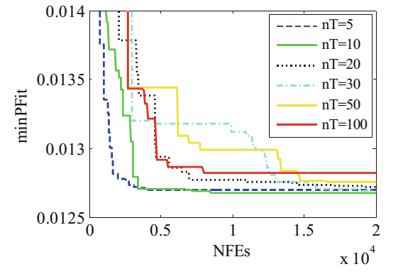
parameters of TWO algorithm. Experimental Evaluation
nT=10; % Number of Teams.
meus=1;meuk=1; % Static and Kinematic coefficients of friction.
deltat=1; % Time step in the movement equation with a constant acceleration.
alpha=0.99; % Controlling parameter of the algorithm's randomness.
beta=0.1; % Scaling factor of team's movement.
values of nT between 10 and 30 are efficient in making a balance between exploration and exploitation

Slide 9

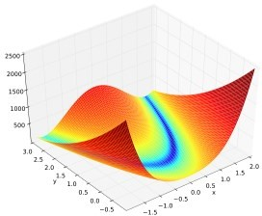
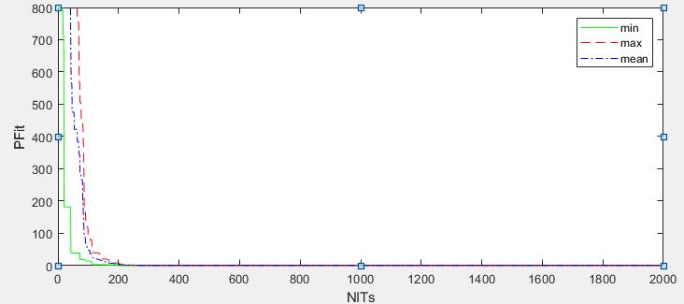
Rosenbrock
Dimensions :30
Range:[-30,30]

Slide 10
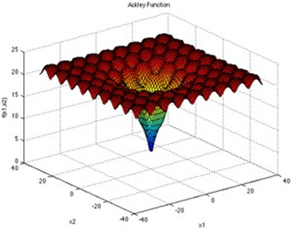

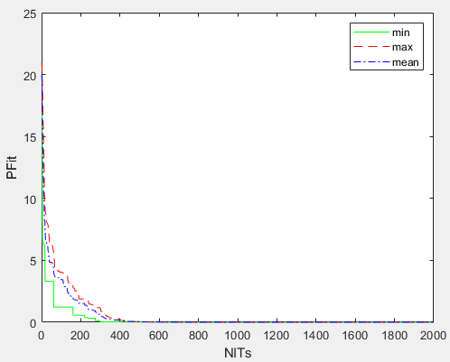
Ackley
Dimensions :2
Range:[-32,32]
variable | Optimal
X1 | 4.49634008607539e-10
X2 | 6.76982734516332e-10

Slide 11
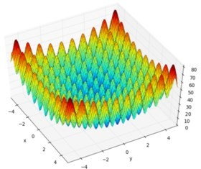
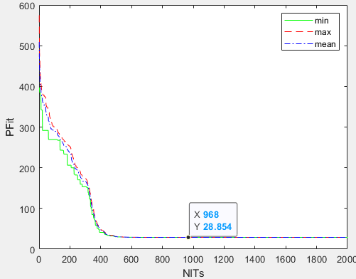
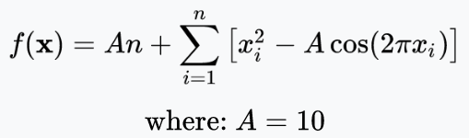
Rastrigin
Dimensions :30
Range:[-5.12,5.12]

Slide 12
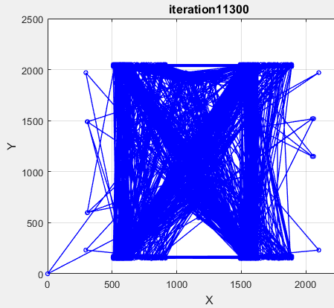
TSM
Failed to solve!
Calculate Cij matrix
Generate random team with to travel to all point
Calculate distance for all team(fit)
Find maximum step size and sweep with napper point

Slide 13

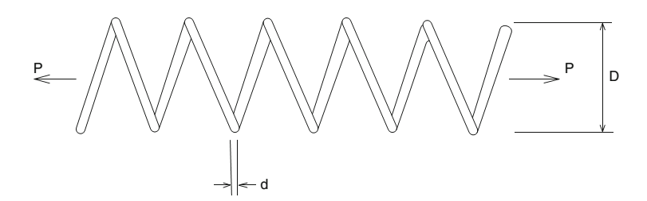
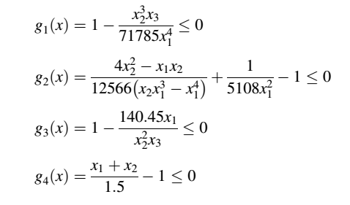
objective function

Slide 14
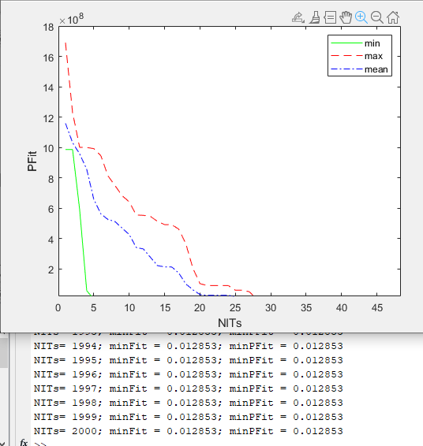
Matlab code resulte
nV=3; % Number of design variables.
Lb=[0.05 0.25 2]; % Lower bounds of design variables.
Ub=[2 1.3 15]; % Upper bounds of design variables.
% Define the parameters of TWO algorithm.
nT=10; % Number of Teams.
meus=1;meuk=1; % Static and Kinematic coefficients of friction.
deltat=1; % Time step in the movement equation with a constant acceleration.
alpha=0.99; % Controlling parameter of the algorithm's randomness.
beta=0.1; % Scaling factor of team's movement.
maxNFEs=20000; % Maximum Number of Objective Function Evaluations.

Slide 15
