Slide 1

OMSCS
Big Data Health CSE-6250-O01
Team 11

Slide 2

Recorded Presentation
Big Data Health CSE-6250-O01 - Team 11

Slide 3
Presentation Material
Big Data Health CSE-6250-O01 - Team 11

Slide 4
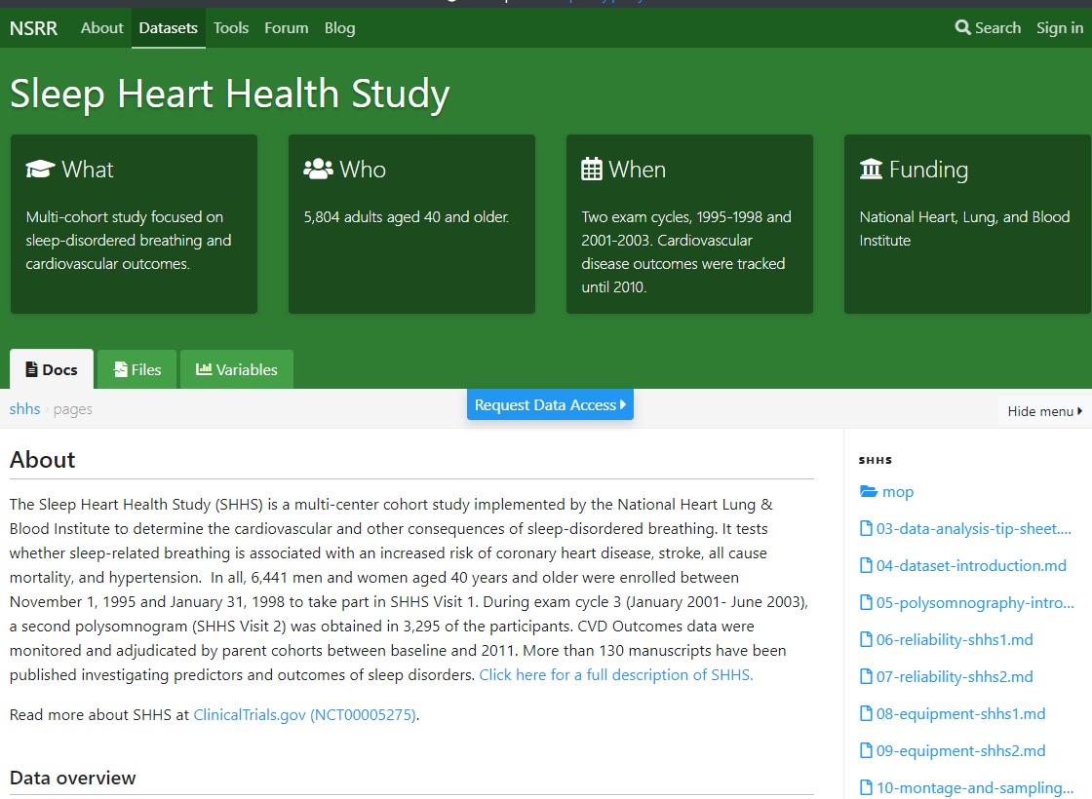
Big Data Health CSE-6250-O01 - Team 11
Notes:
The Sleep Heart Health Study was a multi-cohort study

Slide 5

Big Data Health CSE-6250-O01 - Team 11
Notes:
conducted by the National Heart Lung & Blood Institute.

Slide 6
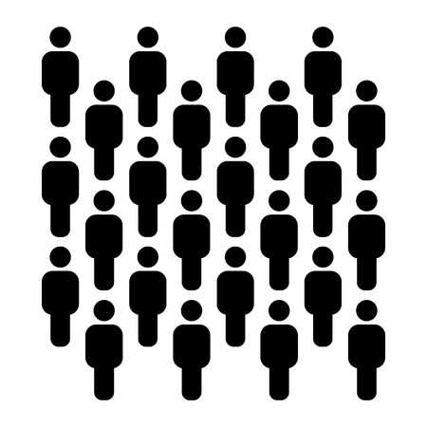



Big Data Health CSE-6250-O01 - Team 11
Notes:
5,804 polysomnograms were recorded in the first stage between 1995 and 1998.

Slide 7
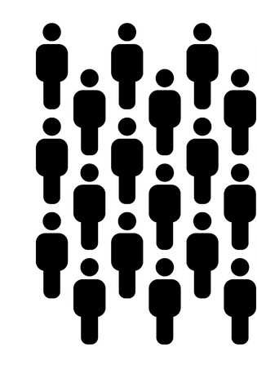


Big Data Health CSE-6250-O01 - Team 11
Notes:
A subset of 4,080 of those patients performed a follow-up between 2001 and 2003.

Slide 8


Big Data Health CSE-6250-O01 - Team 11
Notes:
Their cardiovascular outcomes were recorded during the years 2008-2011, granting the opportunity to analyze the relationship between sleeping patterns and the heart.

Slide 9
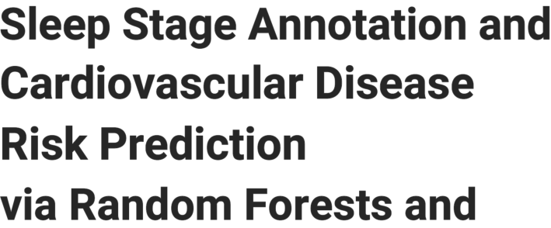

Big Data Health CSE-6250-O01 - Team 11
Notes:
The title of this research study is
Sleep Stage Annotation and Cardiovascular Disease Risk Prediction via Random Forests and Graph Clustering

Slide 10
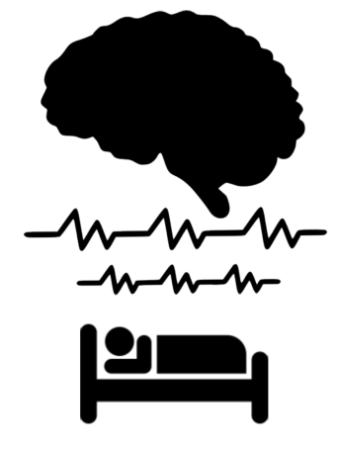
Big Data Health CSE-6250-O01 - Team 11
Notes:
An person undergoes various stages of brainwave activity during the phenomnom of sleep

Slide 11
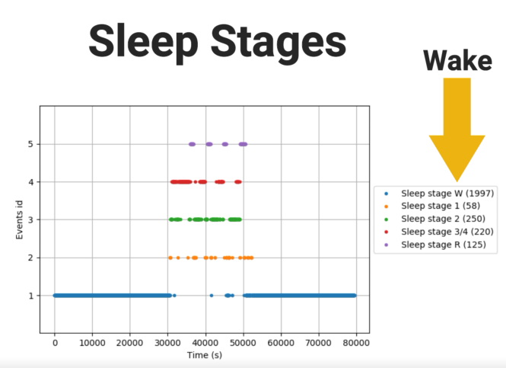


Big Data Health CSE-6250-O01 - Team 11
Notes:
simply called stages 1-3 as well as rapid eye movement, typically referred to as REM. Other than that a person is considered awake.

Slide 12
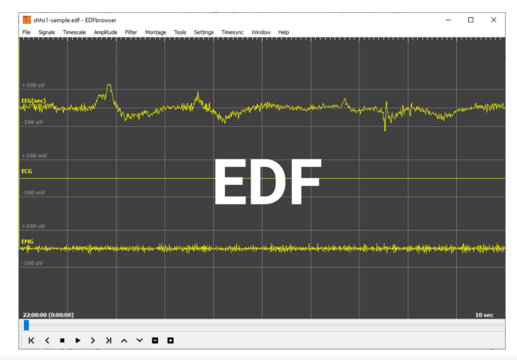
Big Data Health CSE-6250-O01 - Team 11
Notes:
The raw format of measured sleep data is an edf file.

Slide 13

Big Data Health CSE-6250-O01 - Team 11
Notes:
Using Python,

Slide 14
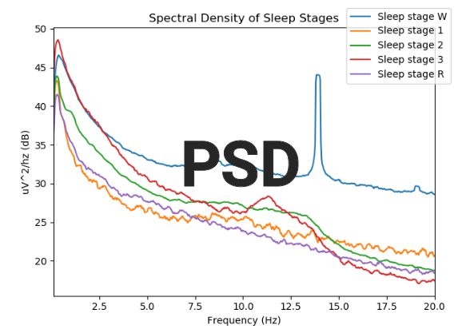
Big Data Health CSE-6250-O01 - Team 11
Notes:
the data was dissected into frequency power spectral densities (PSD).

Slide 15
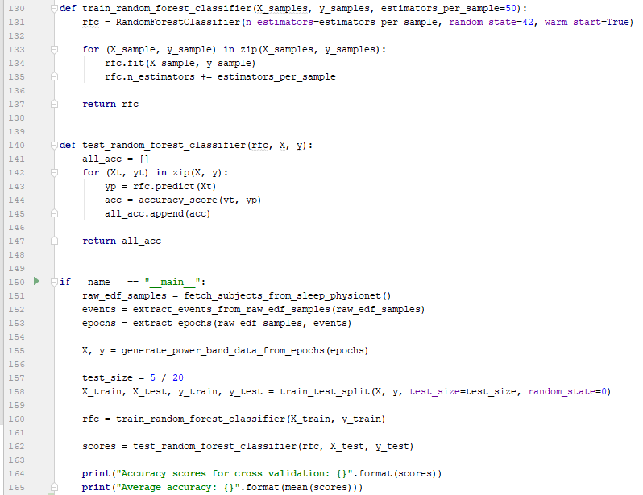
Big Data Health CSE-6250-O01 - Team 11
Notes:
A random forest model is trained using pre-sleep-stage-labeled power bands

Slide 16
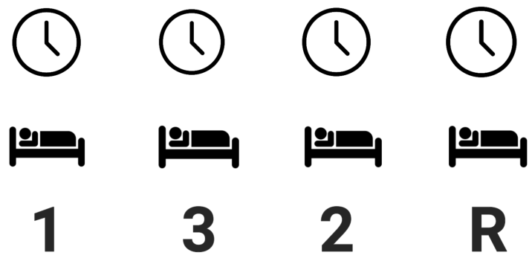
Big Data Health CSE-6250-O01 - Team 11
Notes:
so that over time sleep stages were predicted simply by using attributes of the power band.

Slide 17

Big Data Health CSE-6250-O01 - Team 11
Notes:
But what good is knowing sleep stages?

Slide 18

Big Data Health CSE-6250-O01 - Team 11
Notes:
Every patient who participated in the study provided personal data, including medication, demographics and medical history information.

Slide 19

Big Data Health CSE-6250-O01 - Team 11
Notes:
By understanding the sleep stage patterns of subjects with cardiovalus ailments,

Slide 20
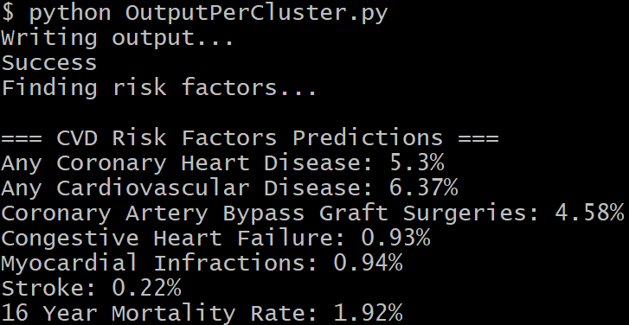
Big Data Health CSE-6250-O01 - Team 11
Notes:
predictive models were created that assess cardiovascular risk factors of new subjects simply by using sleep data alone.

Slide 21
Big Data Health CSE-6250-O01 - Team 11
Notes:
How can these patterned associations best be found?

Slide 22
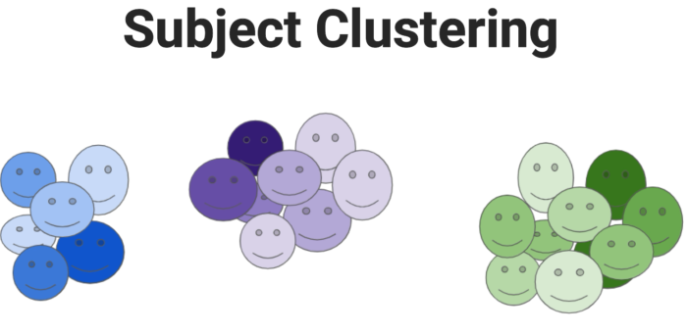
Big Data Health CSE-6250-O01 - Team 11
Notes:
Subject clustering is the process of grouping similar vertices based on specific data attributes.

Slide 23
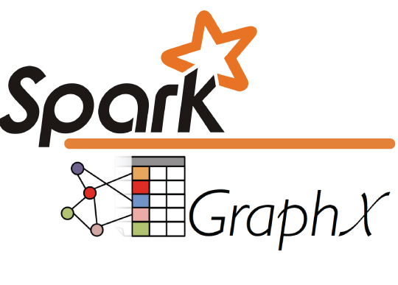

Big Data Health CSE-6250-O01 - Team 11
Notes:
To achieve this, Spark GraphX in Scala was used.

Slide 24
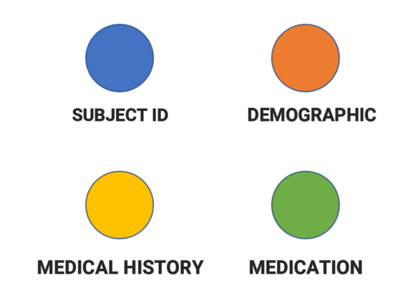
Big Data Health CSE-6250-O01 - Team 11
Notes:
The graph consisted of four vertice models - Subject Id, a 7 variable Demographic classifier, a 25 variable Medical history condition, 42 medication types.

Slide 25
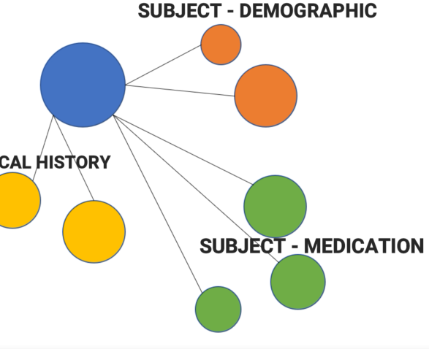
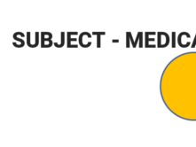
Big Data Health CSE-6250-O01 - Team 11
Notes:
Edges were found between each subject and demographic, medical history condition, and medication.

Slide 26
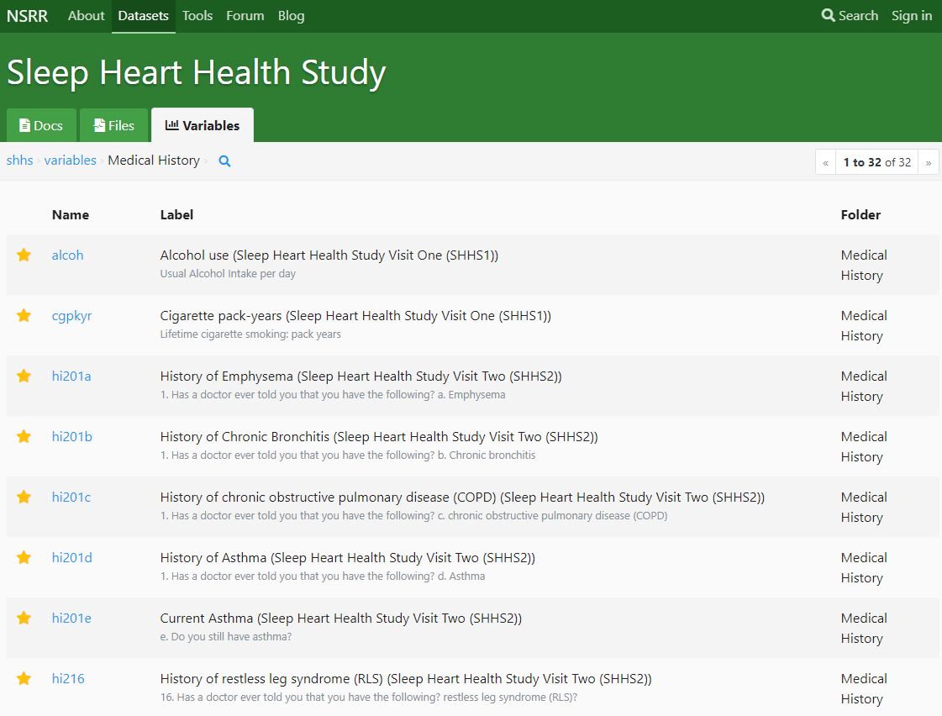
Big Data Health CSE-6250-O01 - Team 11
Notes:
The variables used were taken one deemed most important by the conductors of the study.

Slide 27
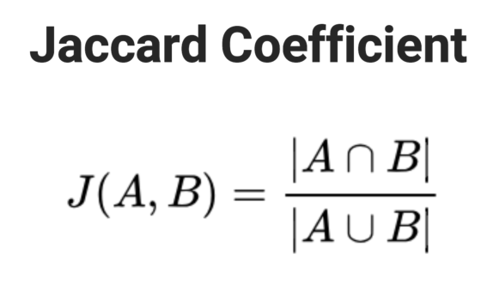
Big Data Health CSE-6250-O01 - Team 11
Notes:
Jaccard coefficient provided the calculation for similarity.

Slide 28

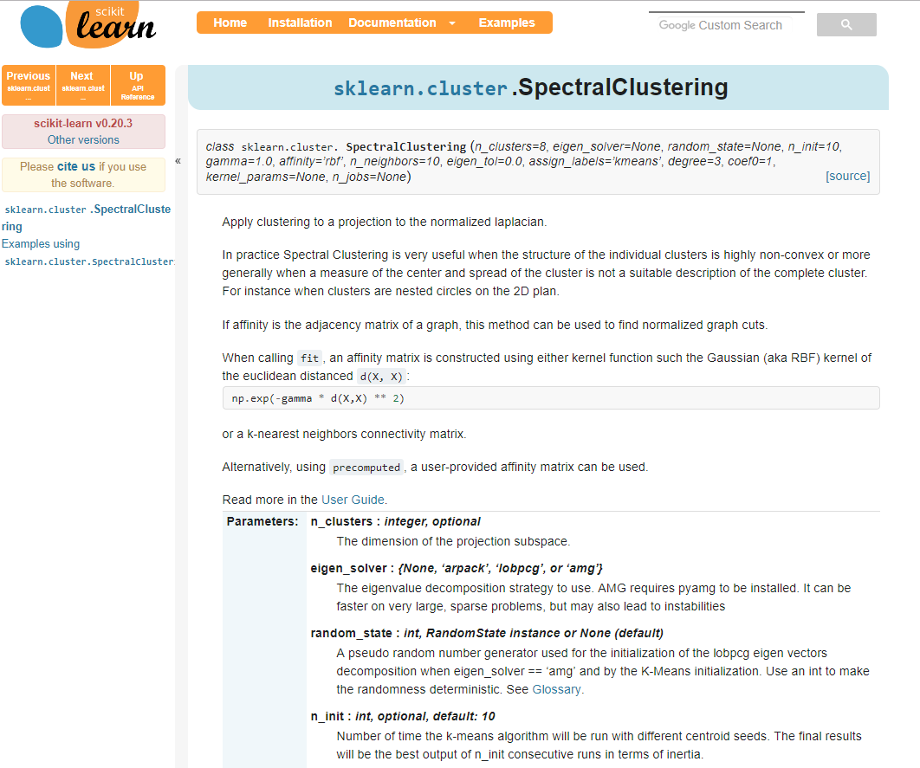
Big Data Health CSE-6250-O01 - Team 11
Notes:
Python’s Scikit learn SpectralClustering library, assigned cluster id’s to each subject.

Slide 29
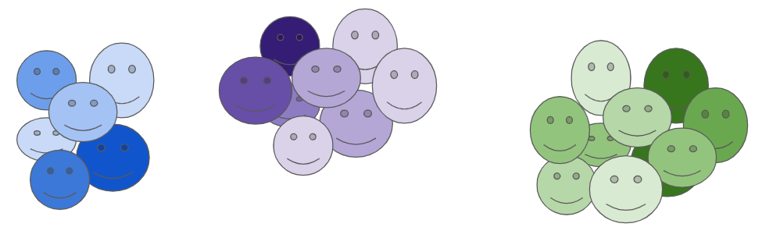
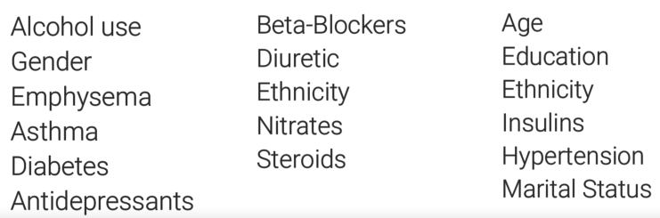
Big Data Health CSE-6250-O01 - Team 11
Notes:
Now that subjects were clustered based on medical and demographic data alone,

Slide 30
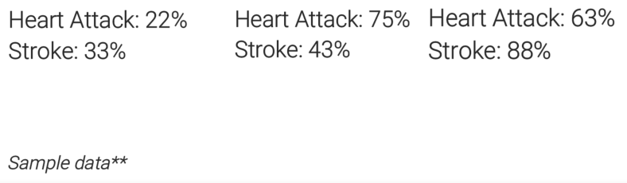
Big Data Health CSE-6250-O01 - Team 11
Notes:
cardiovascular outcomes collected by the study were used to find risk factors per condition.

Slide 31
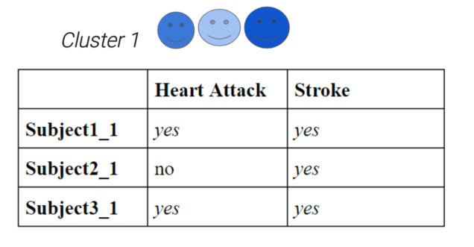


Big Data Health CSE-6250-O01 - Team 11
Notes:
For example let’s assume a cluster of 3 subjects as shown here. This group can be said to have a 66% risk factor of heart attack and 100% risk factor for stroke.

Slide 32
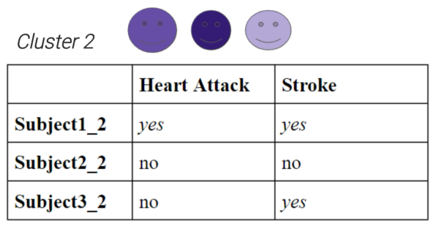


Big Data Health CSE-6250-O01 - Team 11
Notes:
A second cluster may have the following. Here the risk factor for heart attack is 33% while the risk factor for stroke is 66%.

Slide 33
Big Data Health CSE-6250-O01 - Team 11
Notes:
But what good is knowing a cluster’s risk factor?

Slide 34

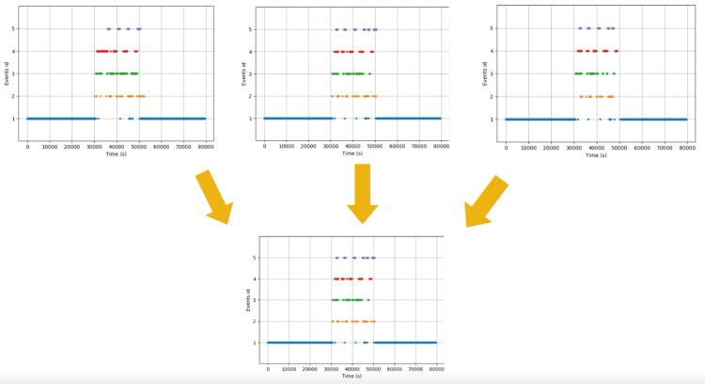

Big Data Health CSE-6250-O01 - Team 11
Notes:
The sleep data from each cluster’s subjects are averaged into a single power spectral density reading representing the cluster as a whole.

Slide 35

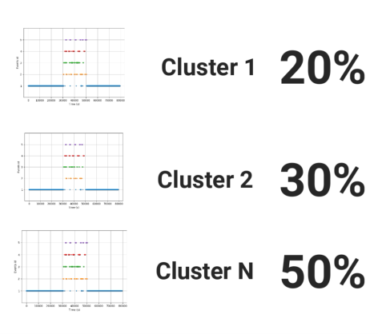
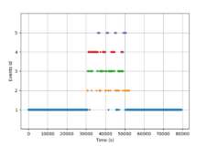
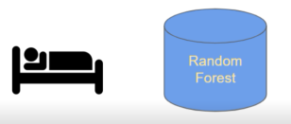
Big Data Health CSE-6250-O01 - Team 11
Notes:
When new sleep data is fed into the model the patterns and attributes of the data are compared against the signatures of each cluster’s singular representation. A similarity percentage is given for how closely the new data matches each cluster.

Slide 36
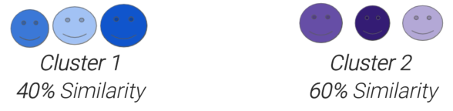
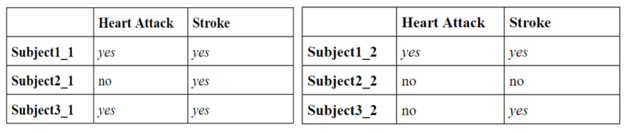
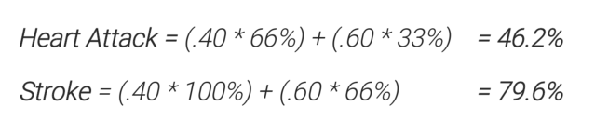
Big Data Health CSE-6250-O01 - Team 11
Notes:
Let’s say new EEG data matched the sleep data from cluster A with 40% similarity and cluster B with 60%. The overall cardiovascular risk assessment for the new subject would be the weighted risks of each cluster:
Heart Attack: .4 * 66 + .6 * 33 = 46.2%
Stroke: .4 * 100 + .6 * 66 = 79.6%

Slide 37
Big Data Health CSE-6250-O01 - Team 11

Slide 38
Big Data Health CSE-6250-O01 - Team 11

