Slide 1

OMSCS
Big Data Health CSE-6250-O01
Team 11

Slide 2

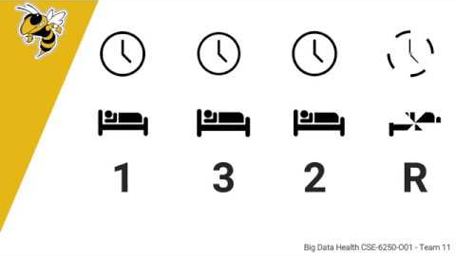
Recorded Presentation
https://youtu.be/EDbqoY_38Go
Big Data Health CSE-6250-O01 - Team 11

Slide 3
Presentation Material
Big Data Health CSE-6250-O01 - Team 11

Slide 4
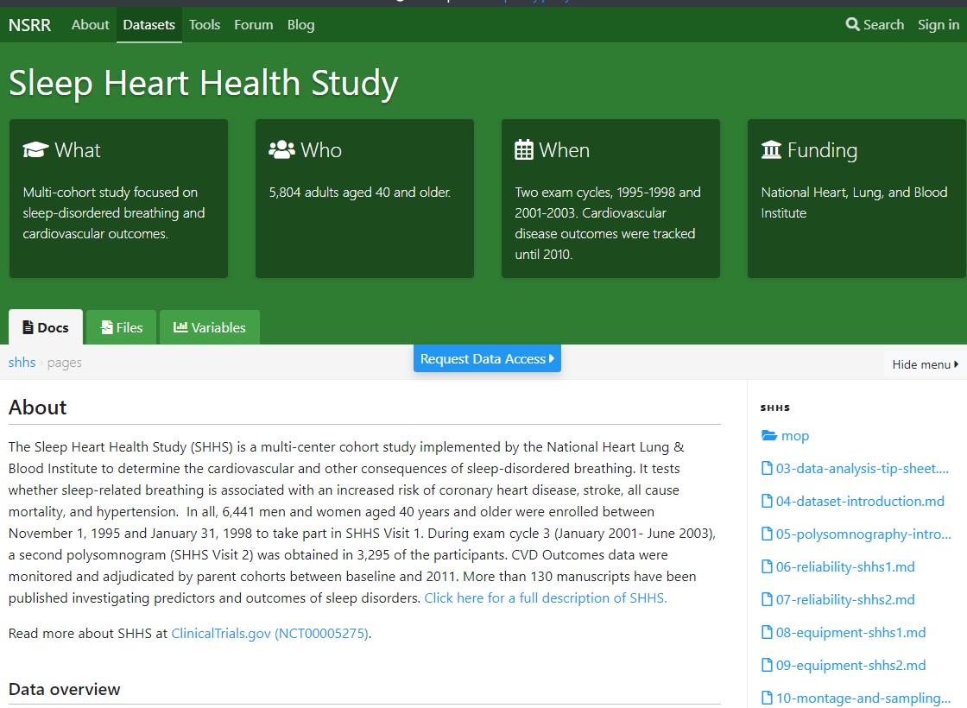
Big Data Health CSE-6250-O01 - Team 11
Notes:
The Sleep Heart Health Study was a multi-cohort study

Slide 5

Big Data Health CSE-6250-O01 - Team 11
Notes:
conducted by the National Heart Lung & Blood Institute.

Slide 6




Big Data Health CSE-6250-O01 - Team 11
Notes:
5,804 polysomnograms were recorded in the first stage between 1995 and 1998.

Slide 7



Big Data Health CSE-6250-O01 - Team 11
Notes:
A subset of 4,080 of those patients performed a follow-up between 2001 and 2003.

Slide 8


Big Data Health CSE-6250-O01 - Team 11
Notes:
Their cardiovascular outcomes were recorded during the years 2008-2011, granting the opportunity to analyze the relationship between sleeping patterns and the heart.

Slide 9
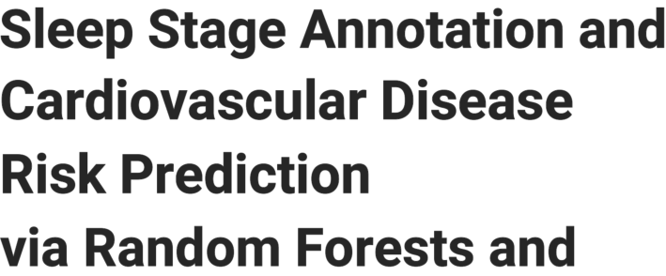

Big Data Health CSE-6250-O01 - Team 11
Notes:
The title of this research study is
Sleep Stage Annotation and Cardiovascular Disease Risk Prediction via Random Forests and Graph Clustering

Slide 10
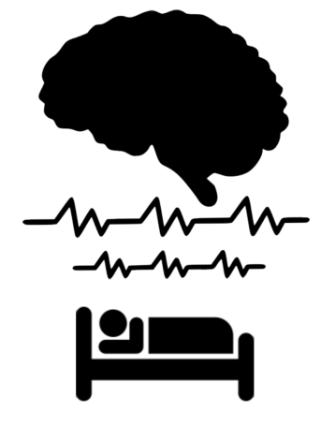
Big Data Health CSE-6250-O01 - Team 11
Notes:
An person undergoes various stages of brainwave activity during the phenomnom of sleep

Slide 11
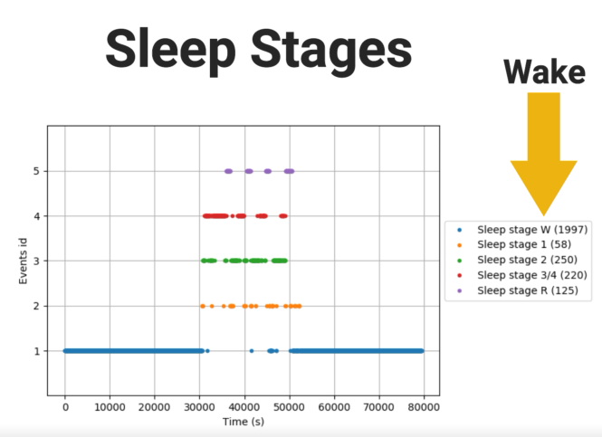


Big Data Health CSE-6250-O01 - Team 11
Notes:
simply called stages 1-3 as well as rapid eye movement, typically referred to as REM. Other than that a person is considered awake.

Slide 12
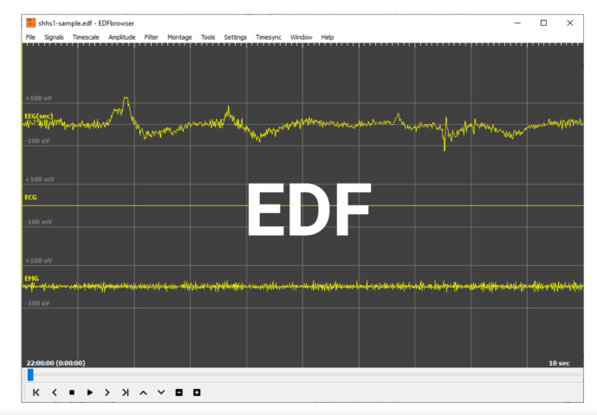
Big Data Health CSE-6250-O01 - Team 11
Notes:
The raw format of measured sleep data is an edf file.

Slide 13

Big Data Health CSE-6250-O01 - Team 11
Notes:
Using Python,

Slide 14
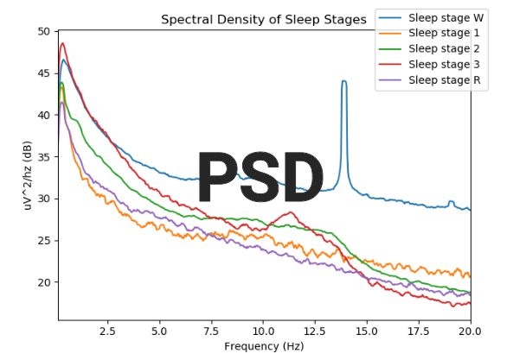
Big Data Health CSE-6250-O01 - Team 11
Notes:
the data was dissected into frequency power spectral densities (PSD).

Slide 15
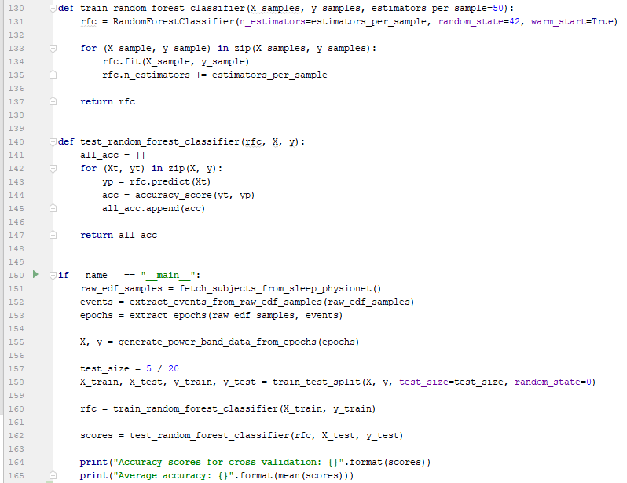
Big Data Health CSE-6250-O01 - Team 11
Notes:
A random forest model is trained using pre-sleep-stage-labeled power bands

Slide 16
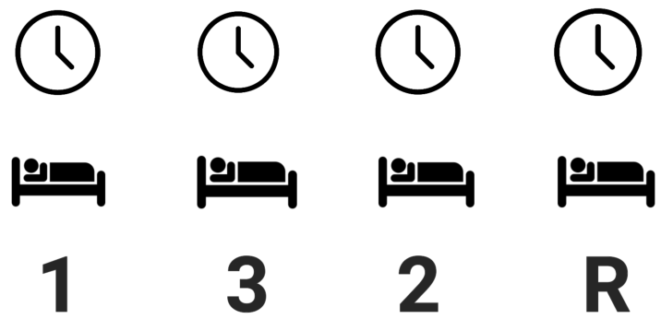
Big Data Health CSE-6250-O01 - Team 11
Notes:
so that over time sleep stages were predicted simply by using attributes of the power band.

Slide 17

Big Data Health CSE-6250-O01 - Team 11
Notes:
But what good is knowing sleep stages?

Slide 18

Big Data Health CSE-6250-O01 - Team 11
Notes:
Every patient who participated in the study provided personal data, including medication, demographics and medical history information.

Slide 19

Big Data Health CSE-6250-O01 - Team 11
Notes:
By understanding the sleep stage patterns of subjects with cardiovalus ailments,

Slide 20
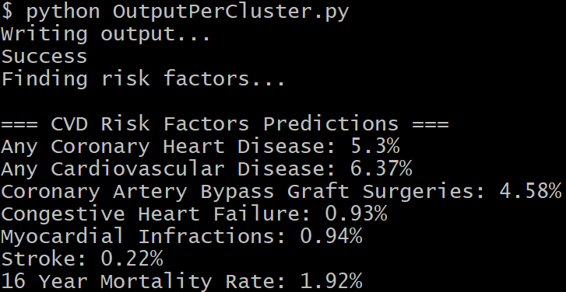
Big Data Health CSE-6250-O01 - Team 11
Notes:
predictive models were created that assess cardiovascular risk factors of new subjects simply by using sleep data alone.

Slide 21
Big Data Health CSE-6250-O01 - Team 11
Notes:
How can these patterned associations best be found?

Slide 22
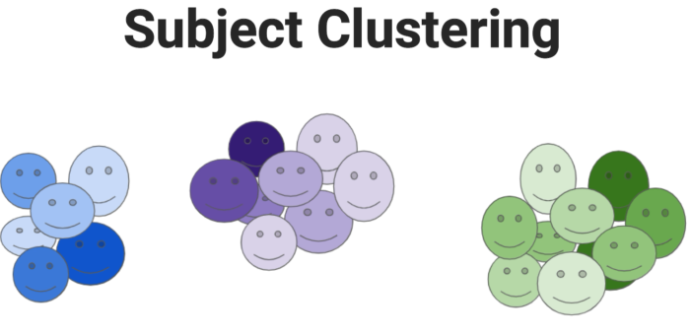
Big Data Health CSE-6250-O01 - Team 11
Notes:
Subject clustering is the process of grouping similar vertices based on specific data attributes.

Slide 23
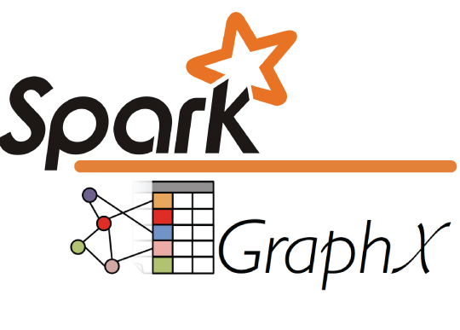

Big Data Health CSE-6250-O01 - Team 11
Notes:
To achieve this, Spark GraphX in Scala was used.

Slide 24
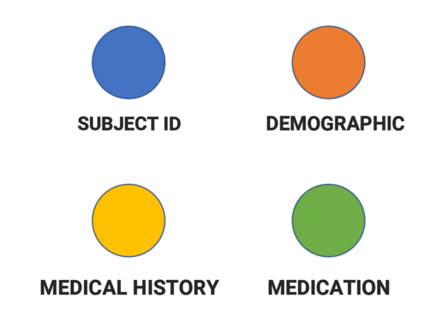
Big Data Health CSE-6250-O01 - Team 11
Notes:
The graph consisted of four vertice models - Subject Id, a 7 variable Demographic classifier, a 25 variable Medical history condition, 42 medication types.

Slide 25
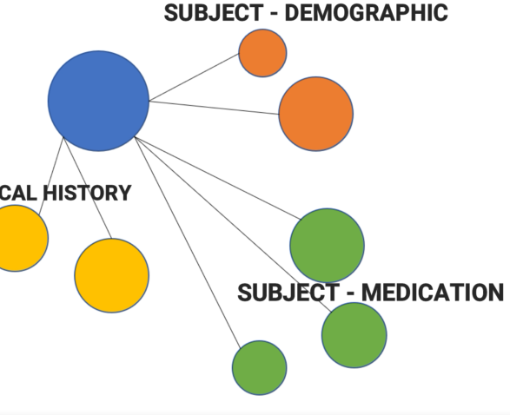
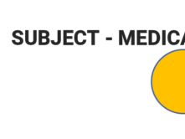
Big Data Health CSE-6250-O01 - Team 11
Notes:
Edges were found between each subject and demographic, medical history condition, and medication.

Slide 26
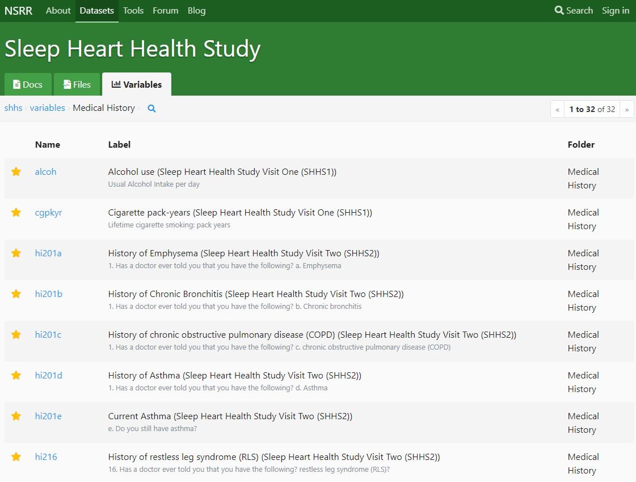
Big Data Health CSE-6250-O01 - Team 11
Notes:
The variables used were taken one deemed most important by the conductors of the study.

Slide 27
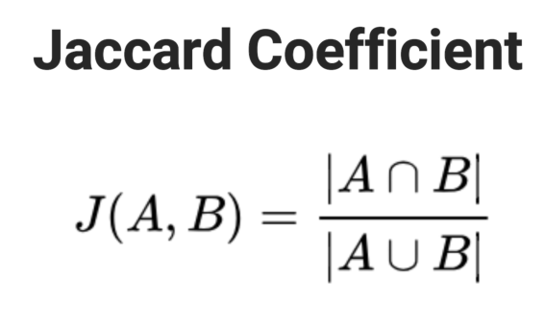
Big Data Health CSE-6250-O01 - Team 11
Notes:
Jaccard coefficient provided the calculation for similarity.

Slide 28

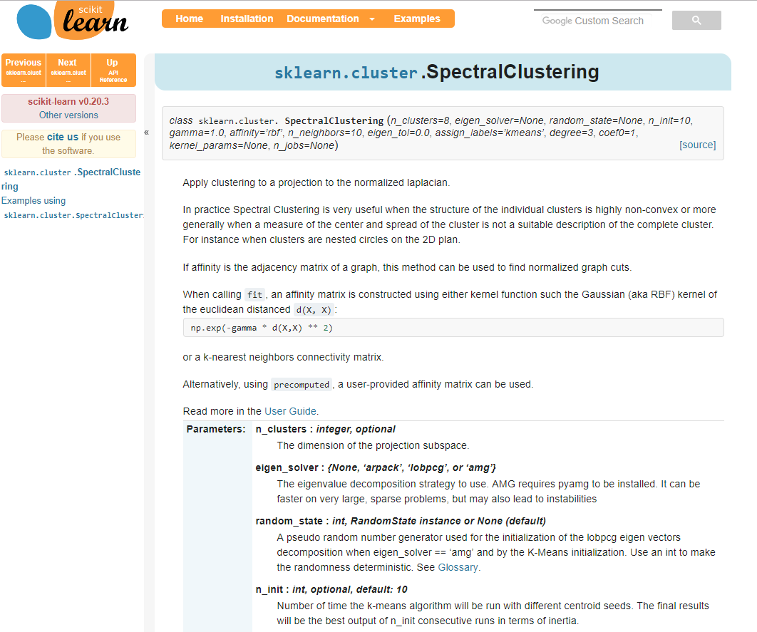
Big Data Health CSE-6250-O01 - Team 11
Notes:
Python’s Scikit learn SpectralClustering library, assigned cluster id’s to each subject.

Slide 29
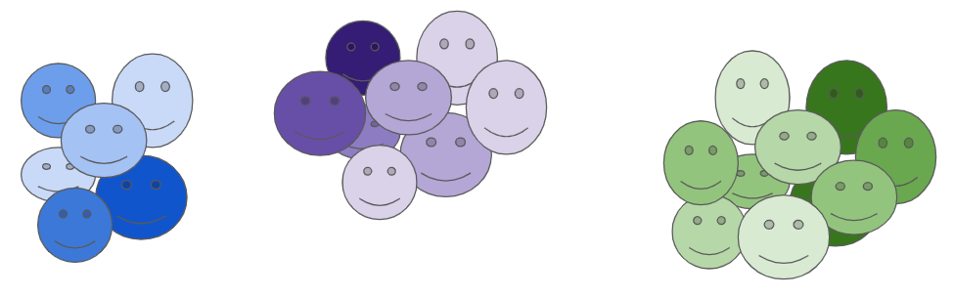
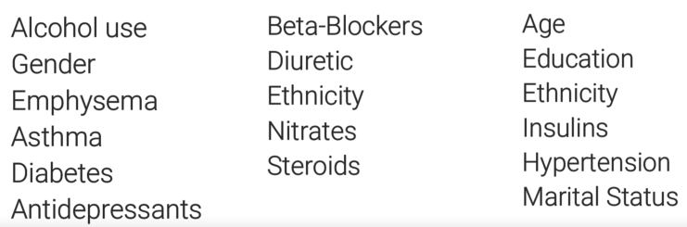
Big Data Health CSE-6250-O01 - Team 11
Notes:
Now that subjects were clustered based on medical and demographic data alone,

Slide 30
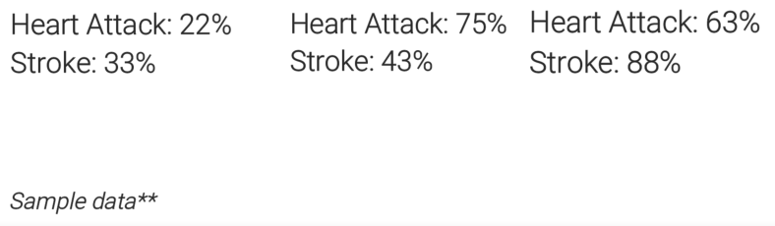
Big Data Health CSE-6250-O01 - Team 11
Notes:
cardiovascular outcomes collected by the study were used to find risk factors per condition.

Slide 31
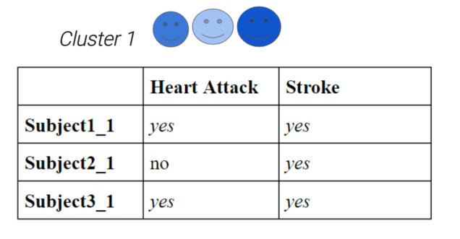


Big Data Health CSE-6250-O01 - Team 11
Notes:
For example let’s assume a cluster of 3 subjects as shown here. This group can be said to have a 66% risk factor of heart attack and 100% risk factor for stroke.

Slide 32
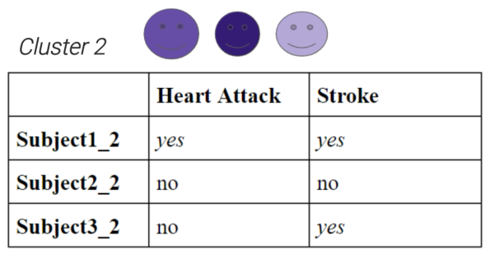


Big Data Health CSE-6250-O01 - Team 11
Notes:
A second cluster may have the following. Here the risk factor for heart attack is 33% while the risk factor for stroke is 66%.

Slide 33
Big Data Health CSE-6250-O01 - Team 11
Notes:
But what good is knowing a cluster’s risk factor?

Slide 34

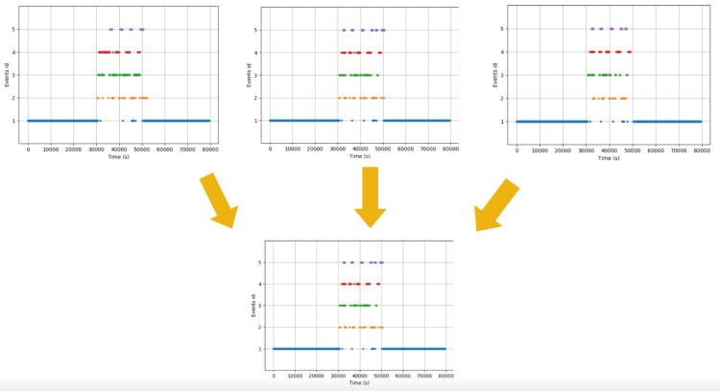

Big Data Health CSE-6250-O01 - Team 11
Notes:
The sleep data from each cluster’s subjects are averaged into a single power spectral density reading representing the cluster as a whole.

Slide 35

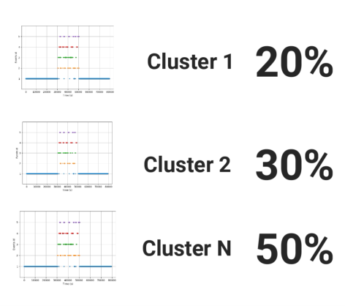
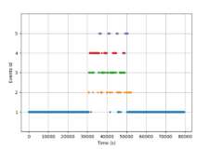
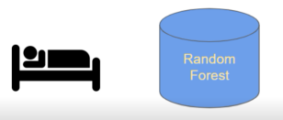
Big Data Health CSE-6250-O01 - Team 11
Notes:
When new sleep data is fed into the model the patterns and attributes of the data are compared against the signatures of each cluster’s singular representation. A similarity percentage is given for how closely the new data matches each cluster.

Slide 36
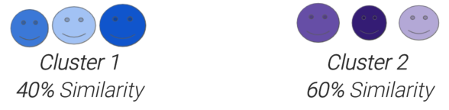
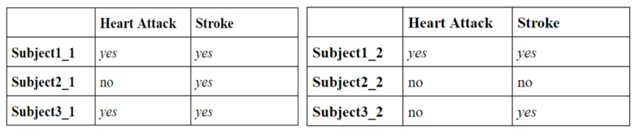
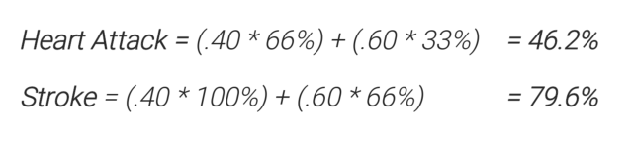
Big Data Health CSE-6250-O01 - Team 11
Notes:
Let’s say new EEG data matched the sleep data from cluster A with 40% similarity and cluster B with 60%. The overall cardiovascular risk assessment for the new subject would be the weighted risks of each cluster:
Heart Attack: .4 * 66 + .6 * 33 = 46.2%
Stroke: .4 * 100 + .6 * 66 = 79.6%

Slide 37
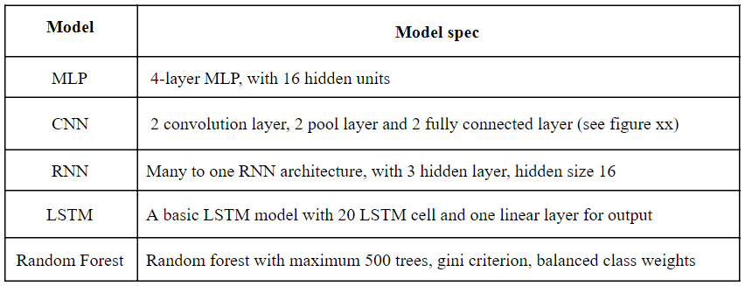
Big Data Health CSE-6250-O01 - Team 11
Notes:
Various models were tested for the initial phase of sleep stage annotation including MLP, Convolution Neural Network, recurrent neural network, long short term memory, and random forest.

Slide 38
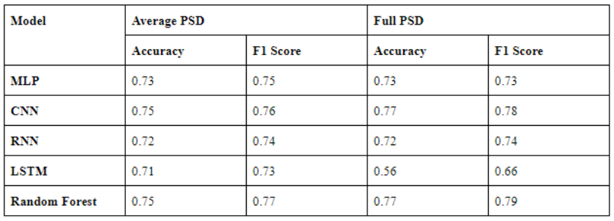
Big Data Health CSE-6250-O01 - Team 11
Notes:
In the final pipeline, considering speed, overall accuracy,

Slide 39
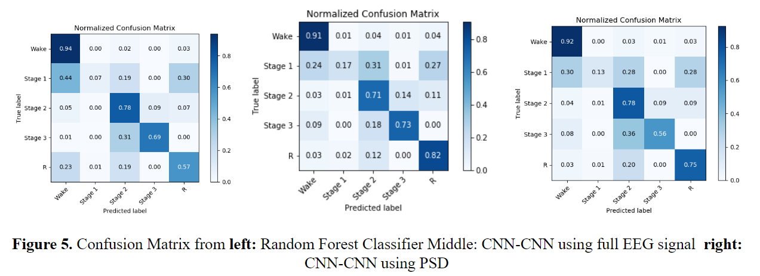
Big Data Health CSE-6250-O01 - Team 11
Notes:
random forest model was used.

Slide 40
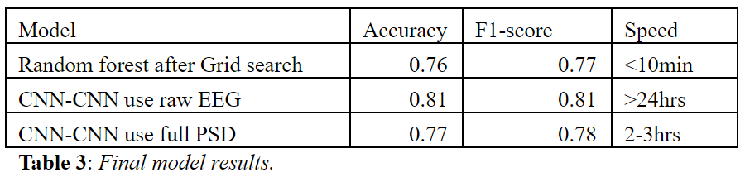
Big Data Health CSE-6250-O01 - Team 11
Notes:
in the future, if further testing on CNN-CNN using PSD can result in accuracy over 80%

Slide 41
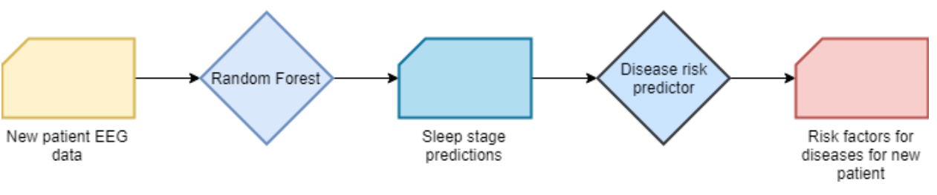
Big Data Health CSE-6250-O01 - Team 11
Notes:
With this research, we demonstrated a pipeline

Slide 42
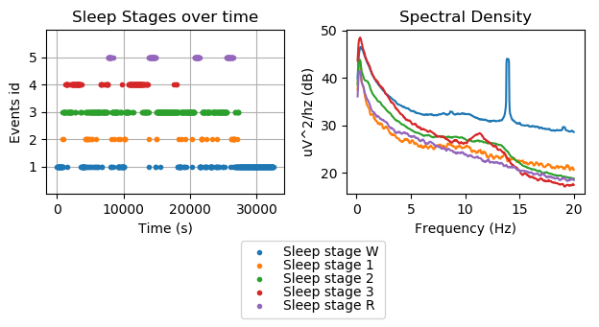
Big Data Health CSE-6250-O01 - Team 11
Notes:
to predict a new patient’s sleep stages

Slide 43
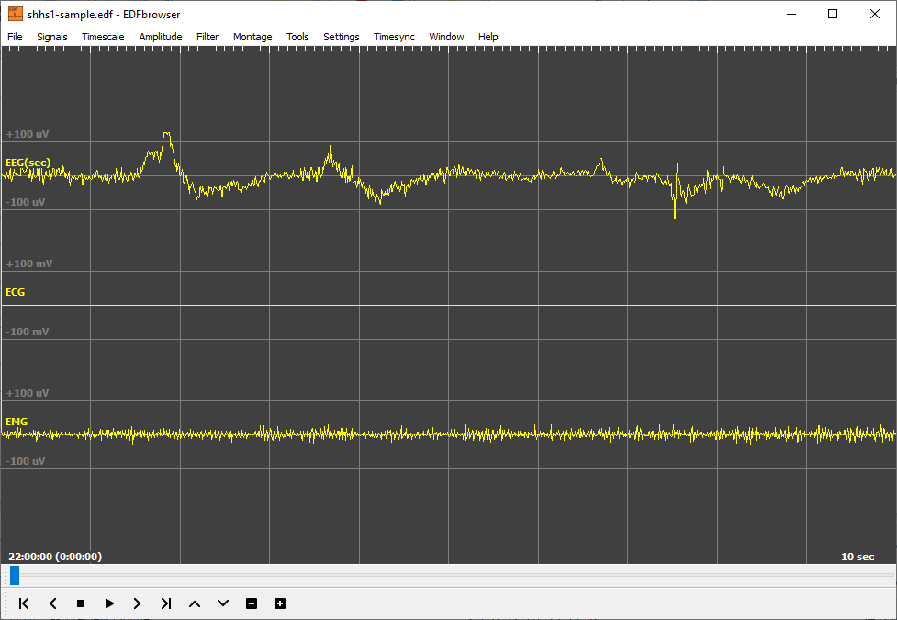
Big Data Health CSE-6250-O01 - Team 11
Notes:
using raw EEG readings

Slide 44
Big Data Health CSE-6250-O01 - Team 11
Notes:
and compare them with pre-trained subject clusters

Slide 45
Big Data Health CSE-6250-O01 - Team 11
Notes:
to predict risk probabilities for cardiovascular diseases.

Slide 46




Big Data Health CSE-6250-O01 - Team 11
Notes:
The pipeline provides a quick and effective way to monitor and assess a subject’s CVD risk, without knowing medical history, medication or demographics.

Slide 47

Big Data Health CSE-6250-O01 - Team 11
Notes:
Thank you!

