Slide 1
Visualizing your data with “R”
Ben Hoover
Harrell Health Sciences Library: Research and Learning Commons

Slide 2
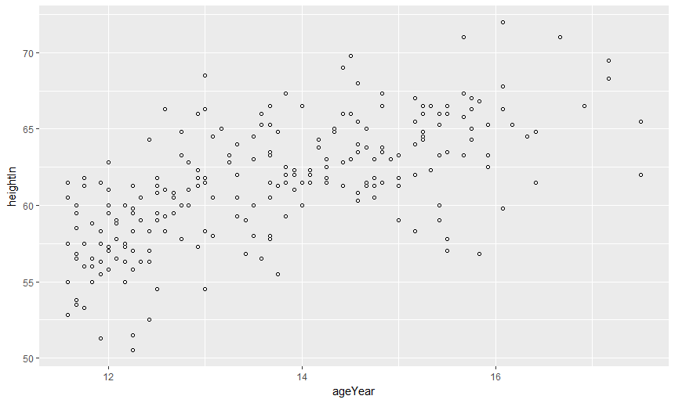
Learning objectives
The capabilities of R
R basics
Best practices
Recipes and how to learn more

Slide 3


What is “R”
Open Source Data science tool
Packet based functionality
Easily reconfigured to custom uses

Slide 4
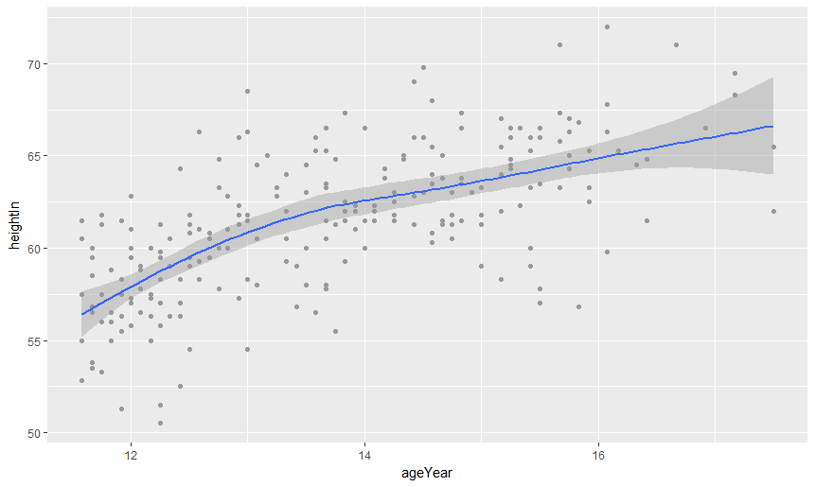
R in the data lifecycle
Collect Data
Clean Data
Use Data
Report
Archive Data

Slide 5
Approaching “R”
https://cran.r-project.org/
https://www.rstudio.com/products/rstudio/download3/

Slide 6
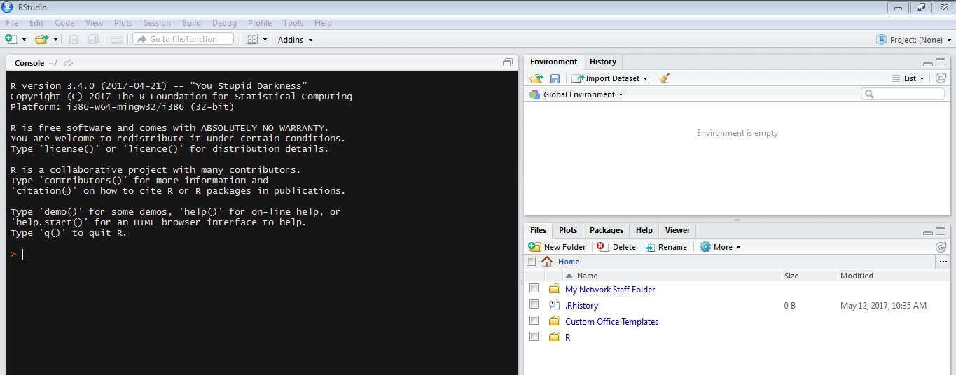
Approaching “R”
Default interface before loading or creating a new project

Slide 7
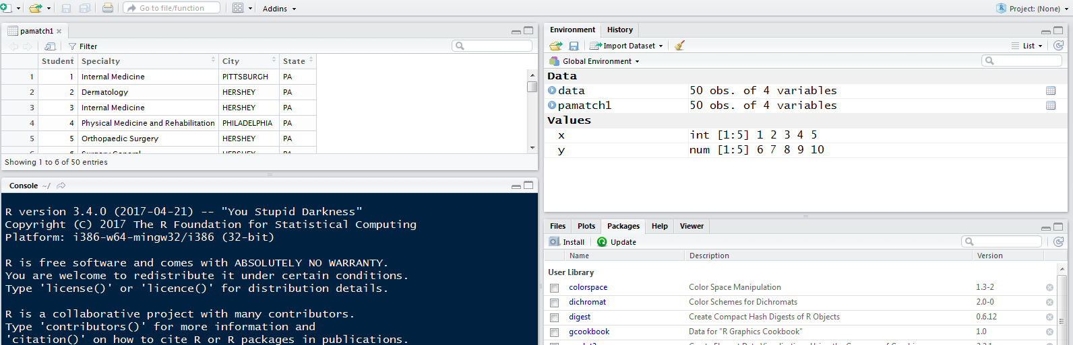
Approaching R
Load packages

Slide 8
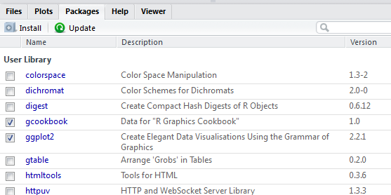
Loading Packages in R
install.packages("ggplot2")
library(ggplot2)

Slide 9
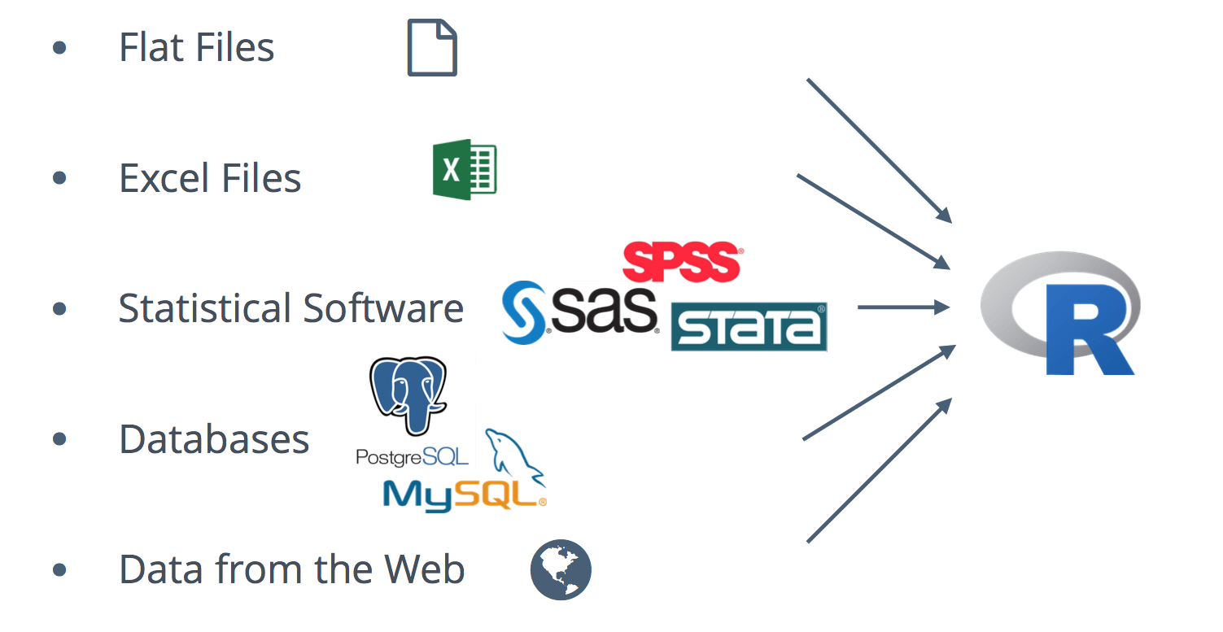
Loading data into R

Slide 10
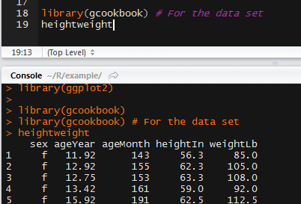
Exploring a Data Set
Heightweight
str(heightweight)

Slide 11
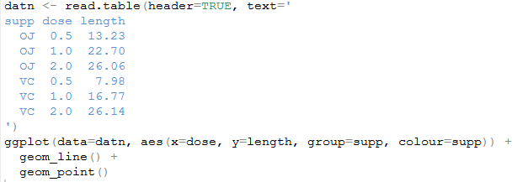
A Basic Visualization

Slide 12
Capabilities for Visualization in R
Publish Online
https://www.shinyapps.io/
GIS
http://spatial.ly/r/
Dashboards
https://plot.ly/r/dashboard/

Slide 13
Best Practices
Cleaning data / prepping data
Versioning
Cognitive Load and chart readability

Slide 14
Tidy data
Plot: 2
Date collected | Species | Sex | Weight
1/8/2014 | NA
1/8/2014 | DM | M | 44
1/8/2014 | DM | M | 38
1/8/2014 | OL
1/8/2014 | PE | M | 22
1/8/2014 | DM | M | 38
1/8/2014 | DM | M | 48
1/8/2014 | DM | M | 43
1/8/2014 | DM | F | 35
1/8/2014 | DM | M | 43
1/8/2014 | DM | F | 37
1/8/2014 | PF | F | 7
1/8/2014 | DM | M | 45
1/8/2014 | OT
1/8/2014 | DS | M | 157
1/8/2014 | OX
2/18/2014 | NA | M | 218
2/18/2014 | PF | F | 7
2/18/2014 | DM | M | 52
 | gray cell means my measurement device wasn't calibrated correctly

Slide 15
Versioning
Box.psu.edu
https://psu.box.com
Github
https://github.com/

Slide 16
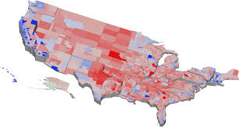
Cognitive Load
https://www.csc2.ncsu.edu/faculty/healey/PP/

Slide 17
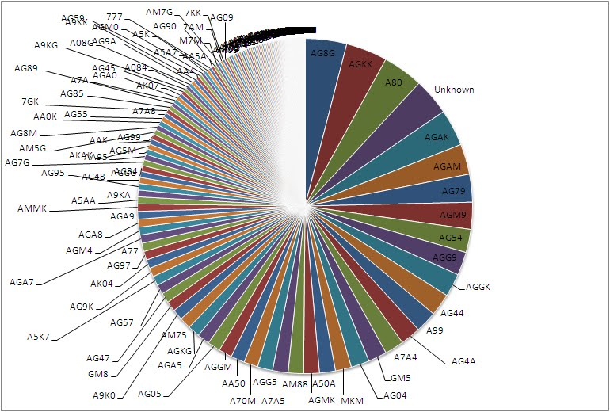
Readability

Slide 18
How To Learn R
http://harrell.library.psu.edu/c.php?g=636627&p=4461714

Slide 19
How To Learn “R”
https://www.r-bloggers.com/
http://r-statistics.co/Top50-Ggplot2-Visualizations-MasterList-R-Code.html
Lynda.com

Slide 20
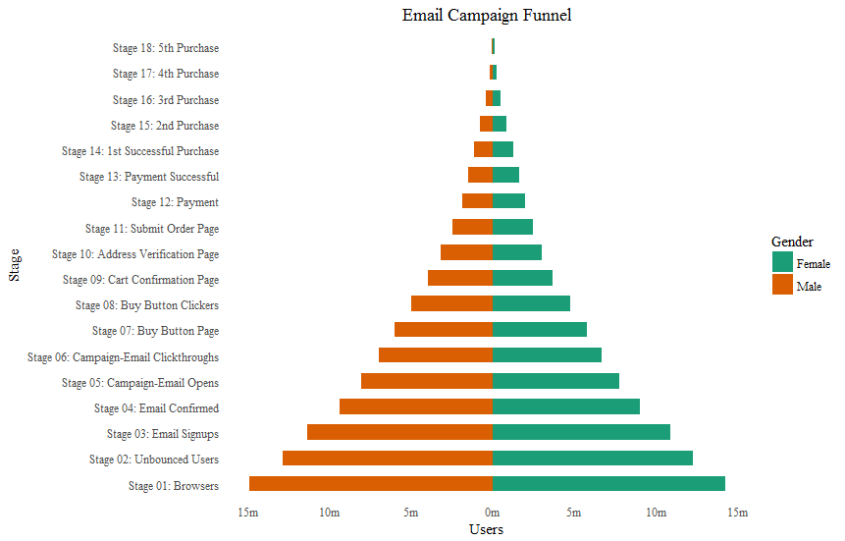
Info
Link to GitHub with todays materials

Slide 21
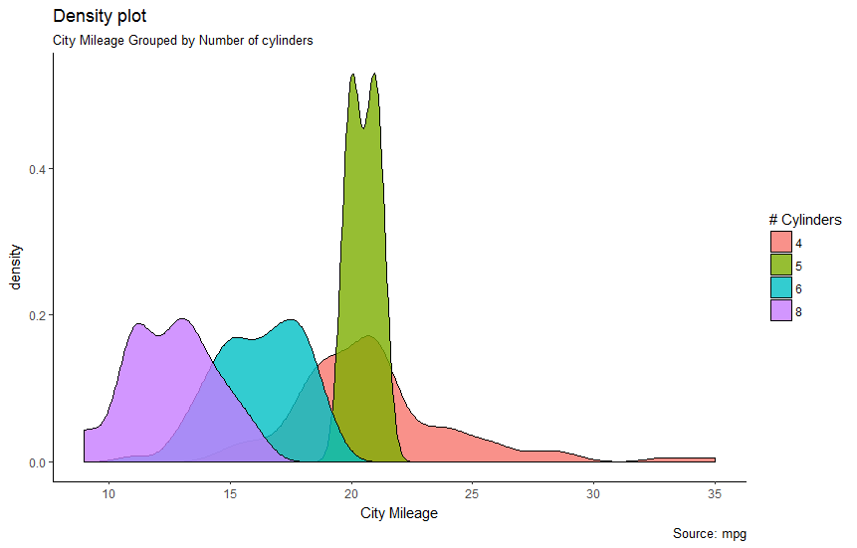
Questions

