Slide 1
Visualizing your Data with “R”
Ben Hoover
Harrell Health Sciences Library: Research and Learning Commons

Slide 2
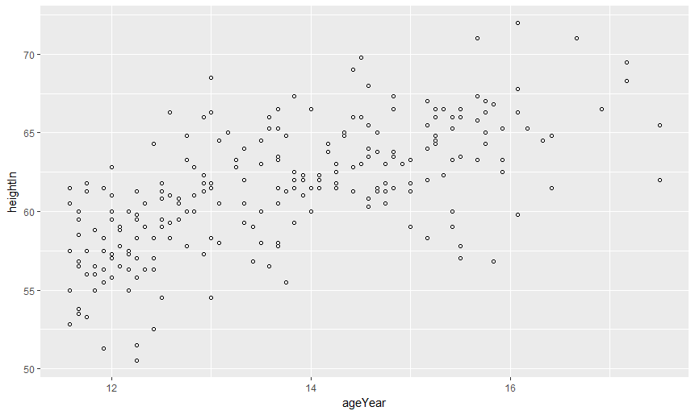
Learning Objectives
The capabilities of R
Inserting data sets
Strategies for learning new recipes

Slide 3


What is “R”
Open Source Data science tool
Python equally popular
Powerful tool capable of doing anything with data conceivable

Slide 4
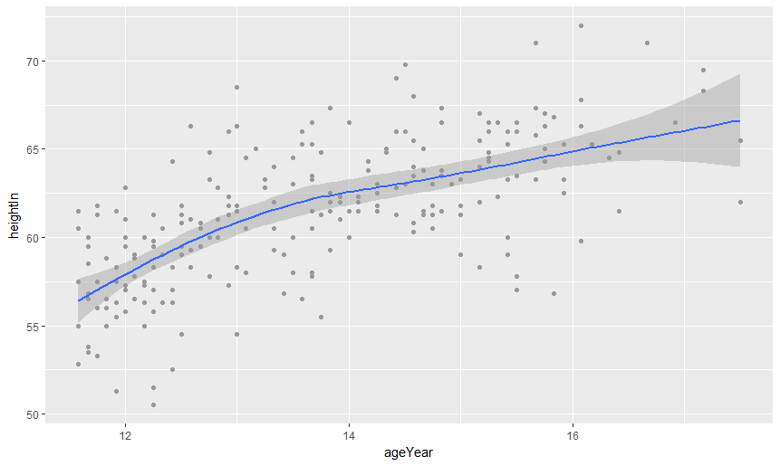
R in the Data lifecycle
Collect Data
Clean Data
Use Data
Report
Archive Data

Slide 5
Approaching “R”
https://cran.r-project.org/
https://www.rstudio.com/products/rstudio/download3/
http://harrell.library.psu.edu/c.php?g=636627&p=4461714

Slide 6
Best Practices
Cleaning data / prepping data
Versioning
Cognitive Load and simplicity of communication

Slide 7
Tidy data
Plot: 2
Date collected | Species | Sex | Weight
1/8/2014 | NA
1/8/2014 | DM | M | 44
1/8/2014 | DM | M | 38
1/8/2014 | OL
1/8/2014 | PE | M | 22
1/8/2014 | DM | M | 38
1/8/2014 | DM | M | 48
1/8/2014 | DM | M | 43
1/8/2014 | DM | F | 35
1/8/2014 | DM | M | 43
1/8/2014 | DM | F | 37
1/8/2014 | PF | F | 7
1/8/2014 | DM | M | 45
1/8/2014 | OT
1/8/2014 | DS | M | 157
1/8/2014 | OX
2/18/2014 | NA | M | 218
2/18/2014 | PF | F | 7
2/18/2014 | DM | M | 52
 | gray cell means my measurement device wasn't calibrated correctly

Slide 8
Versioning
Box.psu.edu
https://psu.box.com/s/i9a3qo7hdy2btmti14pyknftvjymvx73
Github
https://github.com/

Slide 9
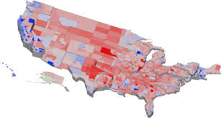
Cognitive Load
https://www.csc2.ncsu.edu/faculty/healey/PP/

