Slide 1
Errors from Decimal Precision
Ben Hammel
1/24/14

Slide 2
Purpose of the Project
Comparison of the truncation errors
Forward derivative (single precision)
Forward derivative (double precision)
Centered derivative (double precision)

Slide 3
Methods of Calculation
The Forward derivative and Center derivative of Sin(x) were taken and compared to the true derivative [ Cos(x) ]
Forward Derivative
Center Derivative

Slide 4
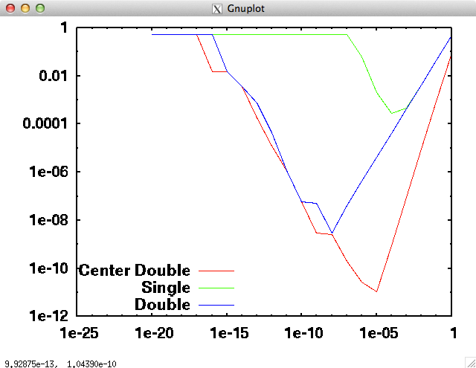
Results

Slide 5
Summary
The error between the derivatives decreases linearly with h until a specific point.
The error then increases due to round-off effects
The Center Derivative with double precision is the most capable method of generating accurate results

