Slide 1
Project 01: Launch a Satellite to the Moon
Ben Hammel

Slide 2
Overview
Calculate circular orbit around the earth using the Euler Scheme
Calculate circular orbit around earth using RK 4th order scheme
Comparison of Euler and RK
Confirmation of escape velocity
Implementation of the ‘adaptive RK4 scheme’ – confirmation of escape velocity
Effects of a stationary moon on orbits
Simulation of orbit around both moon and earth
Is there an analytical solution?

Slide 3
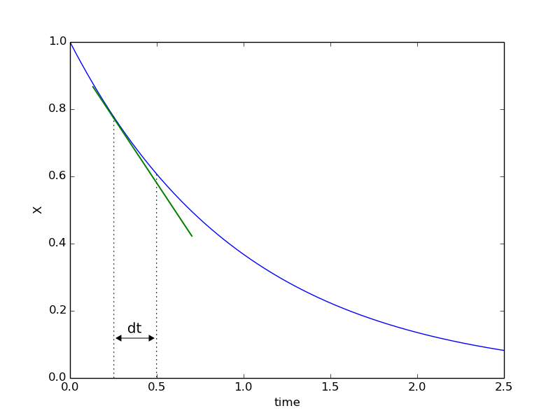
1: Euler Scheme
The 1st order Euler method estimates the next point in a function by multiplying the slope of the function at it’s current location by a time-step ( - set by the user).
Higher order terms are assumed to be zero

Slide 4
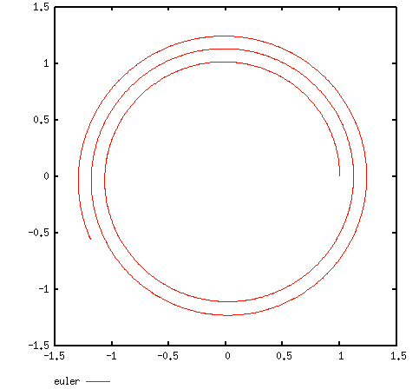
1: Orbit from Euler Scheme
Orbit calculated using the Euler Scheme is drastically inaccurate.
Initial Conditions:
(x, y) = (1, 0)
(v_{x}, v_{y}) = (0,1)
2,000 time-steps of .01 were used.
Smaller time-steps would be needed to generate an accurate result.

Slide 5
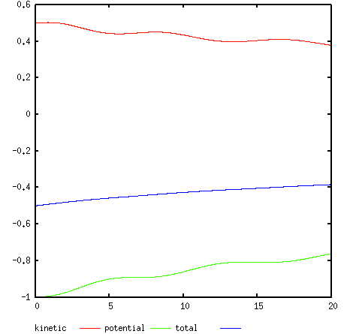
1: Energy of Satellite using Euler
Plotting the energy of the satellite confirms the inaccuracy of the results.
Total energy should be conserved. However, we see it increasing.

Slide 6
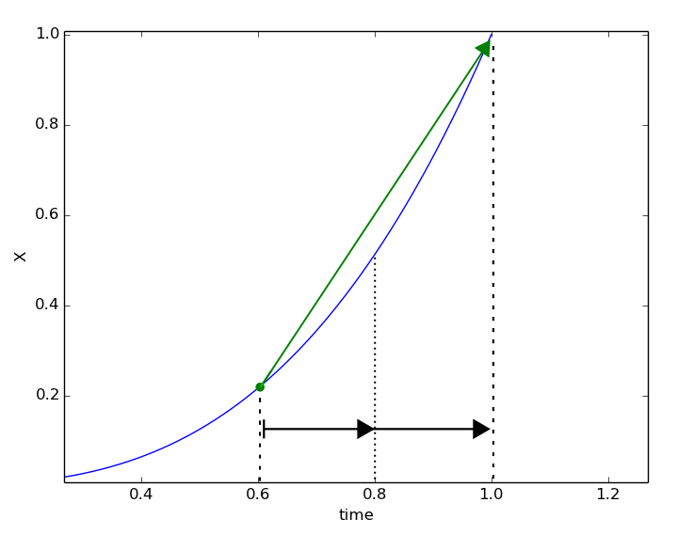
2: Runge-Kutta Method
The accuracy of the estimated function can be improved by implementing the Runge-Kutta Scheme.
Instead of predicting the next point in the function based on the slope at the current location, the trend line is generated by the weighted averages of the slopes at several estimated locations.

Slide 7
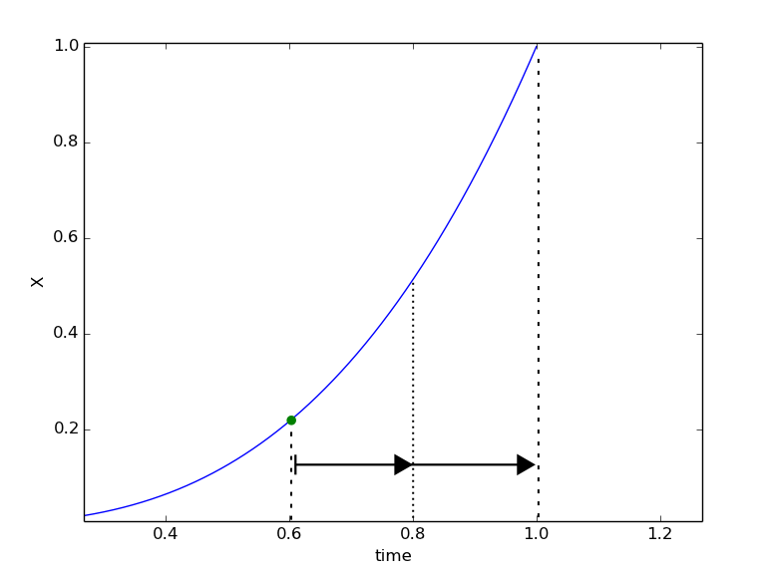
2: Runge-Kutta Method
The accuracy of the estimated function can be improved by implementing the Runge-Kutta Scheme.
The slope at the current location is calculated.

Slide 8
2: Runge-Kutta Method
The accuracy of the estimated function can be improved by implementing the Runge-Kutta Scheme.
Using the slope F₁ the next point is estimated for a half time-step
The slope at that location is then calculated ( F₂ )

Slide 9
2: Runge-Kutta Method
The accuracy of the estimated function can be improved by implementing the Runge-Kutta Scheme.
Slope (F₂) at location estimated by the incrimination based on ( F1 )
Using the slope of F_{2,} estimate the location of the next point, and calculate the slope

Slide 10
2: Runge-Kutta Method
The accuracy of the estimated function can be improved by implementing the Runge-Kutta Scheme.
Slope (F₃) at location estimated by the incrimination based on ( F₂ )
Using the slope of F_{3,} estimate the location of the next point, and calculate the slope

Slide 11
2: Runge-Kutta Method
The 4 Slopes ( F₁, F₂, F₃, F₄) are averaged together based on the Runge-weighting:
Other versions of the RK method use different weightings.
The Kutta weighting is:
The point x_{i+1} is then calculated based on this slope:

Slide 12
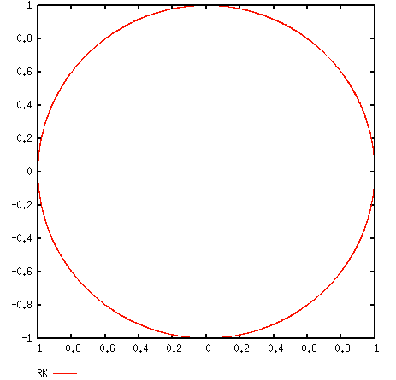
2: Runge-Kutta Orbit
The calculated orbit improves substantially using the 4th order Runge-Kutta method.
Initial conditions (same as Euler):
(x, y) = (1, 0)
(v_{x}, v_{y}) = (0,1)
2,000 time-steps of .01 were used.

Slide 13
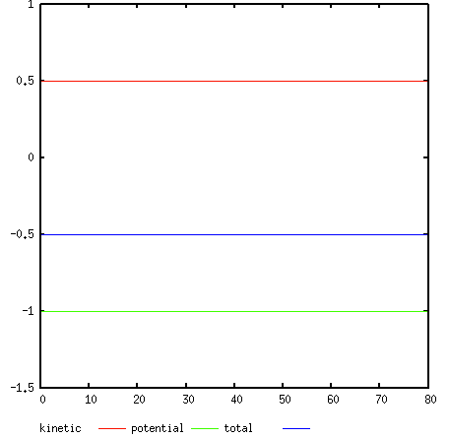
2: Energy of Satellite using RK4
The total energy of the system stays constant, confirming the accuracy of this method.
The Kinetic and Potential energy stay constant.
As expected for a circular orbit.

Slide 14
3: Comparison of RK and Euler
To get accurate results from the Euler scheme, it’s the time-step duration needs to be decreased.
Initial Conditions
Euler Scheme
RK4 Scheme
(x, y) = (1, 0)
(v_{x}, v_{y}) = (0,1)
Parameters
Step size: .01 Steps: 80,000

Slide 15
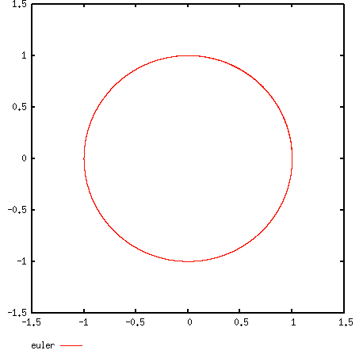
3: Comparison of RK and Euler
The time step needs to be 2 orders of magnitude more accurate for the same Euler scheme generates the same results as the RK method,
Initial Conditions
Euler Scheme
RK4 Scheme
(x, y) = (1, 0)
(v_{x}, v_{y}) = (0,1)
Parameters
Step size: .0001 Steps: 80,000

Slide 16
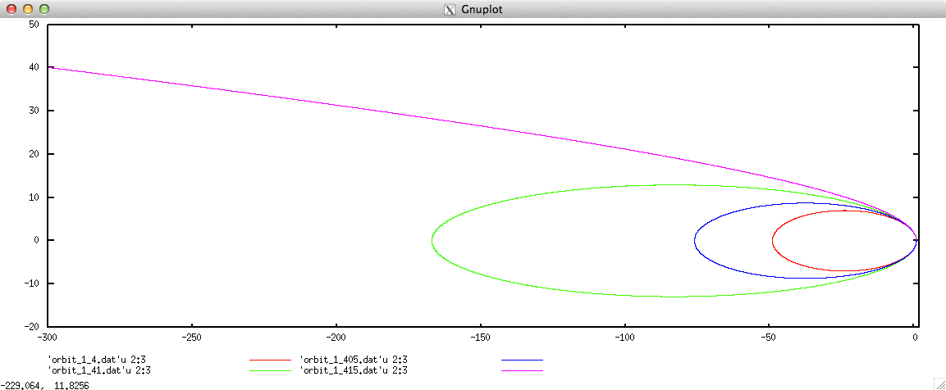
4: Escape Velocity
Using the RK 4th order scheme the escape velocity is calculated to be
100,000 steps at .1

Slide 17
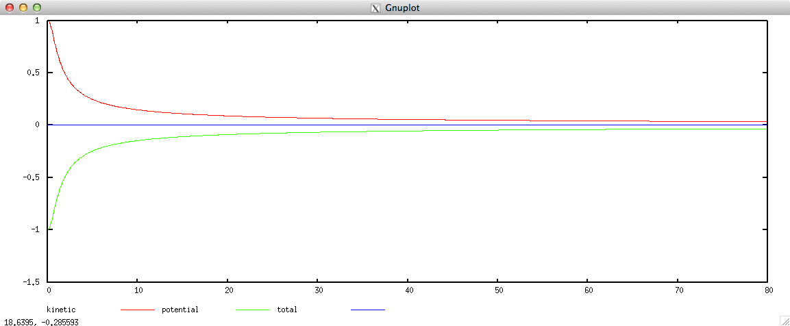
4: Escape Velocity
Total energy of the escaping satellite is still conserved.
Kinetic and potential energy both go to zero.
V= 1.415 100,000 steps at .1

Slide 18
5: Adaptive RK Scheme
An adaptive time-step method can be implemented to further improve the RK4 scheme.
Two time steps are taken for each . A full time step, and two half steps

Slide 19
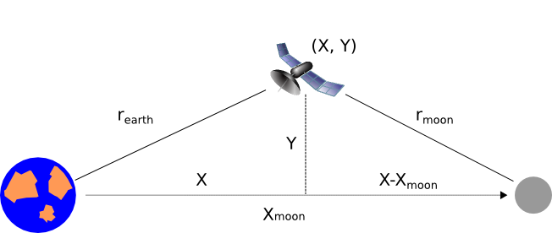
6: Effects of a stationary moon
The moon’s gravity only effects the acceleration of the satellite in the x-direction:

Slide 20
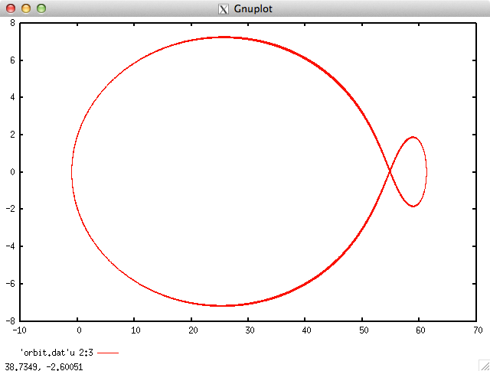
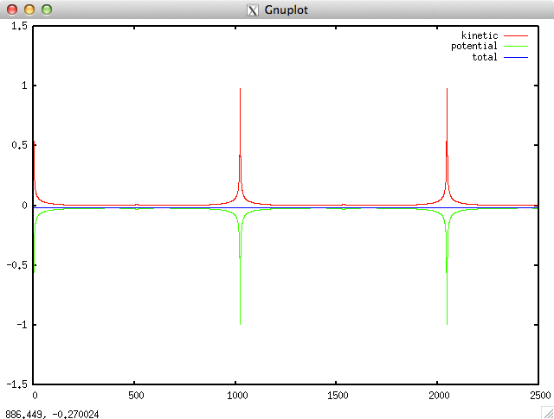
7: Calculation of Launch velocity to orbit moon and earth
Parameters
40,000 steps
.01 step size
.001 Acceptable error level
Initial Conditions
Position = (-1,0)
Velocity = (0, 1.40081635)

Slide 21

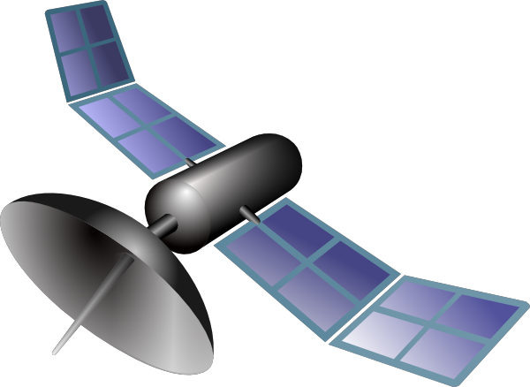

7: Analytical Solution of Launch Velocity
Initial Velocity of the satellite can be solved by equating the energy.
Q
For stable orbit, cross over point needs to be where F_{e}= F_{m}
v₀
Energy of the satellite at the cross over is equal to its initial energy (conservation of energy)
Using these two equations we can solve for the velocity

