Slide 1
P02 – Simplified Fluid Dynamics
Ben Hammel

Slide 2
Purpose
Comparisons of numerical solutions to the wave equations.
FTCS scheme
Lax scheme
Lax-Wendroff Scheme
Investigation of the stability criteria for the numerical solution.
Applications of fluid dynamics for predicting other systems.
Simulation of traffic conditions.

Slide 3
Outline
Propagation of a wave by the FTCS scheme
Propagation of a wave by the Lax scheme
Propagation of a wave by the Lax-Wendroff scheme
Implementation of the general Lax-Wendroff scheme
Application of fluid dynamics to simulate traffic conditions

Slide 4
Numerical Solutions for Fluid Dynamics
A perturbation will move through a medium according to: wherein c is the speed of the wave in the medium.
The definition of the derivative gives:

Slide 5
FTCS
Forward-Time Center-Space
Initial Conditions:
c = 1.
dx = .05
dt = .005
The FTCS scheme is always unstable for any step-size *
*See attached work

Slide 6
Lax
Initial Conditions:
c = 1.
dx = .05
dt = .005
Satisfies Stability Condition:

Slide 7
Lax-Wendroff
Initial Conditions:
c = 1.
dx = .05
dt = .005
Satisfies Stability Condition:

Slide 8
Lax-Wendroff
Propagation of a square-wave using the General Lax-Wendroff Scheme
The high frequency components of the square pulse propagate slower than the low frequency components.

Slide 9
General Lax-Wendroff
Initial Conditions:
c = 1.
dx = .05
dt = .005
Satisfies Stability Condition:

Slide 10
Traffic Flow
Simplified Traffic Conditions can be modeled through the used to fluid dynamics.
The speed the wave can propagate is a function of the density of the wave
General Lax-Wendroff scheme
Initial conditions:
c = v(p)
dx = 5
dt = .2

Slide 11
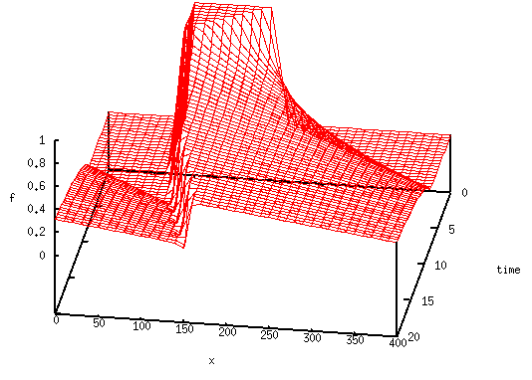
Traffic Flow
Density evolution in time and space with periodic-boundary conditions

Slide 12
Conclusion
The General Lax-Wendroff scheme preformed the best
However, still issues with preserving frequency.
Numerical solution to the General Lax-Wendroff can be used the simulate wave propagation in medium with inhomogeneous speed.

