Slide 1
P03 – Monte Carlo Simulation of
0D Particle Collisions
Ben Hammel

Slide 2
History
  Covers a broad range of methods which use pseudo-randomness to solve.
1930s – Enrico Fermi used a crude method to study neutron diffusion.
1946s – Used to investigate radiation shielding following the Manhattan project.
  Code named ‘Monte Carlo’ after the casino where one of the physicist’s uncle routinely borrowed money.
  Central simulation during the development of the Hydrogen bomb.

Slide 3
The Project
Simulation of gas kinematics in zero-dimensional space
  No position dependence.
  Dilute gas – no two body collisions
Implementation of Monte Carlo technique
  Relies on the boundary conditions set by the user, and mimics the random statistical behavior of nature.
  Simulation on a small (physical) scale, ~ the mean free path of a particle

Slide 4
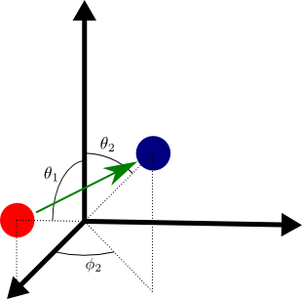
Collision in 3D
The resulting direction of travel and velocity components depend on the angle of the collision, size, and mass of the particles.

Slide 5
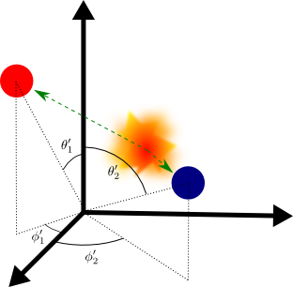
Collision in 3D
The resulting direction of travel and velocity components depend on the angle of the collision, size, and mass of the particles.

Slide 6
Velocity from Collision in
0D Space
We only consider the x,y,z velocity vectors (not position).
  Θ and φ of collision are randomly selected.

Slide 7
Rate of Collisions
Collisions are calculated probabilistically.
  The collision frequency is proportional to the average relative velocities of the particles
  with a probability of collision:

Slide 8
Rate of Collisions
Collisions are calculated probabilistically.
  The collision frequency is proportional to the average relative velocities of the particles
  with a probability of collision:

Slide 9
Monte Carlo Procedure
1
Calculation of each collision is, computationally, too expensive.
Generation of randomly selected pairs.
2
3
4
n

Slide 10
Monte Carlo Procedure
1
Calculation of each collision is, computationally, too expensive.
Generation of randomly selected pairs.
  Shuffle particles
2
3
4
n

Slide 11
Monte Carlo Procedure
1
Calculation of each collision is, computationally, too expensive.
Generation of randomly selected pairs.
  Shuffle particles
  Check if collisions occur
2
3
4
n

Slide 12
Monte Carlo Procedure
1
Calculation of each collision is, computationally, too expensive.
Generation of randomly selected pairs.
  Shuffle particles
  Check if collisions occur
  Exchange energy & momentum
2
3
4
n

Slide 13
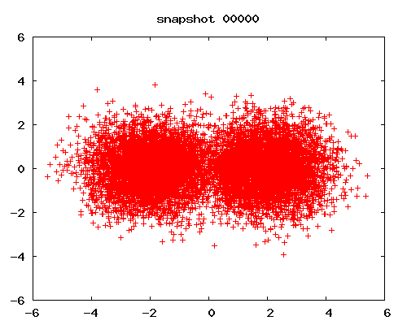
Results

Slide 14
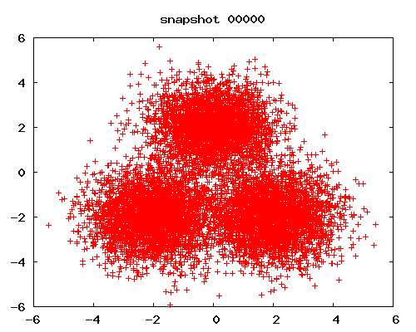
Results

Slide 15
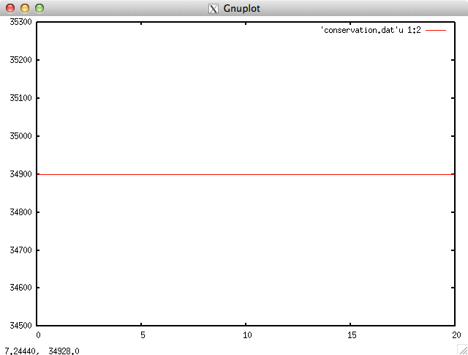
Conservation of Energy

Slide 16
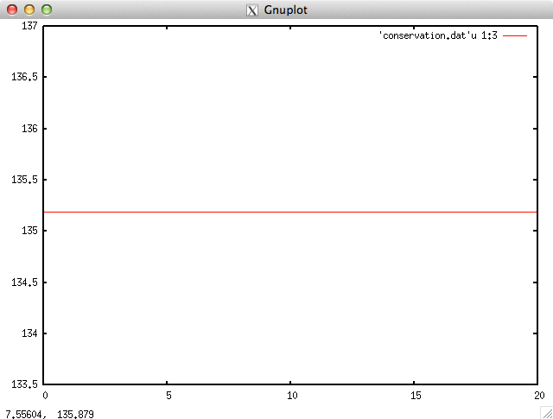
Conservation of Momentum

Slide 17
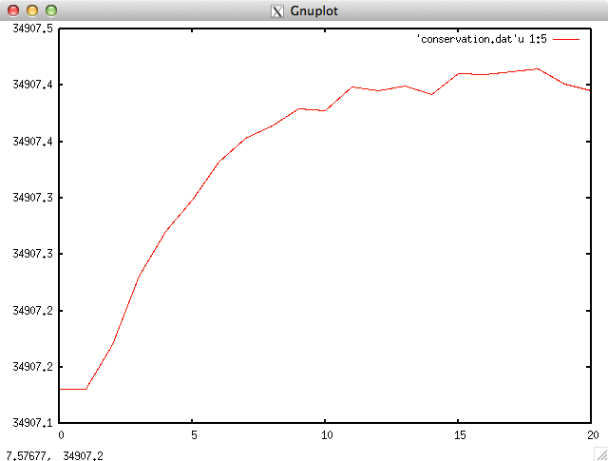
Entropy

Slide 18
Conclusion
Simulation mimics the statistic behavior of nature.
  Probability of collisions and energy exchange
System moves into equilibrium – entropy is at a maximum
Energy and momentum conservation holds

