Slide 1
Digital Portfolio
STUDENT NAME: DHARSHINI B
REGISTER NO AND NMID: 222401240 asunm11024ai130
DEPARTMENT: B .sc Computer science with Artificial intelligence
COLLEGE: D.R.B.C.C.C Hindu college Madras university

Slide 2
PROJECT TITLE
Digital Portfolio

Slide 3


AGENDA
Problem Statement
Project Overview
End Users
Tools and Technologies
Portfolio design and Layout
Features and Functionality
Results and Screenshots
Conclusion
Github Link
3/21/2024 Annual Review

Slide 4

PROBLEM STATEMENT
"In today's competitive world, students and professionals need an effective way to showcase their skills, achievements, and projects. Traditional resumes are limited in design and often fail to highlight creativity and technical abilities. There is a need for an interactive and visually appealing portfolio website that can represent an individual's profile, projects, and contact details in a
professional manner."
"My portfolio is a personal website designed to showcase who I am, my skills, and my work. It includes an About Me section with my background, a Projects section highlighting the work I have done, a Skills section that lists my technical and soft skills, and a Contact section for reaching me. The purpose of this portfolio is to present my achievements and abilities in a professional way."
"My portfolio is a personal website designed to showcase who I am, my skills, and my work. It includes an About Me section with my background, a Projects section highlighting the work I have done, a Skills section that lists my technical and soft skills, and a Contact section for reaching me. The purpose of this portfolio is to present my achievements and abilities in a professional way."
"My portfolio is a personal website designed to showcase who I am, my skills, and my work. It includes an About Me section with my background, a Projects section highlighting the work I have done, a Skills section that lists my technical and soft skills, and a Contact section for reaching me. The purpose of this portfolio is to present my achievements and abilities in a professional way."

Slide 5

PROJECT OVERVIEW
"My portfolio is a personal website designed to showcase who I am, my skills, and my work. It includes an About Me section with my background, a Projects section highlighting the work I have done, a Skills section that lists my technical and soft skills, and a Contact section for reaching me. The purpose of this portfolio is to present my achievements and abilities in a professional way."

Slide 6

WHO ARE THE END USERS?
Students (academic projects, resumes)
Job seekers (to share with recruiters).
Freelancers (to show clients).
Professionals (to highlight experience and achievements).

Slide 7

TOOLS AND TECHNIQUES
HTML Structure (pages, sections).
CSS Styling (colors, layouts, responsiveness).
JavaScript Interactivity (navigation menu, animations, form validation), Mention code editor CODEPEN and hosting platform (GitHub Pages)

Slide 8
POTFOLIO DESIGN AND LAYOUT
Sections included:
Home/About Me
Projects
Skill
Contact Responsive layout (mobile desktop view).
8

Slide 9
FEATURES AND FUNCTIONALITY
Navigation bar with smooth scrolling.
Project showcase with images/details.
Interactive elements (hover effects, animations).
Contact form (with validation).
Responsive design for all devices.

Slide 10

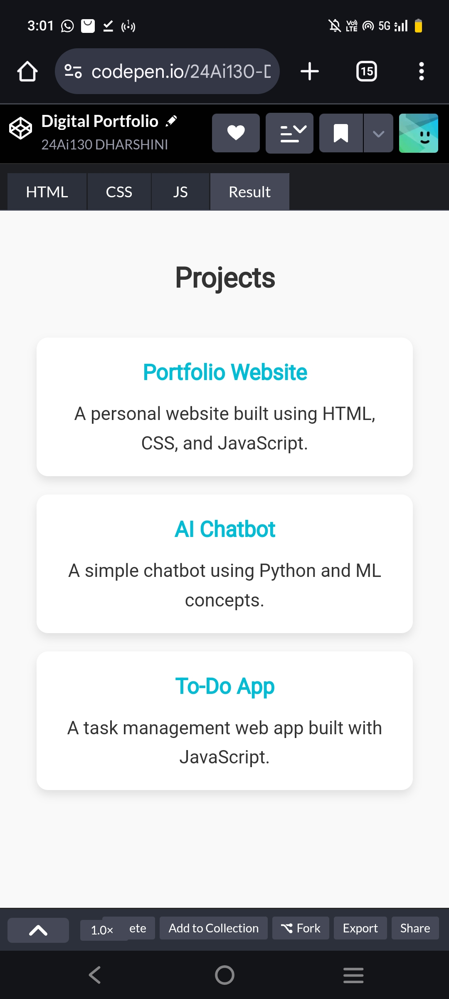
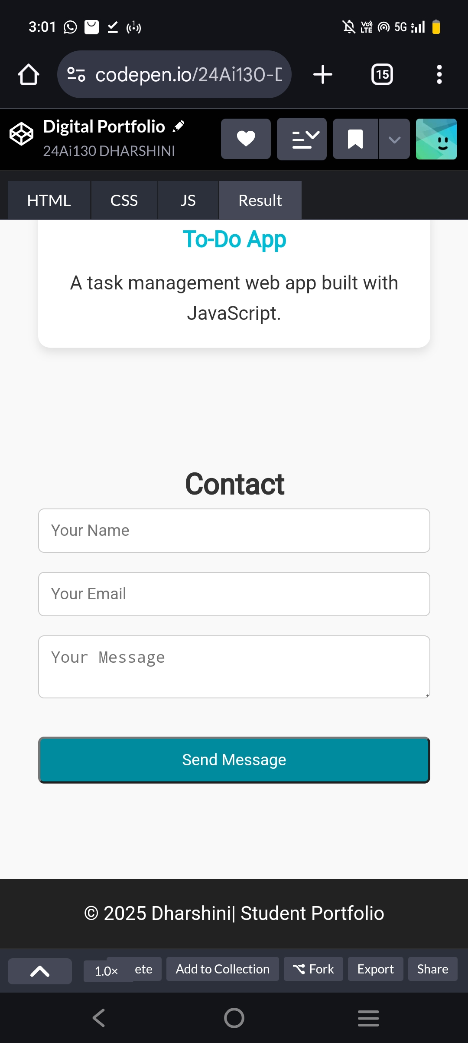
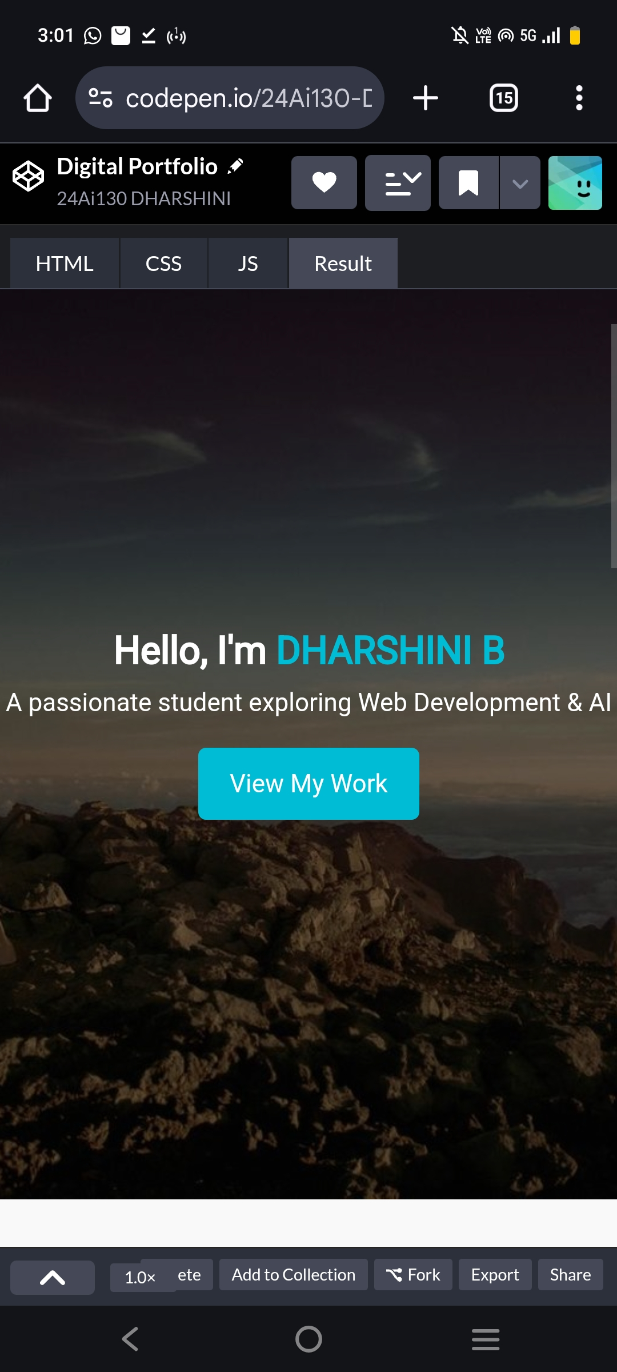
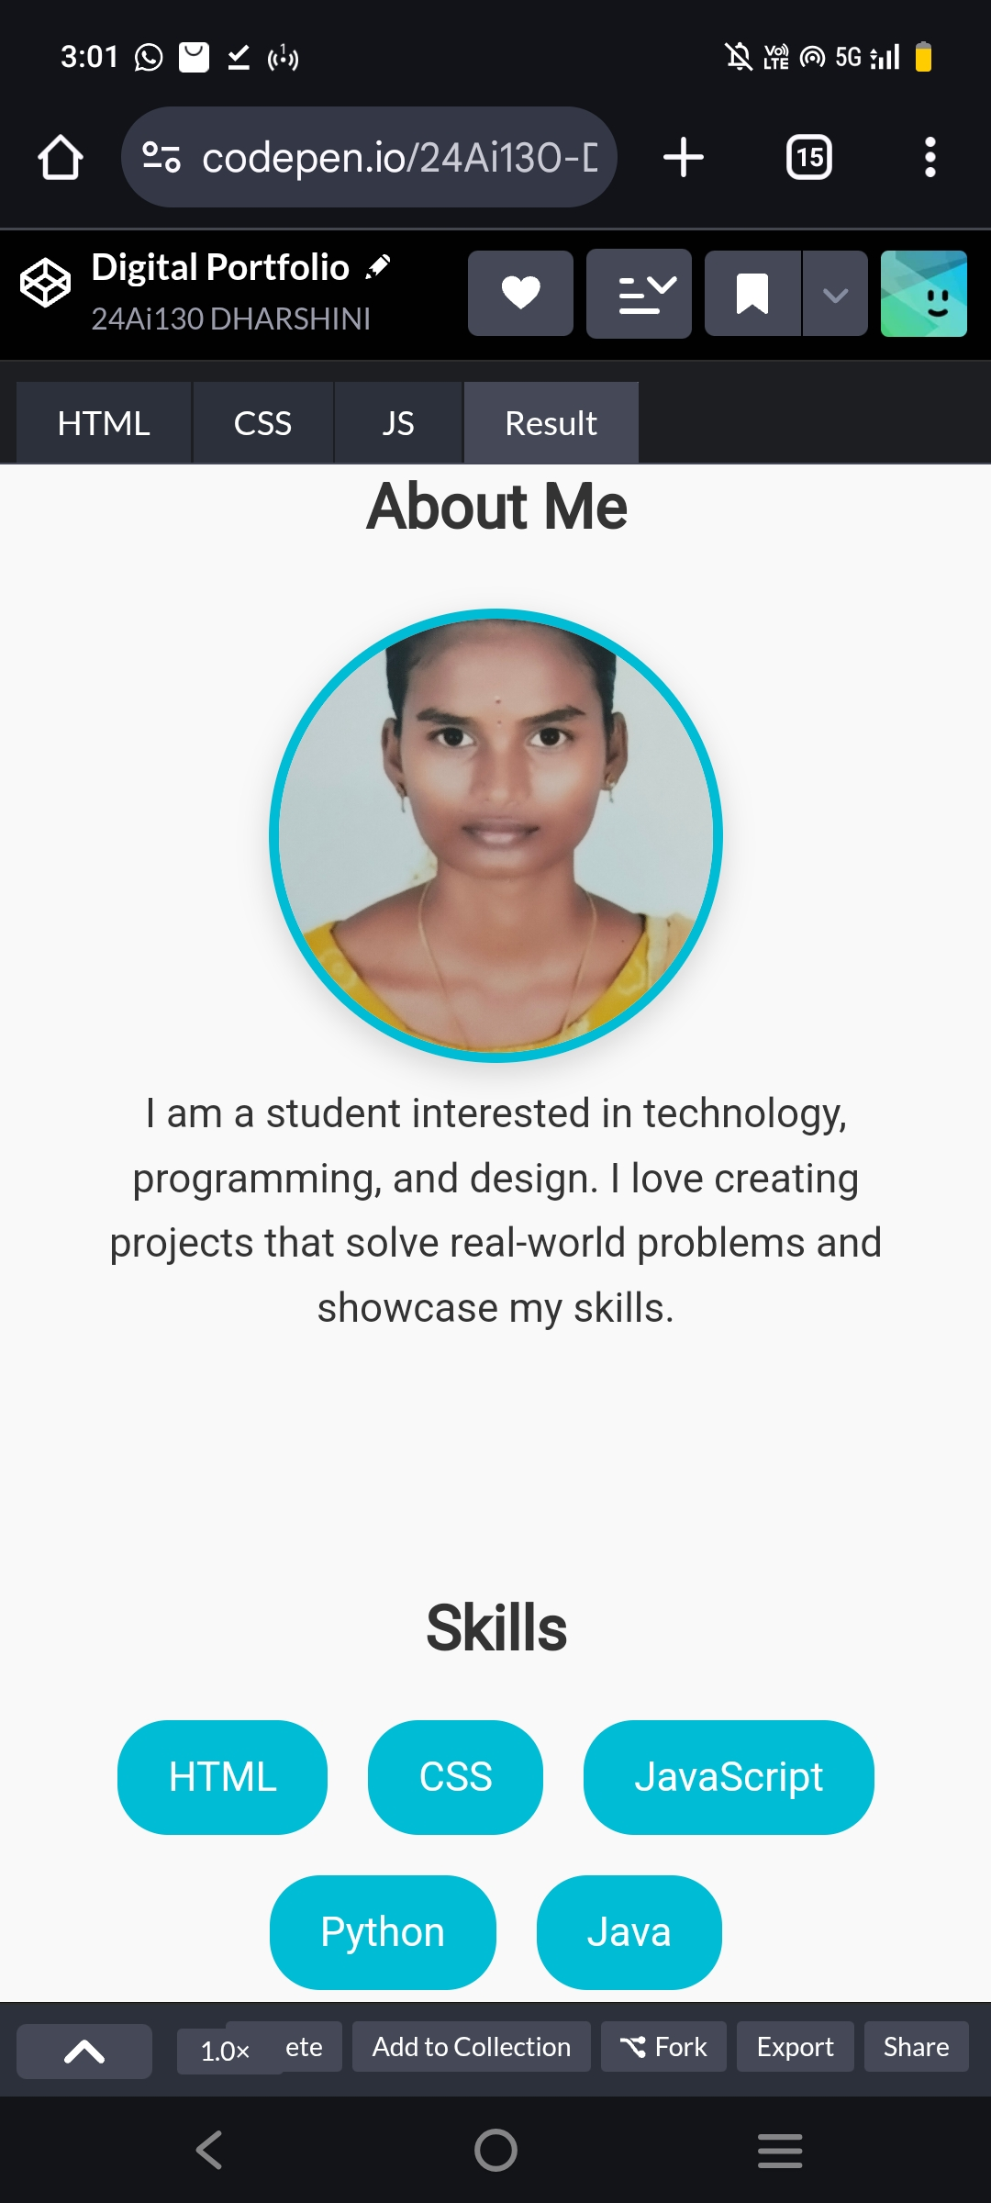
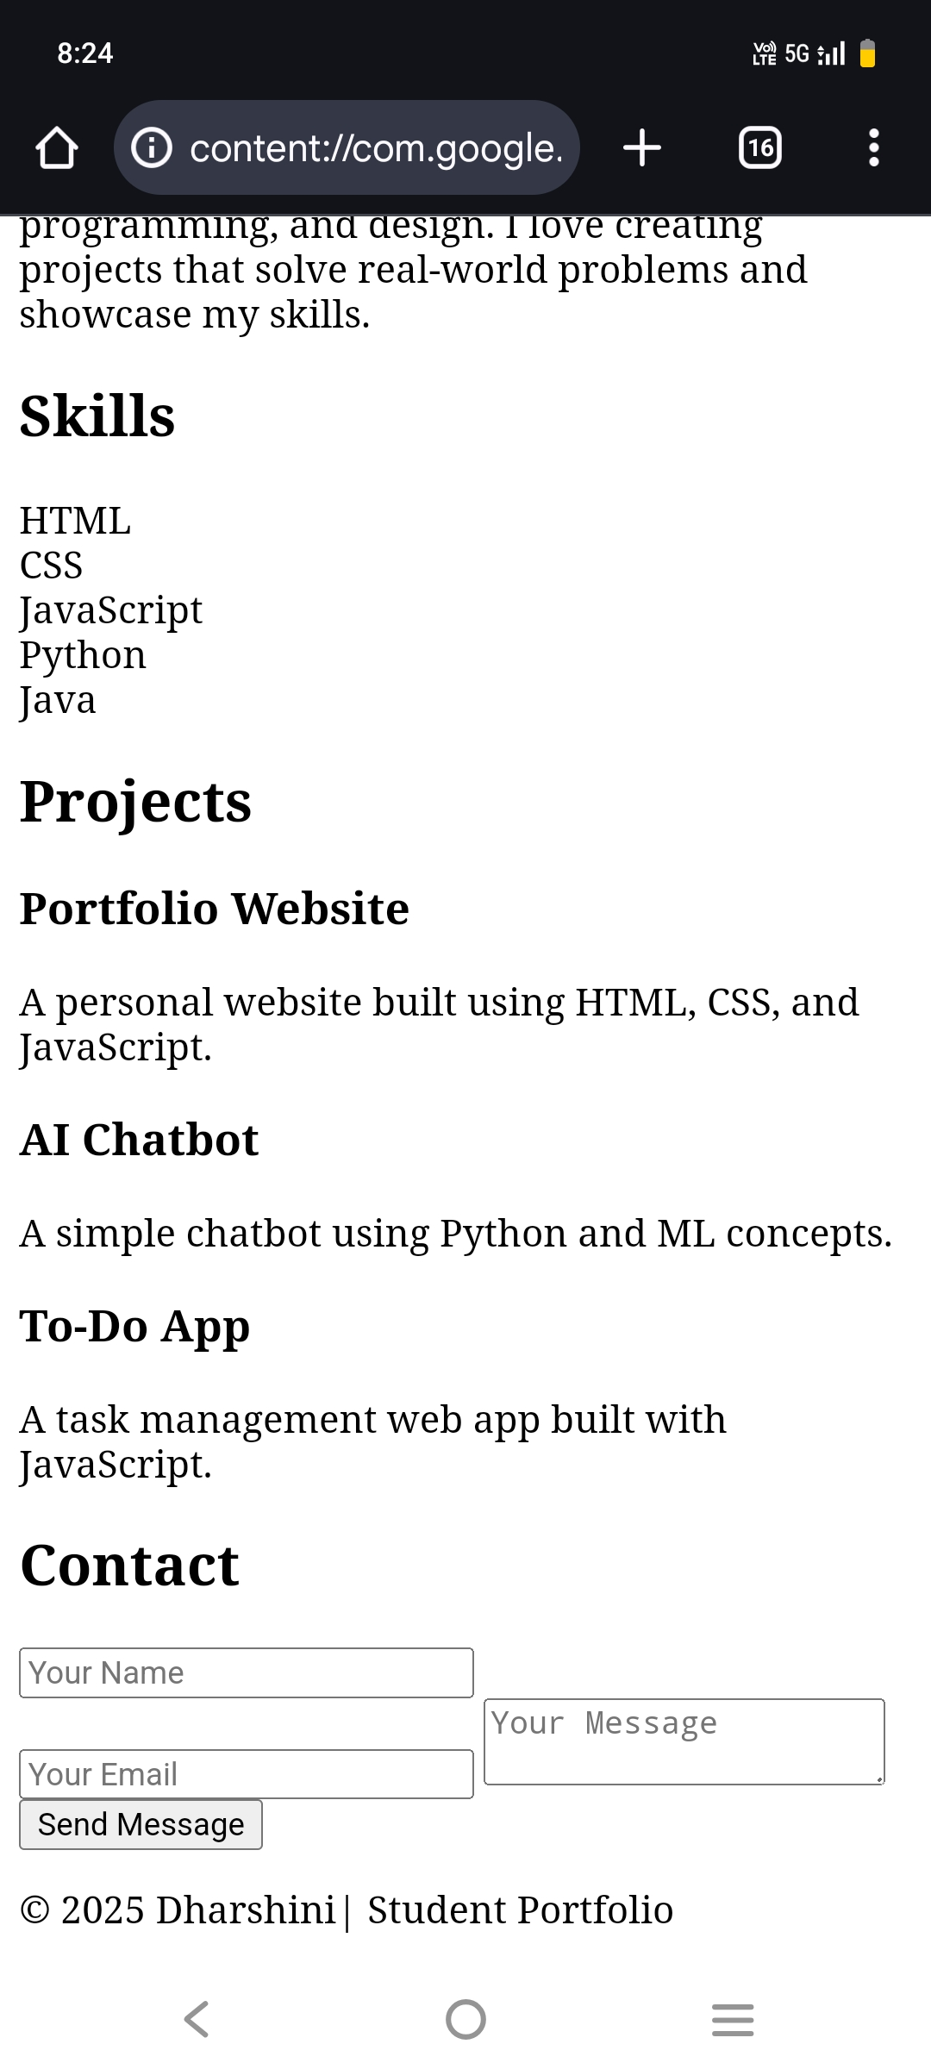
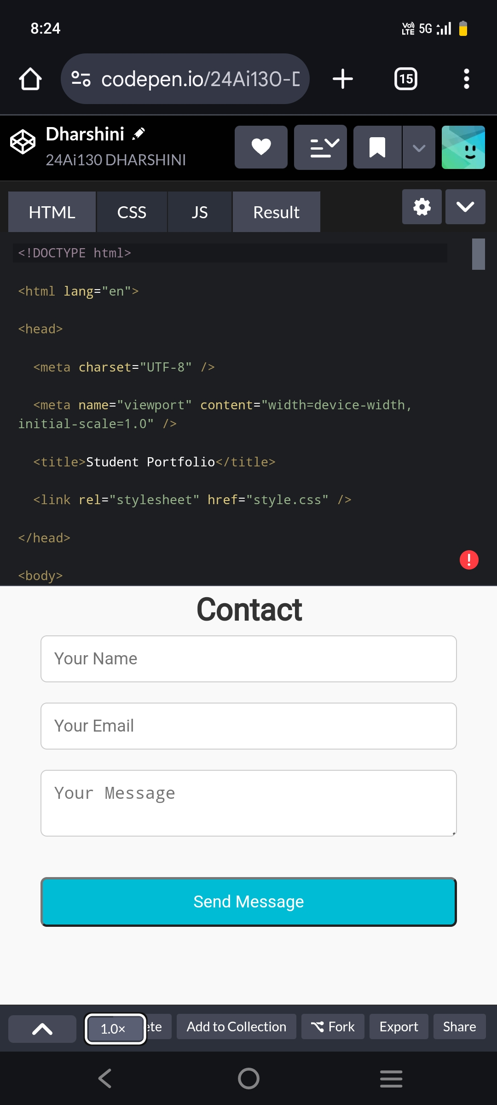
RESULTS AND SCREENSHOTS
Screenshots of each section
Before vs After (plain HTML with CSS & JS).
3/21/2024 Annual Review
10

Slide 11
CONCLUSION
The student portfolio project successfully demonstrates how individuals can present their skills, projects, academic background, and achievements in a professional digital format. By combining HTML, CSS, and JavaScript, the portfolio becomes an interactive and visually appealing platform that goes beyond a traditional resume.
11

