Slide 1
Lesson 1
Python Essentials

Slide 2
Overview
History
Installing & Running Python
Working with Python using VSCode

Slide 3
History
Invented in the Netherlands, early 90s by Guido van Rossum
Named after Monty Python
Open sourced
Designed to be human readable
Scalable, object oriented and functional
Active community

Slide 4
Installing Python
Python is pre-installed on most Unix systems, Linux and MAC OS X
The pre-installed version may not be the most recent one
Download from http://python.org/download/
Python comes with a large library of standard modules

Slide 5
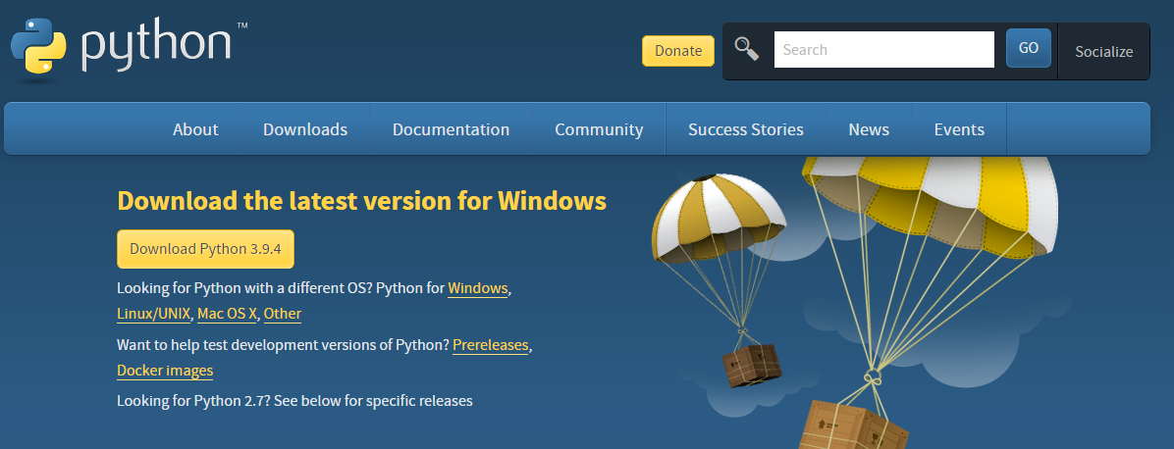

Slide 6
Running Python
Considered a scripting language, but is much more
Python interpreter evaluates each expression
Python programs can act both as a script and as a module to be and used by another python program.

Slide 7
VSCode
There are several options for an IDE.
We will use VSCode.
Python extension available.

Slide 8
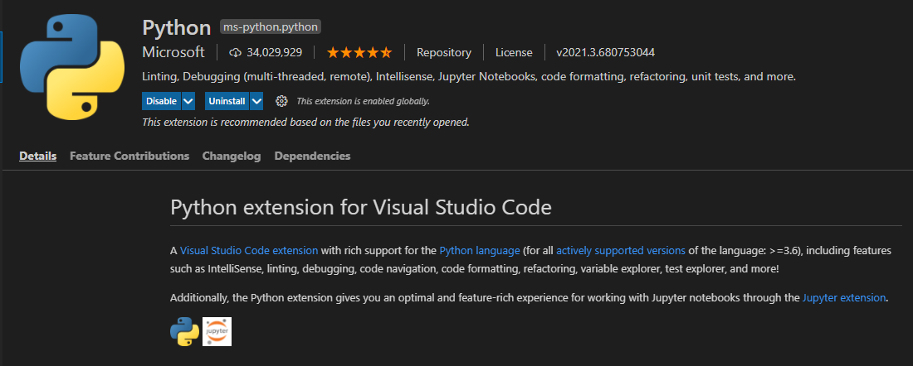

Slide 9
Python Programming Language
Two kinds of programs process high-level languages into low-level languages:
Interpreters: Reads a high-level program and executes it.
Compilers: Translates program into an executable before it is run.
Python uses both processes, but because of the way programmers interact with it, it is usually considered an interpreted language.

Slide 10

image

Slide 11

image

