Slide 1
Lesson 3
Python Essentials

Slide 2
Overview
Conditional Statements
Error Handling
Functions
Lambda functions

Slide 3
Conditional Statements
if country == 'canada': print('Oh look a Canadian') elif country == 'england': print('Oh look an english gentleman') else: print('Not sure where you live')

Slide 4
Symbol | Operation
> | Greater than
< | Less than
>= | Greater than or equal to
<= | Less than or equal to
== | is equal to
!= | is not equal to
x in [a,b,c] | Does x match the value of a, b, or c
Notes:
country == ‘canada’ How you indent your code changes execution
String comparisons are case sensitive
Use string functions to make case insensitive comparisons .lower()

Slide 5
Complex conditions
if gpa >= .85: if lowest_grade >= .70: print('Well done')
if gpa >= .85 and lowest_grade >= .70: print('Well done')

Slide 6
First | Second | And | Or
TRUE | TRUE | TRUE | TRUE
TRUE | FALSE | FALSE | TRUE
FALSE | TRUE | FALSE | TRUE
FALSE | FALSE | FALSE | FALSE
Notes:
Requirements for honour roll
Minimum 85% grade point average
Lowest grade is at least 70%

Slide 7
Handling runtime error
Recover from error state
Logging
Graceful exit
try: print(x / y) except ZeroDivisionError as e: # Optionally, log e somewhere print('Sorry, something went wrong') except: print('Something really went wrong') finally: print('This always runs on success or failure')
Notes:
Notes: - built-in Exceptions: https://docs.python.org/3/library/exceptions.html - handle from more specific to more generic
When to use:
User input
Accessing an external system
REST call
File system

Slide 8
Functions
Encapsulate Logic.
Can receive none, one or more input parameters.
Can return values.
def get_initial(name): initial = name[0:1].upper() return initial first_name = input('Enter your first name: ') first_name_initial = get_initial(first_name) last_name = input('Enter your last name: ') last_name_initial = get_initial(last_name)
Enter your first name: John Enter your last name: Doe Your initials are: SI

Slide 9
Lambda Functions
Inline function
Anonymous, may not have a name
Frequently used with higher-order functions which take functions as arguments

Slide 10
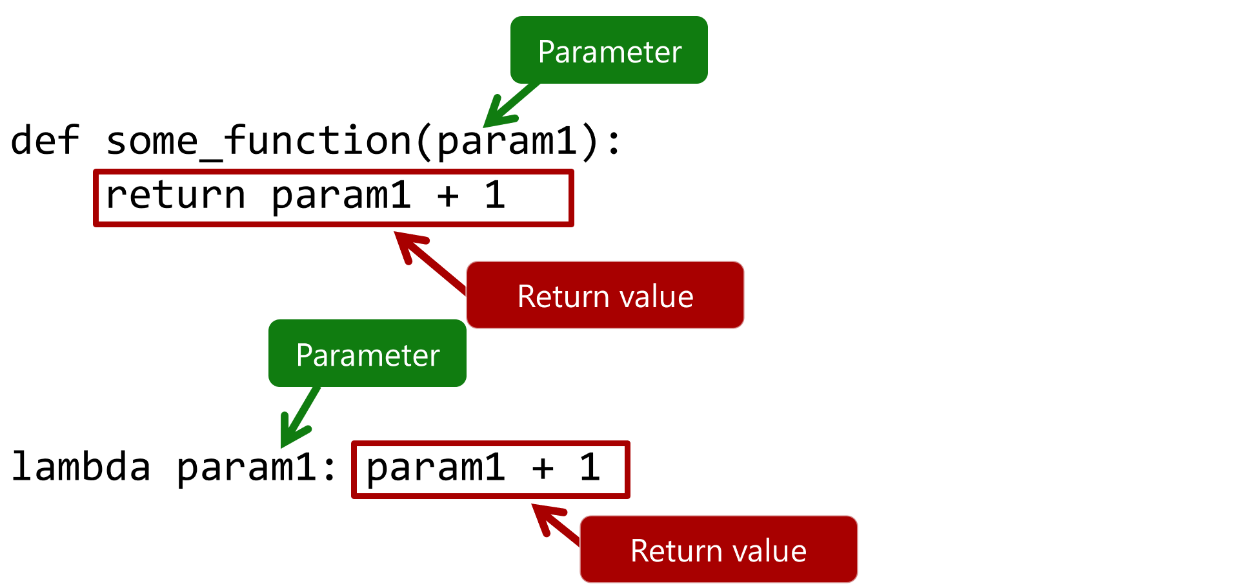
image

Slide 11
(lambda x: x + 1)(2)

