Slide 1
Lesson 7
Python Essentials

Slide 2
Overview
Using modules
Packages
Creating modules
Python virtual environment

Slide 3
Modules Overview
A Python file with functions, classes and other components.
Break code down into reusable structures.
Referenced by using the import statement.
It is customary but not required to place all import statements at the beginning of a module.
To speed up loading modules, Python caches the compiled version of each module in the pycache directory under the name module.version.pyc
# import module as namespace import helpers helpers.display('Not a warning') # import all into current namespace from helpers import * display('Not a warning') # import specific items into current namespace from helpers import display display('Not a warning')

Slide 4
Packages
Modules can be distributed using a Package.
A Package is a published collection of modules.
Defines a namespace like PythonEssentials.Calculator
You can publish to, and install from pypi.org.
Install package with pip.
# Install an individual package pip install colorama # Install from a list of packages pip install -r requirements.txt # requirements.txt colorama

Slide 5
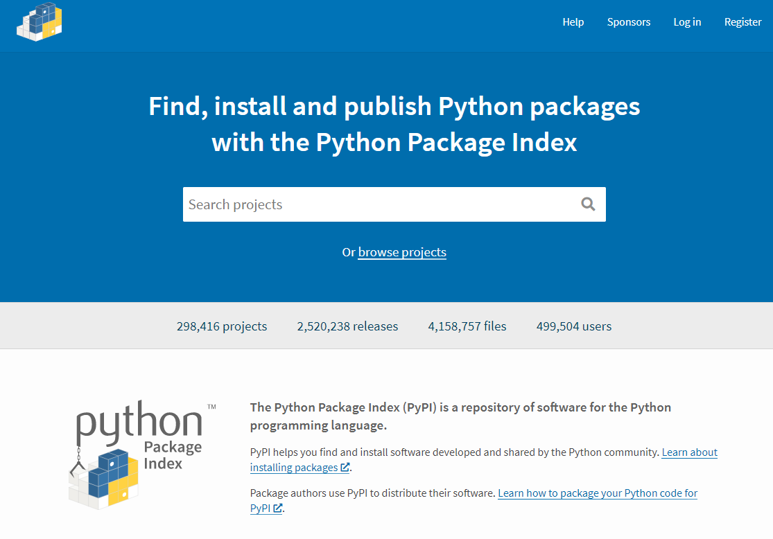

Slide 6
Creating Packages
The __init__.py files tell Python to treat directories containing the file as packages.
The __init__.py can be an empty file, but it can also execute initialization code for the package.
PythonEssentials/ __init__.py calculators/ __init__.py simple_calculator.py advanced_calculator.py parsers/ __init__.py console_input_parser.py console_output_parser.py file_input_parser.py file_output_parser.py
import python_essentials.calculators.simple_calculator from python_essentials.parsers import console_input_parser, console_output_parser

Slide 8
Python Virtual Environment
Isolated environment where to install your dependencies.
Create virtual environnement.
python -m venv .venv
Activate virtual environment in VS Code.
image
Activate virtual environment in command line bash .\.venv\Scripts\activate
Create Requirements file bash python -m pip freeze > requirements.txt
Notes:
https://packaging.python.org/guides/installing-using-pip-and-virtual-environments/
https://code.visualstudio.com/docs/python/debugging
https://code.visualstudio.com/docs/python/environments

