Slide 1
Lesson 4
Python Essentials

Slide 2
Overview
Lists
Arrays
Slicing
Tuples
Sets

Slide 3
Lists
Lists are collections of items.
Lists can be expanded or contracted as needed.
Can contain any data type.
Used to store a single column collection of information
It is possible to nest lists.
empty_list = [] empty_list = list() names = ['James', 'David'] scores = [] scores.append(98) # Add new item to the end scores.append(99) print(names) # ['Christopher', 'Susan'] print(scores) # [98,99] print(scores[1]) # 99

Slide 4
Arrays
Arrays are collections of items.
Designed to store a uniform basic data type, such as integers or floating point numbers.
Use array module
from array import array scores = array('d') scores.append(97) scores.append(98) print(scores) print(scores[1])
Notes:
Notes: - from array library - Later module will talk about libraries and modules and packages. - Basically we are importing an array

Slide 5
Lists Vs. Arrays
Arrays:
Simple types such as numbers
Must all be the same type
Lists:
Store anything
Store any type
Notes:
Notes: - numpy will give you additional support

Slide 6
Common Operations
names = ['James', 'David'] print(len(names)) # Get the number of items names.insert(0, 'Bill') # Insert before index print(names) names.sort() print(names)
2 ['Bill', 'James', 'David'] ['Bill', 'David', 'James']
Notes:
sorts side effect is that it will modify the list

Slide 7
Slicing
names = ['James', 'David', 'Bill','Justin'] names names[3] names[1:3] names[:3]
['James', 'David', 'Bill','Justin'] ['Justin'] ['David', 'Bill'] ['James', 'David', 'Bill']

Slide 8
Sorting
sorted() can be used on lists, tuples and sets.
sort() can only be used with lists
sort() returns None and modifies the values in place

Slide 9
Sorting complex objects
persons = [ {'name': 'James', 'age': 50}, {'name': 'David', 'age': 47} ]
Error: TypeError: ‘<’ not supported between instances of ‘dict’ and ‘dict’
persons.sort() print(persons)
Works!
def sorter(item): return item['name'] presenters.sort(key=sorter)

Slide 10
Dictionaries
Dictionaries are key/value pairs of a collection of items.
Dictionaries use keys to identify each item.
empty_dictionary = {} empty_dictionary = dict() person = {'first': 'John'} person['last'] = 'Doe' print(person) print(person['first'])
{'first': 'John', 'last': 'Doe'} John

Slide 11
Dictionaries Vs Lists
Dictionaries:
Key/Value pairs
Storage order not guaranteed
Lists:
Zero-based index
Storage order guaranteed

Slide 12
Tuples
Create a tuple
empty_tuple = () empty_tuple = tuple() tup = ('32', 4, 'yes', 3.14)
Similar to lists:
tup[1:4] # (4, 'yes', 3.14)
Tuples are immutable
Notes:
Notes: https://docs.python.org/2/library/functions.html#tuple

Slide 13
Sets
Sets are unordered.
Set elements are unique. Duplicate elements are not allowed.
Common operations: union, intersect, and difference.

Slide 14
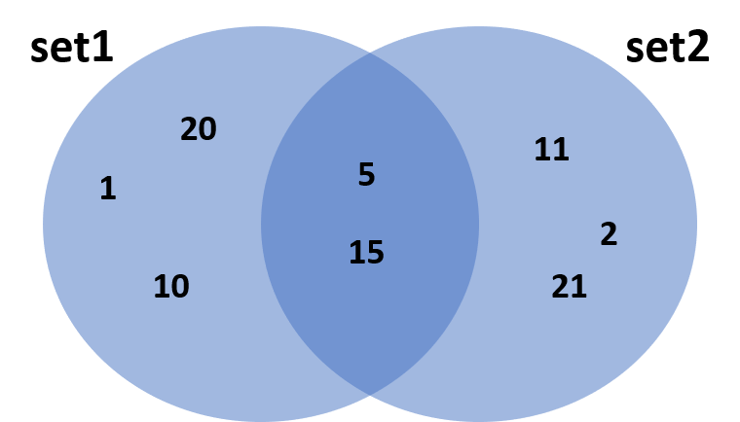
image

Slide 15
empty_set = set() set1 = {1, 5, 10, 15, 20} set2 = {2, 5, 11, 15, 21}

