Slide 1
Lesson 8
Python Essentials

Slide 2
Overview
Clean code
Linting

Slide 3
This is valid, but it is clean?
x = 12 if x== 24: print('Is valid') else: print("Not valid") def helper(name='sample'): pass def convertTouc( name = 'sample' ): return name.upper()
Notes:
touc: to upper case

Slide 4
Why clean code?
Makes code readable
Easier to debug
Easier to maintain by you and others

Slide 5
Spacing
Spaces, not tabs
VSCode automatically converts tabs to spaces
Avoid extraneous whitespaces
{'good': 200} { 'bad' : 100}

Slide 6
Naming
Spaces, not tabs
VSCode automatically converts tabs to spaces
Avoid extraneous whitespaces
Bad: - d - DaysSinceCreation - daysSinceCreation - c = dta_rcrd_102()
Good: - days_since_creation - customer_address = Address()
Notes:
Notes: https://www.python.org/dev/peps/pep-0008/

Slide 7
Functions
Think small
Should do one thing
They should do it well.
They should do it only.
Descriptive names. Don’t fear long names
Reduce number of arguments.
wrap arguments inside meaningful objects
makeCircle(double x, double y, double radius) makeCircle(Point center, double radius)
Notes:
Notes:
Reduce number of arguments 0: ideal 1: ok 2: ok 3: justify 4 or more: avoid

Slide 8
Comments
“Don’t comment bad code—rewrite it.” —Brian W. Kernighan and P. J. Plaugher
Can be helpful or damaging
Inaccurate comments are worse than no comments at all
Used to compensate failure expressing with code
They can lie
Must have them, but minimize them
Express yourself in code
Bad:
# Check to see if the employee is eligible for full benefits if ((employee.flags & HOURLY_FLAG) && (employee.age > 65))
Good:
if (employee.isEligibleForFullBenefits())

Slide 9
Documentation
String literal in the first statement in a module, function, class, or method definition.
Used for documentation.
def print_hello(user_name: str) -> str: """ Generates a greeting to the user by name Parameters: user_name (str): The name of the user Returns: str: The greeting """ return 'Hello, ' + name

Slide 10
Classes
Should be small
Single responsibility principle
Automatically run by Visual Studio Code

Slide 11
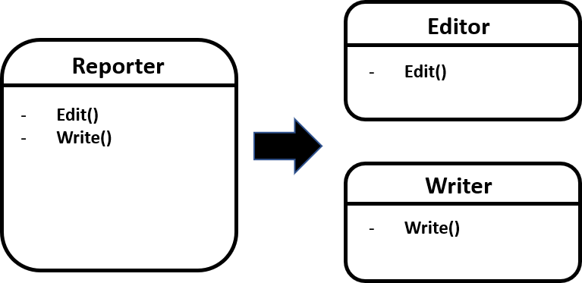
image

Slide 12
Linting
Identify formatting issues
Pylint for Python
Windows:
pip install pylint
macOS or Linux:
pip3 install pylint

Slide 13
Type hints
Tell the editor and linter what data types to expect
DOES NOT cause “compiler” errors
def get_user_greeting(user_name): return 'Hello, ' + user_name greeting = get_user_greeting(42) print(greeting)
Error!
TypeError: must be str, not int
def get_user_greeting(user_name: str) -> str: return 'Hello, ' + user_name greeting = get_user_greeting(42) print(greeting)
Notes:
Notes: - parameter type - return type

