Slide 1
Lesson 10
Python Essentials

Slide 2
Overview
Asynchronous Operations
Calling Web APIs

Slide 3
Async Overview
Asynchronous IO (async IO): pattern that has implementations across many programming languages.
async/await: two new Python keywords that are used to define coroutines.
asyncio: the Python package to implement async pattern.
Consider using with operations take a long time
Web calls
Network IO
Complex data processing

Slide 4
Writing Async operations
async: Flag to create a coroutine (function with an await call)
await: “Pauses” code to wait for response
create_task: Creates a handle (or coroutine) and schedules execution
async with aiohttp.ClientSession() as session: task_one = asyncio.create_task(load_data(session, 2)) task_two = asyncio.create_task(load_data(session, 3)) result_one = await task_one result_two = await task_two
Notes:
Notes:
with will do automatically clean up, but we don’t want it to clean up before we finish our async ops. The keyword asyc tells with to remember to wait.
Operations: - run: Runtime for asynchronous functions - create_task: Creates a handle (or coroutine) and schedules execution - gather: Create a collection of tasks to execute and wait for completion
Creating coroutines (functions using async/await): - async: Flag to create a coroutine (function with an await call) - await: “Pauses” code to wait for response

Slide 5
Calling Web APIs Overview
You can call functions from programs hosted on web servers.
Need: Address or Endpoint, method name, and parameters.
Use request library

Slide 6
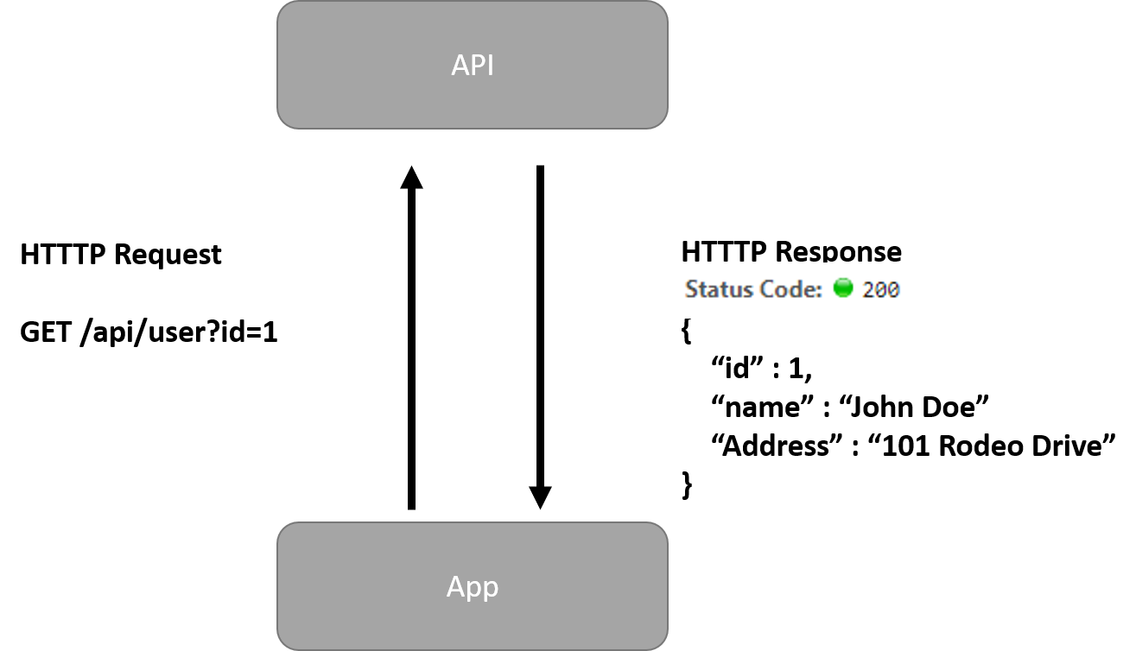
image
Notes:
Notes: We don’t want to stop everything just because one process is taking forever.

Slide 7
Async and Calling Web APIs
By default, socket operations are blocking.
requests.get(url) is not awaitable.
But, almost everything in aiohttp is an awaitable coroutine
session.request()
response.text()

