Slide 1



Amirkabir university of tehcnology
Department of Computer engineering
BOOKZY
Android project
By
Maryam Kermanshahani
Ashkan Shakiba
Armin Ebrahimi Saba
Professor: Dr.Shahreza
1
October 2022

Slide 2
Introduction
03
Features
04
App overview
05
Table of contents
2

Slide 3
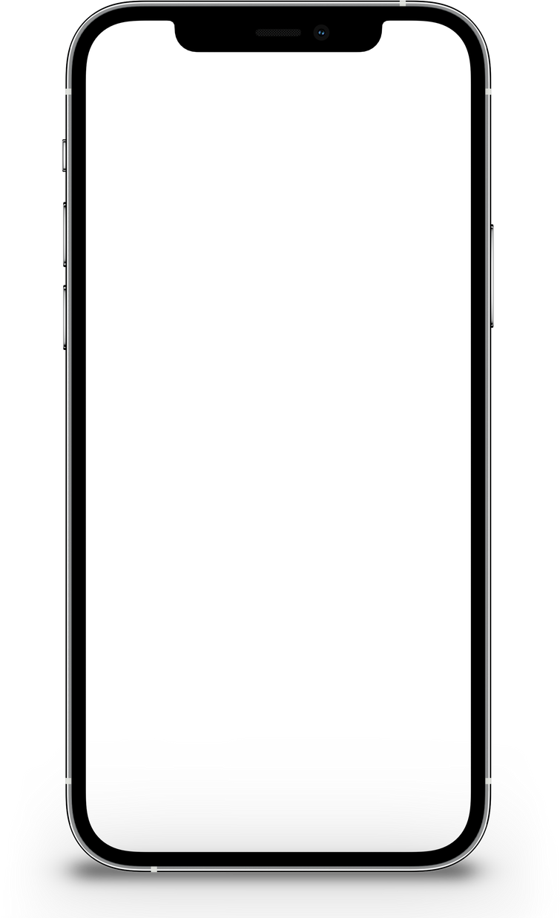

Introduction
READING BOOK IS NOT DEPENDENT ON LOCATION, BUT ON THE DESIRE.
A reader that goes with you
BOOKZY
3

Slide 4








Features
QUOTE
Strong | Focused | Fun | For All
LISTENING TO SONG WHEN READING BOOK
DICTIONARY
DEFAULT BOOKS IN APP LIBRARY
4

Slide 5
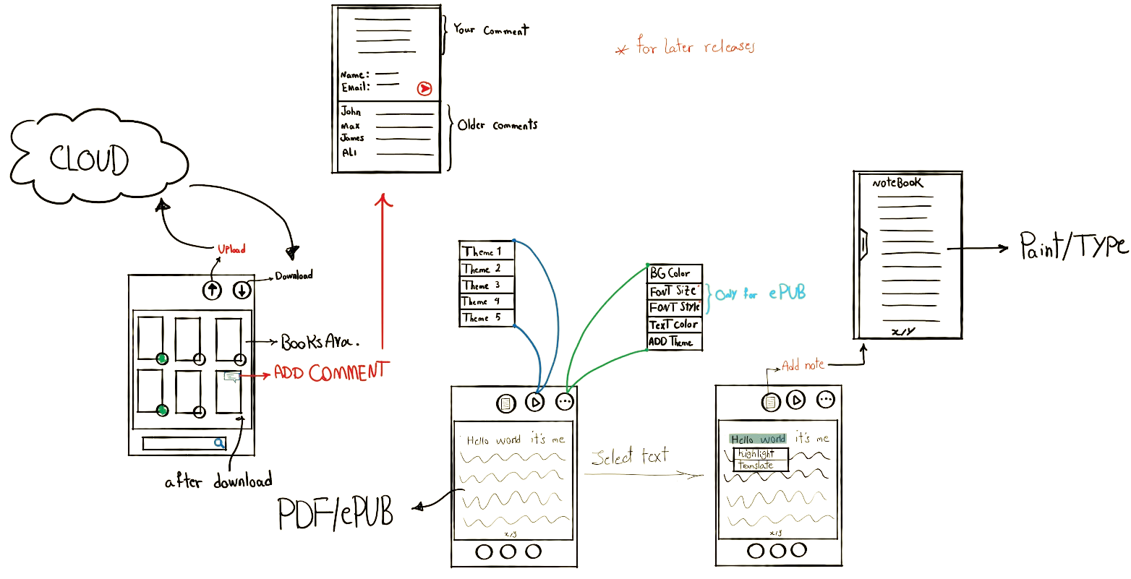
App overview
5

Slide 6

Thank
You
Contact us
maryam.kermanshahani1379@gmail.com
AshkanShakiba11@gmail.com
armines.bin2000@gmail.com
Today a reader
Tomorrow a leader
6

