Slide 1
Remote Control Software

Slide 2
Goals of the software
Take control of users’ screens
View users’ active sessions
Have a user client and a technician client
User friendliness
Easy access for both, user and client

Slide 3
Define the Requirements
Main Features
File transfer
Prompts to show the user that you are connected
Chat function for easy communication
Main Requirements
Licensing and cost per month
Legitimacy of the vendor
Compatibility with various OS’s and devices

Slide 4
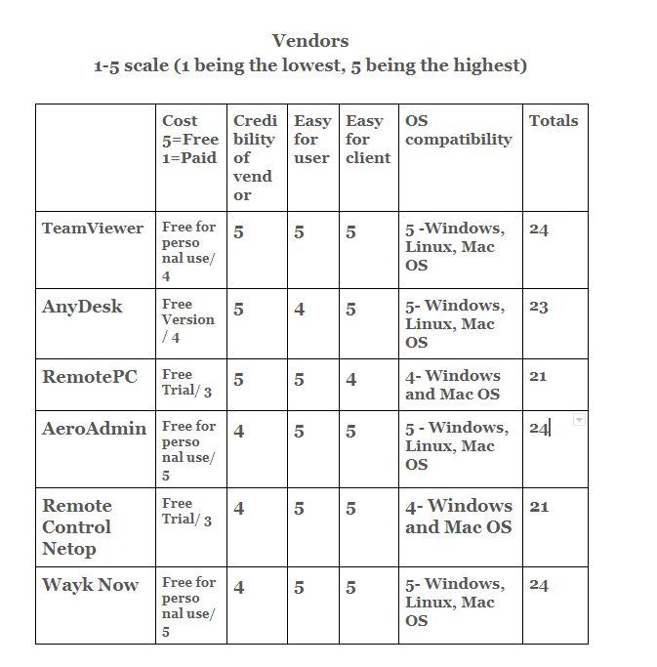
Evaluate Vendors

Slide 5
Evaluate the finalists
Finalists came down to:
TeamViewer
AeroAdmin
Wayk Now
The reasoning for choosing these three is that they all included a client side and a user side to make the overall experience easier to use.

Slide 6
Final Decision
Wayk Now is the winner for our group based on the ease of access, compatibility, and most importantly the price. All three finalists were very similar in the sense that there is a client and a user installer and then the user gives you their ID and you connect, through Wayk now there is an additional step for setting up a password for added security.

Slide 7
Implementation
To implement this in our student run help desk we could put a link on the ROC site for all students to download the free version of Wayk Now and then they could remote to their computers and help with their issues.

