Slide 1

An insight on two neighborhood types in New York City based on their most prevalent venue categories

Slide 2
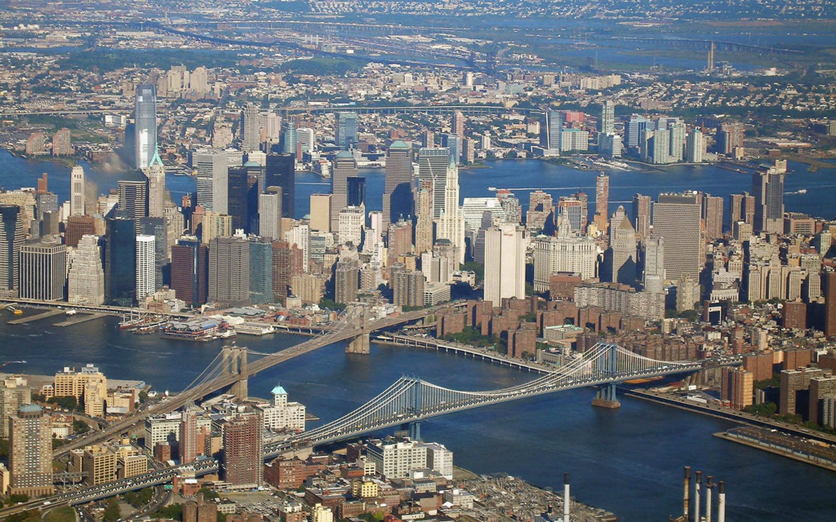
Introduction

Slide 3
Setting up shop in NYC is no trivial matter
New York City (NYC) is the top global metropolis
Lease space in global cities is limited and expensive
Venue opening decisions need to be informed by quality, actionable data
This report provides guidance by offering a machine learning-driven segmentation of the neighborhoods in NYC based on their venue composition
https://www.kearney.com/global-cities/2020

Slide 4

Data and methods

Slide 5
Data sources
Source 1: a dataset available from IBM that offers a breakdown of boroughs and neighborhoods of NYC, with coordinates information
Source 2: information on venues obtained through Foursquare using the Python requests library (see attached Jupyter notebook)
https://cf-courses-data.s3.us.cloud-object-storage.appdomain.cloud/IBMDeveloperSkillsNetwork-DS0701EN-SkillsNetwork/labs/newyork_data.json

Slide 6
Data treatment
Neighborhood-level data were obtained through source 1 in json format. Variables:
  Borough
  Neighborhood
  Coordinates (latitude & longitude)
Data were scraped into a pandas dataframe, and visualized on a map through folium
Venues for each neighborhood fetched through source 2 (limit of 100 venues in a 500 m radius for each neighborhood)

Slide 7
Data treatment contd
For each neighborhood, fetched venues were grouped by category
Categories were used to train a K-means clustering algorithm using k = 5
Two main clusters emerged, plus three minor clusters of no more than two neighborhoods each. Only the main clusters, coded here as A and B, were used in further analysis
For the two main clusters, the aggregate neighborhood modes of the top 10 categories were computed
The modes were grouped into three broad venue types: food locations, shopping locations, and transportation

Slide 8

Results

Slide 9
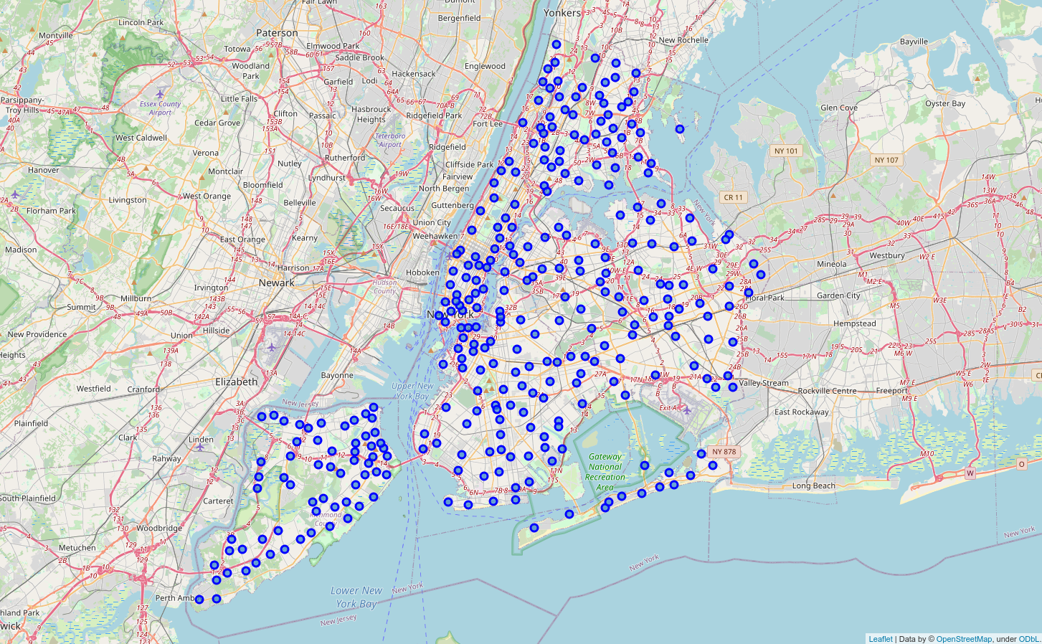
Folium visualization allows identifying NYC neighborhoods
Figure 1: Map of New York City neighborhoods. Each blue dot represents a neighborhood

Slide 10
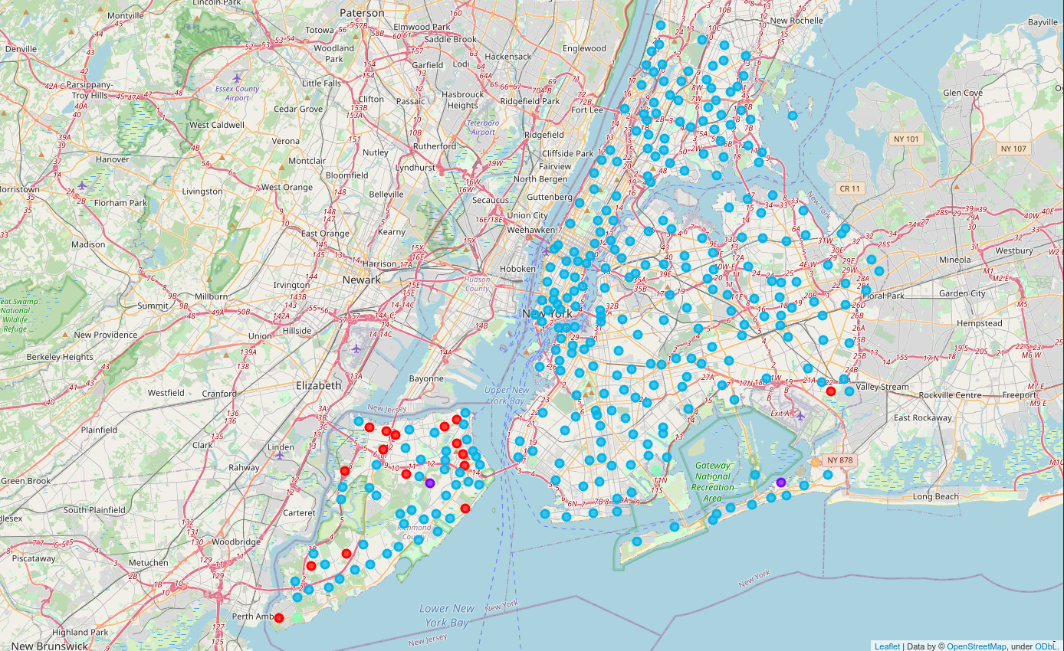
K-means clustering reveals two main clusters, A and B, and three outlier clusters
Red: cluster A
Cyan: cluster B
Figure 2: Map of New York City neighborhoods segmented into clusters based on most common venue types

Slide 11
Clusters A and B are dominated by distinct types of venues
For each neighborhood in both clusters, the mode for each of the top 10 most common venue categories was computed
Each of the 10 modes was assigned to one of three broad venue types: food, shops, and transportation
Types of venue | Cluster A share of top 10 modes | Cluster B share of top 10 modes
Food | 2 | 8
Shops | 5 | 2
Transportation | 3 | 0

Slide 12
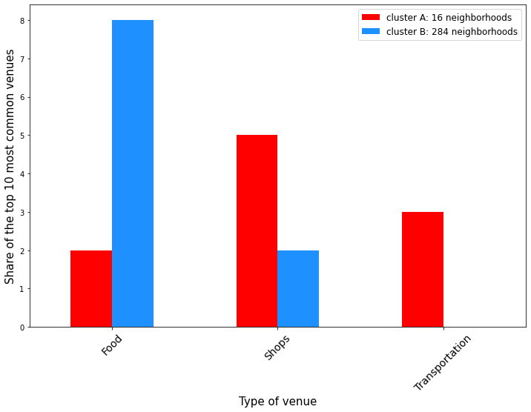
Clusters A and B are dominated by distinct types of venues
Figure 3: Venue type composition of the top 10 neighborhood-level category modes

Slide 13

Conclusion

Slide 14
Conclusion
Two main types of neighborhoods can be defined:
  Cluster A: neighborhoods that are heavily dominated by shops and frequent transportation,
  Cluster B: neighborhoods that chiefly feature eating places, such as cafeterias, restaurants, and bars
Cluster A is dominant throughout New York, but cluster B seems to be chiefly located within the Staten Island borough, possibly due to the unique transportation features of this area
Prospective business owners should leverage this along other data sources to inform their venue opening decisions

