Slide 1
Alexander-Sadiku Fundamentals of Electric Circuits
Chapter 10
Sinusoidal Steady-State Analysis
Copyright © The McGraw-Hill Companies, Inc. Permission required for reproduction or display.

Slide 2
Sinusoidal Steady-State Analysis Chapter 10
10.1 Basic Approach
10.2 Nodal Analysis
10.3 Mesh Analysis
10.4 Superposition Theorem
10.5 Source Transformation
10.6 Thevenin and Norton Equivalent Circuits

Slide 3
Steps to Analyze AC Circuits:
10.1 Basic Approach (1)
Transform the circuit to the phasor or frequency domain.
Solve the problem using circuit techniques (nodal analysis, mesh analysis, superposition, etc.).
Transform the resulting phasor to the time domain.
Time to Freq
Solve variables in Freq
Freq to Time

Slide 4
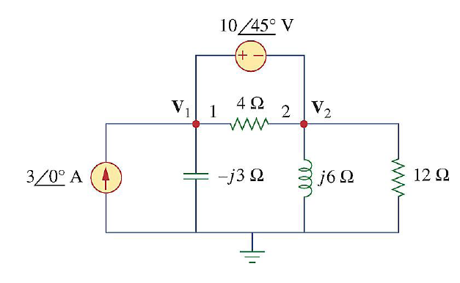
10.2 Nodal Analysis (1)
Example 1
Using nodal analysis, find v₁ and v₂ in the circuit of figure below.
Answer:
v₁(t) = 25.8 ∠-70.5 V
v₂(t) = 31.4 ∠-87 V

Slide 5
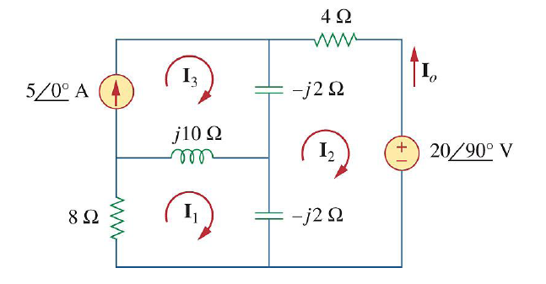
10.3 Mesh Analysis (1)
Example 2
Find I_{o} in the following figure using mesh analysis.
Answer: I_{o} = 6.12 ∠ 144.2 A

Slide 6
10.4 Superposition Theorem (1)
When a circuit has sources operating at different frequencies,
The separate phasor circuit for each frequency must be solved independently, and
The total response is the sum of time-domain responses of all the individual phasor circuits.

Slide 7
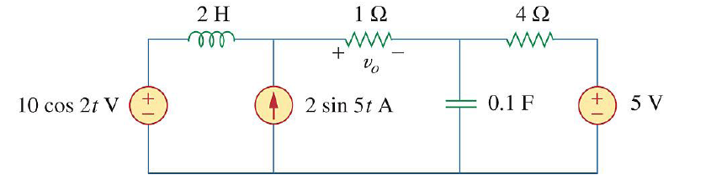
10.4 Superposition Theorem (2)
Example 3
Calculate v_{o} in the circuit of figure shown below using the superposition theorem.

Slide 8
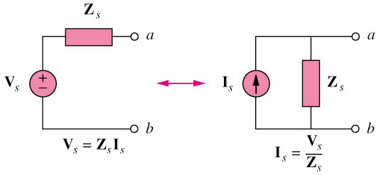
10.5 Source Transformation (1)

Slide 9
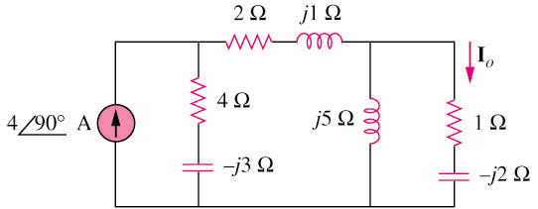
10.5 Source Transformation (2)
Example 4
Find Io in the circuit of figure below using the concept of source transformation.
I_{o} = 3.288∠99.46 A

Slide 10
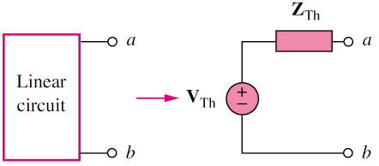
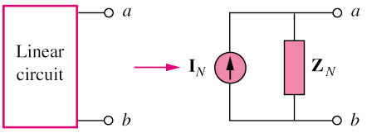
10.6 Thevenin and Norton Equivalent Circuits (1)
Thevenin transform
Norton transform

Slide 11
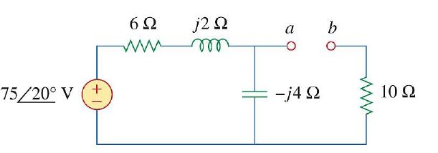
10.6 Thevenin and Norton Equivalent Circuits (2)
Example 5
Find the Thevenin equivalent at terminals a–b of the circuit below.
Z_{th} = 12.4-3.2j
V_{TH} = 47.4 ∠ -51.6 V

Slide 12
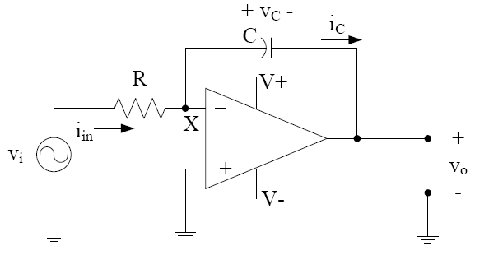
Op-amp AC circuits
Example
Find the (closed-loop) gain of the circuit below.

