Slide 1
Fundamentals of Electric Circuits
Chapter 2
Basic Laws
Copyright © The McGraw-Hill Companies, Inc. Permission required for reproduction or display.

Slide 2
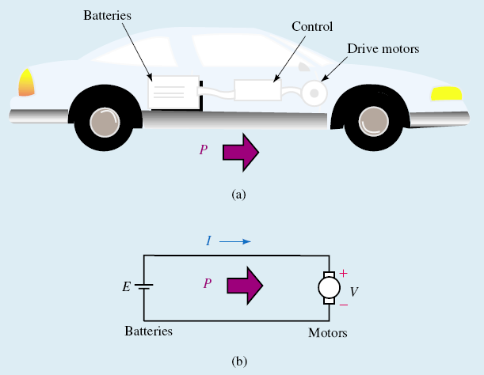
Basic Laws - Chapter 2
2.1 Ohm’s Law.
2.2 Nodes, Branches, and Loops.
2.3 Kirchhoff’s Laws.
2.4 Series Resistors and Voltage Division.
2.5 Parallel Resistors and Current Division.
2.6 Wye-Delta Transformations.

Slide 3
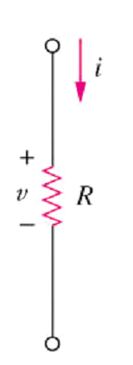
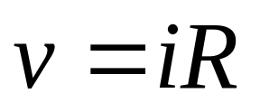
2.1 Ohms Law (1)
Ohm’s law states that the voltage across a resistor is directly proportional to the current I flowing through the resistor.
Mathematical expression for Ohm’s Law is as follows:
Two extreme possible values of R: 0 (zero) and ∞ (infinite) are related with two basic circuit concepts: short circuit and open circuit.

Slide 4
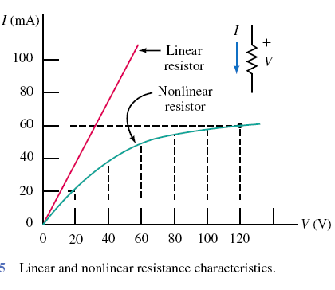
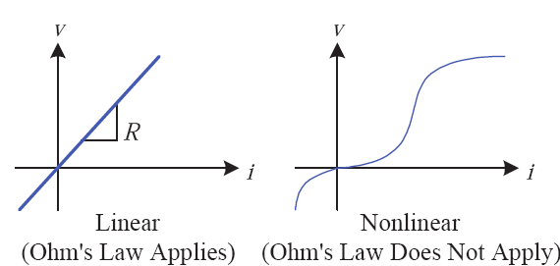
Linear and nonlinear resistance

Slide 5
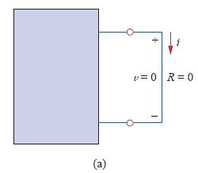
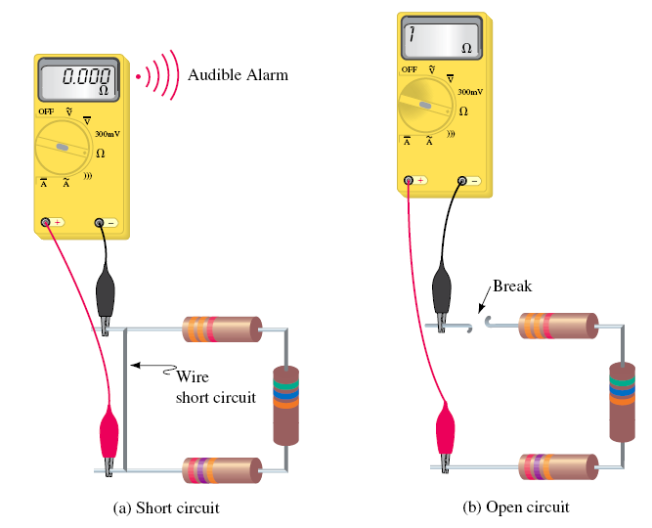
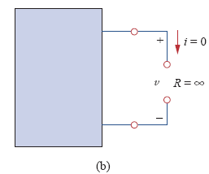
Short and open circuit

Slide 6
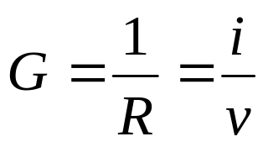
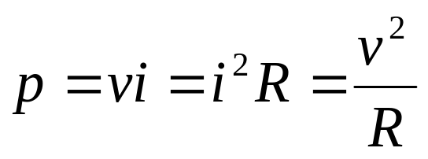
2.1 Ohms Law (2)
Conductance is the ability of an element to conduct electric current; it is the reciprocal of resistance R and is measured in mhos or siemens.
The power dissipated by a resistor:

Slide 7
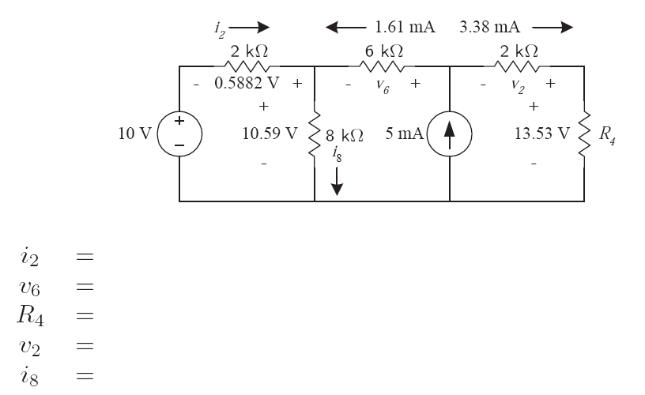
Example

Slide 8
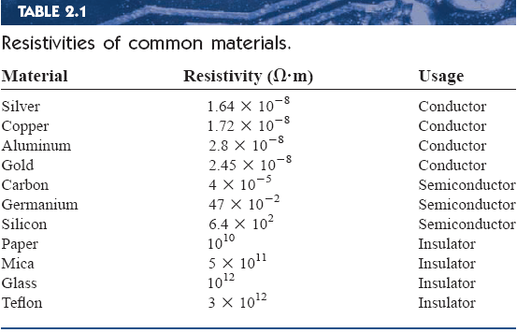
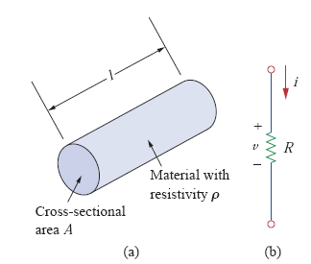

Conductance and resistivites

Slide 9
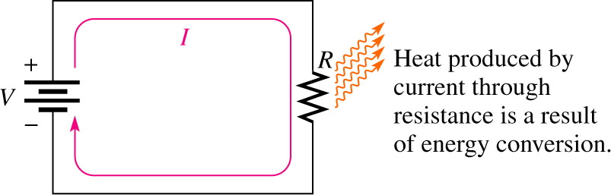
Heat produced by Current
When there is current through resistance, the collisions of the electrons produce heat, as a result of the conversion of electrical energy.

Slide 10
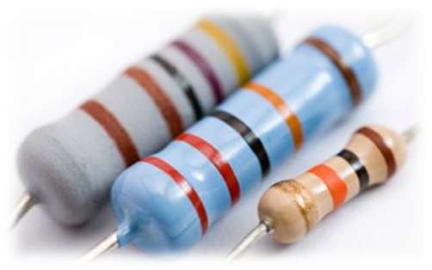
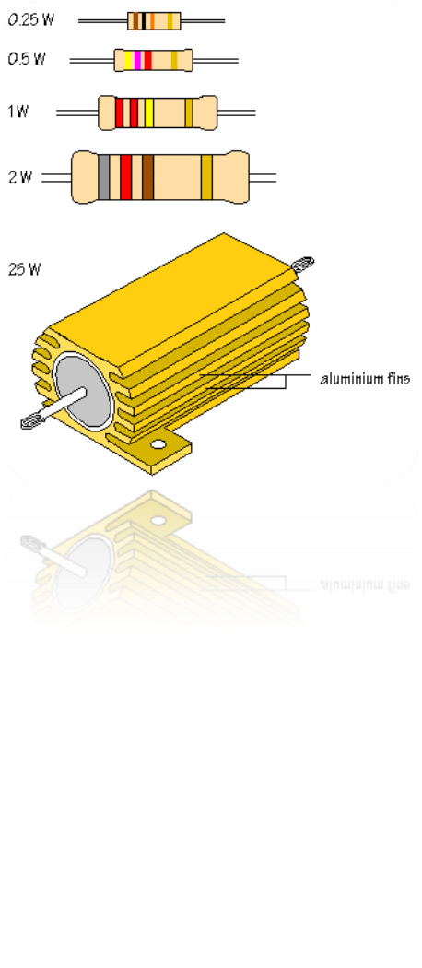
Resistor Power Rating
Resistor power rating is not related to ohmic value (resistance) but rather is determined by the physical composition, size and shape of the resistor.
Basic Electronics for Computer Engineering

Slide 11
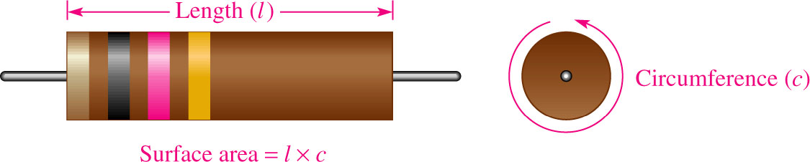
Resistor Power Rating
Power rating of a resistor is the maximum amount of power that a resistor can dissipate without being damaged by excessive heat buildup.
Power rating is directly related to surface area.
Basic Electronics for Computer Engineering

Slide 12
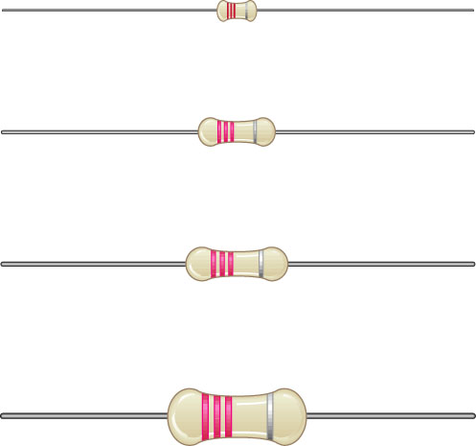
Metal-film Resistors
Metal-film resistors have standard power ratings of 1/8 W, 1/4 W, 1/2 W, and 1 W.
Basic Electronics for Computer Engineering

Slide 13
Selecting the Proper Power Rating
A resistor used in a circuit must have a power rating in excess of what it will have to handle.
Ideally, a rating that is approximately twice the actual power should be used when possible.
Basic Electronics for Computer Engineering

Slide 14
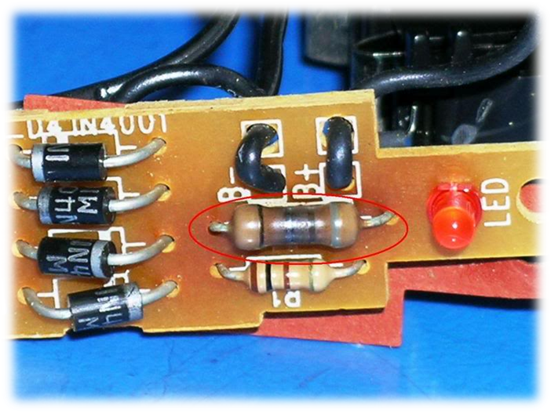
Resistor Failures
When excessive power is applied to a resistor, the resistor will overheat.
The resistor will burn open, or its resistance value will be greatly altered.
Overheated resistors may be charred, or the surface color may change.
Resistors suspected of being damaged should be removed from the circuit and checked with an ohmmeter.

Slide 15
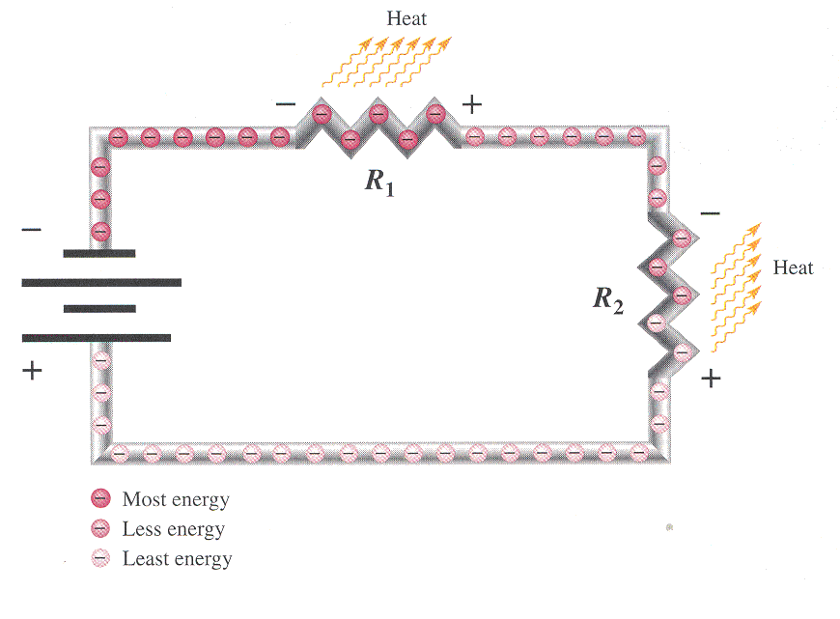
Energy Conversion and Voltage Drop in Resistance
As electrons flow through resistors, some of their energy is given up as heat.
The same number of electrons entering a resistor will exit it, only their energy will be less, so the voltage exiting a resistor is less than the voltage entering the resistor.

Slide 16
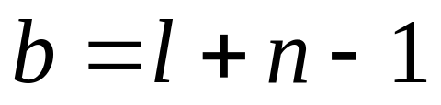
2.2 Nodes, Branches and Loops (1)
A branch represents a single element such as a voltage source or a resistor.
A node is the point of connection between two or more branches.
A loop is any closed path in a circuit.
A network with b branches, n nodes, and l independent loops will satisfy the fundamental theorem of network topology:

Slide 17
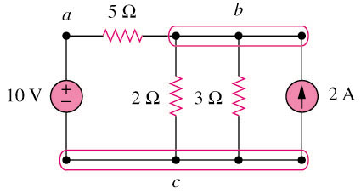
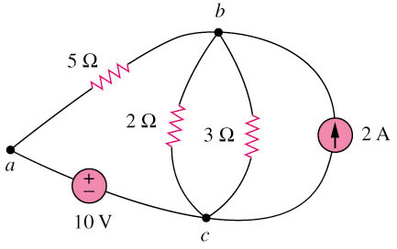
2.2 Nodes, Branches and Loops (2)
Example 1
Original circuit
Equivalent circuit
How many branches, nodes and loops are there?

Slide 18
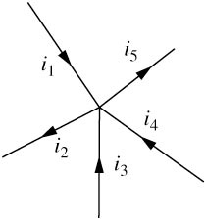
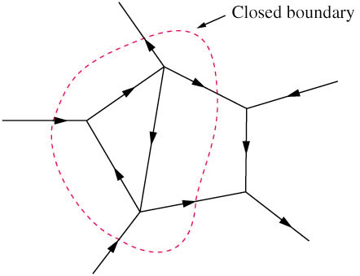
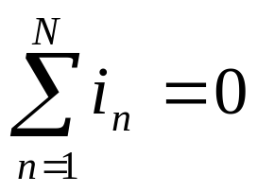
2.3 Kirchhoff’s Laws (1)
Kirchhoff’s current law (KCL) states that the algebraic sum of currents entering a node (or a closed boundary) is zero.
Mathematically,

Slide 19
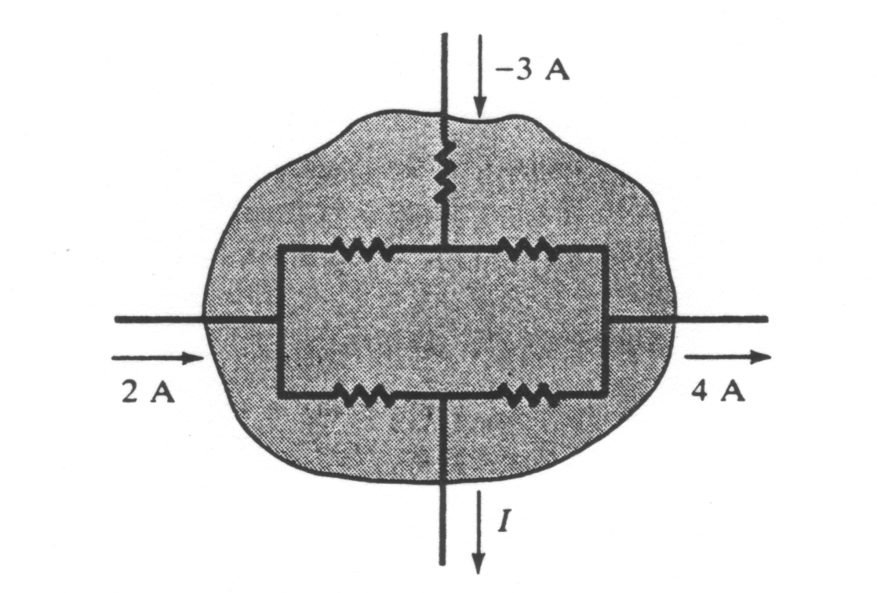
2.3 Kirchhoff’s Laws (2)
Example 4
Determine the current I for the circuit shown in the figure below.
I + 4-(-3)-2 = 0
I = -5A
This indicates that the actual current for I is flowing in the opposite direction.
We can consider the whole enclosed area as one “node”.

Slide 20
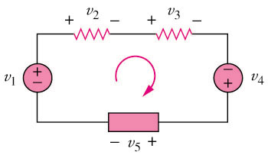

2.3 Kirchhoff’s Laws (3)
Kirchhoff’s voltage law (KVL) states that the algebraic sum of all voltages around a closed path (or loop) is zero.
Mathematically,

Slide 21
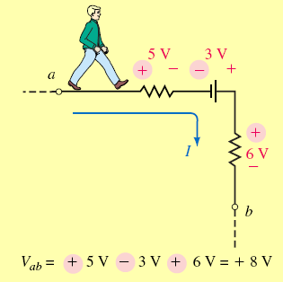
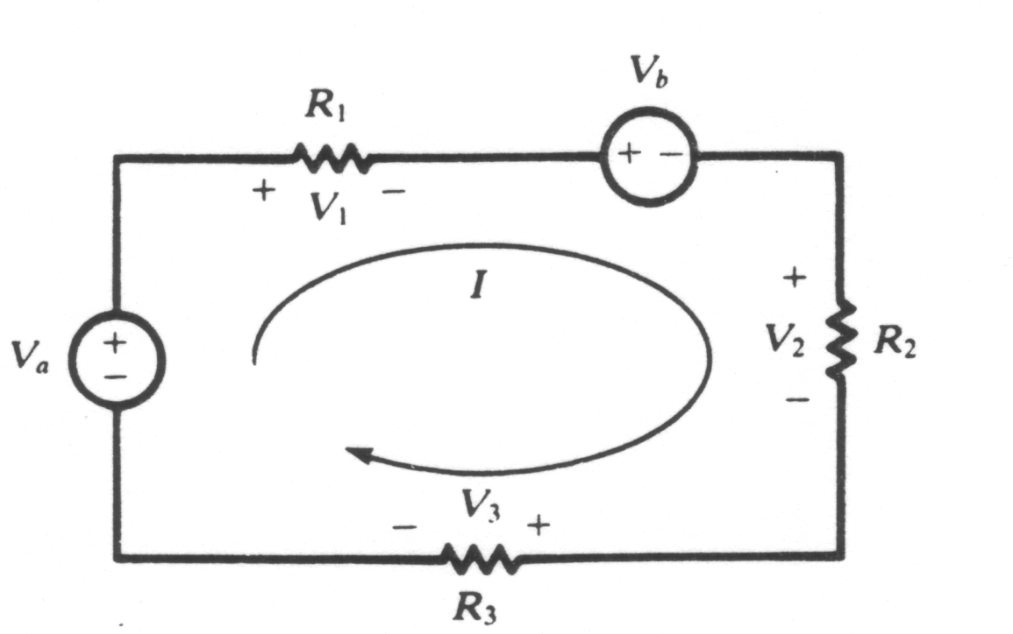
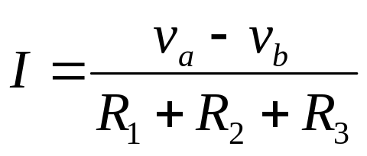
2.3 Kirchhoff’s Laws (4)
Example 5 Applying the KVL equation for the circuit of the figure below.
v_{a}-v₁-v_{b}-v₂-v₃ = 0
V₁ = IR₁ v₂ = IR₂ v₃ = IR₃
v_{a}-v_{b} = I(R₁ + R₂ + R₃)

Slide 22
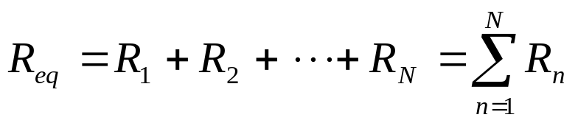
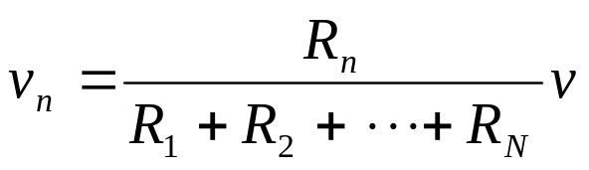
2.4 Series Resistors and Voltage Division (1)
Series: Two or more elements are in series if they are cascaded or connected sequentially and consequently carry the same current.
The equivalent resistance of any number of resistors connected in a series is the sum of the individual resistances.
The voltage divider can be expressed as

Slide 23
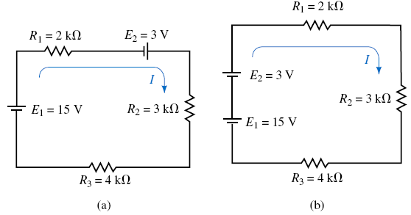
Interchanging Series Components

Slide 24
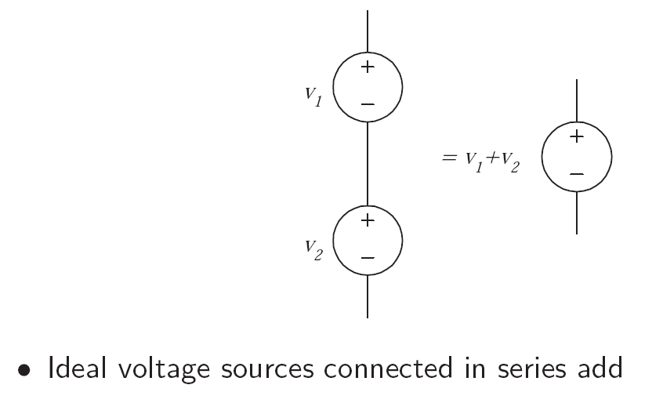
Voltage source in series

Slide 25
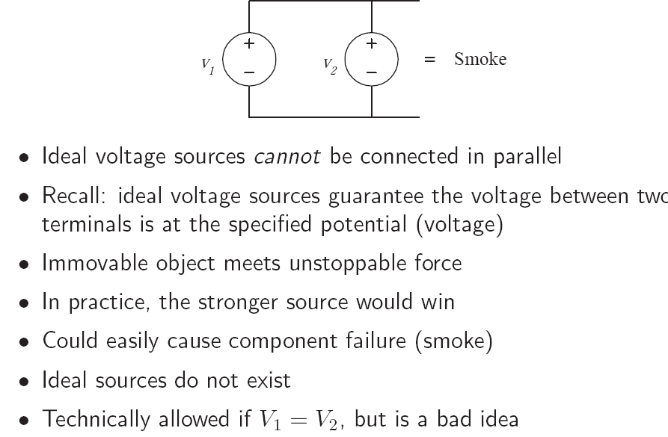
Voltage source in parallel

Slide 26
2.4 Series Resistors and Voltage Division (1)
Example 3
10V and 5Ω are in series

Slide 27
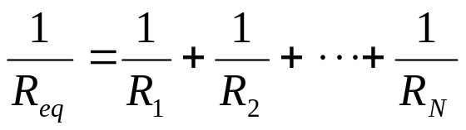
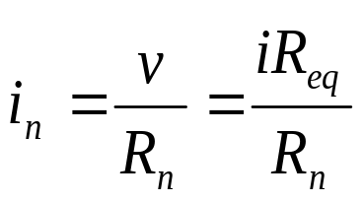
2.5 Parallel Resistors and Current Division (1)
Parallel: Two or more elements are in parallel if they are connected to the same two nodes and consequently have the same voltage across them.
The equivalent resistance of a circuit with N resistors in parallel is:
The total current i is shared by the resistors in inverse proportion to their resistances. The current divider can be expressed as:

Slide 28
2.5 Parallel Resistors and Current Division (1)
Example 4
2Ω, 3Ω and 2A are in parallel

Slide 29
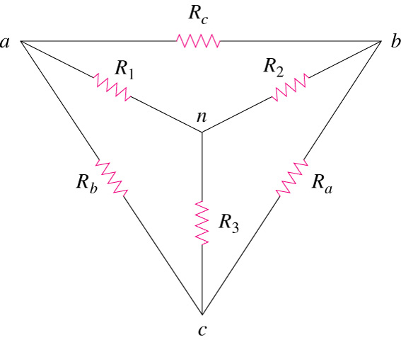
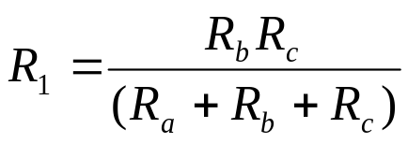
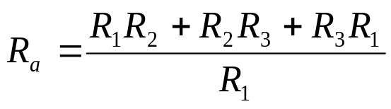
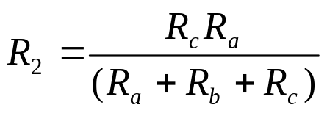


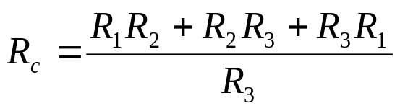
2.6 Wye-Delta Transformations
Delta -> Star
Star -> Delta

