Slide 1
Alexander-Sadiku
Fundamentals of Electric Circuits
Chapter 3
Methods of Analysis
Copyright © The McGraw-Hill Companies, Inc. Permission required for reproduction or display.

Slide 2
Methods of Analysis - Chapter 3
3.1 Motivation
3.2 Nodal analysis.
3.3 Nodal analysis with voltage sources.
3.4 Mesh analysis.
3.5 Mesh analysis with current sources.
3.6 Nodal and mesh analysis by inspection.
3.7 Nodal versus mesh analysis.

Slide 3
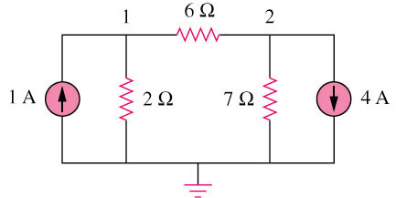
3.1 Motivation (1)
If you are given the following circuit, how can we determine (1) the voltage across each resistor, (2) current through each resistor. (3) power generated by each current source, etc.
What are the things which we need to know in order to determine the answers?

Slide 4
Things we need to know in solving any resistive circuit with current and voltage sources only:
3.1 Motivation (2)
Kirchhoff’s Current Laws (KCL)
Kirchhoff’s Voltage Laws (KVL)
Ohm’s Law
How should we apply these laws to determine the answers?

Slide 5
3.2 Nodal Analysis (1)
It provides a general procedure for analyzing circuits using node voltages as the circuit variables.
Example 1
3

Slide 6
3.2 Nodal Analysis (2)
Steps to determine the node voltages:
  Select a node as the reference node.
  Assign voltages v1,v2,…,vn-1 to the remaining n-1 nodes. The voltages are referenced with respect to the reference node.
  Apply KCL to each of the n-1 non-reference nodes. Use Ohm’s law to express the branch currents in terms of node voltages.
  Solve the resulting simultaneous equations to obtain the unknown node voltages.

Slide 7
3.2 Nodal Analysis (3)
Example 2 – circuit independent current source only
Apply KCl at node 1 and 2
v₁
v₂
3
*Refer to in-class illustration, textbook, answer v₁ = -2V, v₂ = -14V

Slide 8
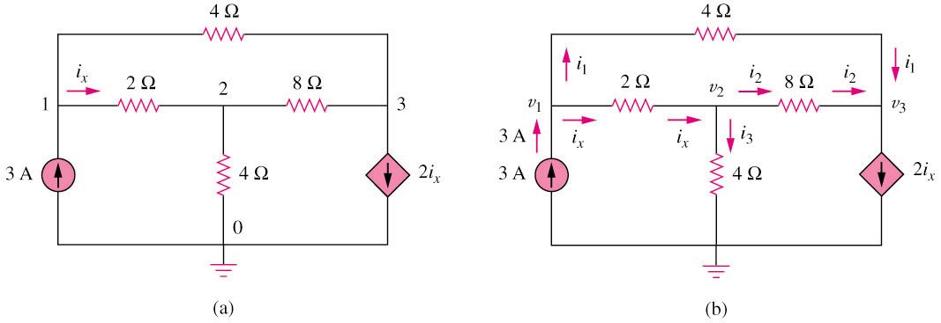
3.2 Nodal Analysis (4)
Example 3 – current with dependant current source
*Refer to in-class illustration, textbook,
answer v₁= 4.8V, v₂ = 2.4V, v₃ = -2.4V

Slide 9
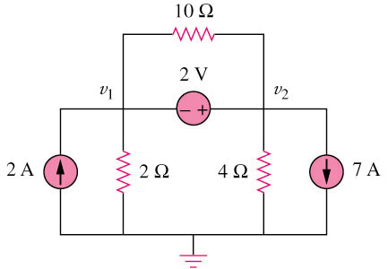
3.3 Nodal Analysis with Voltage Source (1)
Example 4 –circuit with independent voltage source
How to handle the 2V voltage source?

Slide 10
3.3 Nodal Analysis with Voltage Source (2)
A super-node is formed by enclosing a (dependent or independent) voltage source connected between two non-reference nodes and any elements connected in parallel with it.
*Note: We analyze a circuit with super-nodes using the same three steps mentioned above except that the super-nodes are treated differently.

Slide 11
3.3 Nodal Analysis with Voltage Source (3)
Basic steps:
Take off all voltage sources in super-nodes and apply KCL to super-nodes.
Put voltage sources back to the nodes and apply KVL to relative loops.

Slide 12
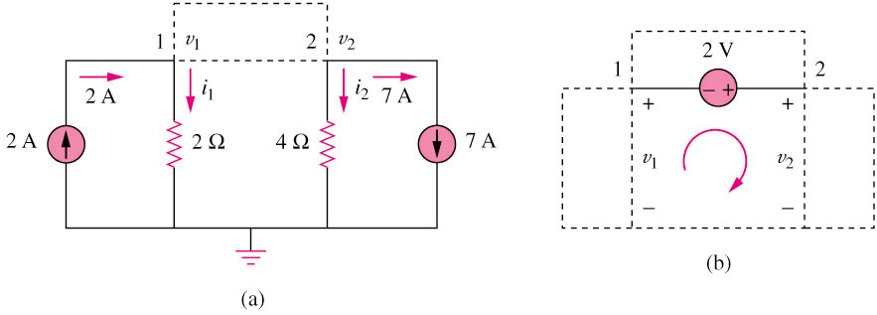
3.3 Nodal Analysis with Voltage Source (4)
Example 5 – circuit with independent voltage source
Super-node => 2-i₁-i₂-7 = 0
Apply KVL => v₁+2-v₂ = 0

Slide 13
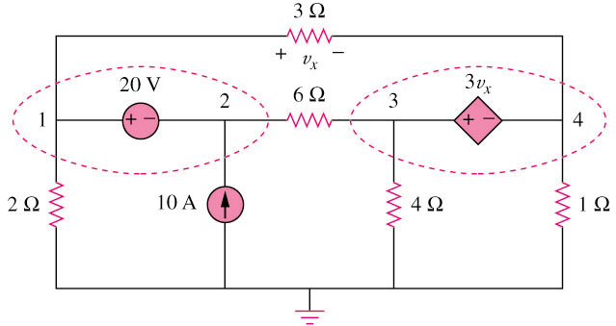
3.3 Nodal Analysis with Voltage Source (5)
Example 6 – circuit with two independent voltage sources

Slide 14
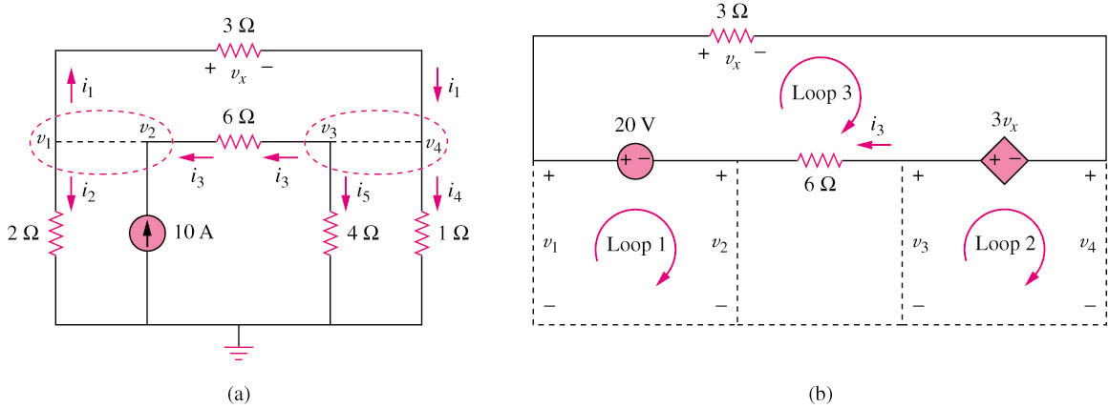
3.3 Nodal Analysis with Voltage Source (6)
Example 7 – circuit with two independent voltage sources
-i₁-i₂ + i₃ = 0
-i₃-i₅-i₄ + i₁ = 0
v₁-20-v₂ = 0
v₃-3v_{x}-v₄ = 0

Slide 15
3.4 Mesh Analysis (1)
  Mesh analysis provides another general procedure for analyzing circuits using mesh currents as the circuit variables.
  Nodal analysis applies KCL to find unknown voltages in a given circuit, while mesh analysis applies KVL to find unknown currents.
  A mesh is a loop which does not contain any other loops within it.

Slide 16
3.4 Mesh Analysis (2)
Steps to determine the mesh currents:
  Assign mesh currents i₁, i₂, …, in to the n meshes.
  Apply KCL to each of the n meshes. Use Ohm’s law to express the voltages in terms of the mesh currents.
  Solve the resulting n simultaneous equations to get the mesh currents.

Slide 17
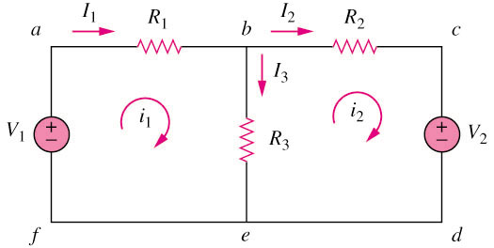
3.4 Mesh Analysis (3)
Example 8 – circuit with independent voltage sources
Note:
i₁ and i₂ are mesh current (imaginative, not measurable directly)
I₁, I₂ and I₃ are branch current (real, measurable directly)
I₁ = i₁; I₂ = i₂; I₃ = i₁ - i₂
*Refer to in-class illustration, textbook

Slide 18
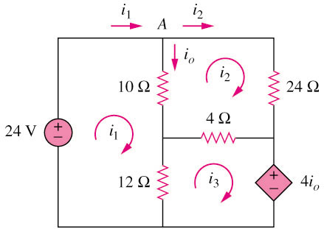
3.4 Mesh Analysis (4)
Example 9 – circuit with dependent voltage source
*Refer to in-class illustration, textbook, answer I_{o} = 1.5A

Slide 19
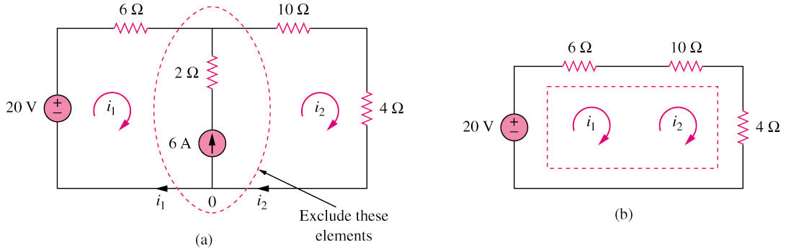
3.5 Mesh Analysis with Current Source (1)
Circuit with current source
A super-mesh results when two meshes have a (dependent or independent) current source in common as shown in (a). We create a super-mesh by excluding the current source and any elements connected in series with it as shown in (b).
*Refer to in-class illustration, textbook

Slide 20
3.5 Mesh Analysis with Current Source (2)
The properties of a super-mesh:
The current source in the super-mesh is not completely ignored; it provides the constraint equation necessary to solve for the mesh currents.
A super-mesh has no current of its own.
A super-mesh requires the application of both KVL and KCL.

Slide 21
3.6 Nodal and Mesh Analysis with Inspection (1)
The properties of a super-mesh:
The current source in the super-mesh is not completely ignored; it provides the constraint equation necessary to solve for the mesh currents.
A super-mesh has no current of its own.
A super-mesh requires the application of both KVL and KCL.

Slide 22
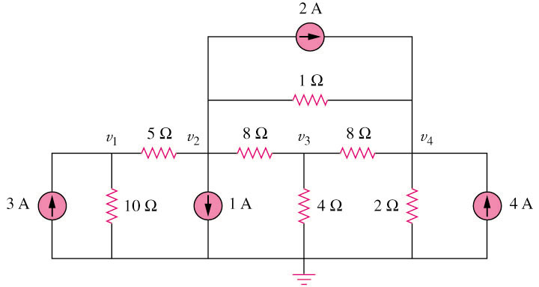
3.6 Nodal and Mesh Analysis with Inspection (2)
Example 10 – By inspection, write the nodal voltage equations for the circuit
*Refer to in-class illustration, textbook

Slide 23
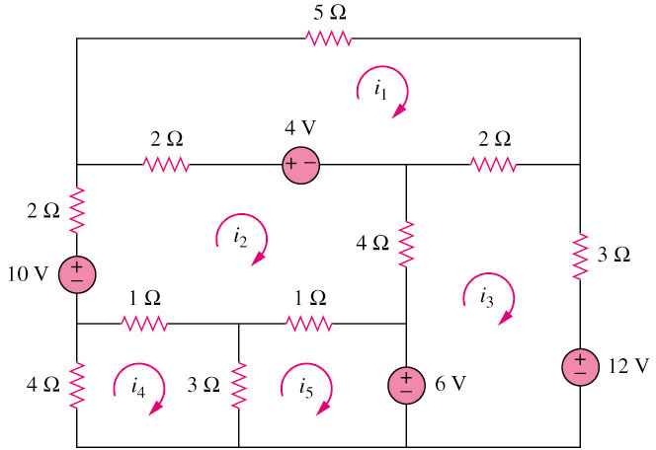
3.6 Nodal and Mesh Analysis with Inspection (3)
Example 11 – By inspection, write the mesh-current equations for the circuit
*Refer to in-class illustration, textbook

Slide 24
3.7 Nodal versus Mesh Analysis (1)
To select the method that results in the smaller number of equations. For example:
Choose nodal analysis for circuit with fewer nodes than meshes.
  *Choose mesh analysis for circuit with fewer meshes than nodes.
  *Networks that contain many series connected elements, voltage sources, or supermeshes are more suitable for mesh analysis.
  *Networks with parallel-connected elements, current sources, or supernodes are more suitable for nodal analysis.
If node voltages are required, it may be expedient to apply nodal analysis. If branch or mesh currents are required, it may be better to use mesh analysis.

