Slide 1
Alexander-Sadiku
Fundamentals of Electric Circuits
Chapter 5
Operational Amplifier
Copyright © The McGraw-Hill Companies, Inc. Permission required for reproduction or display.

Slide 2
Operational Amplifier - Chapter 5
5.1 What is an Op Amp?
5.2 Ideal Op Amp
5.3 Configuration of Op Amp
5.4 Cascaded Op Amp
5.5 Application
  – Digital-to Analog Converter

Slide 3
5.1 What is an Op Amp (1)
It is an electronic unit that behaves like a voltage-controlled voltage source.
It is an active circuit element designed to perform mathematical operations of addition, subtraction, multiplication, division, differentiation and integration.
The ability of the op amp to perform these mathematical operations is the reason it is called an operational amplifier. It is also the reason for the widespread use of op amps in analog design.
Notes:
Op amp is a building block of modern electronic instrumentation. There-
fore, mastery of operational amplier fundamentals is paramount to any
practical application of electronic circuits. They are popular in practical
circuit designs because they are versatile, inexpensive, easy to use, and fun
to work with.

Slide 4
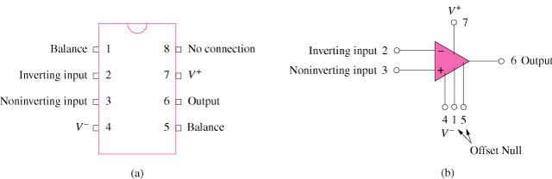
5.1 What is an Op Amp (2)
A typical op amp: (a) pin configuration, (b) circuit symbol
Notes:
An op amp consisting of a complex arrangement of resistors, transistors, capacitors, and diodes. Here, we ignore the details.
The circuit symbol for the op amp is shown below.
It has two inputs and one output.
The inputs are marked with minus (-) and plus (+) to specify in-
verting and noninverting inputs, respectively.
An input applied to the noninverting terminal will appear with the
same polarity at the output, while an input applied to the inverting
terminal will appear inverted at the output.

Slide 5
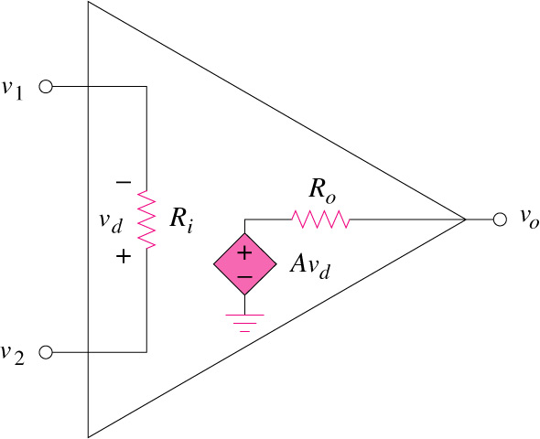
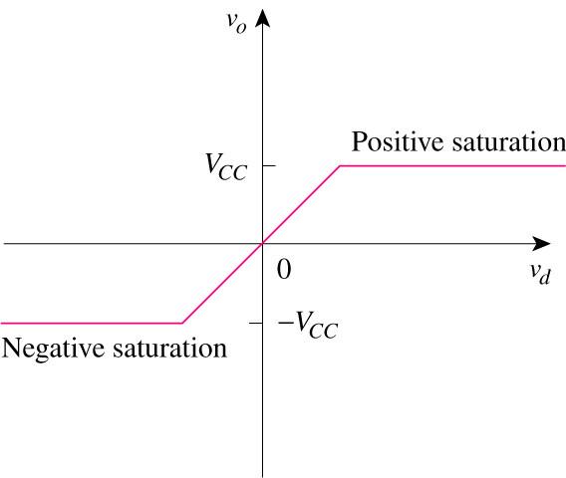
5.1 What is an Op Amp (3)
The equivalent circuit
Of the non-ideal op amp
Op Amp output:
v_{o} as a function of V_{d}
v_{d} = v₂ – v₁; v_{o} = Av_{d} = A(v₂ –v₁)
Notes:
A practical limitation of the op amp is that the magnitude of its
output voltage cannot exceed |VCC|. In other words, the output voltage
is dependent on and is limited by the power supply voltage. Figure 5.5
illustrates that the op amp can operate in three modes, depending on
the differential input voltage vd:
1. Positive saturation, vo =VCC.
2. Linear region, -VCC <=vo =Avd <=VCC.
3. Negative saturation, vo = -VCC.
If we attempt to increase vd beyond the linear range, the op amp
becomes saturated and yields vo VCC or vo VCC. Throughout
this book, we will assume that our op amps operate in the linear mode.
This means that the output voltage is restricted by
-VCC <= vo <= VCC

Slide 6
5.1 What is an Op Amp (4)
Typical ranges for op amp parameters
Parameter | Typical range | Ideal values
Open-loop gain, A | 10⁵ to 10⁸ Ω | ∞
Input resistance, R_{i} | 10⁵ to 10¹³ Ω | ∞ Ω
Output resistance, R_{o} | 10 to 100 Ω | 0 Ω
Supply voltage, V_{CC} | 5 to 24 V

Slide 7
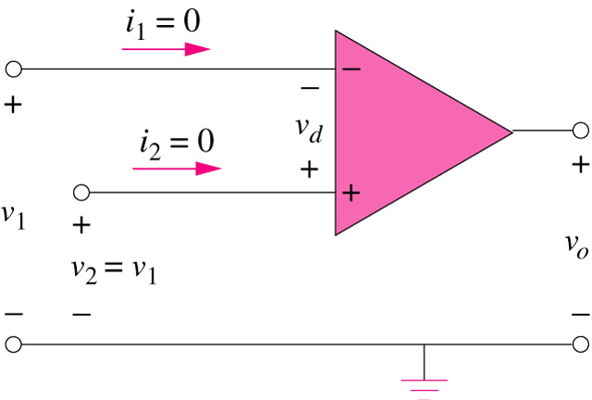
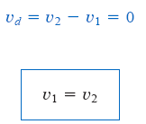


5.2 Ideal Op Amp (1)
An ideal op amp has the following characteristics:
  Infinite open-loop gain, A ≈ ∞
  Infinite input resistance, R_{i} ≈ ∞
  Zero output resistance, R_{o} ≈ 0

Slide 8
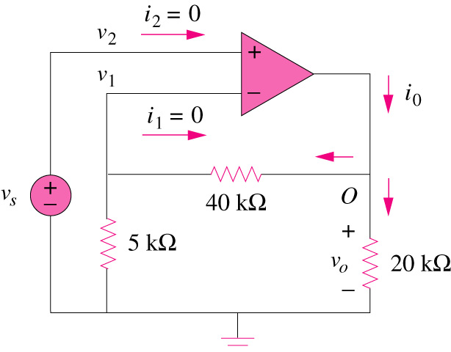
5.2 Ideal Op Amp (2)
Example 1:
Determine the value of i_{o.}
*Refer to in-class illustration, textbook Ans: 0.65mA

Slide 9
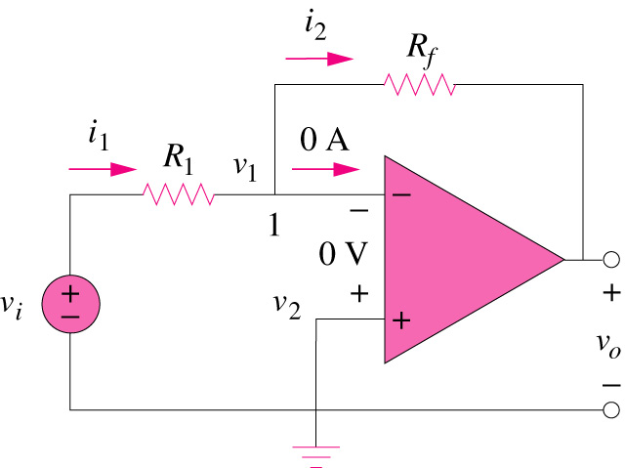
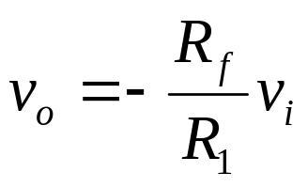
5.3 Configuration of Op amp (1)
Inverting amplifier reverses the polarity of the input signal while amplifying it

Slide 10
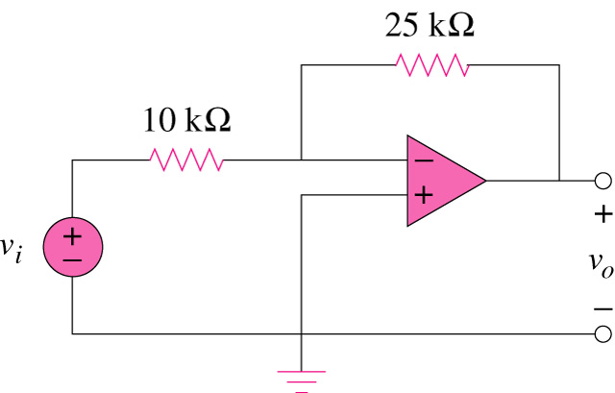
5.3 Configuration of Op amp (2)
Example 2
Refer to the op amp below. If v_{i} = 0.5V, calculate: (a) the output voltage, v_{o} and (b) the current in the 10kΩ resistor.
Ans:
(a) -1.25V; (b) 50μA
*Refer to in-class illustration, textbook

Slide 11
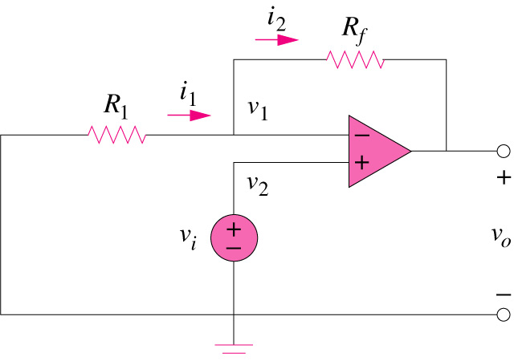
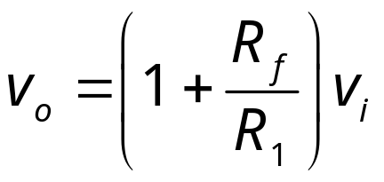
5.3 Configuration of Op amp (3)
Non-inverting amplifier is designed to produce positive voltage gain

Slide 12
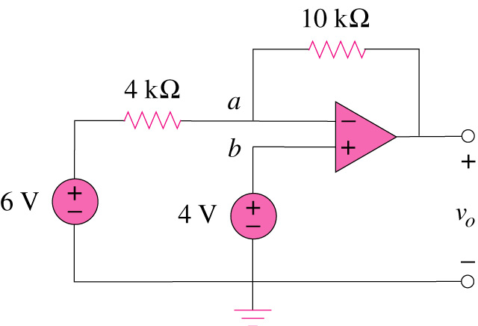
5.3 Configuration of Op amp (4)
Example 3
For the op amp shown below, calculate the output voltage v_{o}.
*Refer to in-class illustration, textbook
Ans: -1V

Slide 13
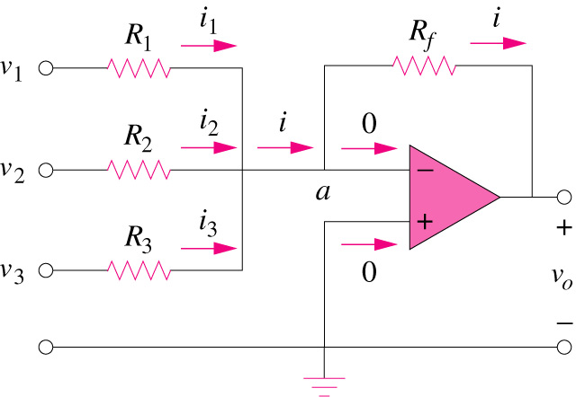
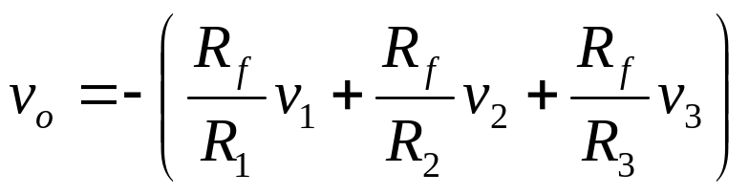
5.3 Configuration of Op amp (5)
Summing Amplifier is an op amp circuit that combines several inputs and produces an output that is the weighted sum of the inputs.

Slide 14
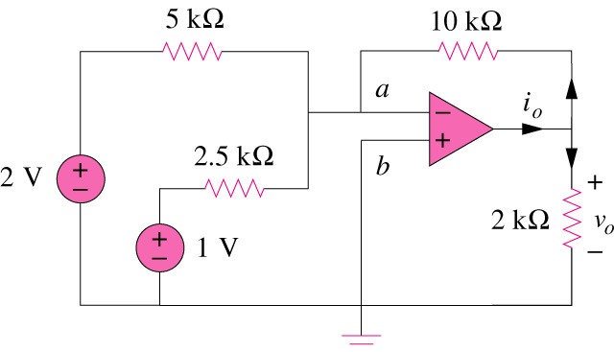
5.3 Configuration of Op amp (6)
Example 4
Calculate v_{o} and i_{o} in the op amp circuit shown below.
*Refer to in-class illustration, textbook
Ans: -8V, -4.8mA

Slide 15
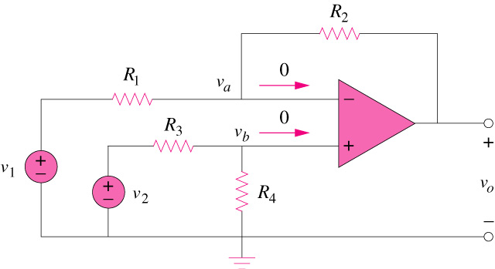
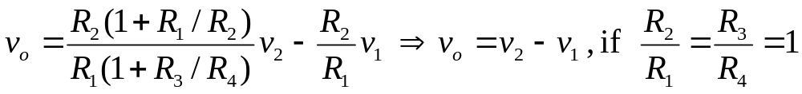
5.3 Configuration of Op amp (7)
Difference amplifier is a device that amplifies the difference between two inputs but rejects any signals common to the two inputs.

Slide 16
5.3 Configuration of Op amp (1)
Inverting amplifier reverses the polarity of the input signal while amplifying it

Slide 17
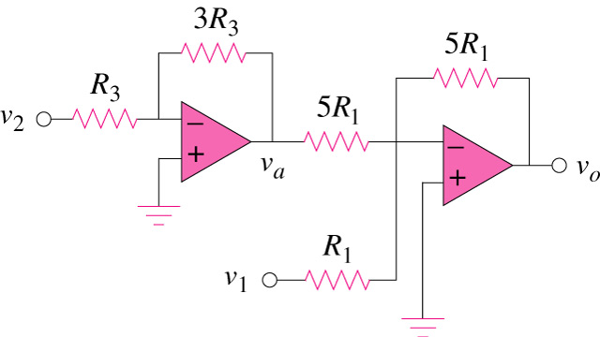
5.3 Configuration of Op amp (6)
Example 5
Determine R₁, R₂, R₃ and R₄ so that v_{o} = -5v₁+3v₂ for the circuit shown below.
Ans:
R₁ = 10kΩ
R₂ = 50kΩ
R₃ = 20kΩ
R₄ = 20kΩ
*Refer to in-class illustration, textbook

Slide 18

5.4 Cascaded Op Amp (1)
It is a head-to-tail arrangement of two or more op amp circuits such that the output to one is the input of the next.

Slide 19
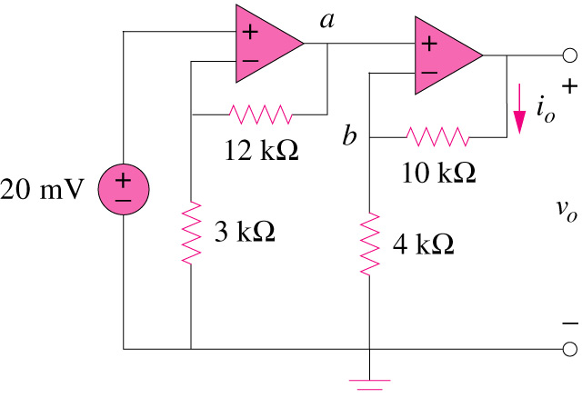
5.4 Cascaded Op Amp (2)
Example 6
Find v_{o} and i_{o} in the circuit shown below.
*Refer to in-class illustration, textbook
Ans: 350mV, 25μA

Slide 20
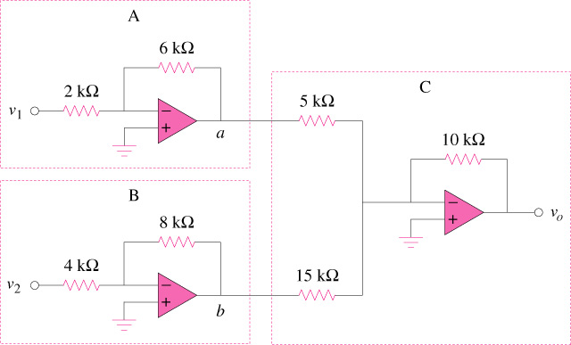
5.4 Cascaded Op Amp (3)
Example 7
If v₁ = 1V and v₂ = 2V, find v_{o} in the op amp circuit shown below.
*Refer to in-class illustration, textbook
Ans: 8.667 V

Slide 21
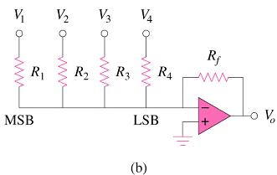
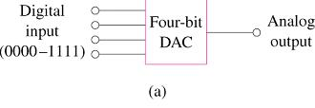
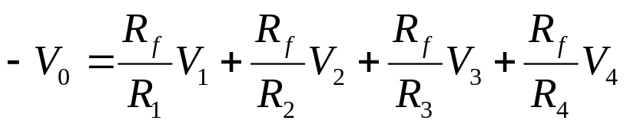
5.5 Application (1)
Digital-to Analog Converter (DAC) : it is a device which transforms digital signals into analog form.
Four-bit DCA: (a) block diagram (b) binary weighted ladder type
where
V₁ – MSB, V₄ – LSB
V₁ to V₄ are either 0 or 1 V

Slide 22
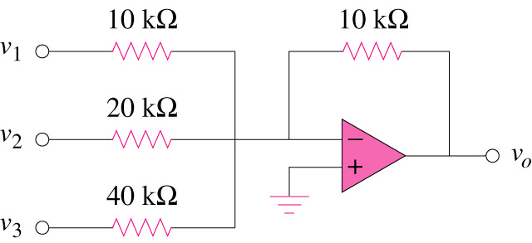
5.5 Application(2)
Example 8
For the circuit shown below, calculate v_{o} if v₁= 0V,v₂=1V and v₃ = 1V.
*Refer to in-class illustration, textbook
Ans:-0.75V

