Slide 1
Alexander-Sadiku
Fundamentals of Electric Circuits
Chapter 6
Capacitors and Inductors
Copyright © The McGraw-Hill Companies, Inc. Permission required for reproduction or display.

Slide 2
Capacitors and Inductors Chapter 6
6.1 Capacitors
6.2 Series and Parallel Capacitors
6.3 Inductors
6.4 Series and Parallel Inductors

Slide 3
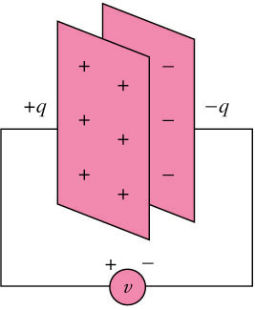
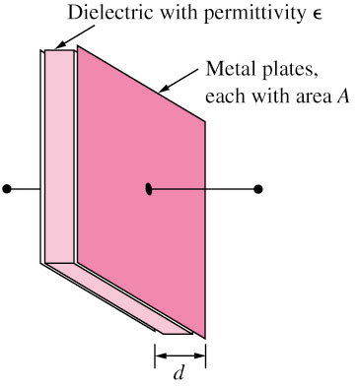
6.1 Capacitors (1)
A capacitor is a passive element designed to store energy in its electric field.
A capacitor consists of two conducting plates separated by an insulator (or dielectric).

Slide 4
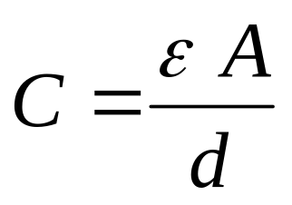
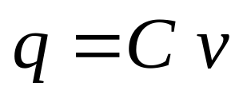
6.1 Capacitors (2)
Capacitance C is the ratio of the charge q on one plate of a capacitor to the voltage difference v between the two plates, measured in farads (F).
and
Where ε is the permittivity of the dielectric material between the plates, A is the surface area of each plate, d is the distance between the plates.
Unit: F, pF (10^{–12}), nF (10^{–9}), and
μF (10^{–6})

Slide 5
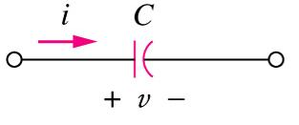
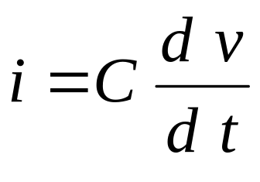
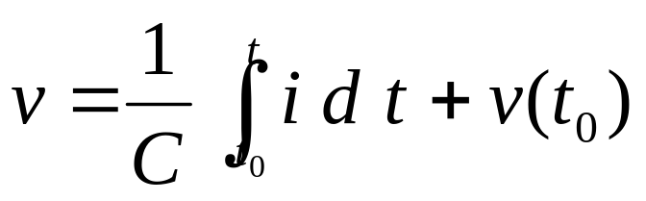
6.1 Capacitors (3)
If i is flowing into the +ve terminal of C
  Charging => i is +ve
  Discharging => i is –ve
The current-voltage relationship of capacitor according to above convention is
and

Slide 6
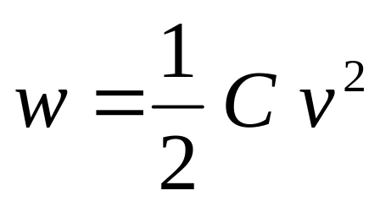
6.1 Capacitors (4)
The energy, w, stored in the capacitor is
A capacitor is
  an open circuit to dc (dv/dt = 0).
  its voltage cannot change abruptly.

Slide 7
6.1 Capacitors (5)
Example 1
  The current through a 100-μF capacitor is
  i(t) = 50 sin(120 πt) mA.
  Calculate the voltage across it at t =1 ms and
  t = 5 ms.
  Take v(0) =0.
Answer:
v(1ms) = 93.14mV
v(5ms) = 1.7361V

Slide 8
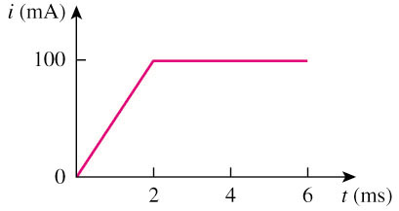
6.1 Capacitors (6)
Example 2
  An initially uncharged 1-mF capacitor has the current shown below across it.
  Calculate the voltage across it at t = 2 ms and
  t = 5 ms.
Answer:
v(2ms) = 100 mV
v(5ms) = 500 mV

Slide 9
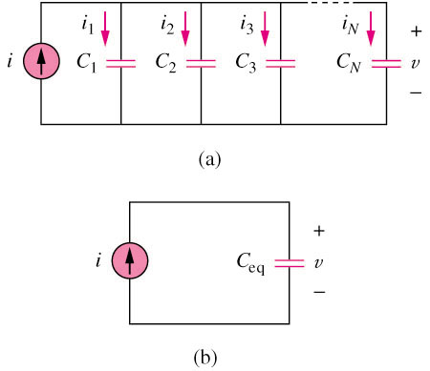
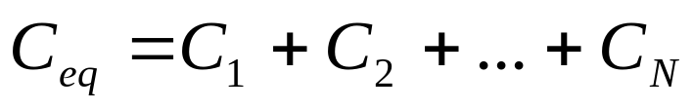
6.2 Series and Parallel
Capacitors (1)
The equivalent capacitance of N parallel-connected capacitors is the sum of the individual capacitances.

Slide 10
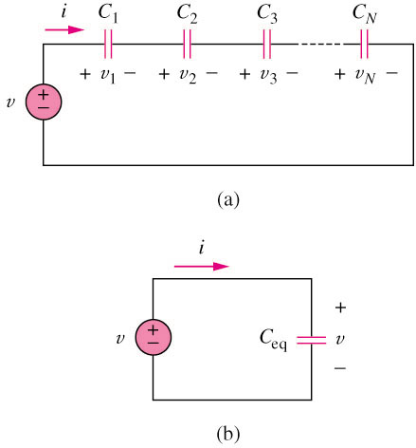
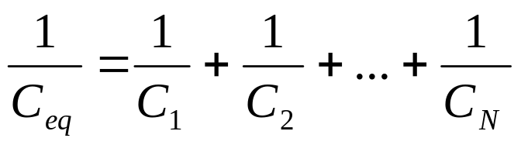
6.2 Series and Parallel
Capacitors (2)
The equivalent capacitance of N series-connected capacitors is the reciprocal of the sum of the reciprocals of the individual capacitances.

Slide 11
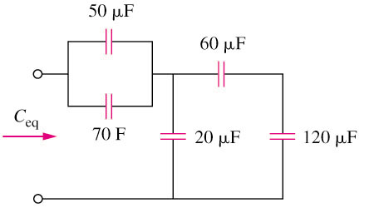
6.2 Series and Parallel
Capacitors (3)
Example 3
Find the equivalent capacitance seen at the terminals of the circuit in the circuit shown below:
Answer:
C_{eq} = 40μF

Slide 12
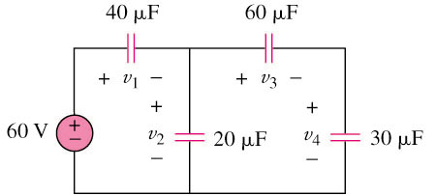
6.2 Series and Parallel
Capacitors (4)
Example 4
Find the voltage across each of the capacitors in the circuit shown below:
Answer:
v₁ = 30V
v₂ = 30V
v₃ = 10V
v₄ = 20V

Slide 13
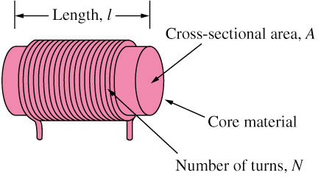
6.3 Inductors (1)
An inductor is a passive element designed to store energy in its magnetic field.
An inductor consists of a coil of conducting wire.

Slide 14
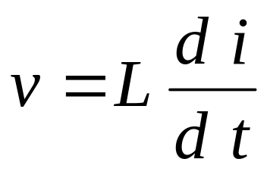
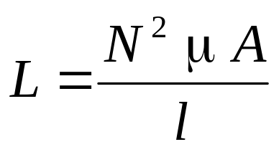
6.3 Inductors (2)
Inductance is the property whereby an inductor exhibits opposition to the change of current flowing through it, measured in henrys (H).
and
The unit of inductors is Henry (H), mH (10^{–3}) and μH (10^{–6}).

Slide 15
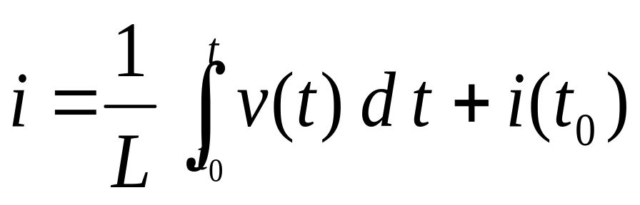
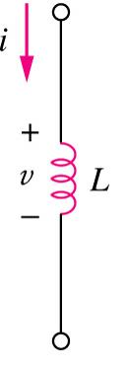
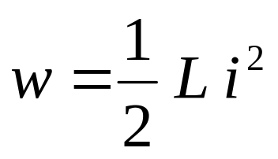
6.3 Inductors (3)
The current-voltage relationship of an inductor:
The power stored by an inductor:
An inductor acts like a short circuit to dc (di/dt = 0) and its current cannot change abruptly.

Slide 16
6.3 Inductors (4)
Example 5
The terminal voltage of a 2-H inductor is
  v = 10(1-t) V
Find the current flowing through it at t = 4 s and the energy stored in it within 0 < t < 4 s.
Assume i(0) = 2 A.
Answer:
i(4s) = -18V
w(4s) = 320J

Slide 17
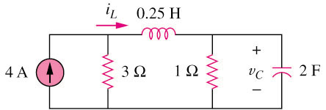
6.3 Inductors (5)
Example 6
Determine v_{c}, i_{L}, and the energy stored in the capacitor and inductor in the circuit of circuit shown below under dc conditions.
Answer:
i_{L} = 3A
v_{C} = 3V
w_{L} = 1.125J
w_{C} = 9J

Slide 18
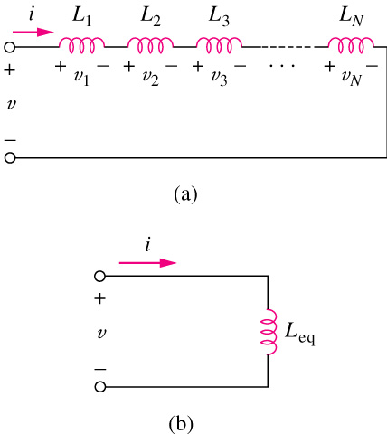
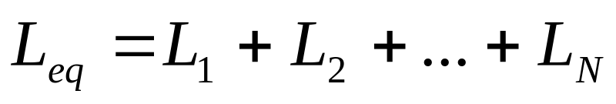
6.4 Series and Parallel
Inductors (1)
The equivalent inductance of series-connected inductors is the sum of the individual inductances.

Slide 19
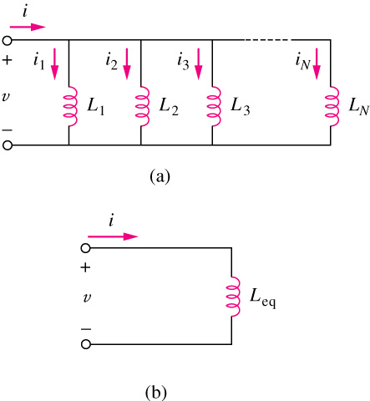
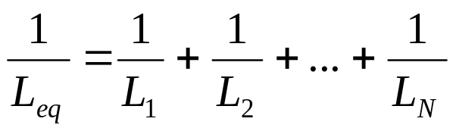
6.4 Series and Parallel
Inductors (2)
The equivalent capacitance of parallel inductors is the reciprocal of the sum of the reciprocals of the individual inductances.

Slide 20
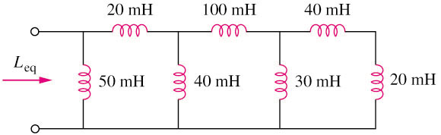
6.4 Series and Parallel
Capacitors (3)
Example 7
Calculate the equivalent inductance for the inductive ladder network in the circuit shown below:
Answer:
L_{eq} = 25mH

Slide 21
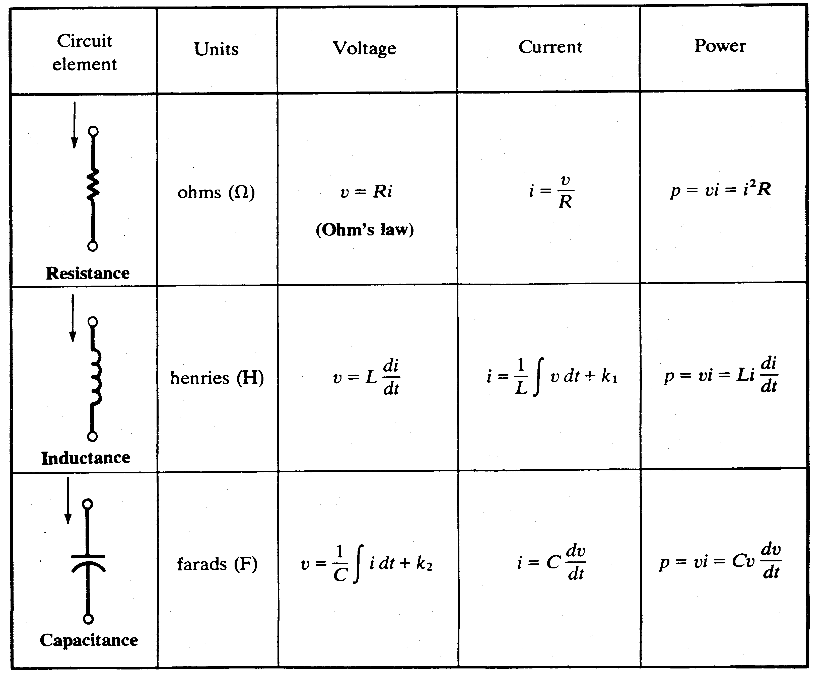
6.4 Series and Parallel
Capacitors (4)
Current and voltage relationship for R, L, C
+
+
+

