Slide 1
Alexander-Sadiku
Fundamentals of Electric Circuits
Chapter 7
First-Order Circuits
Copyright © The McGraw-Hill Companies, Inc. Permission required for reproduction or display.

Slide 2
First-Order Circuits
Chapter 7
7.1 The Source-Free RC Circuit
7.2 The Source-Free RL Circuit
7.3 Unit-step Function
7.4 Step Response of an RC Circuit
7.5 Step Response of an RL Circuit

Slide 3
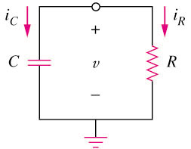
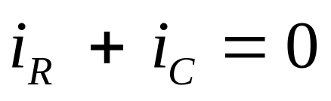
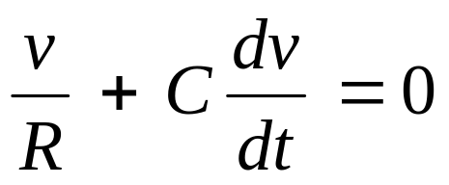
7.1 The Source-Free
RC Circuit (1)
A first-order circuit is characterized by a first-order differential equation.
By KCL
Ohms law
Capacitor law
Apply Kirchhoff’s laws to purely resistive circuit results in algebraic equations.
Apply the laws to RC and RL circuits produces differential equations.

Slide 4
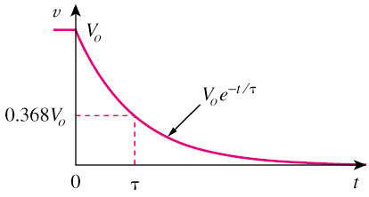
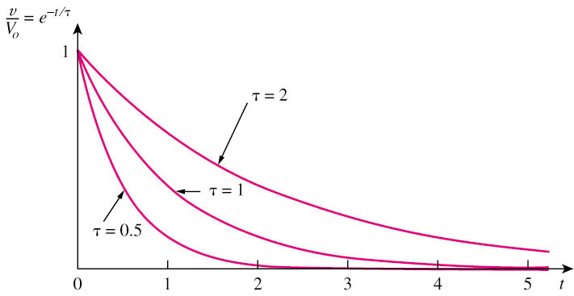

7.1 The Source-Free
RC Circuit (2)
The natural response of a circuit refers to the behavior (in terms of voltages and currents) of the circuit itself, with no external sources of excitation.
Time constant
Decays more slowly
Decays faster
The time constant τ of a circuit is the time required for the response to decay by a factor of 1/e or 36.8% of its initial value.
v decays faster for small τ and slower for large τ.

Slide 5
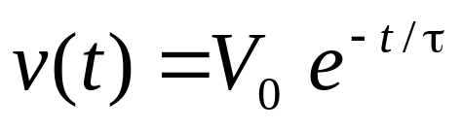
7.1 The Source-Free
RC Circuit (3)
The key to working with a source-free RC circuit is finding:
where
The initial voltage v(0) = V₀ across the capacitor.
The time constant τ = RC.

Slide 6
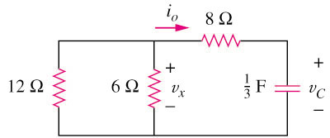
7.1 The Source-Free
RC Circuit (4)
Example 1
Refer to the circuit below, determine v_{C}, v_{x}, and i_{o} for t ≥ 0.
Assume that v_{C}(0) = 30 V.
Please refer to lecture or textbook for more detail elaboration.
Answer: v_{C} = 30e^{–0.25t} V ; v_{x} = 10e^{–0.25t} ; i_{o} = –2.5e^{–0.25t} A

Slide 7
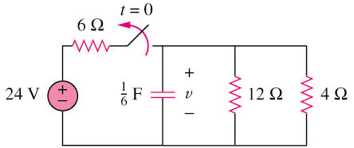
7.1 The Source-Free
RC Circuit (5)
Example 2
The switch in circuit below is opened at t = 0, find v(t) for t ≥ 0.
Please refer to lecture or textbook for more detail elaboration.
Answer: V(t) = 8e^{–2t} V

Slide 8
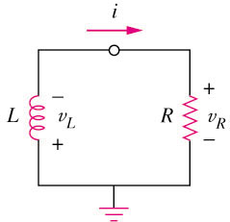
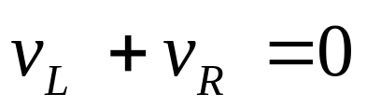
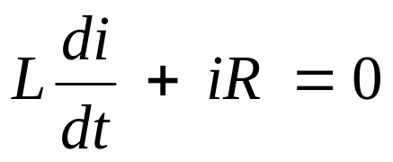
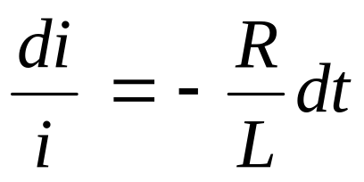
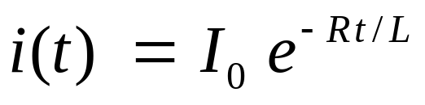
7.2 The Source-Free
RL Circuit (1)
A first-order RL circuit consists of a inductor L (or its equivalent) and a resistor (or its equivalent)
By KVL
Inductors law
Ohms law

Slide 9
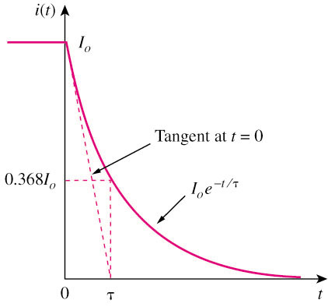
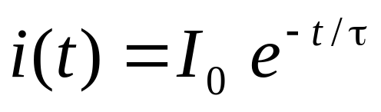
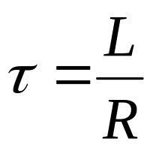
7.2 The Source-Free
RL Circuit (2)
A general form representing a RL
where
The time constant τ of a circuit is the time required for the response to decay by a factor of 1/e or 36.8% of its initial value.
i(t) decays faster for small τ and slower for large τ.
The general form is very similar to a RC source-free circuit.

Slide 10


7.2 The Source-Free
RL Circuit (3)
Comparison between a RL and RC circuit
A RL source-free circuit
A RC source-free circuit
where
where

Slide 11
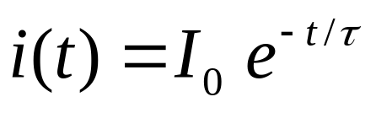
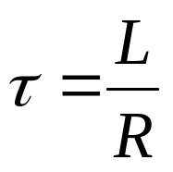
7.2 The Source-Free
RL Circuit (4)
The key to working with a source-free RL circuit is finding:
where
The initial voltage i(0) = I₀ through the inductor.
The time constant τ = L/R.

Slide 12
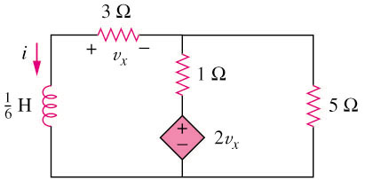
7.2 The Source-Free
RL Circuit (5)
Example 3
Find i and v_{x} in the circuit.
Assume that i(0) = 5 A.
Please refer to lecture or textbook for more detail elaboration.
Answer: i(t) = 5e^{–53t} A

Slide 13
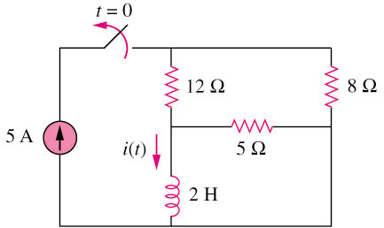
7.2 The Source-Free
RL Circuit (6)
Example 4
For the circuit, find i(t) for t > 0.
Please refer to lecture or textbook for more detail elaboration.
Answer: i(t) = 2e^{–2t} A

Slide 14
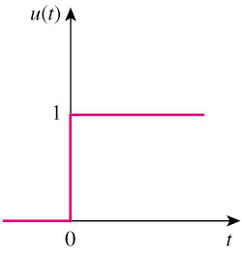
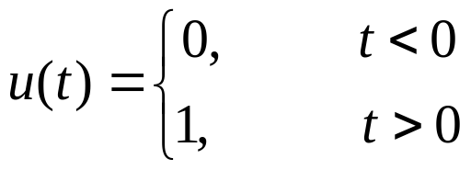
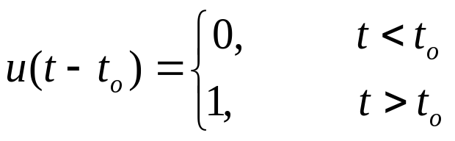
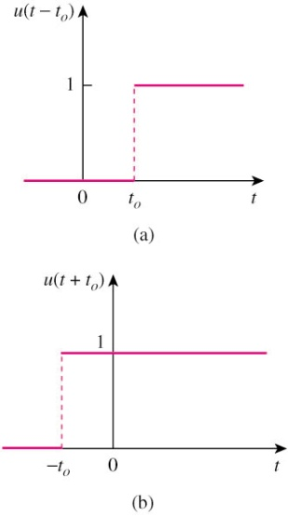
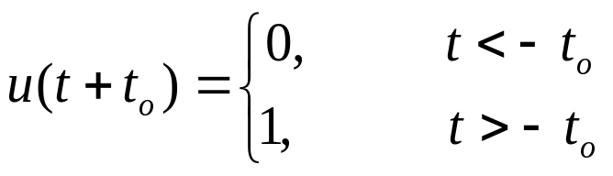
7.3 Unit-Step Function (1)
The unit step function u(t) is 0 for negative values of t and 1 for positive values of t.

Slide 15
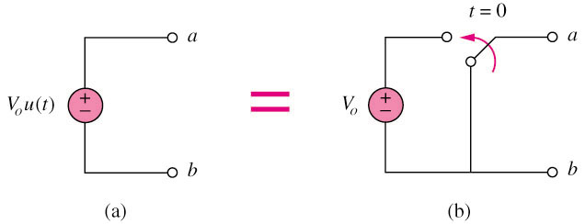
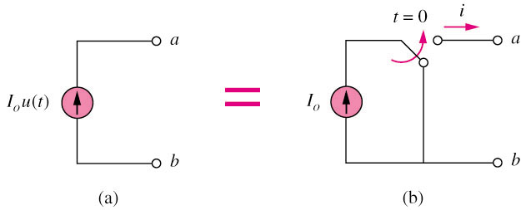
7.3 Unit-Step Function (2)
Represent an abrupt change for:
  voltage source.
  for current source:

Slide 16
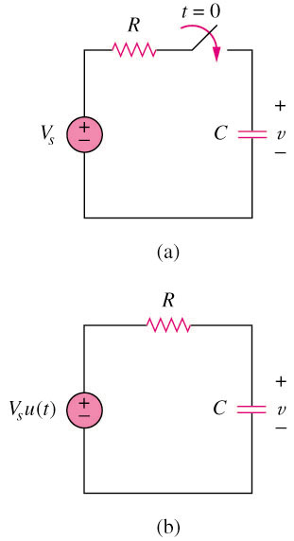
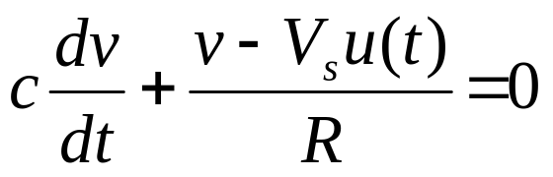
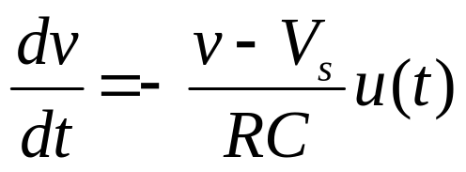
7.4 The Step-Response of a RC Circuit (1)
The step response of a circuit is its behavior when the excitation is the step function, which may be a voltage or a current source.
Initial condition:
v(0-) = v(0+) = V₀
Applying KCL,
or
Where u(t) is the unit-step function

Slide 17
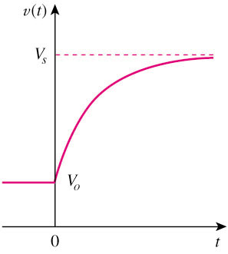
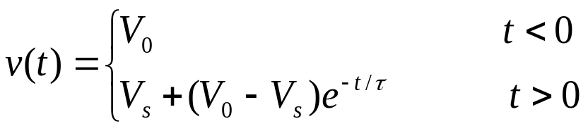
7.4 The Step-Response of a RC Circuit (2)
Integrating both sides and considering the initial conditions, the solution of the equation is:
Final value at t -> ∞
Initial value at t = 0
Source-free Response
Complete Response = Natural response + Forced Response
(stored energy) (independent source)
= V₀e^{–t/τ} + V_{s}(1–e^{–t/τ})

Slide 18
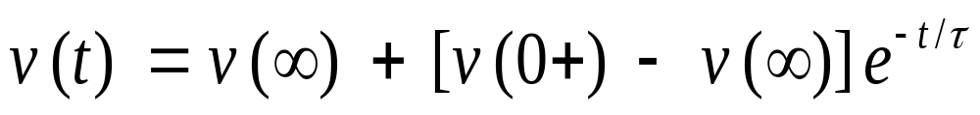
7.4 The Step-Response of a RC Circuit (3)
Three steps to find out the step response of an RC circuit:
The initial capacitor voltage v(0).
The final capacitor voltage v(∞) — DC voltage across C.
The time constant τ.
Note: The above method is a short-cut method. You may also determine the solution by setting up the circuit formula directly using KCL, KVL , ohms law, capacitor and inductor VI laws.

Slide 19
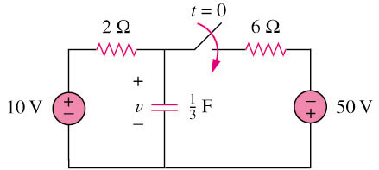

7.4 The Step-Response of a RC Circuit (4)
Example 5
Find v(t) for t > 0 in the circuit in below. Assume the switch has been open for a long time and is closed at t = 0.
Calculate v(t) at t = 0.5.
Please refer to lecture or textbook for more detail elaboration.
Answer: and v(0.5) = 0.5182V

Slide 20
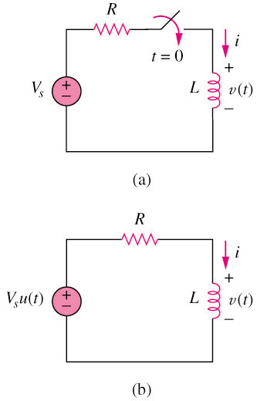
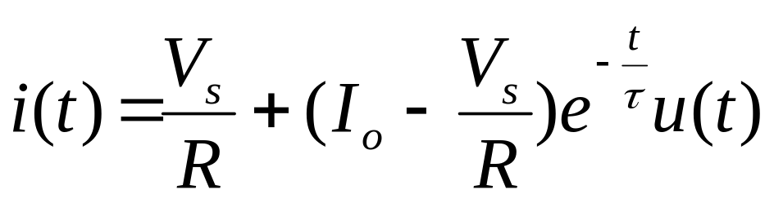
7.5 The Step-response of a RL Circuit (1)
The step response of a circuit is its behavior when the excitation is the step function, which may be a voltage or a current source.
Initial current
i(0-) = i(0+) = I_{o}
Final inductor current
i(∞) = Vs/R
Time constant τ = L/R

Slide 21
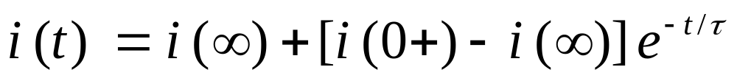
7.5 The Step-Response of a RL Circuit (2)
Three steps to find out the step response of an RL circuit:
The initial inductor current i(0) at t = 0+.
The final inductor current i(∞).
The time constant τ.
Note: The above method is a short-cut method. You may also determine the solution by setting up the circuit formula directly using KCL, KVL , ohms law, capacitor and inductor VI laws.

Slide 22
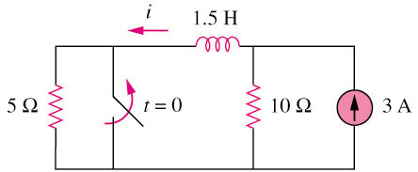

7.5 The Step-Response of a RL Circuit (4)
Example 6
The switch in the circuit shown below has been closed for a long time. It opens at t = 0.
Find i(t) for t > 0.
Please refer to lecture or textbook for more detail elaboration.
Answer:

