Slide 1
Alexander-Sadiku
Fundamentals of Electric Circuits
Chapter 9
Sinusoidal Steady-State Analysis
Copyright © The McGraw-Hill Companies, Inc. Permission required for reproduction or display.

Slide 2
Sinusoids and Phasor
Chapter 9
9.1 Motivation
9.2 Sinusoids’ features
9.3 Phasors
9.4 Phasor relationships for circuit elements
9.5 Impedance and admittance
9.6 Kirchhoff’s laws in the frequency domain
9.7 Impedance combinations

Slide 3
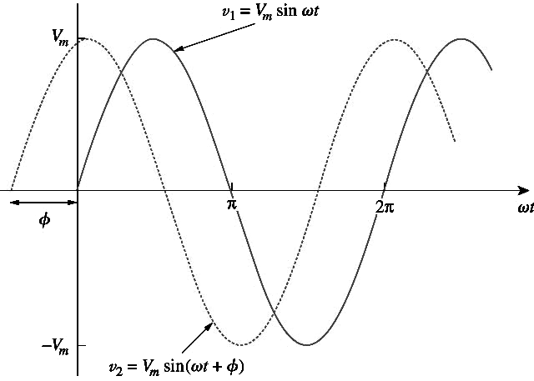
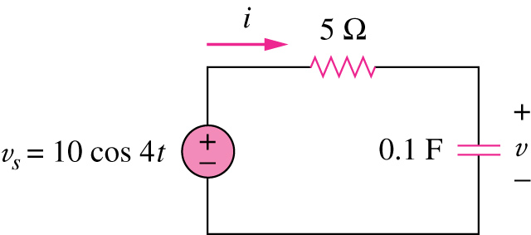
How to determine v(t) and i(t)?
9.1 Motivation (1)
v_{s}(t) = 10V
How can we apply what we have learned before to determine i(t) and v(t)?

Slide 4
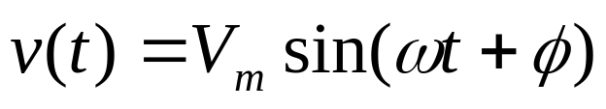
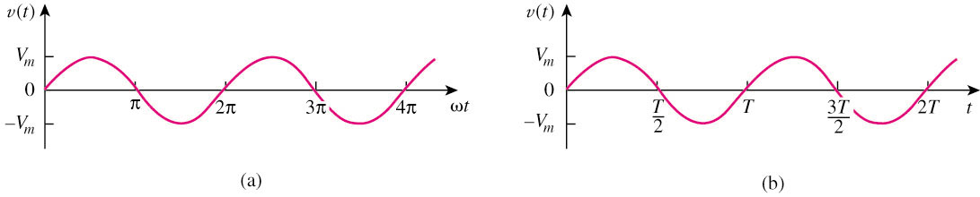
9.2 Sinusoids (1)
A sinusoid is a signal that has the form of the sine or cosine function.
A general expression for the sinusoid,
where
Vm = the amplitude of the sinusoid
ω = the angular frequency in radians/s
Ф = the phase

Slide 5
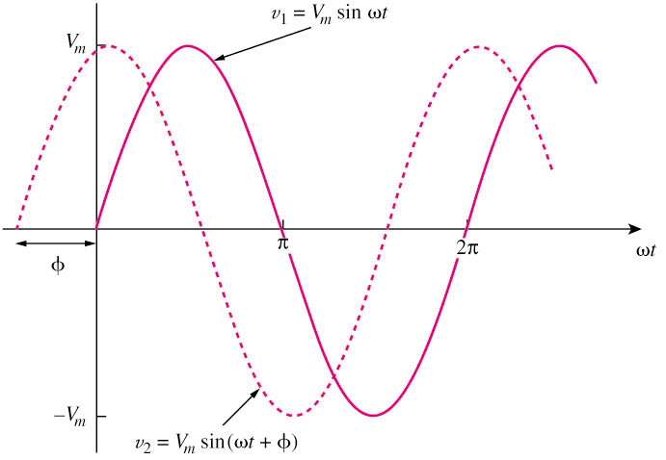

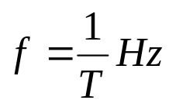

9.2 Sinusoids (2)
A periodic function is one that satisfies v(t) = v(t + nT), for all t and for all integers n.
Only two sinusoidal values with the same frequency can be compared by their amplitude and phase difference.
If phase difference is zero, they are in phase; if phase difference is not zero, they are out of phase.

Slide 6

9.2 Sinusoids (3)
Example 1
Given a sinusoid, , calculate its amplitude, phase, angular frequency, period, and frequency.
Solution:
Amplitude = 5, phase = –60º, angular frequency = 4π rad/s, Period = 0.5 s, frequency = 2 Hz.

Slide 7
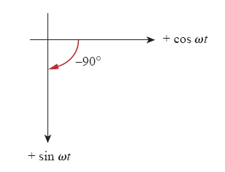
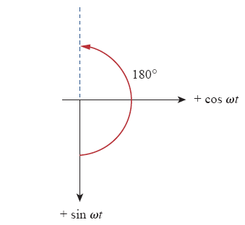


9.2 Sinusoids (4)
Example 2
Find the phase angle between and , does i₁ lead or lag i₂?
Solution:
Since sin(ωt+90º) = cos ωt
therefore, i₁ leads i₂ 155º.

Slide 8
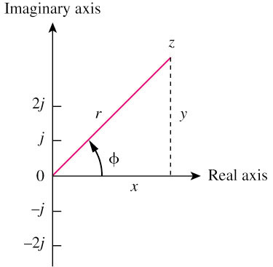




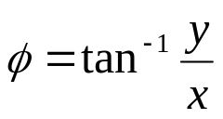
9.3 Phasor (1)
A phasor is a complex number that represents the amplitude and phase of a sinusoid.
It can be represented in one of the following three forms:
Rectangular
Polar
Exponential
where

Slide 9

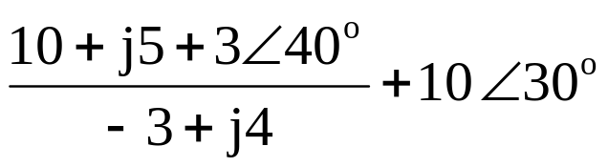
9.3 Phasor (2)
Example 3
Evaluate the following complex numbers:
  a.
  b.
Solution:
  a. –15.5 + j13.67
  b. 8.293 + j2.2

Slide 10



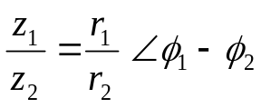
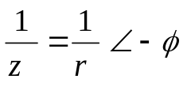



9.3 Phasor (3)
Mathematic operation of complex number:
Addition
Subtraction
Multiplication
Division
Reciprocal
Square root
Complex conjugate
Euler’s identity

Slide 11
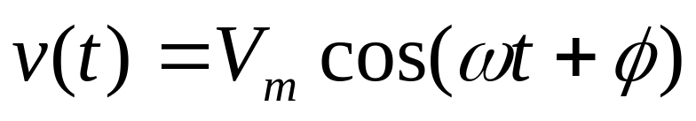
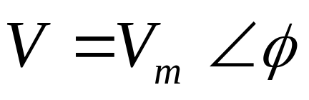
9.3 Phasor (4)
Transform a sinusoid to and from the time domain to the phasor domain:
(time domain) (phasor domain)
Amplitude and phase difference are two principal concerns in the study of voltage and current sinusoids.
Phasor will be defined from the cosine function in all our proceeding study. If a voltage or current expression is in the form of a sine, it will be changed to a cosine by subtracting from the phase.

Slide 12


9.3 Phasor (5)
Example 4
Transform the following sinusoids to phasors:
  i = 6cos(50t – 40º) A
  v = –4sin(30t + 50º) V
Solution:
a. I A
b. Since –sin(A) = cos(A+90º);
v(t) = 4cos (30t+50º+90º) = 4cos(30t+140º) V
Transform to phasor => V V

Slide 13


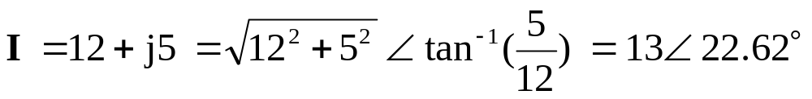
9.3 Phasor (6)
Example 5:
Transform the sinusoids corresponding to phasors:
Solution:
  v(t) = 10cos(ωt + 210º) V
  Since
  i(t) = 13cos(ωt + 22.62º) A

Slide 14
9.3 Phasor (7)
The differences between v(t) and V:
v(t) is instantaneous or time-domain representation
V is the frequency or phasor-domain representation.
v(t) is time dependent, V is not.
v(t) is always real with no complex term, V is generally complex.
Note: Phasor analysis applies only when frequency is constant; when it is applied to two or more sinusoid signals only if they have the same frequency.

Slide 15
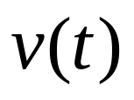
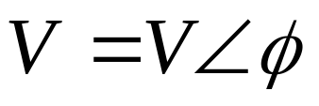
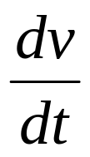

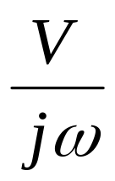
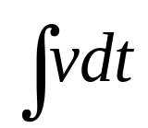
9.3 Phasor (8)
Relationship between differential, integral operation in phasor listed as follow:

Slide 16
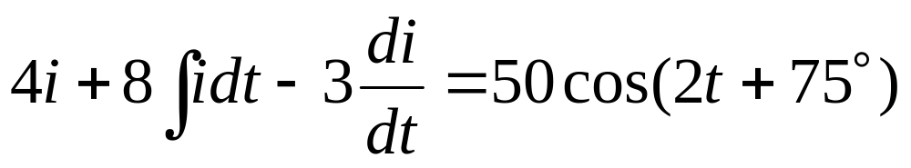
9.3 Phasor (9)
Example 6
Use phasor approach, determine the current i(t) in a circuit described by the integro-differential equation.
Answer: i(t) = 4.642cos(2t + 143.2º) A

Slide 17
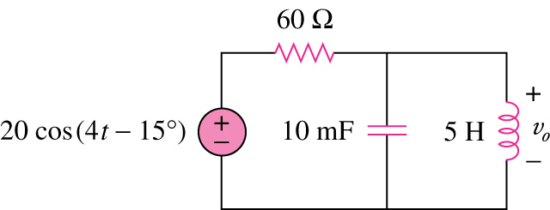
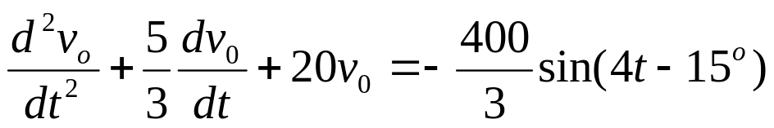
9.3 Phasor (10)
In-class exercise for Unit 6a, we can derive the differential equations for the following circuit in order to solve for v_{o}(t) in phase domain V_{o}.
However, the derivation may sometimes be very tedious.
Is there any quicker and more systematic methods to do it?

Slide 18
9.3 Phasor (11)
The answer is YES!
Instead of first deriving the differential equation and then transforming it into phasor to solve for V_{o,} we can transform all the RLC components into phasor first, then apply the KCL laws and other theorems to set up a phasor equation involving V_{o} directly.

Slide 19
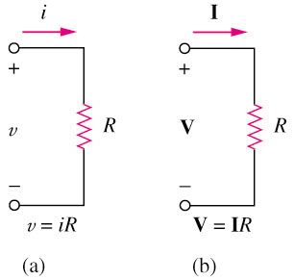
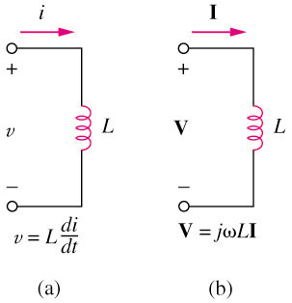
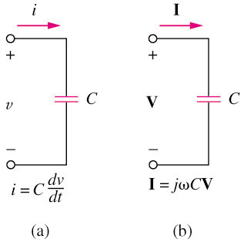
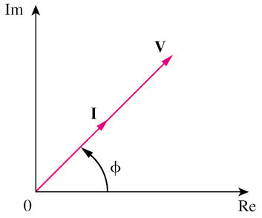
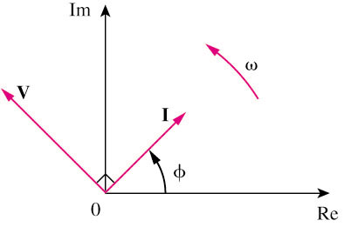
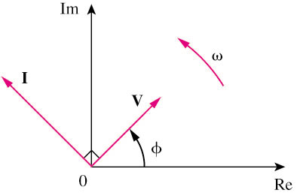
9.4 Phasor Relationships for Circuit Elements (1)
Resistor:
Inductor:
Capacitor:

Slide 20


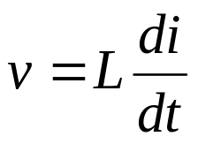

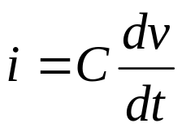
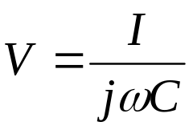
9.4 Phasor Relationships for Circuit Elements (2)
Summary of voltage-current relationship
Element | Time domain | Frequency domain
R
L
C

Slide 21
9.4 Phasor Relationships for Circuit Elements (3)
Example 7
If voltage v(t) = 6cos(100t – 30º) is applied to a 50 μF capacitor, calculate the current, i(t), through the capacitor.
Answer: i(t) = 30 cos(100t + 60º) mA

Slide 22
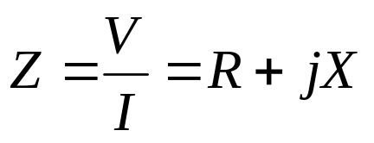
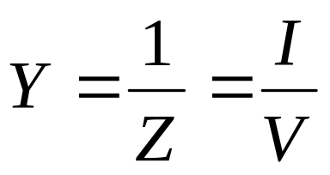
9.5 Impedance and Admittance (1)
The impedance Z of a circuit is the ratio of the phasor voltage V to the phasor current I, measured in ohms Ω.
where R = Re, Z is the resistance and X = Im, Z is the reactance. Positive X is for L and negative X is for C.
The admittance Y is the reciprocal of impedance, measured in siemens (S).

Slide 23
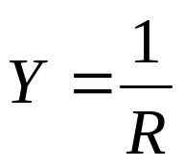

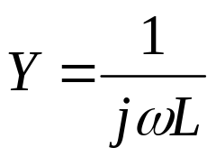
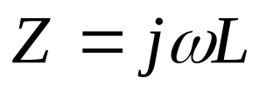
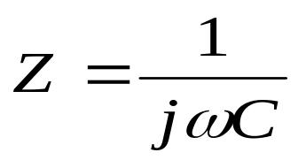

9.5 Impedance and Admittance (2)
Impedances and admittances of passive elements
Element | Impedance | Admittance
R
L
C

Slide 24
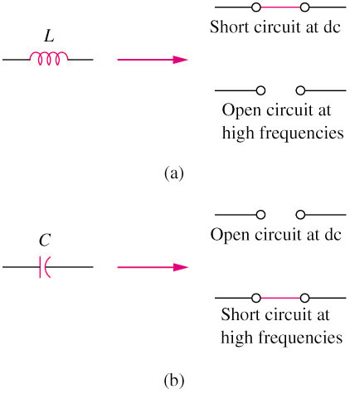
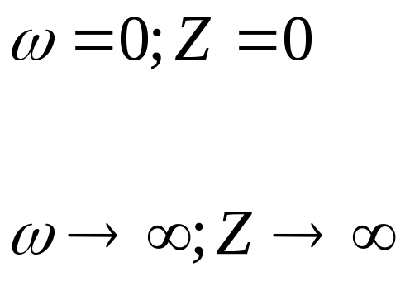
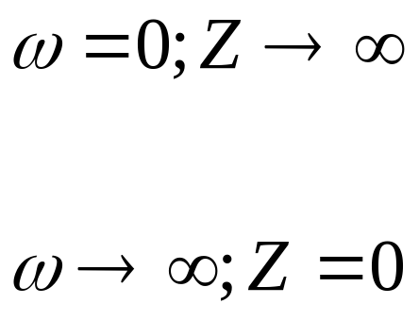
9.5 Impedance and Admittance (3)

Slide 25
9.5 Impedance and Admittance (4)
After we know how to convert RLC components from time to phasor domain, we can transform a time domain circuit into a phasor/frequency domain circuit.
Hence, we can apply the KCL laws and other theorems to directly set up phasor equations involving our target variable(s) for solving.

Slide 26
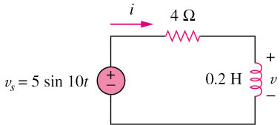

9.5 Impedance and Admittance (5)
Example 8
Refer to Figure below, determine v(t) and i(t).
Answers: i(t) = 1.118cos(10t – 26.56º) A; v(t) = 2.236cos(10t + 63.43º) V

Slide 27
9.6 Kirchhoff’s Laws in the Frequency Domain (1)
Both KVL and KCL are hold in the phasor domain or more commonly called frequency domain.
Moreover, the variables to be handled are phasors, which are complex numbers.
All the mathematical operations involved are now in complex domain.

Slide 28
9.7 Impedance Combinations (1)
The following principles used for DC circuit analysis all apply to AC circuit.
For example:
  voltage division
  current division
  circuit reduction
  impedance equivalence
  Y-Δ transformation

Slide 29
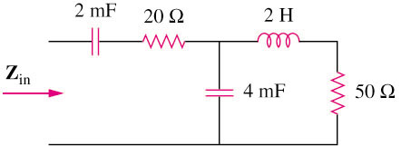
9.7 Impedance Combinations (2)
Example 9
Determine the input impedance of the circuit in figure below at ω =10 rad/s.
Answer: Z_{in} = 32.38 – j73.76

