Slide 1

Syntax Analysis

Slide 2
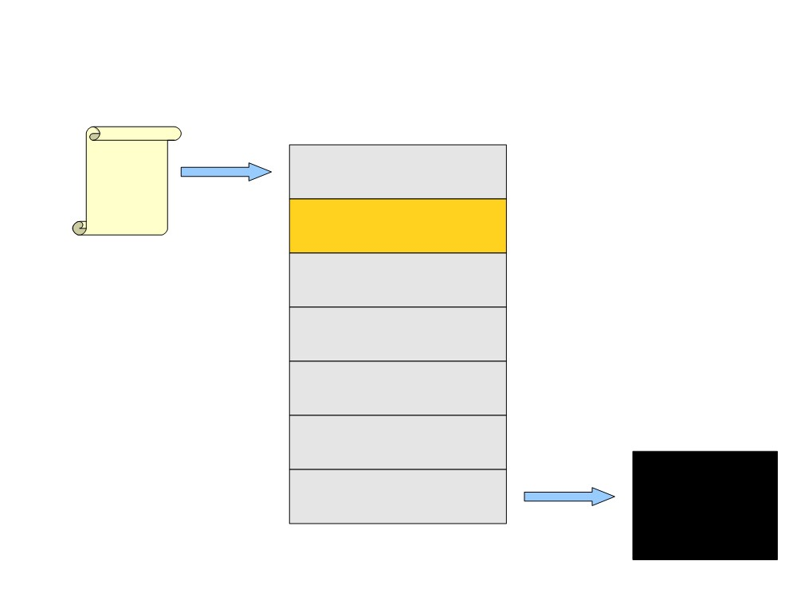
Where We Are
Source
Code
Lexical Analysis
Syntax Analysis
Semantic Analysis
IR Generation
IR Optimization
Code Generation
Optimization
Machine
Code

Slide 3
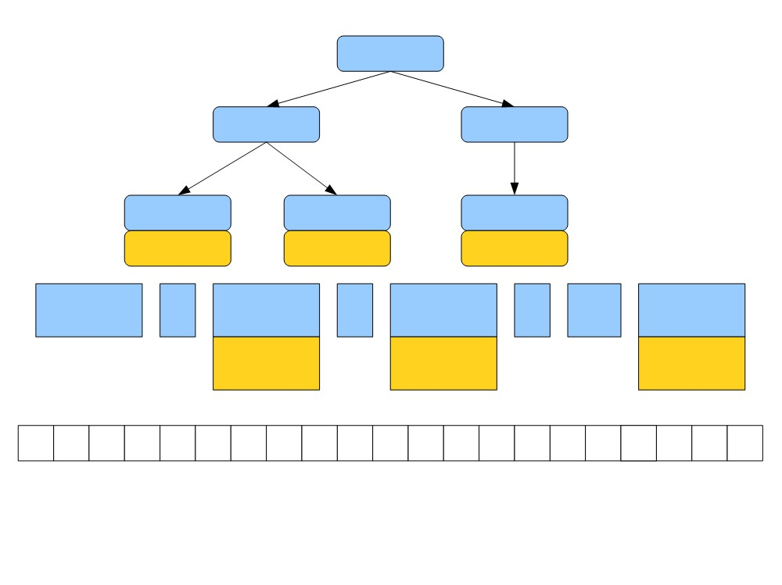
While
<
++
Ident
Ident
Ident
ip
z
ip
T_While
(
T_Ident
<
T_Ident
)
++
T_Ident
ip
z
ip
w
h
i
l
e
(
i
p
<
z
)
\n
\t
+
+
i
p
;
while (ip < z)
++ip;

Slide 4
What is Syntax Analysis?
● After lexical analysis (scanning), we have a
series of tokens.
● Syntax Analysis: Find the structure (Syntax Tree)
described by that series of tokens and report
errors if those tokens do not properly encode
a structure

Slide 5
Context-Free Grammars (CFGs)
● A tool for describing
languages that is strictly
more powerful than
regular languages.
Example
BLOCK → STMT
|
{ STMTS }
STMTS → ε
|
STMT STMTS
STMT
→ EXPR;
● A production form
|
if (EXPR) BLOCK
A → B1B2 … Bn
|
while (EXPR) BLOCK
|
do BLOCK while (EXPR);
A is a nonterminal
Bi's are either terminals or
nonterminals.
|
BLOCK
|
…
EXPR
→ identifier
|
constant
|
EXPR + EXPR
|
EXPR - EXPR
|
EXPR * EXPR

Slide 6
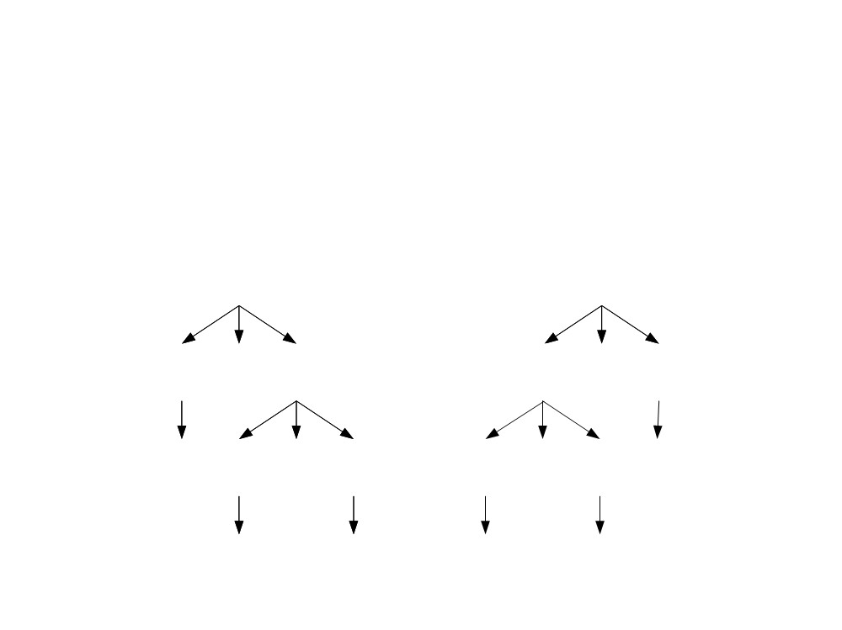
Ambiguity
● A CFG is said to be ambiguous if there is at least one
string with two or more derivations.
● R → int | R + R | R - R
R
R
R
- R
R
+ R
5
R
+ R
R
- R
7
3
7
5
3

Slide 7
Abstract Syntax Trees (ASTs)
● Tree structure encoding the logical structure
of a piece of code.
Example a = b + c
AST
←
stmt
Parse tree
a
+
id
=
expr
● As the input is parsed, associate code creates
AST with each production.
● This is called a syntax-directed translation
or semantic action.
b
c
id
+
id

Slide 8
Syntax-directed translation (in Bison)
exp: factor { $$ = $1 }
| factor PLUS factor
{ $$ = makeNode($1, $3, PLUS, "+") }
| factor MINUS factor
{ $$ = makeNode($1, $3, MINUS, "-") }
factor : NUMBER
{ $$ = makeNode(0,0, NUMBER, (char *)yylval) }
*Left Token Lexeme *Right
Node

Slide 9
Syntax-directed translation (in Bison)
Example: AST for the input string “1+2”
$$ (exp)
PLUS “+”
$1 (factor)
$3 (factor)
0 NUMBER “1” 0
0 NUMBER “2” 0

Slide 10

Top-Down
Parsing

Slide 11
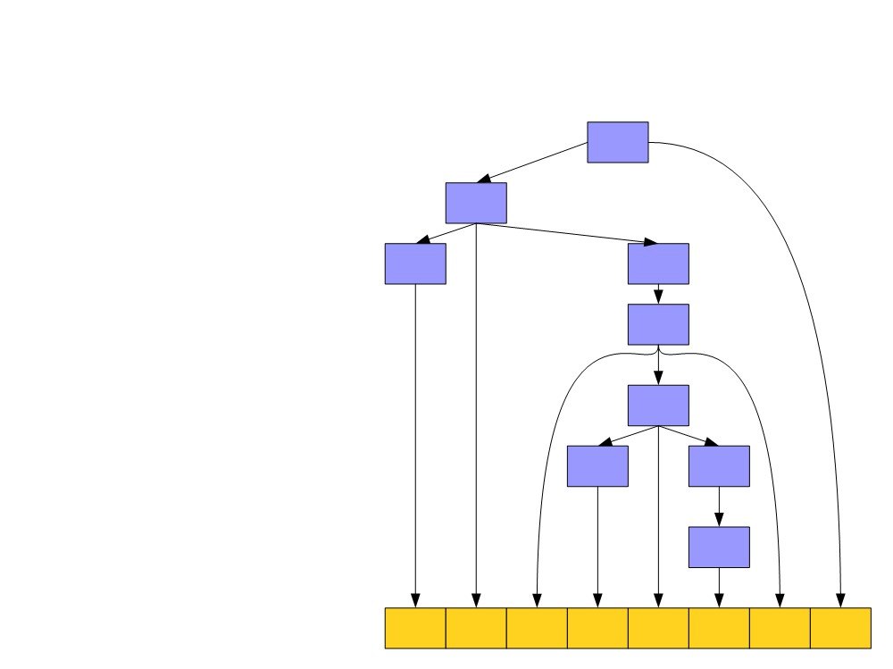
S → E$
E → T
Top-Down Parsing
S
E
E → T + E
T → int
T → (E)
T E
T
E
T
E
T
int + ( int +
int ) $

Slide 12
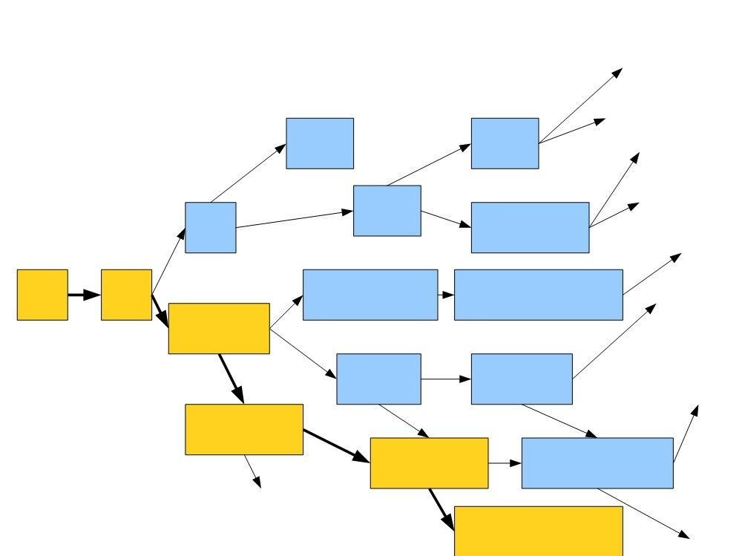
Huge Search Space
…
S → E$
E → T
…
…
int$ (T) $
E → T + E
T → int
(E) $
…
T → (E)
T$
(T + E) $
…
S E$
T + T + E$
int + T + E$
…
T + E$
T + T$
T + (E) $
…
int + E$
int + T$
int + (E)
$
…
int + int$
…

Slide 13
BFS is Slow
● Enormous time and memory usage:
● Lots of wasted effort:
- Generates a lot of sentential forms that couldn't possibly
match.
● High branching factor:
- Each sentential form can expand in (potentially) many
ways for each nonterminal it contains.

Slide 14
Predictive Parsing
● There is another class of parsing algorithms
called predictive algorithms (no backtracking).
● Idea: Lookahead tokens.
● LL(1) : Top-down, predictive parsing
● L: Left-to-right scan of the tokens
● L: Leftmost derivation.
●
(1): One token of lookahead
● When expanding a nonterminal, we predict the
production to use by looking at the next token
of the input.

Slide 15
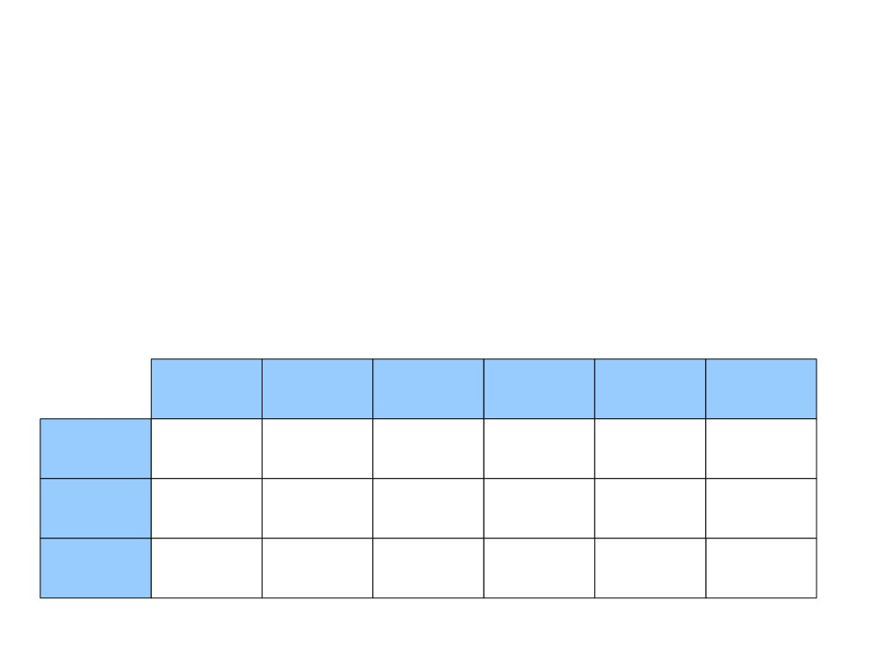
LL(1) Parse Tables
S → E$
E → int
E → (E Op E)
Op → +
Op → *
int
(
)
+
*
$
S
E$
E$
E
int
(E Op E)
Op
+
*
We will learn how to create the LL(1) parsing table soon.

Slide 16
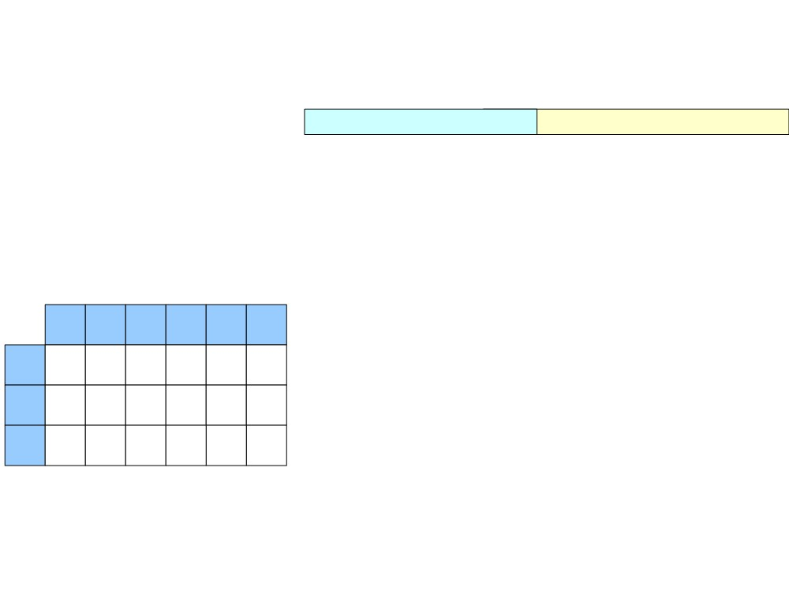
Predictive Top-Down Parsing
S
(int + (int * int))$
1. S → E$
2. E → int
Parsing stack
Remaining input
3. E → (E Op E)
4. Op → +
5. Op → *
int
(
)
+
*
$
S
1
1
E
2
3
Op
4
5

Slide 17
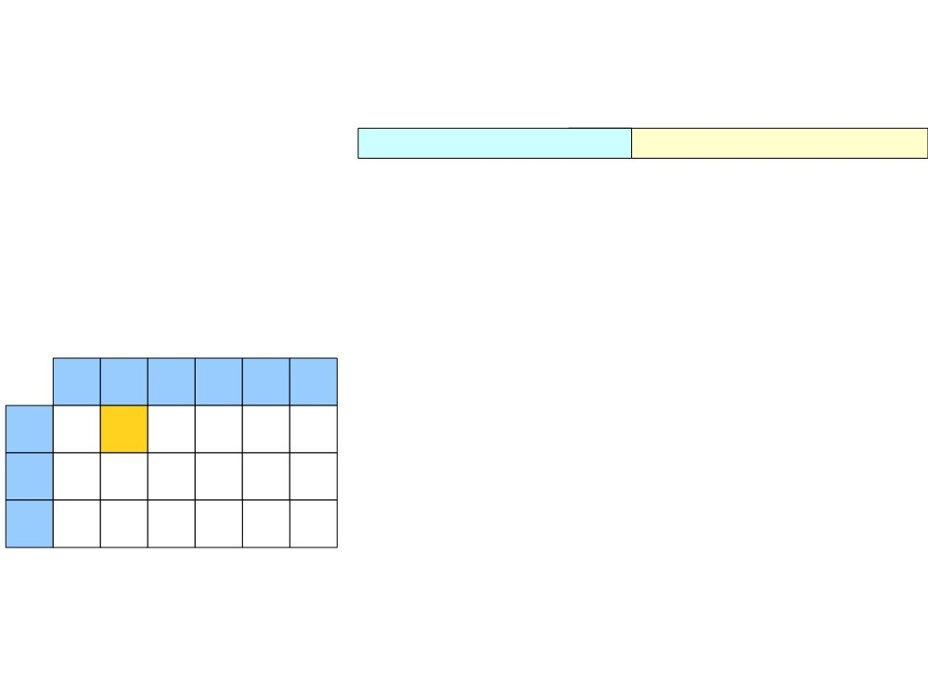
Predictive Top-Down Parsing
S
(int + (int * int))$
1. S → E$
2. E → int
3. E → (E Op E)
4. Op → +
5. Op → *
int
(
)
+
*
$
S
1
1
E
2
3
Op
4
5

Slide 18
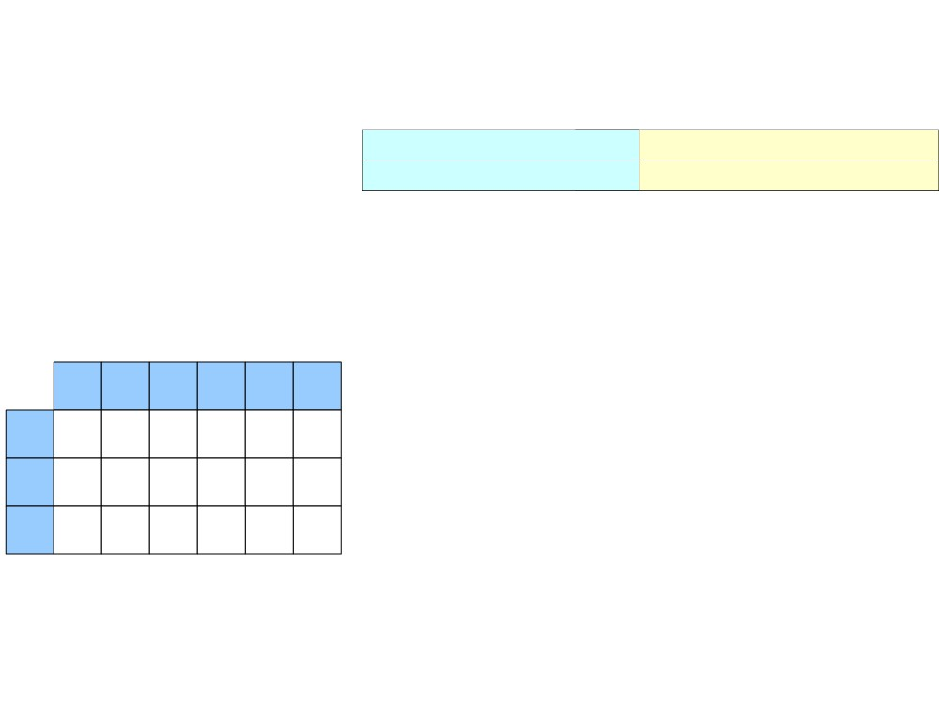
Predictive Top-Down Parsing
S
(int + (int * int))$
1. S → E$
E$
(int + (int * int))$
2. E → int
3. E → (E Op E)
4. Op → +
5. Op → *
int
(
)
+
*
$
S
1
1
E
2
3
Op
4
5

Slide 19
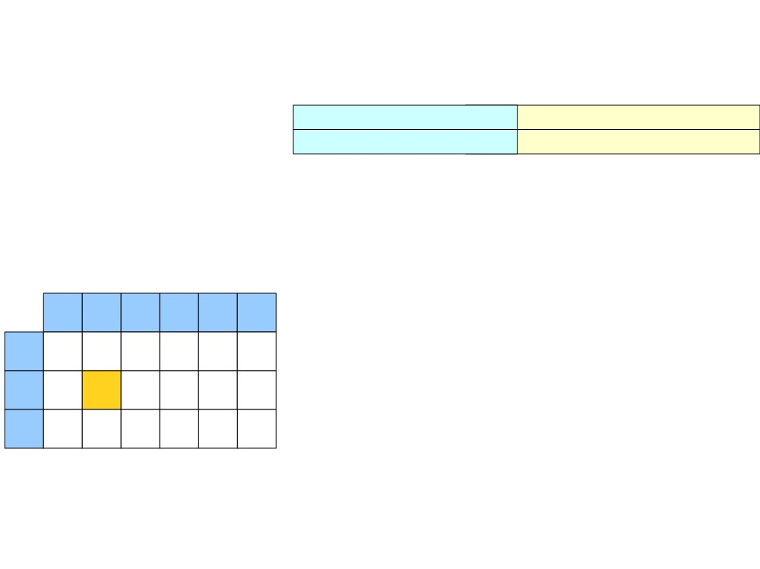
Predictive Top-Down Parsing
S
(int + (int * int))$
1. S → E$
E$
(int + (int * int))$
2. E → int
3. E → (E Op E)
4. Op → +
5. Op → *
int
(
)
+
*
$
S
1
1
E
2
3
Op
4
5

Slide 20
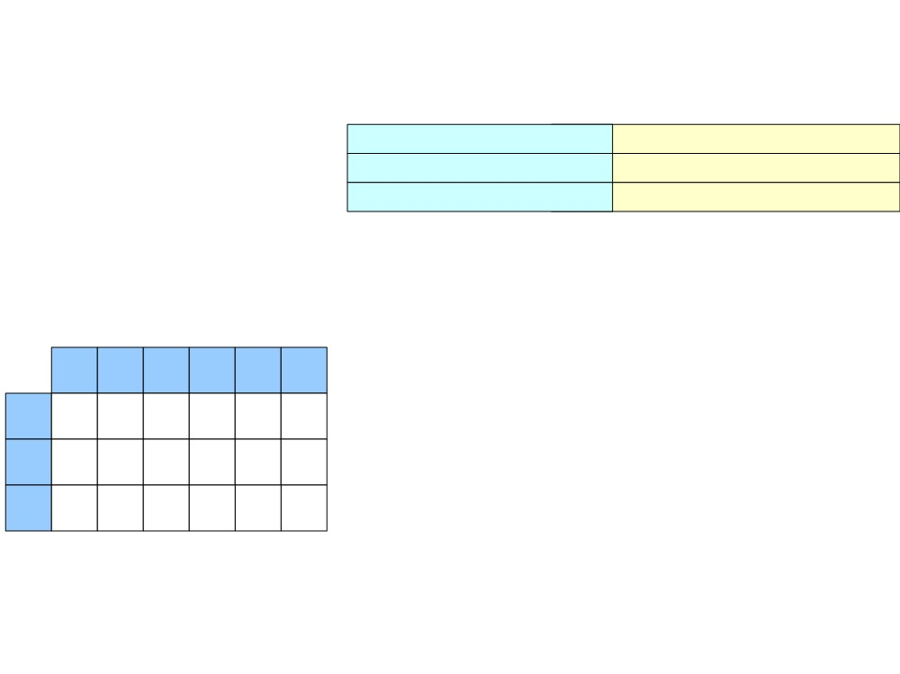
Predictive Top-Down Parsing
S
(int + (int * int))$
1. S → E$
E$
(int + (int * int))$
2. E → int
(E Op E)$
(int + (int * int))$
3. E → (E Op E)
4. Op → +
5. Op → *
int
(
)
+
*
$
S
1
1
E
2
3
Op
4
5

Slide 21
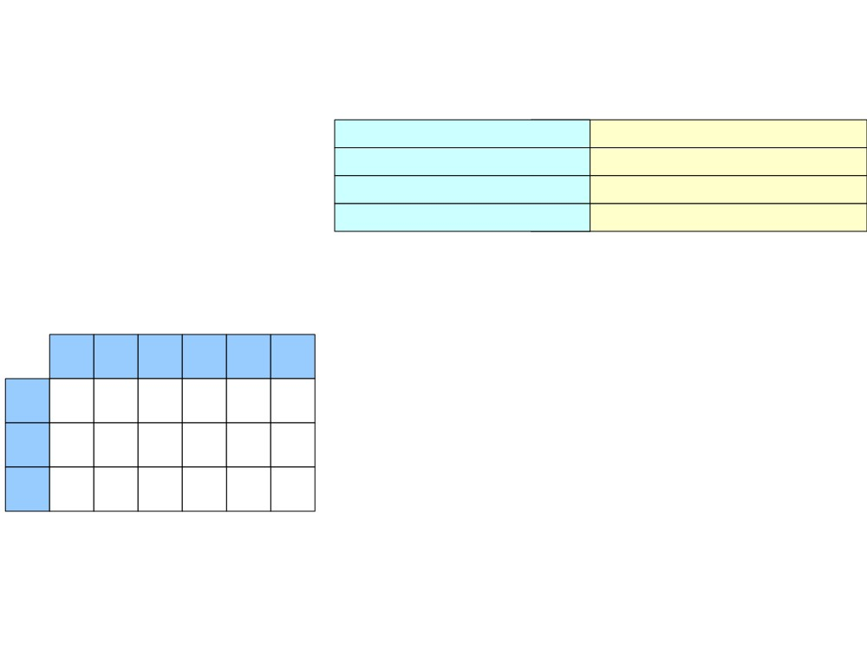
Predictive Top-Down Parsing
S
(int + (int * int))$
(int + (int * int))$
(int + (int * int))$
int + (int * int))$
1. S → E$
E$
2. E → int
(E Op E)$
E Op E)$
3. E → (E Op E)
4. Op → +
Pop ‘(’ out of the stack and advance to the next token
5. Op → *
int ( ) + *
$
S
1
1
E
2
3
Op
4
5

Slide 22
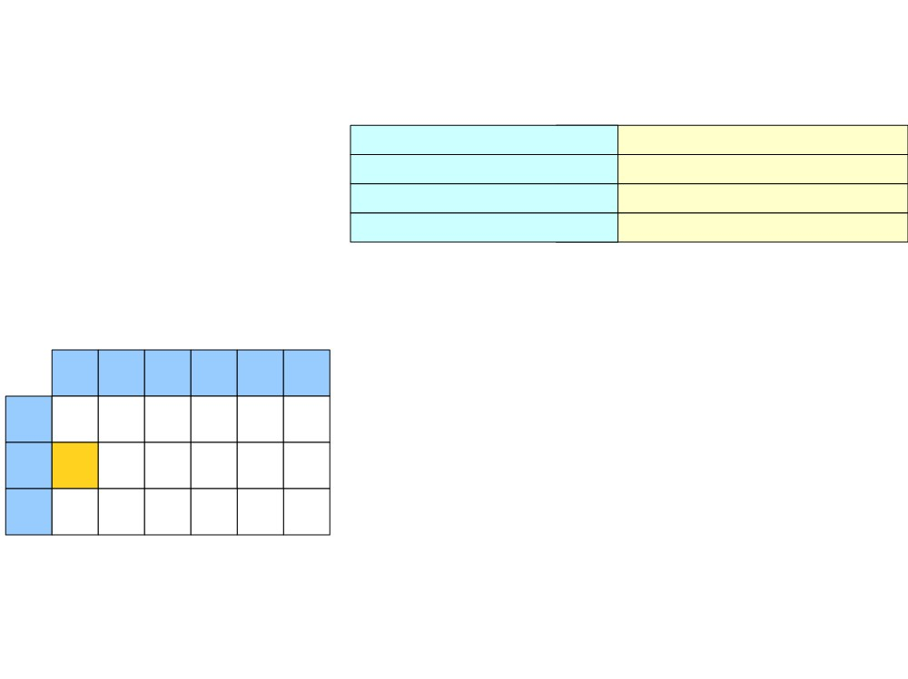
Predictive Top-Down Parsing
S
(int + (int * int))$
(int + (int * int))$
(int + (int * int))$
int + (int * int))$
1. S → E$
E$
2. E → int
(E Op E)$
E Op E)$
3. E → (E Op E)
4. Op → +
5. Op → *
int ( ) + *
$
S
1
1
E
2
3
Op
4
5

Slide 23
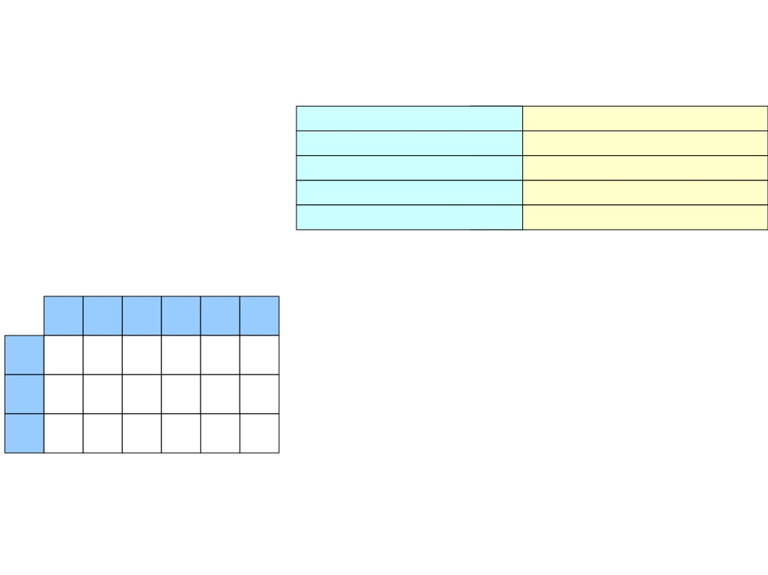
Predictive Top-Down Parsing
S
(int + (int * int))$
(int + (int * int))$
(int + (int * int))$
1. S → E$
E$
2. E → int
(E Op E)$
E Op E)$
int Op E)$
3. E → (E Op E)
int + (int * int))$
int + (int * int))$
4. Op → +
5. Op → *
int ( ) + *
$
S
1
1
E
2
3
Op
4
5

Slide 24

Predictive Top-Down Parsing
S
(int + (int * int))$
(int + (int * int))$
(int + (int * int))$
1. S → E$
E$
2. E → int
(E Op E)$
E Op E)$
int Op E)$
3. E → (E Op E)
int + (int * int))$
int + (int * int))$
+ (int * int))$
4. Op → +
Op E)$
5. Op → *
Pop ‘int’ out of the stack and advance to the next token
int ( ) + *
$
S
1
1
E
2
3
Op
4
5

Slide 25
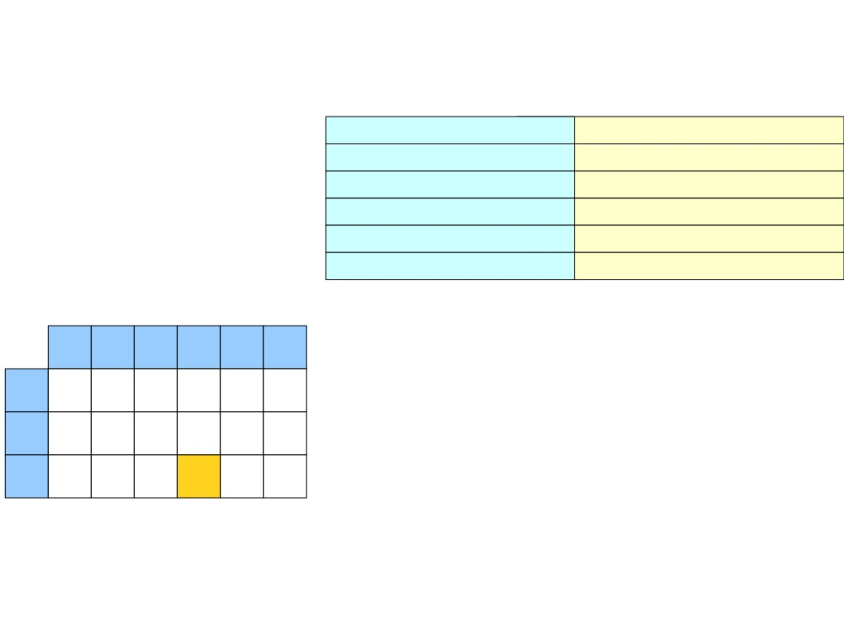
Predictive Top-Down Parsing
S
(int + (int * int))$
(int + (int * int))$
(int + (int * int))$
1. S → E$
E$
2. E → int
(E Op E)$
E Op E)$
int Op E)$
3. E → (E Op E)
int + (int * int))$
int + (int * int))$
+ (int * int))$
4. Op → +
Op E)$
5. Op → *
int ( ) + *
$
S
1
1
E
2
3
Op
4
5

Slide 26
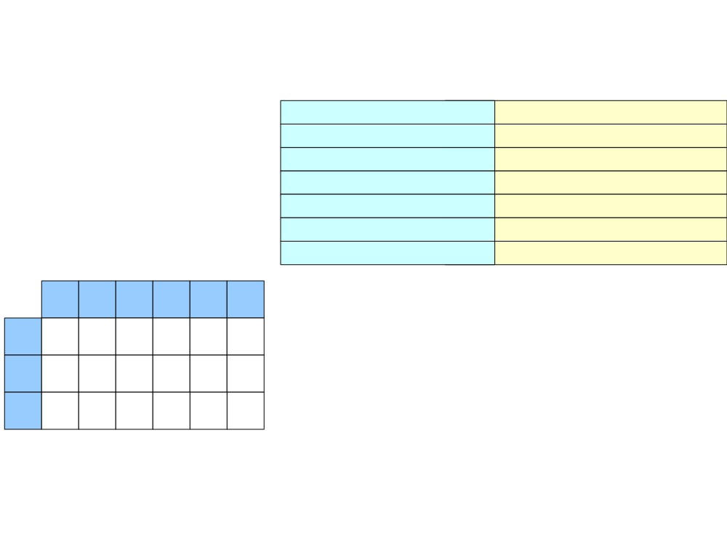
Predictive Top-Down Parsing
S
(int + (int * int))$
(int + (int * int))$
(int + (int * int))$
1. S → E$
E$
2. E → int
(E Op E)$
E Op E)$
int Op E)$
3. E → (E Op E)
int + (int * int))$
int + (int * int))$
4. Op → +
Op E)$
+ E)$
+ (int * int))$
+ (int * int))$
5. Op → *
int
(
)
+
*
$
S
1
1
E
2
3
Op
4
5

Slide 27
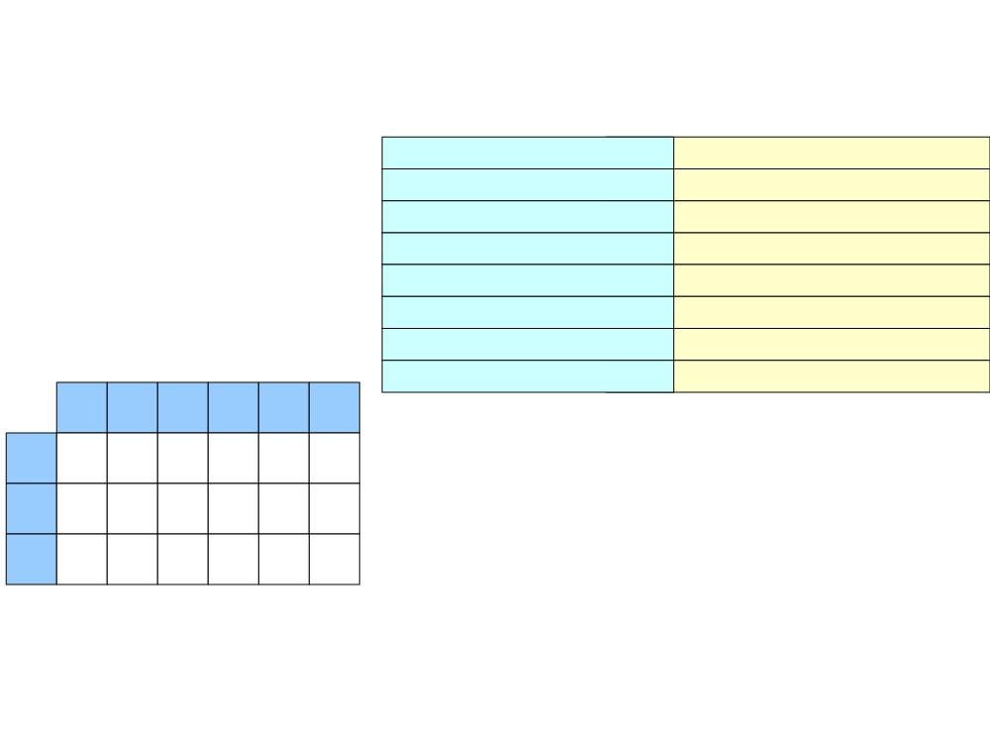
Predictive Top-Down Parsing
S
(int + (int * int))$
(int + (int * int))$
(int + (int * int))$
1. S → E$
E$
2. E → int
(E Op E)$
E Op E)$
int Op E)$
3. E → (E Op E)
int + (int * int))$
int + (int * int))$
4. Op → +
Op E)$
+ E)$
E)$
+ (int * int))$
+ (int * int))$
(int * int))$
5. Op → *
int ( ) + * $
Pop ‘+’ out of the stack and
advance to the next token
S
1
1
E
2
3
Op
4
5

Slide 28
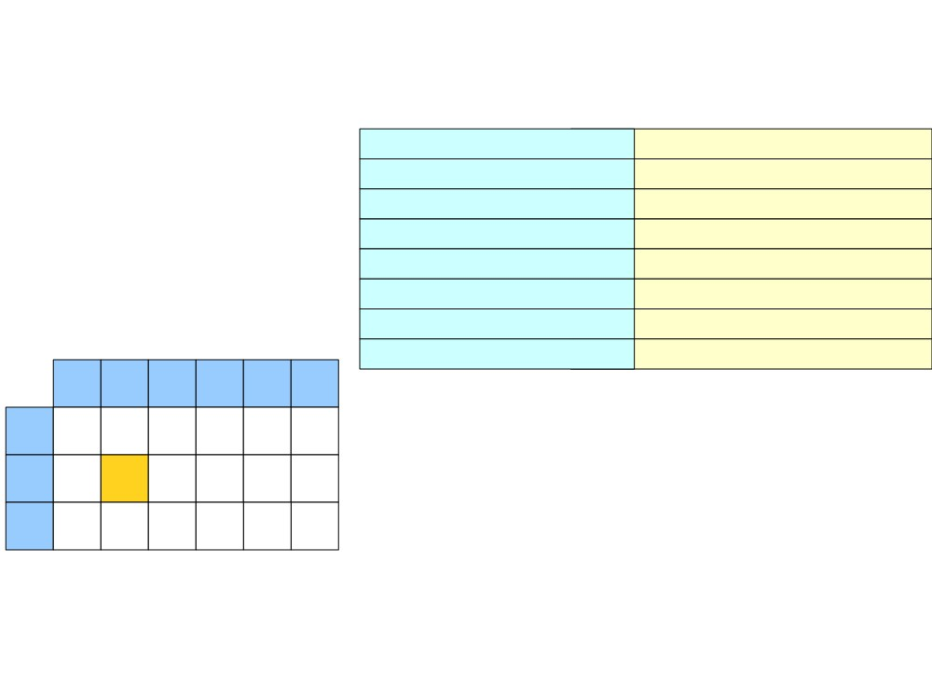
Predictive Top-Down Parsing
S
(int + (int * int))$
(int + (int * int))$
(int + (int * int))$
1. S → E$
E$
2. E → int
(E Op E)$
E Op E)$
int Op E)$
3. E → (E Op E)
int + (int * int))$
int + (int * int))$
4. Op → +
Op E)$
+ E)$
E)$
+ (int * int))$
+ (int * int))$
(int * int))$
5. Op → *
int ( ) + * $
S
1
1
E
2
3
Op
4
5

Slide 29
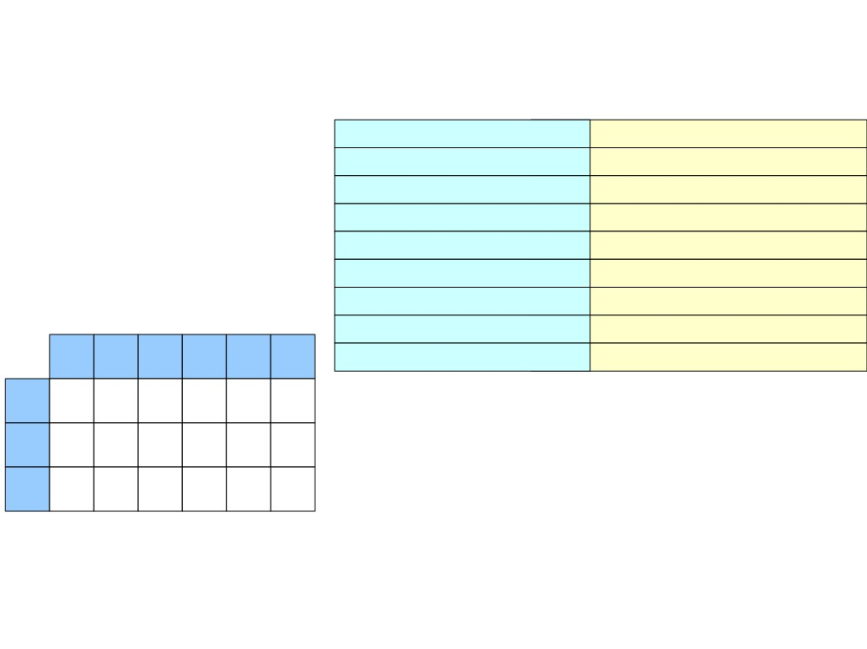
Predictive Top-Down Parsing
S
(int + (int * int))$
(int + (int * int))$
(int + (int * int))$
1. S → E$
E$
2. E → int
(E Op E)$
E Op E)$
int Op E)$
3. E → (E Op E)
int + (int * int))$
int + (int * int))$
4. Op → +
Op E)$
+ E)$
+ (int * int))$
+ (int * int))$
5. Op → *
E)$
(E Op E))$
(int * int))$
(int * int))$
int ( ) + * $
S
1
1
E
2
3
Op
4
5

Slide 30
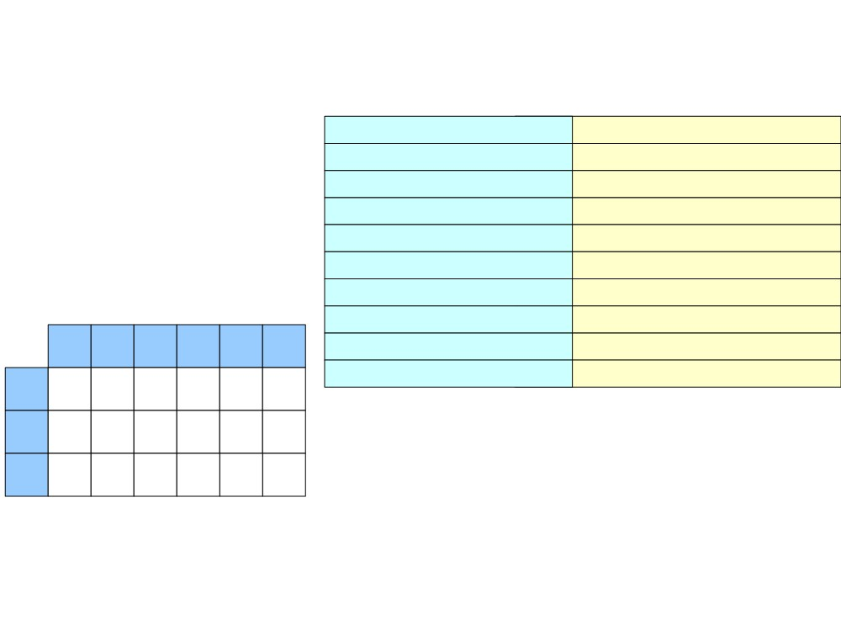
Predictive Top-Down Parsing
S
(int + (int * int))$
(int + (int * int))$
(int + (int * int))$
1. S → E$
E$
2. E → int
(E Op E)$
E Op E)$
int Op E)$
3. E → (E Op E)
int + (int * int))$
int + (int * int))$
4. Op → +
Op E)$
+ E)$
+ (int * int))$
+ (int * int))$
5. Op → *
E)$
(int * int))$
(int * int))$
int * int))$
int ( ) + * $
(E Op E))$
E Op E))$
S 1 1
E
2
3
Pop ‘(’out of the stack and
advance to the next token
Op
4
5

Slide 31
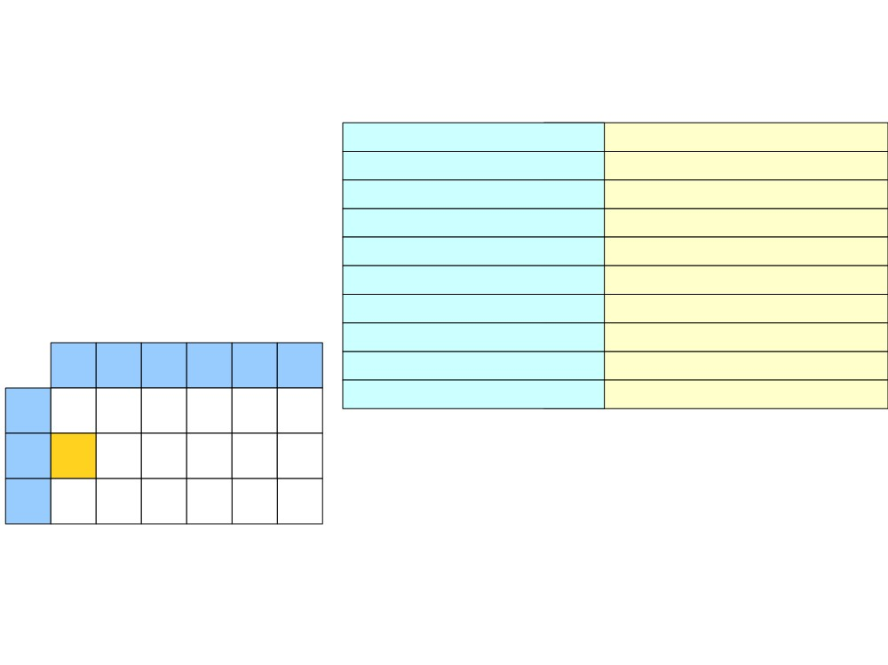
Predictive Top-Down Parsing
S
(int + (int * int))$
(int + (int * int))$
(int + (int * int))$
1. S → E$
E$
2. E → int
(E Op E)$
E Op E)$
int Op E)$
3. E → (E Op E)
int + (int * int))$
int + (int * int))$
4. Op → +
Op E)$
+ E)$
+ (int * int))$
+ (int * int))$
5. Op → *
E)$
(int * int))$
(int * int))$
int * int))$
int ( ) + * $
(E Op E))$
E Op E))$
S 1 1
E
2
3
Op
4
5

Slide 32
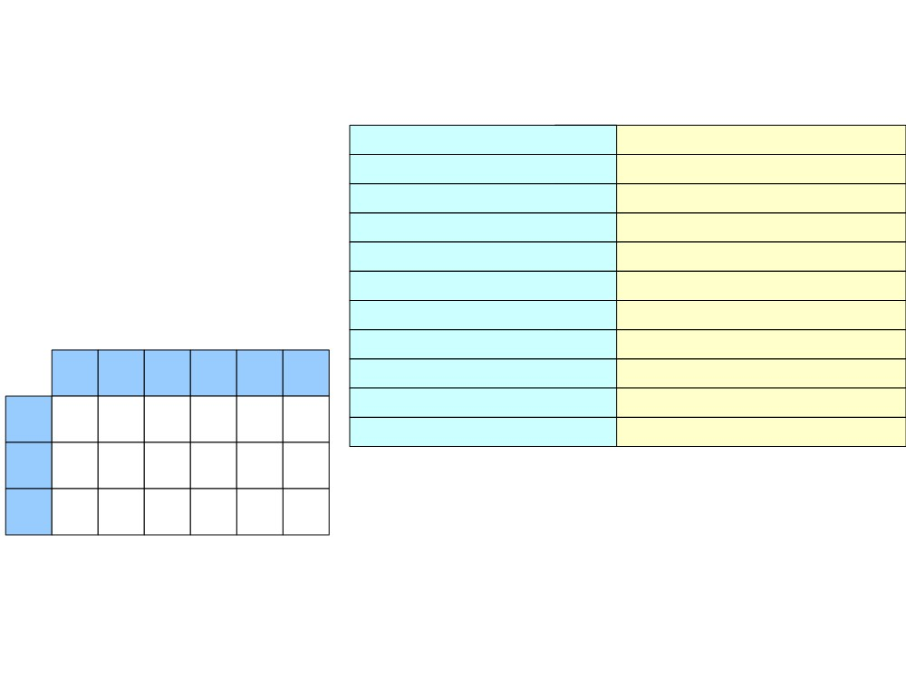
Predictive Top-Down Parsing
S
(int + (int * int))$
(int + (int * int))$
(int + (int * int))$
1. S → E$
E$
2. E → int
(E Op E)$
E Op E)$
int Op E)$
3. E → (E Op E)
int + (int * int))$
int + (int * int))$
4. Op → +
Op E)$
+ E)$
+ (int * int))$
+ (int * int))$
5. Op → *
E)$
(int * int))$
(int * int))$
int ( ) + * $
(E Op E))$
E Op E))$
int Op E))$
int * int))$
int * int))$
S 1 1
E
2
3
Op
4
5

Slide 33
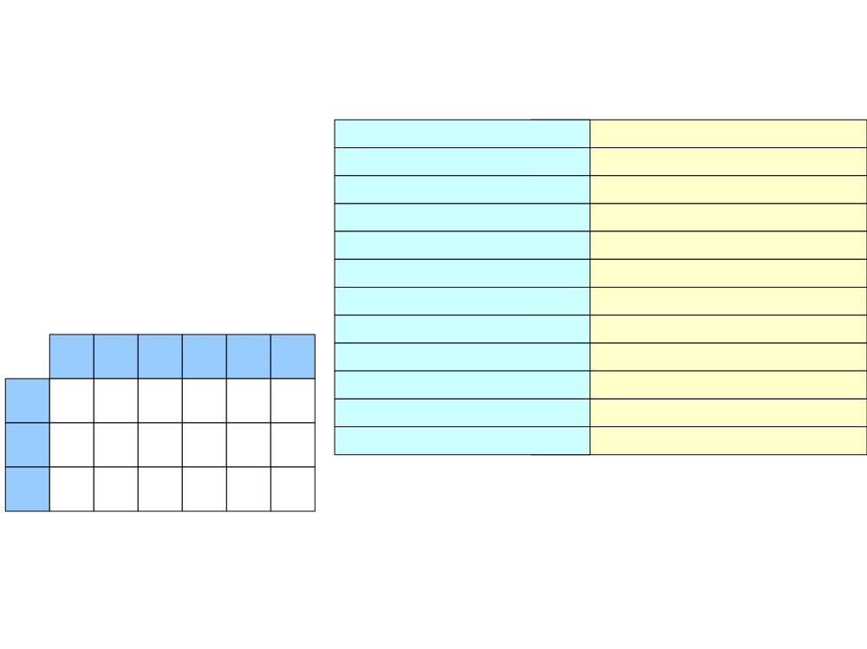
Predictive Top-Down Parsing
S
(int + (int * int))$
(int + (int * int))$
(int + (int * int))$
1. S → E$
E$
2. E → int
(E Op E)$
E Op E)$
int Op E)$
3. E → (E Op E)
int + (int * int))$
int + (int * int))$
4. Op → +
Op E)$
+ E)$
+ (int * int))$
+ (int * int))$
5. Op → *
E)$
(int * int))$
(int * int))$
int ( ) + * $
(E Op E))$
E Op E))$
int Op E))$
Op E))$
S 1 1
E 2 3
int * int))$
int * int))$
* int))$
Op
4
5
Pop ‘int’ out of the stack and
advance to the next token

Slide 34
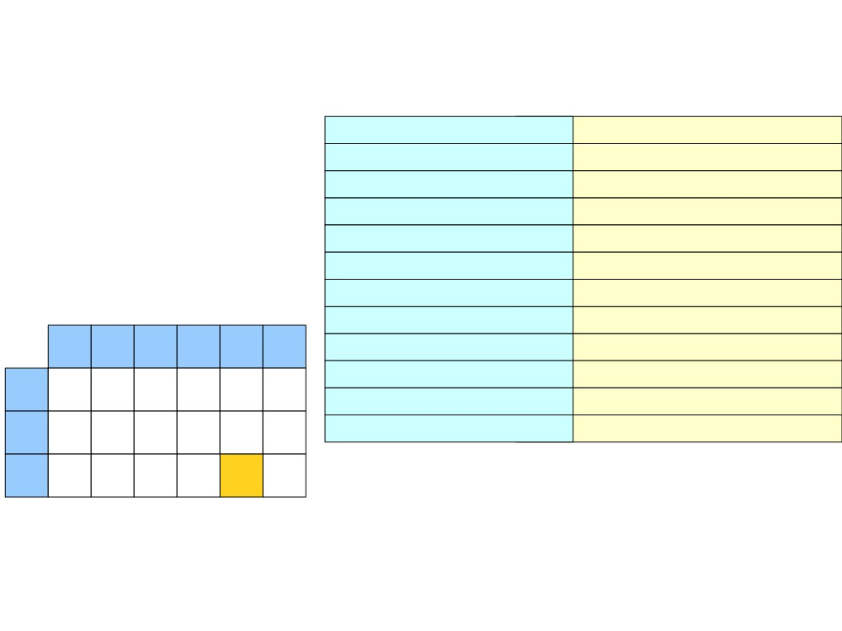
Predictive Top-Down Parsing
S
(int + (int * int))$
(int + (int * int))$
(int + (int * int))$
1. S → E$
E$
2. E → int
(E Op E)$
E Op E)$
int Op E)$
3. E → (E Op E)
int + (int * int))$
int + (int * int))$
4. Op → +
Op E)$
+ E)$
+ (int * int))$
+ (int * int))$
5. Op → *
E)$
(int * int))$
(int * int))$
int ( ) + * $
(E Op E))$
E Op E))$
int Op E))$
Op E))$
S 1 1
E 2 3
int * int))$
int * int))$
* int))$
Op
4
5

Slide 35
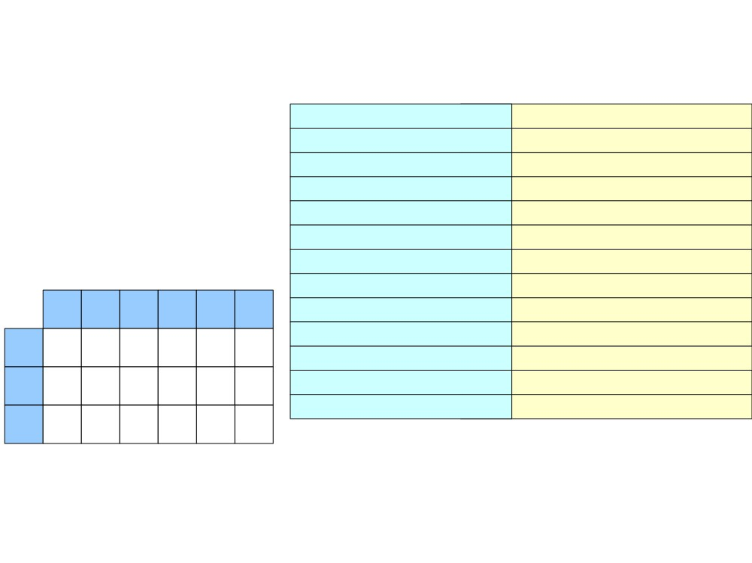
Predictive Top-Down Parsing
S
(int + (int * int))$
(int + (int * int))$
(int + (int * int))$
1. S → E$
E$
2. E → int
(E Op E)$
E Op E)$
int Op E)$
3. E → (E Op E)
int + (int * int))$
int + (int * int))$
4. Op → +
Op E)$
+ E)$
+ (int * int))$
+ (int * int))$
5. Op → *
E)$
(int * int))$
(int * int))$
int ( ) + * $
(E Op E))$
E Op E))$
int Op E))$
int * int))$
int * int))$
S 1 1
E 2 3
Op 4 5
Op E))$
* E))$
* int))$
* int))$

Slide 36
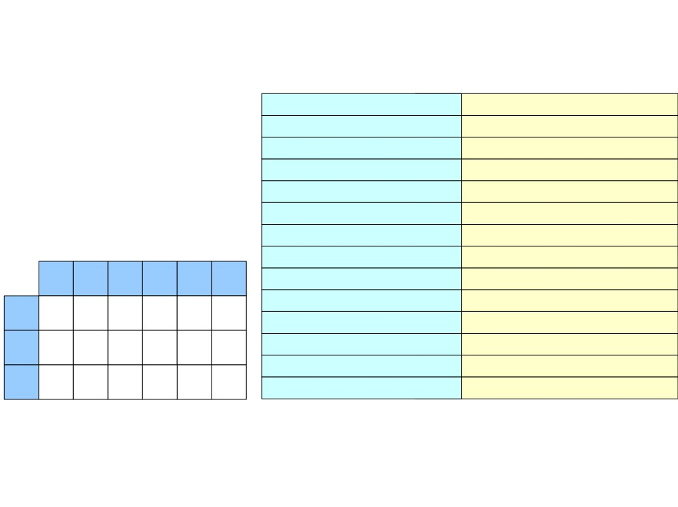
Predictive Top-Down Parsing
S
(int + (int * int))$
(int + (int * int))$
(int + (int * int))$
1. S → E$
E$
2. E → int
(E Op E)$
E Op E)$
int Op E)$
3. E → (E Op E)
int + (int * int))$
int + (int * int))$
4. Op → +
Op E)$
+ E)$
+ (int * int))$
+ (int * int))$
5. Op → *
E)$
(int * int))$
(int * int))$
int ( ) + * $
(E Op E))$
E Op E))$
int Op E))$
int * int))$
int * int))$
S 1 1
E 2 3
Op 4 5
Op E))$
* E))$
* int))$
* int))$
int))$
E))$
Pop ‘*’ out of the stack and
advance to the next token

Slide 37
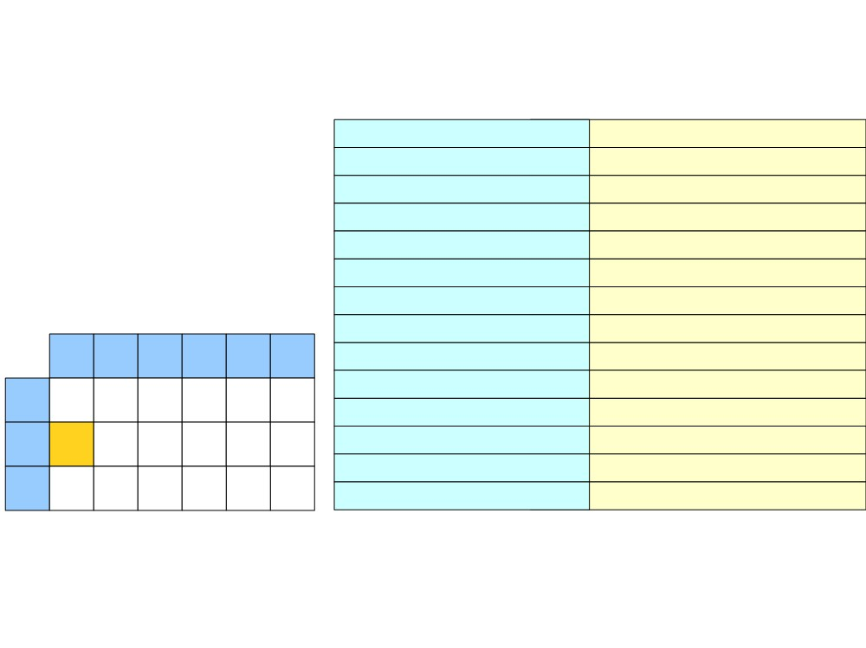
Predictive Top-Down Parsing
S
(int + (int * int))$
(int + (int * int))$
(int + (int * int))$
1. S → E$
E$
2. E → int
(E Op E)$
E Op E)$
int Op E)$
3. E → (E Op E)
int + (int * int))$
int + (int * int))$
4. Op → +
Op E)$
+ E)$
+ (int * int))$
+ (int * int))$
5. Op → *
E)$
(int * int))$
(int * int))$
int ( ) + * $
(E Op E))$
E Op E))$
int Op E))$
int * int))$
int * int))$
S 1 1
E 2 3
Op 4 5
Op E))$
* E))$
* int))$
* int))$
int))$
E))$

Slide 38
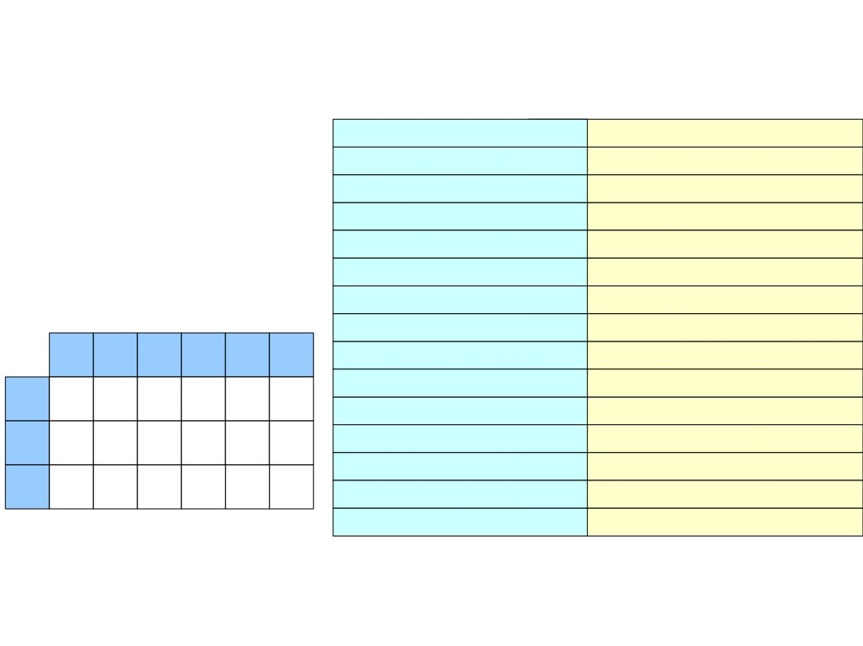
Predictive Top-Down Parsing
S
(int + (int * int))$
(int + (int * int))$
(int + (int * int))$
1. S → E$
E$
2. E → int
(E Op E)$
E Op E)$
int Op E)$
3. E → (E Op E)
int + (int * int))$
int + (int * int))$
4. Op → +
Op E)$
+ E)$
+ (int * int))$
+ (int * int))$
5. Op → *
E)$
(int * int))$
(int * int))$
int ( ) + * $
(E Op E))$
E Op E))$
int Op E))$
int * int))$
int * int))$
S 1 1
E 2 3
Op 4 5
Op E))$
* E))$
* int))$
* int))$
E))$
int))$
int))$
int))$

Slide 39
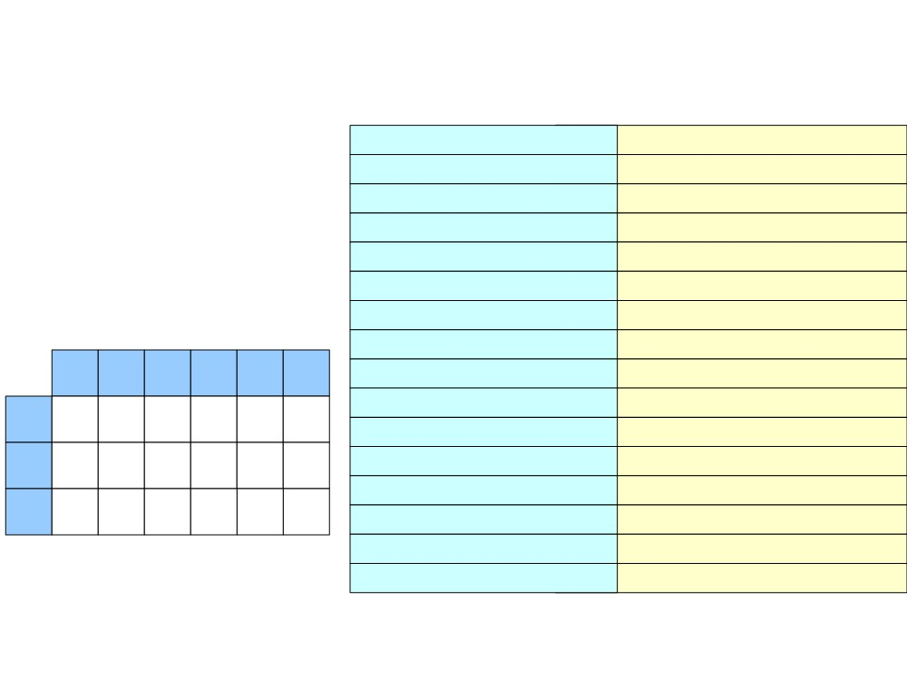
Predictive Top-Down Parsing
S
(int + (int * int))$
(int + (int * int))$
(int + (int * int))$
1. S → E$
E$
2. E → int
(E Op E)$
E Op E)$
int Op E)$
3. E → (E Op E)
int + (int * int))$
int + (int * int))$
4. Op → +
Op E)$
+ E)$
+ (int * int))$
+ (int * int))$
5. Op → *
E)$
(int * int))$
(int * int))$
int ( ) + * $
(E Op E))$
E Op E))$
int Op E))$
int * int))$
int * int))$
S 1 1
E 2 3
Op 4 5
Op E))$
* E))$
* int))$
* int))$
E))$
int))$
int))$
))$
int))$
))$

Slide 40
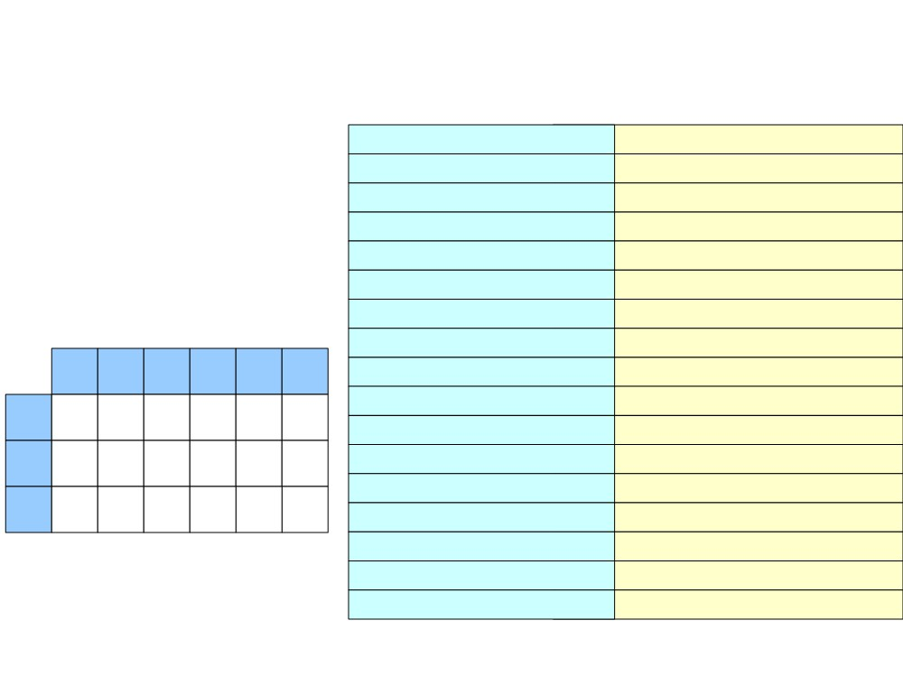
Predictive Top-Down Parsing
S
(int + (int * int))$
(int + (int * int))$
(int + (int * int))$
1. S → E$
E$
2. E → int
(E Op E)$
E Op E)$
int Op E)$
3. E → (E Op E)
int + (int * int))$
int + (int * int))$
4. Op → +
Op E)$
+ E)$
+ (int * int))$
+ (int * int))$
5. Op → *
E)$
(int * int))$
(int * int))$
int ( ) + * $
(E Op E))$
E Op E))$
int Op E))$
int * int))$
int * int))$
S 1 1
E 2 3
Op 4 5
Op E))$
* E))$
* int))$
* int))$
E))$
int))$
int))$
int))$
))$
))$
)$
)$

Slide 41
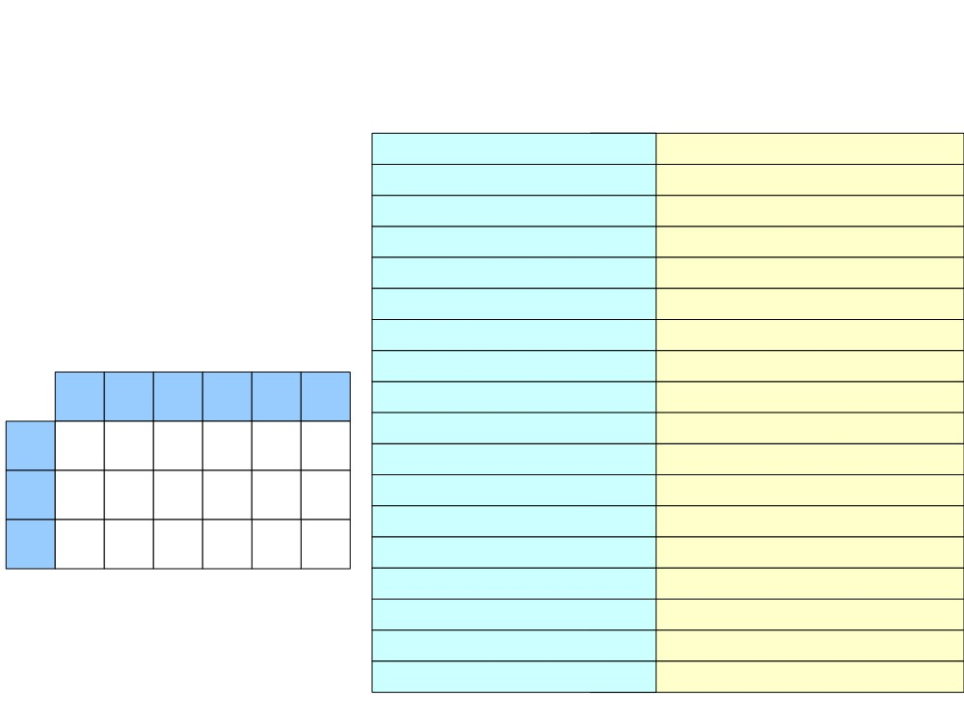
Predictive Top-Down Parsing
S
(int + (int * int))$
(int + (int * int))$
(int + (int * int))$
1. S → E$
E$
2. E → int
(E Op E)$
E Op E)$
int Op E)$
3. E → (E Op E)
int + (int * int))$
int + (int * int))$
4. Op → +
Op E)$
+ E)$
+ (int * int))$
+ (int * int))$
5. Op → *
E)$
(int * int))$
(int * int))$
int ( ) + * $
(E Op E))$
E Op E))$
int Op E))$
int * int))$
int * int))$
S 1 1
E 2 3
Op 4 5
Op E))$
* E))$
* int))$
* int))$
E))$
int))$
int))$
int))$
))$
))$
)$
Accepted !
)$
$
$

Slide 42
Error Detection
S
(int (int))$
1. S → E$
2. E → int
3. E → (E Op E)
4. Op → +
5. Op → *
int
(
)
+
*
$
S
1
1
E
2
3
Op
4
5

Slide 43
Error Detection
S
(int (int))$
1. S → E$
E$
(int (int))$
2. E → int
3. E → (E Op E)
4. Op → +
5. Op → *
int
(
)
+
*
$
S
1
1
E
2
3
Op
4
5

Slide 44
Error Detection
S
(int (int))$
1. S → E$
E$
(int (int))$
2. E → int
3. E → (E Op E)
4. Op → +
5. Op → *
int
(
)
+
*
$
S
1
1
E
2
3
Op
4
5

Slide 45
Error Detection
S
(int (int))$
1. S → E$
E$
(int (int))$
2. E → int
(E Op E)$
(int (int))$
3. E → (E Op E)
4. Op → +
5. Op → *
int
(
)
+
*
$
S
1
1
E
2
3
Op
4
5

Slide 46
Error Detection
S
(int (int))$
(int (int))$
(int (int))$
int (int))$
1. S → E$
E$
2. E → int
(E Op E)$
E Op E)$
3. E → (E Op E)
4. Op → +
5. Op → *
int ( ) + *
$
S
1
1
E
2
3
Op
4
5

Slide 47
Error Detection
S
(int (int))$
(int (int))$
(int (int))$
int (int))$
1. S → E$
E$
2. E → int
(E Op E)$
E Op E)$
3. E → (E Op E)
4. Op → +
5. Op → *
int ( ) + *
$
S
1
1
E
2
3
Op
4
5

Slide 48
Error Detection
S
(int (int))$
(int (int))$
(int (int))$
1. S → E$
E$
2. E → int
(E Op E)$
E Op E)$
int Op E)$
3. E → (E Op E)
int (int))$
int (int))$
4. Op → +
5. Op → *
int ( ) + *
$
S
1
1
E
2
3
Op
4
5

Slide 49
Error Detection
S
(int (int))$
(int (int))$
(int (int))$
1. S → E$
E$
2. E → int
(E Op E)$
E Op E)$
int Op E)$
3. E → (E Op E)
int (int))$
int (int))$
(int))$
4. Op → +
Op E)$
5. Op → *
int ( ) + *
$
S
1
1
E
2
3
Op
4
5

Slide 50
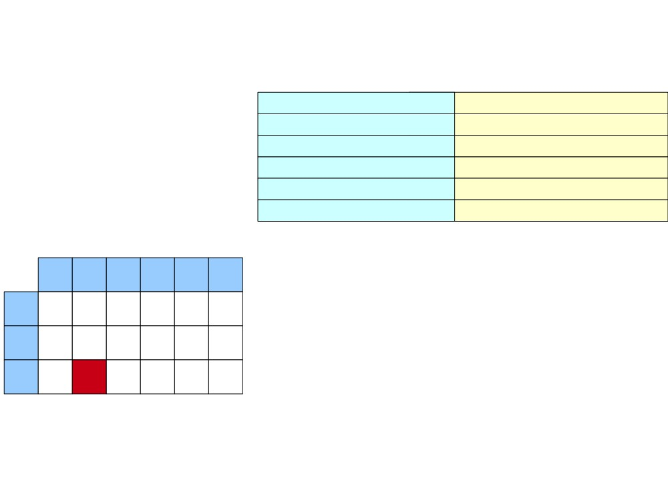
Error Detection
S
(int (int))$
(int (int))$
(int (int))$
1. S → E$
E$
2. E → int
(E Op E)$
E Op E)$
int Op E)$
3. E → (E Op E)
int (int))$
int (int))$
(int))$
4. Op → +
Op E)$
5. Op → *
Rejected !
int ( ) + *
$
S
1
1
E
2
3
Op
4
5

Slide 51
Self review
The LL(1) Algorithm
● Given an LL(1) parsing table T and input w:
● Initialize a stack containing S.
● Repeat until the stack is just $:
● Let the next character of w be c.
● If the top of the stack is a terminal t:
- If c and t don't match, report an error.
- Otherwise consume the character c and pop t from the stack.
● Otherwise, the top of the stack is a nonterminal A:
- If T[A, c] is undefined, report an error.
- Replace the top of the stack with T[A, c].

Slide 52
LL(1) Grammar
In order to use LL(1) algorithm, our CFG grammar must be LL(1).
We can determine which production to be used by looking at only the current token.
Example:
STMT → if EXPR then STMT
| while EXPR do STMT
| EXPR ;
EXPR → TERM → id
| zero? TERM
| not EXPR
|
++ id
|
-- id
TERM → id
| constant

Slide 53
Constructing LL(1) Parsing Table
Table T
 |  | Token c
Var. A |  | T[A, c]
● T[A, c] should be a production
A → A1 A2 … An
if A₁ ultimately derives something starting with c.
● The systematic way to filling in table entries is to use notions
of First sets and Follow sets.

Slide 54

FIRST Sets
● Definition: FIRST(A) = { t | A →* tw }
● The set of tokens that appear first in the
production of A.
● Set T[A, c] = A₁ A₂ … A_{n} if c FIRST(A₁)
and A → A₁A₂…A_{n}

Slide 55
Computing FIRST Sets
● Initially, for each production A → tw ,
FIRST(A) = { t | A → tw } // t is a terminal symbol
● Then, for each A → Bw, iteratively compute
FIRST(A) = FIRST(A) ∪ FIRST(B)
● When no changes occur, the resulting sets are
the FIRST sets.
S
A
tw
First(A)

Slide 56

Iterative FIRST Computations
STMT → if EXPR then STMT
| while EXPR do STMT
STMT EXPR TERM
| EXPR ;
EXPR → TERM → id
| zero? TERM
| not EXPR
| ++ id
| -- id
TERM → id
| constant

Slide 57
Iterative FIRST Computations
STMT → if EXPR then STMT
| while EXPR do STMT
STMT EXPR
TERM
| EXPR ;
if zero?
id
constant
while not
EXPR → TERM → id
| zero? TERM
++
--
| not EXPR
| ++ id
| -- id
TERM → id
| constant

Slide 58
Iterative FIRST Computations
STMT → if EXPR then STMT
| while EXPR do STMT
STMT EXPR
TERM
| EXPR ;
if zero?
id
constant
while not
EXPR → TERM → id
| zero? TERM
zero? ++
not --
| not EXPR
| ++ id
++
| -- id
--
TERM → id
| constant

Slide 59
Iterative FIRST Computations
STMT → if EXPR then STMT
| while EXPR do STMT
STMT EXPR
TERM
| EXPR ;
if zero?
id
constant
while not
EXPR → TERM → id
| zero? TERM
zero? ++
not --
| not EXPR
| ++ id
++ id
| -- id
-- constant
TERM → id
| constant
EXPR has been changed.
Recompute First(STMT) again.

Slide 60
Iterative FIRST Computations
STMT → if EXPR then STMT
STMT
EXPR
TERM
| while EXPR do STMT
| EXPR ;
if
zero?
not
id
constant
while
zero?
EXPR → TERM → id
++
| zero? TERM
not
++
--
id
| not EXPR
| ++ id
| -- id
--
id
constant
TERM → id
constant
| constant
Done !

Slide 61
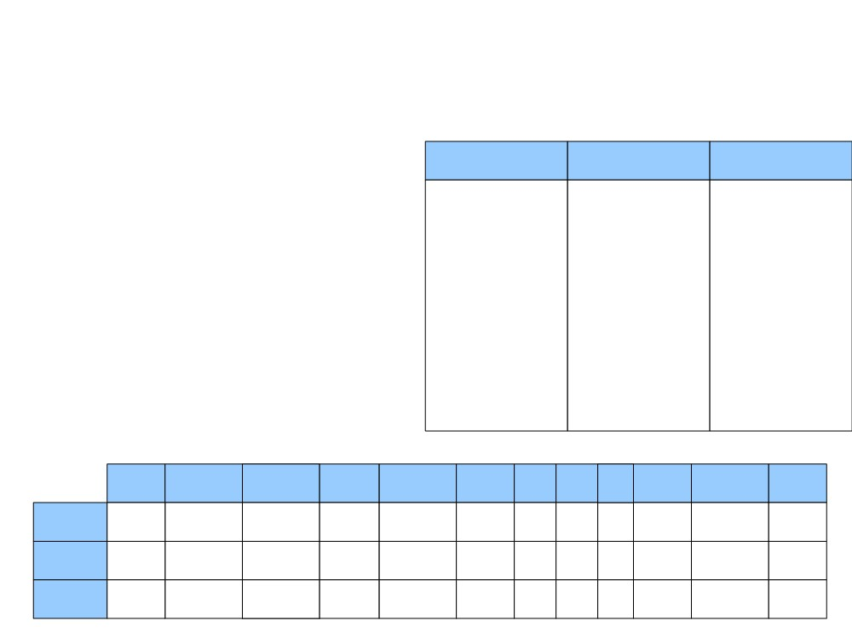
From FIRST Sets to LL(1) Tables
STMT → if EXPR then STMT (1)
| while EXPR do STMT (2)
STMT
EXPR
TERM
| EXPR ; (3)
id
constant
if
zero?
not
EXPR → TERM → id (4)
while
zero?
| zero? TERM (5)
++
| not EXPR (6)
not
++
--
id
| ++ id (7)
| -- id (8)
--
id
constant
TERM → id (9)
| constant (10)
constant
if
then
while
do
zero?
not
++
--
→
id
const
;
STMT
EXPR
TERM

Slide 62
From FIRST Sets to LL(1) Tables
STMT → if EXPR then STMT (1)
| while EXPR do STMT (2)
STMT
EXPR
TERM
| EXPR ; (3)
id
constant
if
zero?
not
EXPR → TERM → id (4)
while
zero?
| zero? TERM (5)
++
| not EXPR (6)
not
++
--
id
| ++ id (7)
| -- id (8)
--
id
constant
TERM → id (9)
| constant (10)
constant
if
then
while
do
zero?
not
++
--
→
id
const
;
STMT
1
2
3
3
3
3
3
3
EXPR
TERM

Slide 63
From FIRST Sets to LL(1) Tables
STMT → if EXPR then STMT (1)
| while EXPR do STMT (2)
STMT
EXPR
TERM
| EXPR ; (3)
id
constant
if
zero?
not
EXPR → TERM → id (4)
while
zero?
| zero? TERM (5)
++
| not EXPR (6)
not
++
--
id
| ++ id (7)
| -- id (8)
--
id
constant
TERM → id (9)
| constant (10)
constant
if
then
while
do
zero?
not
++
--
→
id
const
;
STMT
1
2
3
3
3
3
3
3
EXPR
5
6
7
8
4
4
TERM

Slide 64
From FIRST Sets to LL(1) Tables
STMT → if EXPR then STMT (1)
| while EXPR do STMT (2)
STMT
EXPR
TERM
| EXPR ; (3)
id
constant
if
zero?
not
EXPR → TERM → id (4)
while
zero?
| zero? TERM (5)
++
| not EXPR (6)
not
++
--
id
| ++ id (7)
| -- id (8)
--
id
constant
TERM → id (9)
| constant (10)
constant
if
then
while
do
zero?
not
++
--
→
id
const
;
STMT
1
2
3
3
3
3
3
3
EXPR
5
6
7
8
4
4
TERM
9
10

Slide 65

FIRST Sets with ε
Number → Sign Digits
Thing gets complicated if
we allow ε-production in
our grammar.
Digits
→ Digit | Digit Digits
Digit
→ 0 | 1 | 2 | … | 9
Sign
→ + | - | ε
Number
Digits
Digit
Sign
0
+
1
-
2
ε
3
4
5
6
7
8
9

Slide 66

FIRST Sets with ε
Number → Sign Digits
Digits
→ Digit | Digit Digits
Digit
→ 0 | 1 | 2 | … | 9
Sign
→ + | - | ε
Number
Digits
Digit
Sign
0
0
+
1
1
-
ε
2
2
3
3
4
4
5
5
6
6
7
7
8
8
9
9

Slide 67
FIRST Sets with ε
Number → Sign Digits
Digits
→ Digit | Digit Digits
Digit
→ 0 | 1 | 2 | … | 9
Sign
→ + | - | ε
Number
Digits
Digit
Sign
+
0
0
+
-
1
1
-
ε
2
2
3
3
4
4
5
5
6
6
7
7
8
8
9
9

Slide 68
FIRST Sets with ε
Number → Sign Digits
Since Sign can be empty,
First(Digits) must be also
included in First(Number).
Digits
→ Digit | Digit Digits
Digit
→ 0 | 1 | 2 | … | 9
Sign
→ + | - | ε
Number
Digits
Digit
Sign
+
0
0
+
-
1
1
-
ε
0
2
2
1
3
3
2
4
4
3
5
5
4
6
6
5
7
7
6
8
8
7
9
9
8
9

Slide 69
Updated FIRST Set Computation
● If A →A
A … A and A
cannot produce ε,
1
2
n
1
FIRST(A) contains FIRST(A
)
1
● If A →A
A … A and A
can produce ε,
1 2 n 1
FIRST(A) contains both FIRST(A
) and FIRST(A )
1 2
● If A →A
A … A and all A
can produce ε,
1
2
n
i
FIRST(A) contains all FIRST(A ) and ε.
i

Slide 70
FOLLOW Sets
● Can be computed iteratively:
● Initially, set FOLLOW(B) = FIRST(w) - {ε} for all
rules C → vBw. // we don’t consider ε in follow sets
● FOLLOW(B) = FOLLOW(B) ∪ FOLLOW(C)
if w can derive ε.
C
vBw
Follow(B)
Follow(C)

Slide 71
Example1
First sets
E → TE’
E’ → ε | +E
T → FT’
T’ → ε | *T
F → id | ( E )
E | E’ | T | T’ | F
id | ε | id | ε | id
( | + | ( | * | (
For all rule C → vBw
FOLLOW(B) = FIRST(w) - {ε}
FOLLOW(B) = FOLLOW(B) ∪ FOLLOW(C)
if w can derive ε.

Slide 72
Example1
First sets
E → TE’
E’ → ε | +E
T → FT’
T’ → ε | *T
F → id | ( E )
E | E’ | T | T’ | F
id | ε | id | ε | id
( | + | ( | * | (
Follow sets
E | E’ | T | T’ | F
$ | Follow(E) | + | Follow(T) | *
) |  | Follow(E) |  | Follow(T)
Follow(E’) |  | Follow(T’)
Start symbol E automatically contains $ in its follow set.
Consider non-terminals on the Right-hand Side of the production

Slide 73
Example1
First sets
E → TE’
E’ → ε | +E
T → FT’
T’ → ε | *T
F → id | ( E )
E | E’ | T | T’ | F
id | ε | id | ε | id
( | + | ( | * | (
Follow sets
E | E’ | T | T’ | F
$ | Follow(E) | + | Follow(T) | *
) |  | Follow(E) |  | Follow(T)
Follow(E’) |  | Follow(T’)
We need to break two infinite cycles.

Slide 74
Example1
First sets
E → TE’
E’ → ε | +E
T → FT’
T’ → ε | *T
F → id | ( E )
E | E’ | T | T’ | F
id | ε | id | ε | id
( | + | ( | * | (
Follow sets
E | E’ | T | T’ | F
$ | $ | + | + | *
) | ) | Follow(E) | Follow(E) | Follow(T)

Slide 75
Example1
First sets
E → TE’
E’ → ε | +E
T → FT’
T’ → ε | *T
F → id | ( E )
E | E’ | T | T’ | F
id | ε | id | ε | id
( | + | ( | * | (
Follow sets
E | E’ | T | T’ | F
$ | $ | + | + | *
) | ) | $ | $ | +
 |  | ) | ) | $
 |  |  |  | )

Slide 76
Example2
First sets
statement → if expr then statement else statement
| if expr then statement
| id = expr
| id ( expr )
expr → id | expr + id
statement | expr
if | id
id
Follow sets
statement | expr

Slide 77
Example2
First sets
statement → if expr then statement else statement
| if expr then statement
| id = expr
| id ( expr )
expr → id | expr + id
statement | expr
if | id
id
Follow sets
statement | expr
$
else
Follow(statement)

Slide 78
Example2
First sets
statement → if expr then statement else statement
| if expr then statement
| id = expr
| id ( expr )
expr → id | expr + id
statement | expr
if | id
id
Follow sets
statement | expr
$
else
Follow(statement)

Slide 79
Example2
First sets
statement → if expr then statement else statement
| if expr then statement
| id = expr
| id ( expr )
expr → id | expr + id
statement | expr
if | id
id
Follow sets
statement | expr
$ | then
else | Follow(statement)
 | )
 | +

Slide 80
Example2
First sets
statement → if expr then statement else statement
| if expr then statement
| id = expr
| id ( expr )
expr → id | expr + id
statement | expr
if | id
id
Follow sets
statement | expr
$ | then
else | $
 | else
 | )
 | +

Slide 81
Example3
statement → if-stmt | other
if-stmt → if ( exp ) statement else-part
else-part → else statement | ε
exp → 0 | 1
First sets
statement | if-stmt | else-part | exp
if | if | else | 0
other |  | ε | 1
Follow sets
statement | if-stmt | else-part | exp

Slide 82
Example3
statement → if-stmt | other
if-stmt → if ( exp ) statement else-part
else-part → else statement | ε
exp → 0 | 1
First sets
statement | if-stmt | else-part | exp
if | if | else | 0
other |  | ε | 1
Follow sets
statement | if-stmt | else-part | exp
$ | Follow(statement) | Follow(if-stmt) | )
First(else-part)
Follow(if-stmt)
Follow(else-part)

Slide 83
Example3
statement → if-stmt | other
if-stmt → if ( exp ) statement else-part
else-part → else statement | ε
exp → 0 | 1
First sets
statement | if-stmt | else-part | exp
if | if | else | 0
other |  | ε | 1
Follow sets
statement | if-stmt | else-part | exp
$ | Follow(statement) | Follow(if-stmt) | )
else
Follow(if-stmt)
Follow(else-part)

Slide 84
Example3
statement → if-stmt | other
if-stmt → if ( exp ) statement else-part
else-part → else statement | ε
exp → 0 | 1
First sets
statement | if-stmt | else-part | exp
if | if | else | 0
other |  | ε | 1
Follow sets
statement | if-stmt | else-part | exp
$ | Follow(statement) | Follow(if-stmt) | )
else
Follow(if-stmt)
Follow(else-part)

Slide 85
Example3
statement → if-stmt | other
if-stmt → if ( exp ) statement else-part
else-part → else statement | ε
exp → 0 | 1
First sets
statement | if-stmt | else-part | exp
if | if | else | 0
other |  | ε | 1
Follow sets
statement | if-stmt | else-part | exp
$ | Follow(statement) | Follow(if-stmt) | )
else
Follow(if-stmt)
Follow(else-part)

Slide 86
Example3
statement → if-stmt | other
if-stmt → if ( exp ) statement else-part
else-part → else statement | ε
exp → 0 | 1
First sets
statement | if-stmt | else-part | exp
if | if | else | 0
other |  | ε | 1
Follow sets
statement | if-stmt | else-part | exp
$ | Follow(statement) | Follow(if-stmt) | )
else
Follow(if-stmt)
Follow(else-part)

Slide 87
Example3
statement → if-stmt | other
if-stmt → if ( exp ) statement else-part
else-part → else statement | ε
exp → 0 | 1
First sets
statement | if-stmt | else-part | exp
if | if | else | 0
other |  | ε | 1
Follow sets
statement | if-stmt | else-part | exp
$ | $ | $ | )
else | else | else

Slide 88
Next Time
● A More Elaborate Example
● Bottom-Up Parsing
● Shift/reduce parsing
● LR(0)
● LR(1)

