Slide 1
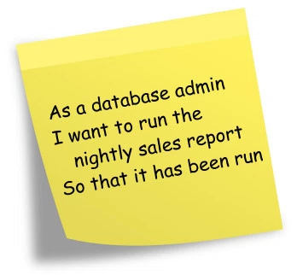
15 man-day

Slide 2
Example: Setting Priority
Use Case | Man-Day | Stakeholders |  |  | Score
Story A
Story B
Story C
Story D
Story E
login

Slide 3
Example: Setting Priority
Use Case | Man-Day | Stakeholders |  |  | Score
Story A | 5
Story B | 10
Story C | 15
Story D | 10
Story E | 5
login

Slide 4
Example: Setting Priority
Use Case | Man-Day | Stakeholders |  |  | Score
 |  | Lisa
Story A | 5 | Critical (9)
Story B | 10 | Important (3)
Story C | 15 | Important (3)
Story D | 10 | Useful (1)
Story E | 5 | Useful (1)
login

Slide 5
Example: Setting Priority
Use Case | Man-Day | Stakeholders |  |  | Score
 |  | Lisa | Tom
Story A | 5 | Critical (9) | Important (3)
Story B | 10 | Important (3) | Useful (1)
Story C | 15 | Important (3) | Critical (9)
Story D | 10 | Useful (1) | Important (3)
Story E | 5 | Useful (1) | Critical (9)
login

Slide 6
Example: Setting Priority
Use Case | Man-Day | Stakeholders |  |  | Score
 |  | Lisa | Tom | Kim
Story A | 5 | Critical (9) | Important (3) | Important (3)
Story B | 10 | Important (3) | Useful (1) | Useful (1)
Story C | 15 | Important (3) | Critical (9) | Critical (9)
Story D | 10 | Useful (1) | Important (3) | Critical (9)
Story E | 5 | Useful (1) | Critical (9) | Useful (1)
login

Slide 7
Example: Setting Priority
Use Case | Man-Day | Stakeholders |  |  | Score
 |  | Lisa | Tom | Kim
Story A | 5 | Critical (9) | Important (3) | Important (3) | 15
Story B | 10 | Important (3) | Useful (1) | Useful (1) | 5
Story C | 15 | Important (3) | Critical (9) | Critical (9) | 21
Story D | 10 | Useful (1) | Important (3) | Critical (9) | 13
Story E | 5 | Useful (1) | Critical (9) | Useful (1) | 11
login

Slide 8
Example: Setting Priority
Use Case | Man-Day | Stakeholders |  |  | Score
 |  | Lisa | Tom | Kim
Story C | 15 | Important (3) | Critical (9) | Critical (9) | 21
Story A | 5 | Critical (9) | Important (3) | Important (3) | 15
Story D | 10 | Useful (1) | Important (3) | Critical (9) | 13
Story E | 5 | Useful (1) | Critical (9) | Useful (1) | 11
Story B | 10 | Important (3) | Useful (1) | Useful (1) | 5
login

