Slide 1

MUSICAL NOTES IDENTIFICATION APPLICATION USING SIGNAL PROCESSING
MUSICAL NOTES IDENTIFICATION APPLICATION USING SIGNAL PROCESSING
Presented by
Sujithra S 23BEC1035
Thershna TK 23BEC1197
T Lasya 23BEC1233
Bojja Divya 23BEC1329

Slide 2

OBJECTIVES AND GOALS
The objective is to design a MATLAB-based musical note recognition software that identifies notes by analyzing input frequency. It should capture real-time or pre-recorded audio, apply noise reduction, and normalize the signal. Using Fast Fourier Transform (FFT), the software will convert the audio signal into its frequency components and detect the dominant frequency. This frequency is then mapped to the corresponding musical note.

Slide 3

ABSTRACT
Music is an integral part of everyone’s lives. Music helps in relaxation, therapy and entertainment. The audio industry is booming with online platforms for music streaming. This program helps identify the musical notes in a piece of audio and gives valuable information about its pitch, frequency and type. The music piece fed to the system can be decoded to identify which note the signal corresponds to.

Slide 4
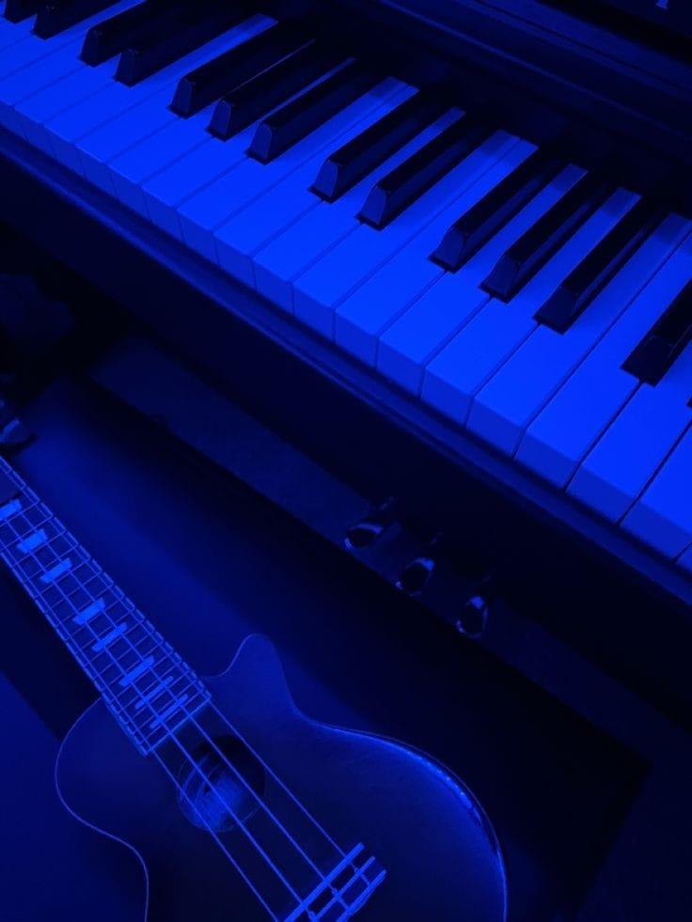
DESIGN CONCEPT
The audio signal is processed using MATLAB's Fast Fourier Transform (FFT) to convert it from the time domain to the frequency domain, allowing the identification of each note's fundamental frequency.
The fundamental frequency is matched with a predefined table of musical note frequencies. The system compares the detected frequency to identify the corresponding musical note.

Slide 5

FAST FOURIER TRANSFORM
The Fast Fourier Transform (FFT) is an efficient algorithm used to compute the Discrete Fourier Transform (DFT) and its inverse. It reduces the complexity of calculating the DFT from to , making it much faster for large datasets. In signal processing, FFT converts a time-domain signal into its frequency-domain representation, allowing the identification of the signal's frequency components. This is essential in applications like audio analysis, where the dominant frequencies (such as musical notes) need to be extracted from complex waveforms.

Slide 6
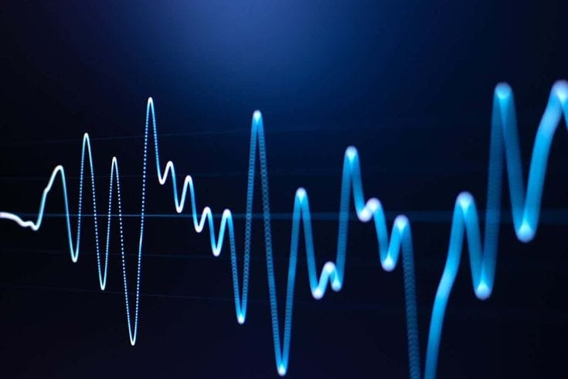
SOFTWARE ANALYSIS
The process begins by recording a sequence of musical notes whose frequencies are to be found. The signal is then analyzed in MATLAB and plotted in the time domain. Next, a windowing technique is applied to identify the start and end points of each note by detecting drops in energy between notes. After determining the windows, each note is converted to the frequency domain using FFT. The fundamental frequency is then extracted by identifying the maximum frequency for each note. Finally, the program matches the frequency to a musical note by comparing it with reference pitch values.

Slide 7
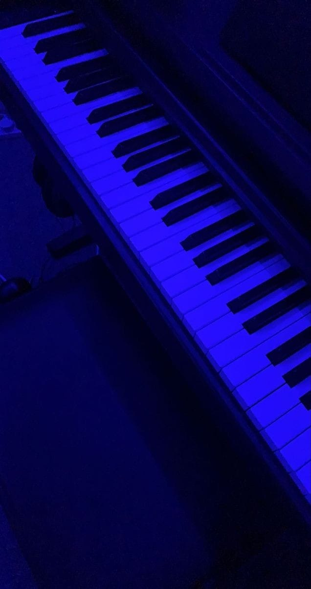
MIDDLE C OCTAVE
Middle C (C4) is the central C note on a standard piano keyboard, used as a reference point in music.
Frequency: Middle C has a frequency of approximately 261.63 Hz.
Octave Context:
C3: One octave below Middle C (130.81 Hz)
C4: Middle C
C5: One octave above Middle C (523.25 Hz)
Importance in Note Recognition : Serves as a baseline for determining pitch and octave in musical note recognition systems.

Slide 8
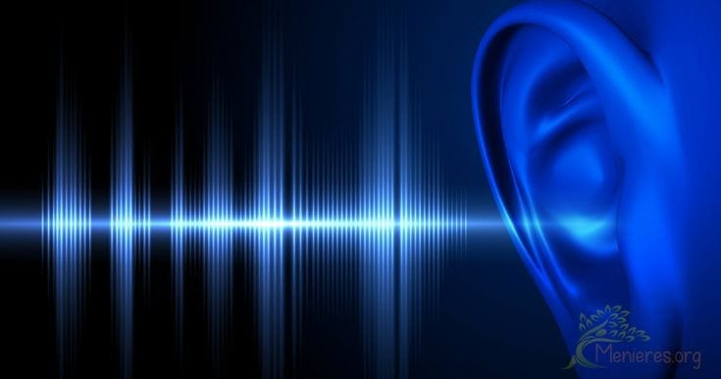
PITCH DETERMINATION
Below Middle C Octave:
Multiply frequency by 2 and repeat.
Above Middle C Octave:
Divide frequency by 2 and repeat.
Middle C Octave:
Identify pitch based on frequency ranges and return octave relative to Middle C.

Slide 9

CONCLUSION
In our project, we designed and implemented an effective and user-friendly frequency estimation system with Fourier Analysis .The target users of the system are not only the people practicing music, but also professional musicians who cannot waste their time figuring out the notes of an audio sample.

Slide 10
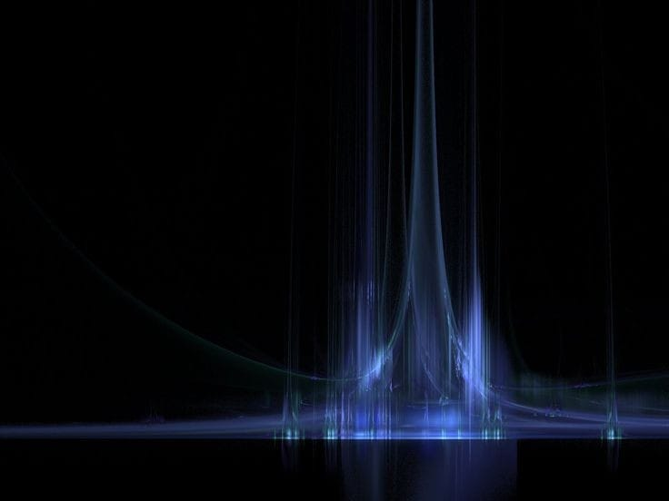
FUTURE SCOPE
There is still much room for future development that would enhance the system and increase its usage value. The following items are some suggestions:
Advanced Note Detection: Improve note detection by focusing on frequency changes rather than intensity variations. Address challenges in tracking gradual frequency changes.
Non-Periodic Signal Analysis: Enhance analysis for real-life, time-varying signals. Develop algorithms to improve frequency estimation beyond traditional Fourier Analysis.
Multiple Notes Detection : Adapt system to handle multiple simultaneous notes. Use advanced Fourier Analysis techniques to isolate and analyze individual notes.

Slide 11

REFERENCES
www.google.com
www.wikipedia.com
https://www.clear.rice.edu
https://in.mathworks.com/matlabcentral/fileexchange

Slide 12
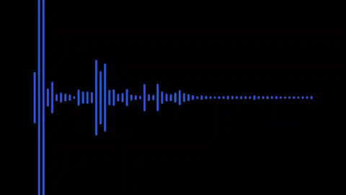
THANK YOU

