Slide 1
Steam Game Data Search Engine: Data Preparation
Bruno Mendes - up201906166@edu.fe.up.pt
Fernando Rego - up201905951@edu.fe.up.pt
Joel Fernandes - up201904977@edu.fe.up.pt
PRI 2022/2023 T1G8

Slide 2



Data Sourcing

Slide 3
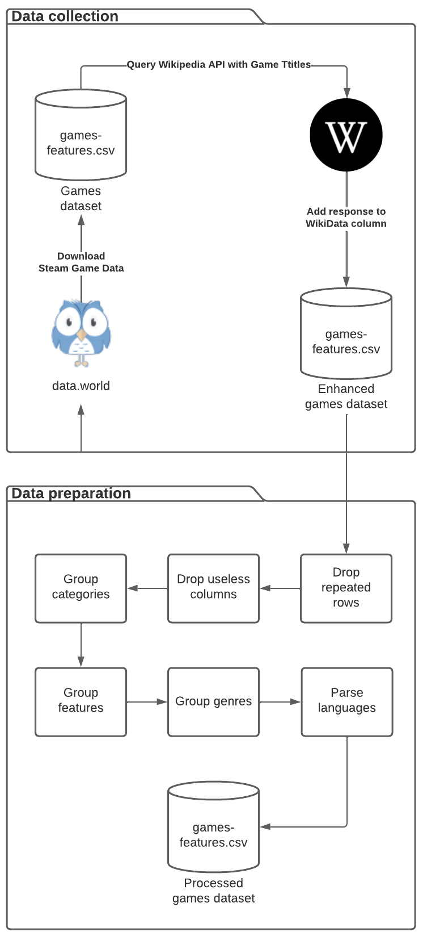
Data Processing Pipeline

Slide 4
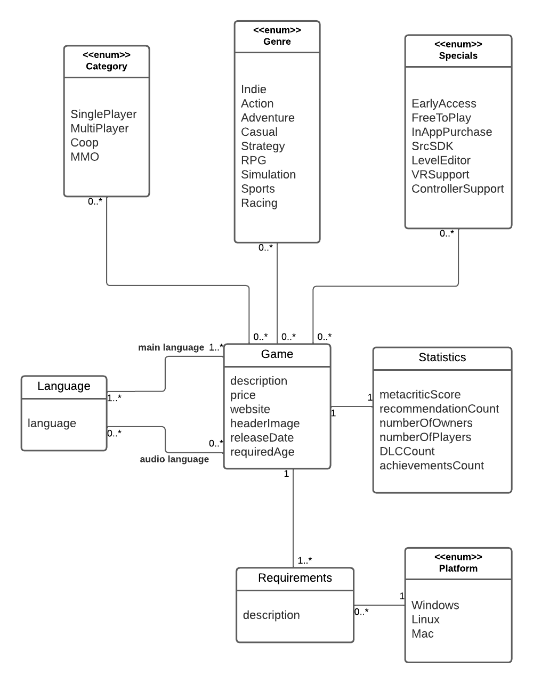
Data Conceptual Model

Slide 5
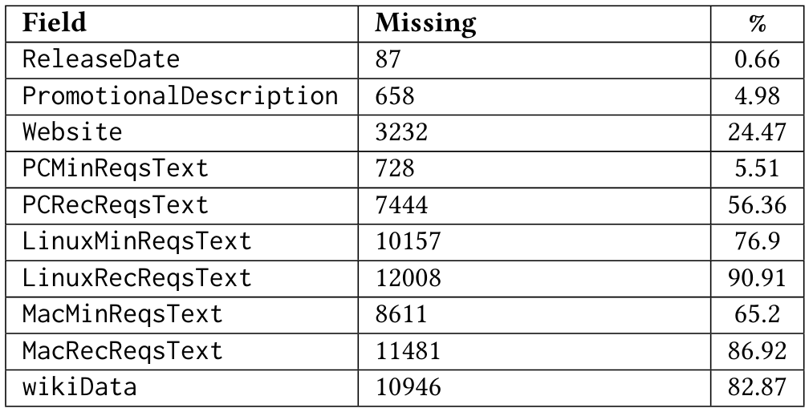
Data Characterization Missing values

Slide 6
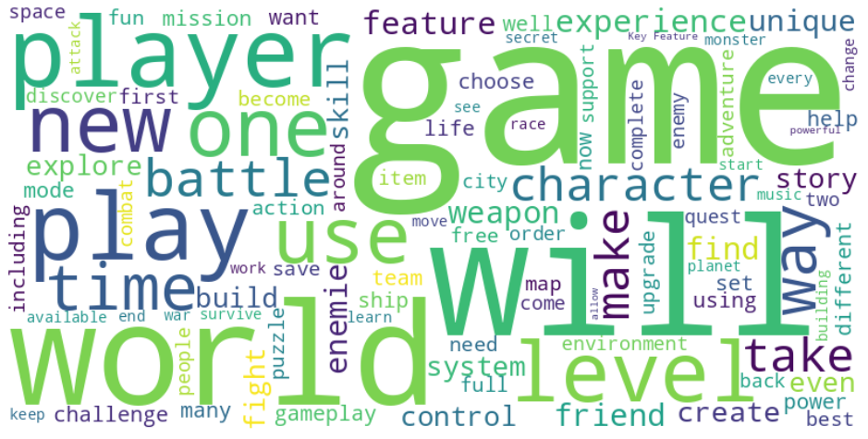
Data Characterization Word cloud for Steam’s promotional description

Slide 7
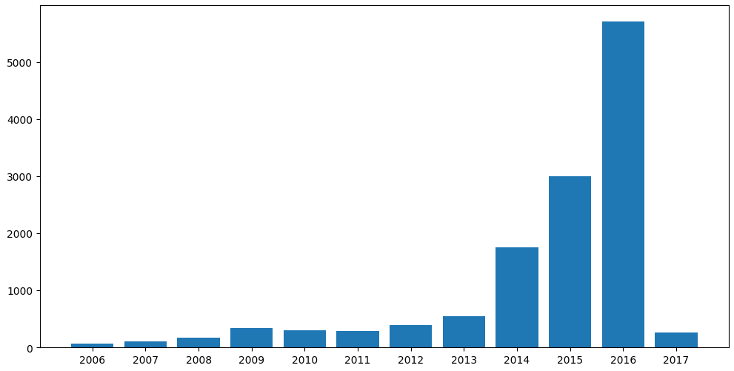
Data Characterization Number of games released per year

Slide 8
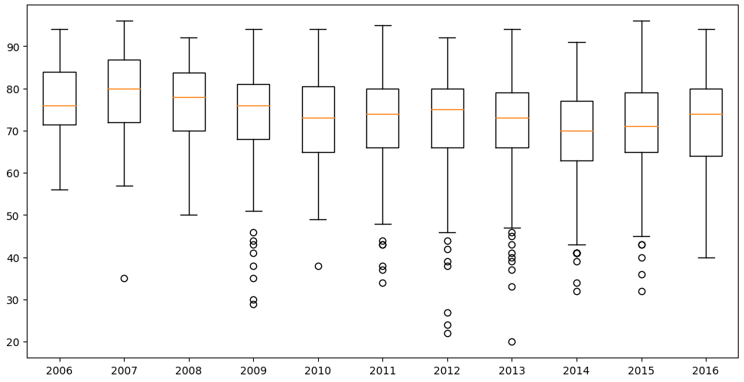
Data Characterization Metacritic games scores over the years

Slide 9
Information Needs
Which are the games with most players?
Which are the action games?
Which games are Linux compatible?
Which games released in 2015 have more than 10000 players?
Which games are free and support a controller?

