Slide 1

World University of Bangladesh
Department of Computer Science and Engineering
Project Name:
POS System with Low-Stock Notifications

Slide 2
A project report submitted to the department of Computer Science and Engineering of the World University of Bangladesh in partial fulfillment of the requirement for award of the degree of Bachelor of Science in Computer Science & Engineering
Submitted by:
Supervised by:
Mithun Kumar PK
Sr. Lecturer
Dept. of Computer Science and Engineering
Md. Al Imran Akash | Moshiur Rahman | MD Arif Babu
ID: 2381 | ID: 2382 | ID: 2413

Slide 3
Introduction
A computerized POS System helps retail and other businesses keep their stock levels updated as new stocks arrive, hence making it easier to identify and manage which items are selling and which items are not.

Slide 4
Objectives of the Study
To identify and lay out the existing sales process.
To detect problems that occur in the existing sales system
To describe the features and functions of the system
To test the acceptability, usability, and performance of the system

Slide 5
Justification of the Study
This research can be used as reference for future developers in the field of sales and inventory software development.
This Sales system can be an effective tool for,
Brick and Mortar Retailers
Managers
Cashiers
Customers
Suppliers
Developers

Slide 6
Scope of the Study
The study will focus on the development of a Sales and Inventory System as part of the academic curriculum and its functionality with regards to the following features,
Product Entry with Category, Quantity and Supplier Information
Management of Customers (Credit, Paid, Credit/Debit Wise)
Management of Stocks and Units Based on Categories and Suppliers
Management of Purchases and Invoice
Payment Methods
Daily, Weekly, Monthly and Annual Report of Sales

Slide 7
Computation of Customer Bills and Discounts
Generation of Receipts
Low-Stock Notifications
Auto-Order Suggestions
Not Included
Transactions Through Credit Cards and Checks
Advertisements, Special Offers, and Installments
Reservations

Slide 8
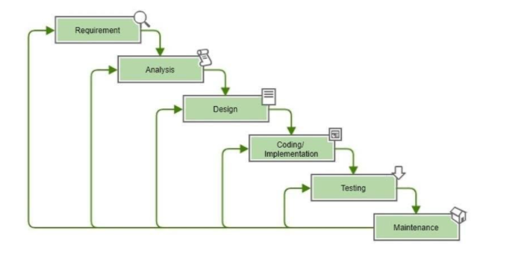
Diagrammatic Presentation of the Methodology
The Waterfall Model has been followed for the purpose of development.

Slide 9
Justification of the Methodology
Well-Defined and Fully Documented Requirements
Free of Ambiguity in All Phases
Employment of Stable Technologies
Ample Development Resources
Availability of the Required Expertise

Slide 10
Steps Required by the Model (Methodology)
Project Requirement Compilation and Analysis
Design (Data Flow, Entity Relationship, Use Case, Activity Diagrams)
Implementation of Technologies (HTML5, CSS,Bootstrap, Php,OOP(php), Laravel, MySQL)
Integration and Testing (Functionality, Usability, Compatibility)
Deployment of the System
Bug Fixing, Stability Improvement, and Maintenance

Slide 11
Conclusion
This automated sales and inventory system is designed to help retailers have a better understanding of their customers’ demands through the analysis of their sales and inventory as well as get complete control over the business.

