Slide 1
Lecture 21: VSEPR Model
California State University, Fullerton
2023 Fall Semester – Chem 123

Slide 2
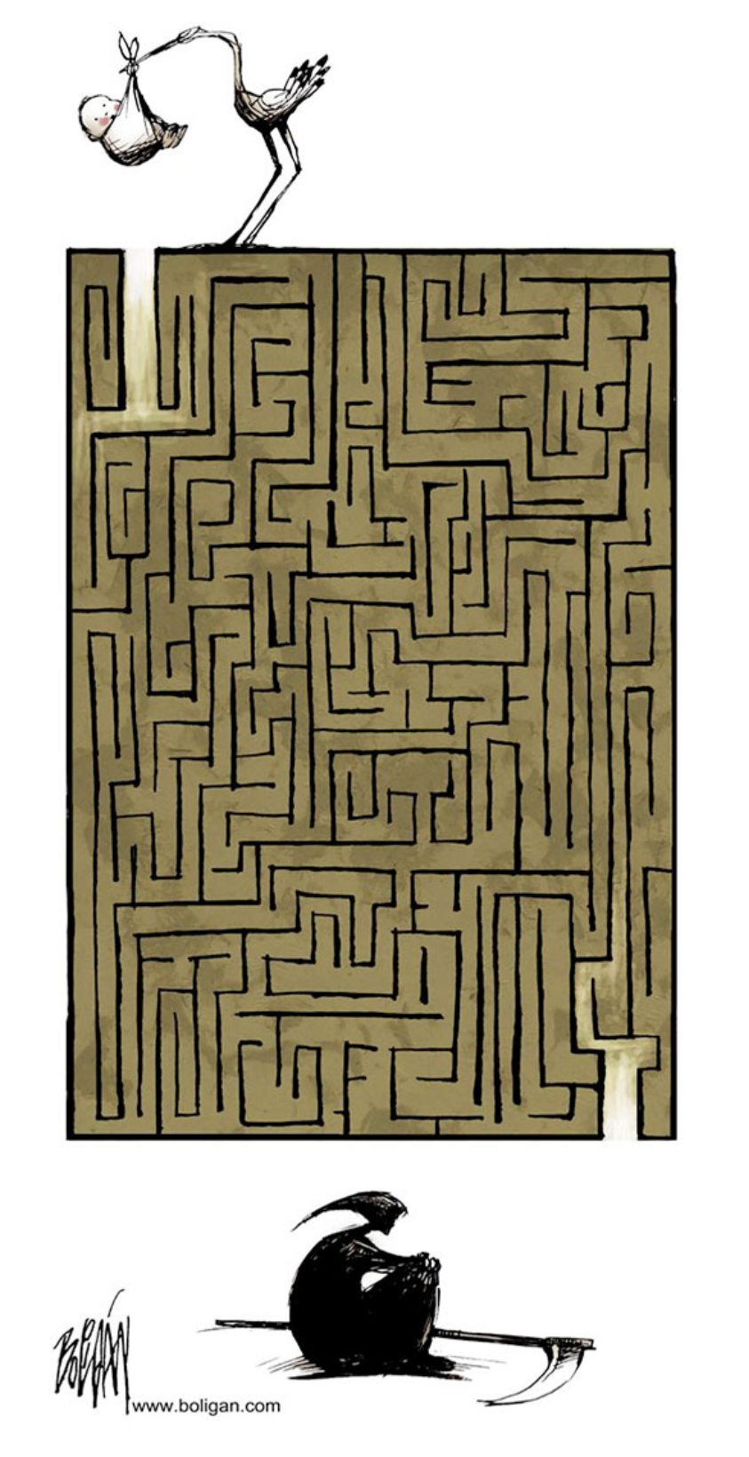
QUESTIONS, COMMENTS, AND CONCERNS?

Slide 3
Outline
Announcements
Highlights prior lecture – Ch. 10
Ch. 11: Molecular Shape and Bonding Theories
VSEPR and Molecular Geometry
Polar and Nonpolar Molecules

Slide 4
announcements
Study Material Available on Achieve – lectures, odd+even numbered solutions
Chs 10+11 in-class worksheet Mon, Nov 13th
Exam 3 coming up Weds, Nov 15th covering Chs 8-10, and part of 11
Final Exam on Dec 11th at 5:00pm – 6:50pm in MH 121

Slide 5
Outline
Announcements
Highlights prior lecture – Ch. 10
Ch. 11: Molecular Shape and Bonding Theories
VSEPR and Molecular Geometry
Polar and Nonpolar Molecules

Slide 6
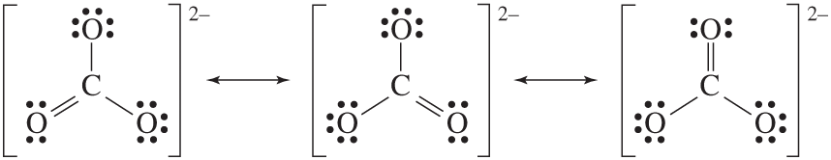
Resonance structures
Valid Lewis structures satisfying the criteria
Resonance structures – the movement of electrons
Example: CO₃²⁻

Slide 7
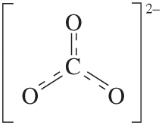
Delocalization of charge (electrons)
Superposition of all three valid CO₃²⁻ structures
Resonance hybrid structure:
Each oxygen carries –2/3 charge

Slide 8
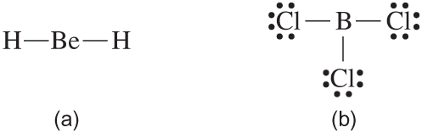

Exceptions to the octet rule
Octet rule is an observation looking at the reactivity of compounds (prefer lowest energy state – ground state energy)
Hydrogen only require two electrons to be stable
Beryllium and Boron do not require satisfying the octet rule
Radicals – Uneven number of total valence electrons

Slide 9
Outline
Announcements
Highlights prior lecture – Ch. 10
Ch. 11: Molecular Shape and Bonding Theories
VSEPR and Molecular Geometry
Polar and Nonpolar Molecules

Slide 10
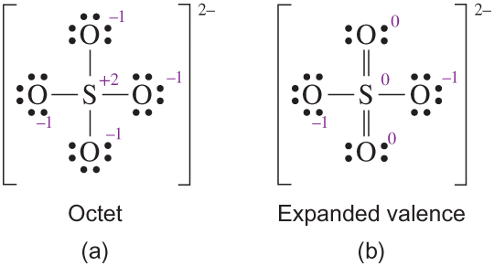
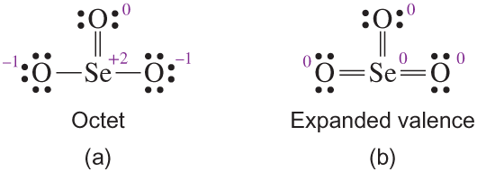
Lewis structure – expanded valence shell
Exception to Octet Rule
Atoms that have ability to form extra bonds more than the octet
Availability of empty d-orbitals

Slide 11
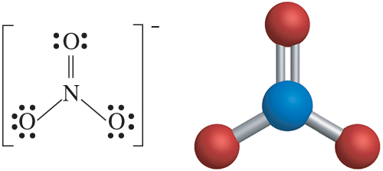
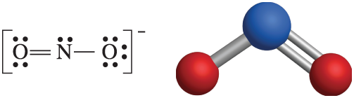
Vsepr and Molecular geometry
VSEPR Model – describes that lone pair electrons occupies (delocalized) large space compared to bonds (localized)

Slide 12
Electronic arrangement and Molecular geometry
Electronic arrangement – includes the lone pair electrons around the central atom to describe the shape
Molecular geometry – actual shape of the compound occupied by the atoms
Electron arrangement: trigonal planar
Molecular geometry: trigonal planar
Electron arrangement: trigonal planar
Molecular geometry: bent

Slide 13
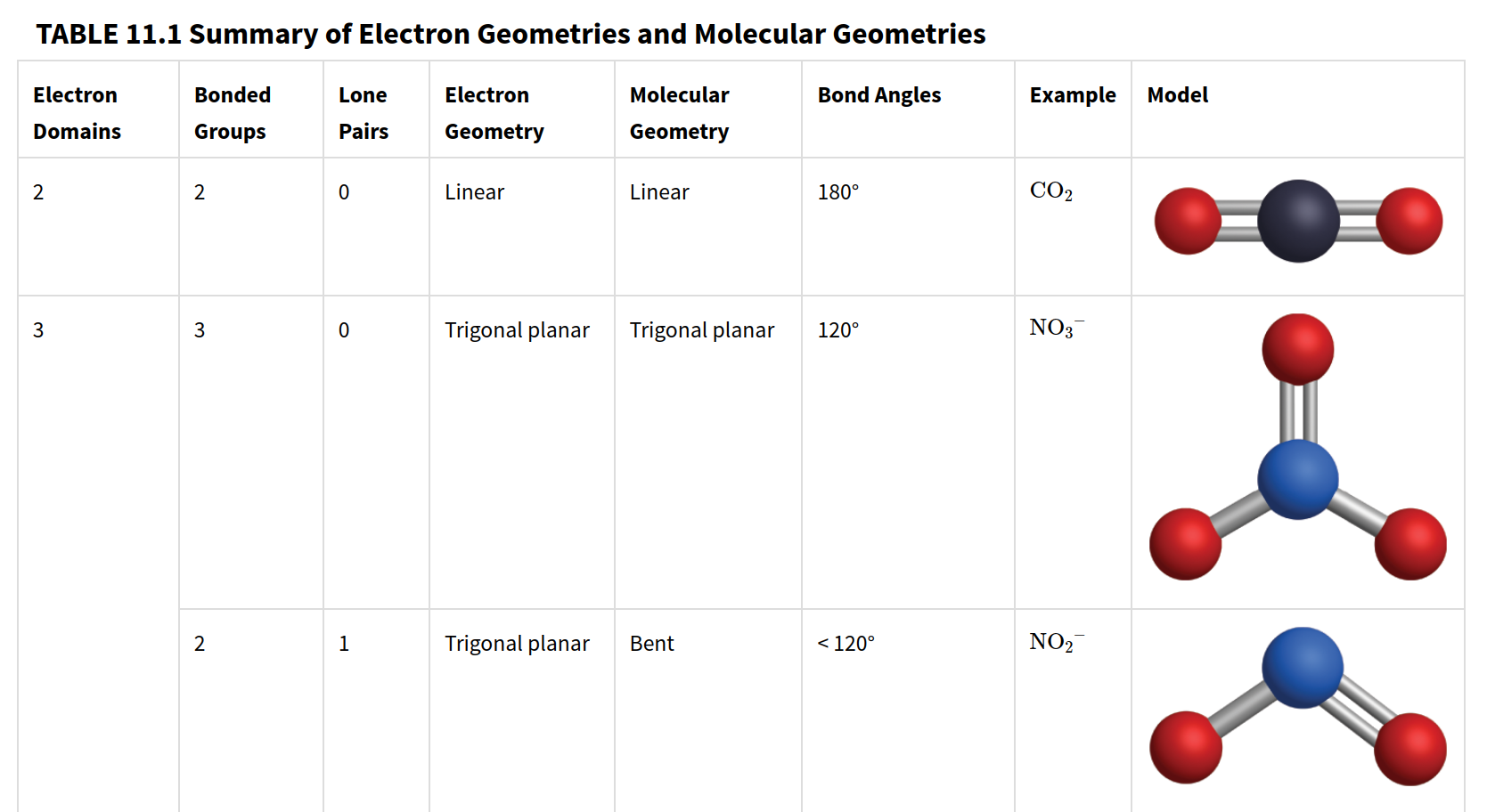
Vsepr and Molecular geometry

Slide 14
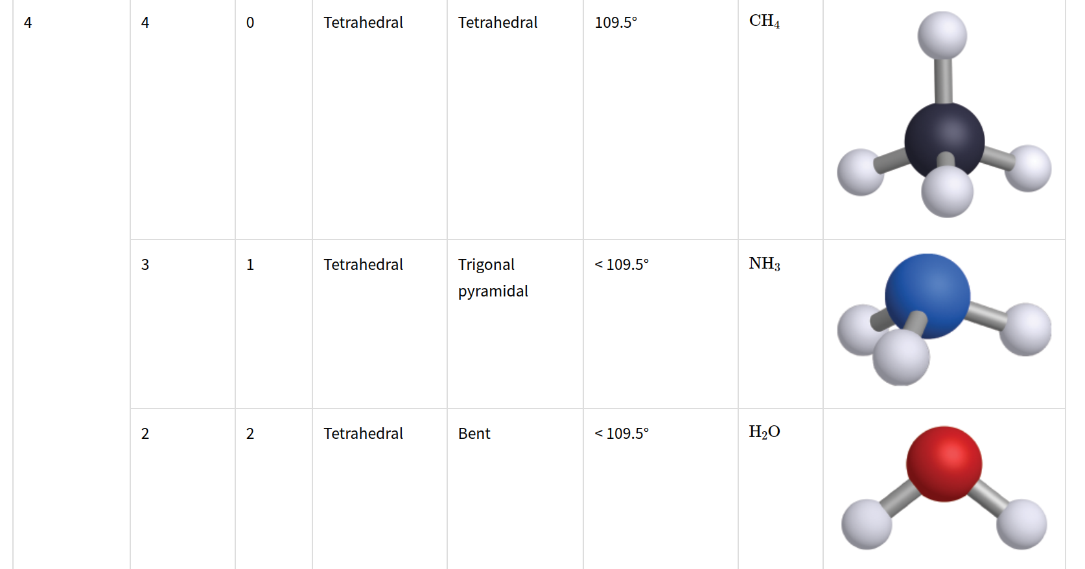

Slide 15
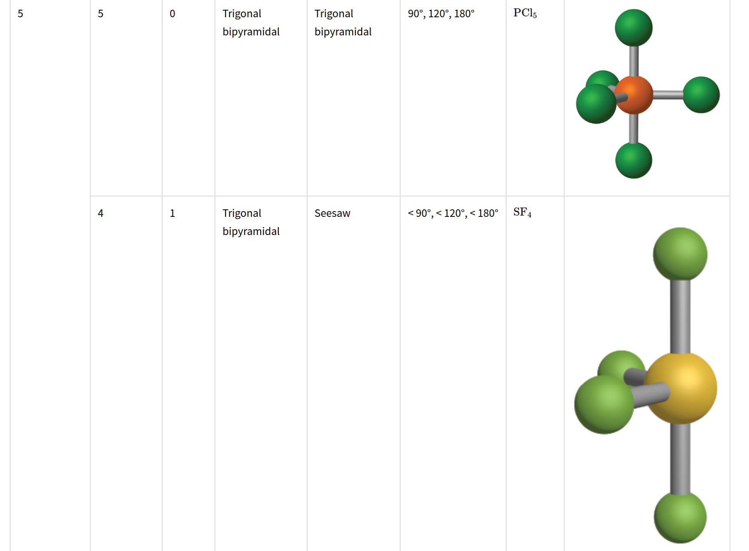

Slide 16
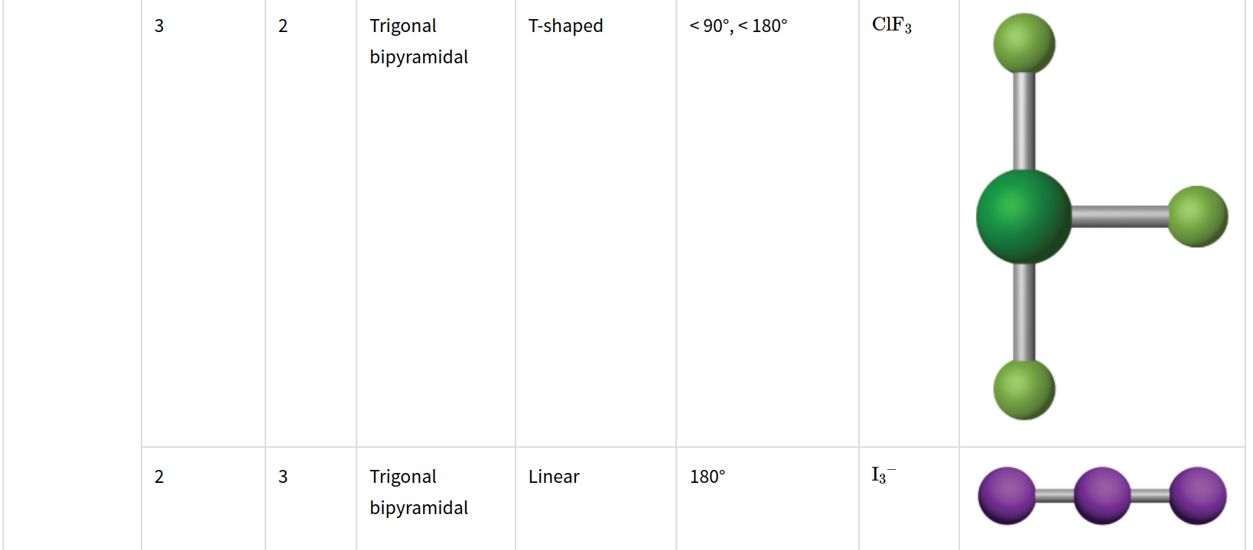

Slide 17
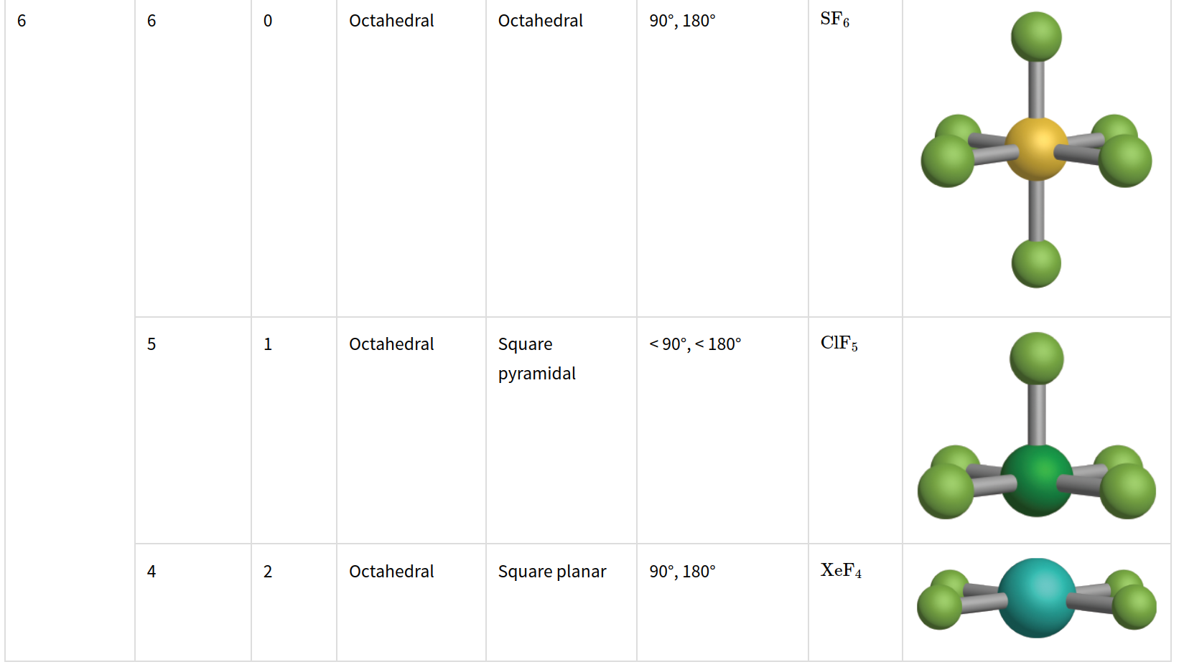

Slide 18
Outline
Announcements
Highlights prior lecture – Ch. 10
Ch. 11: Molecular Shape and Bonding Theories
VSEPR and Molecular Geometry
Polar and Nonpolar Molecules

Slide 19
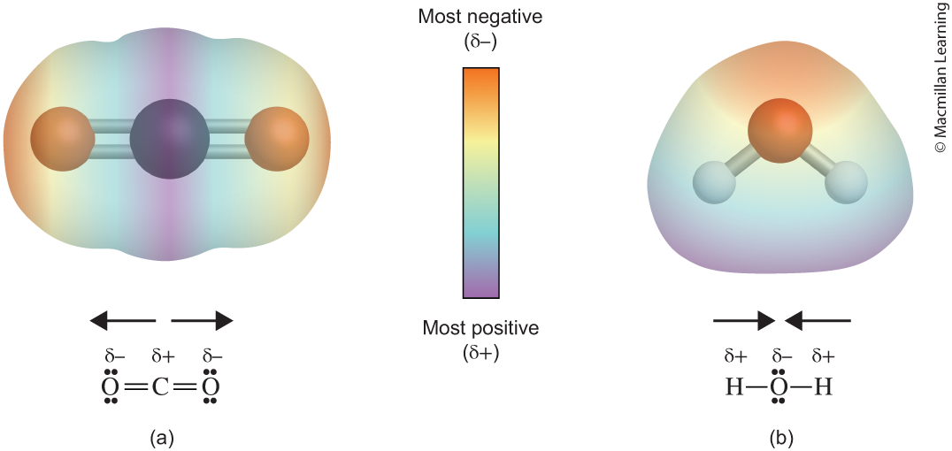
polarity of a molecule: Nonpolar or polar
Polar molecule – contains a net dipole moment
Nonpolar molecule – does not have a net dipole moment

Slide 20
polarity of a molecule: Nonpolar or polar
Molecules can be nonpolar even though it contains polar bonds e.g. NO₃⁻
Polarity of a molecule depends on looking at the net dipole moment

Slide 21
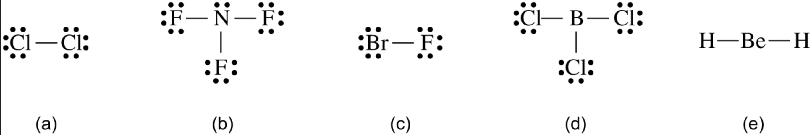
Example: which molecule is polar?

