Slide 1
Lecture 11: Thermodynamics
California State University, Fullerton
2023 Fall Semester – Chem 123

Slide 2

QUESTIONS, COMMENTS, AND CONCERNS?

Slide 3
Outline
Announcements
Grading...
Ch. 6 & 18: Thermodynamics
Concept of Energy (Kinetic v. Potential) and Units for Energy
Energy, Heat, and Work
0th and 1st Law of Thermodynamics
Energy as a State Function

Slide 4
announcements
Lots of grading to catch up on. Thank you for your patience
Extended Ch 6 homework to Oct 12th at 11:59 pm
Exam 2 will cover Chs. 5 – 7
5-6 questions all free response
Practice! Practice! Practice!

Slide 5
Outline
Announcements
Grading...
Ch. 6 & 18: Thermodynamics
Concept of Energy (Kinetic v. Potential) and Units for Energy
Energy, Heat, and Work
0th and 1st Law of Thermodynamics
Energy as a State Function

Slide 6
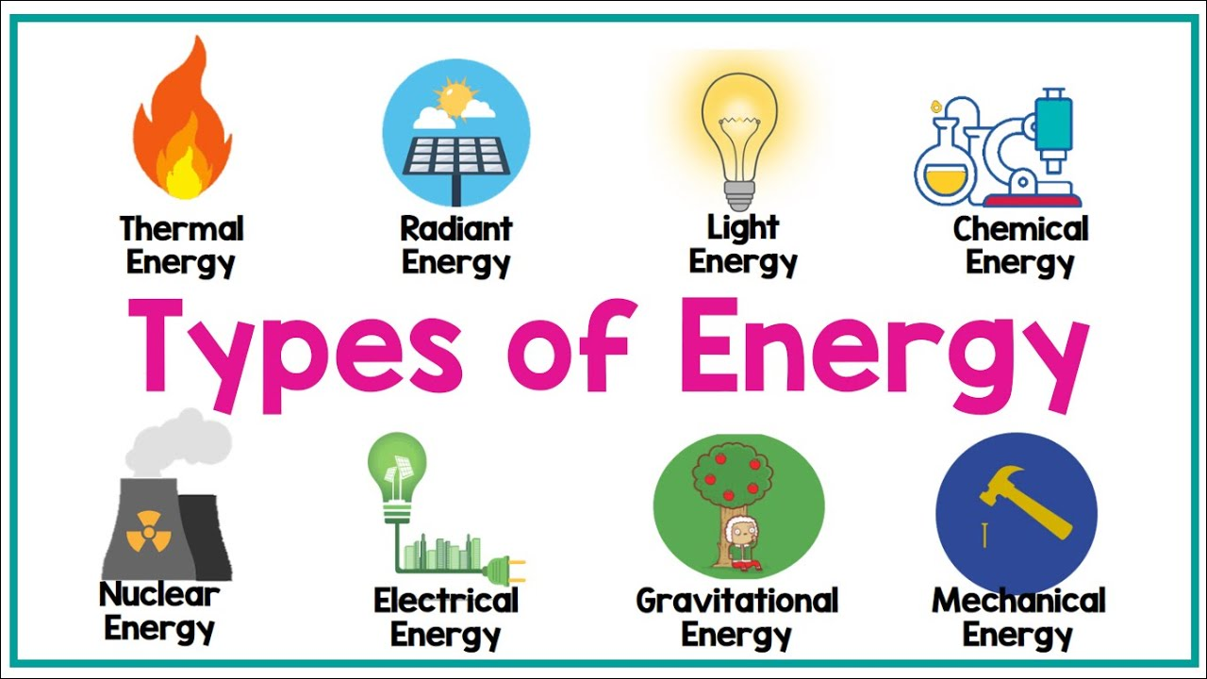
Thermodynamics
Definition: the relations between heat and other forms of energy (such as mechanical, electrical, or chemical energy)the relations between heat and other forms of energy (such as mechanical, electrical, or chemical energy)

Slide 7
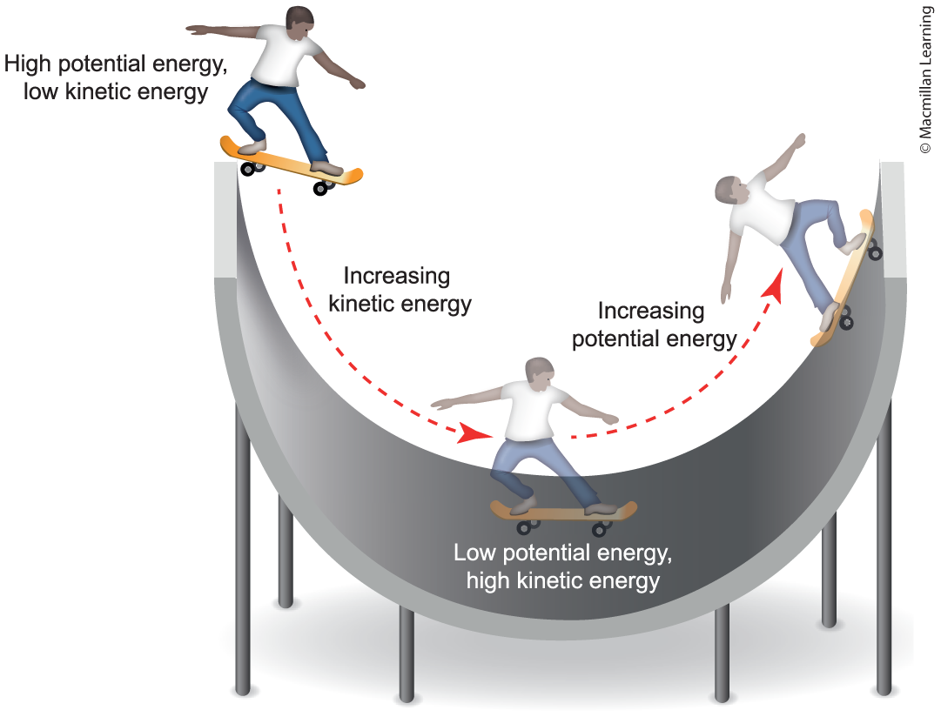
Concept of energy – Kinetic v. potential
KE = ½ mv²
PE = mgh
m = mass
g = gravity
h = height
v = velocity
Kinetic energy (KE) – whenever an object is in motion
Potential energy (PE) – amount of stored energy
Total energy = KE + PE
Units of energy – Joules (J = kg m²/s²)

Slide 8
Additional Units of energy
Unit | Equivalent Value
Joule (J) | 1 kg m²/s²
calorie (cal) | 4,184 J
Calorie (Cal) | 1,000 cal = 1 kcal = 4,184 J = 4.184 kJ
Note: Familiarize with the units of energy

Slide 9
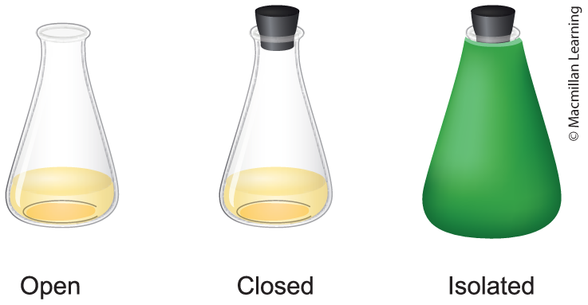
System and the surrounding
E(Universe) = E(System) + E(Surrounding)
System – chemical reaction
Surrounding – everything else not part of the system
System – Open, Closed, Isolated
Open – Heat and material transfer
Closed – Only heat transfer
Isolated – No heat or material transfer

Slide 10
Outline
Announcements
Grading...
Ch. 6 & 18: Thermodynamics
Concept of Energy (Kinetic v. Potential) and Units for Energy
Energy, Heat, and Work
0th and 1st Law of Thermodynamics
Energy as a State Function

Slide 11
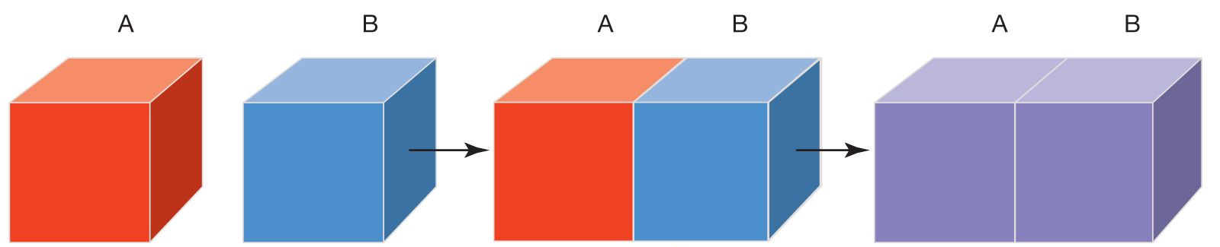
Thermal equilibrium
Thermal Equilibrium – When temperature balances out, lead to no net flow of energy between the two blocks
Block A is hotter than B -> heat flow from hot to cold reaching thermal equilibrium

Slide 12
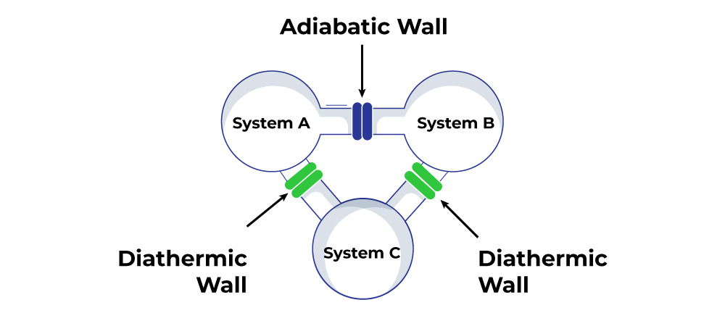
0th law of thermodynamic
If two thermodynamic systems are each in thermal equilibrium with the third one, then they are in thermal equilibrium with each other

Slide 13
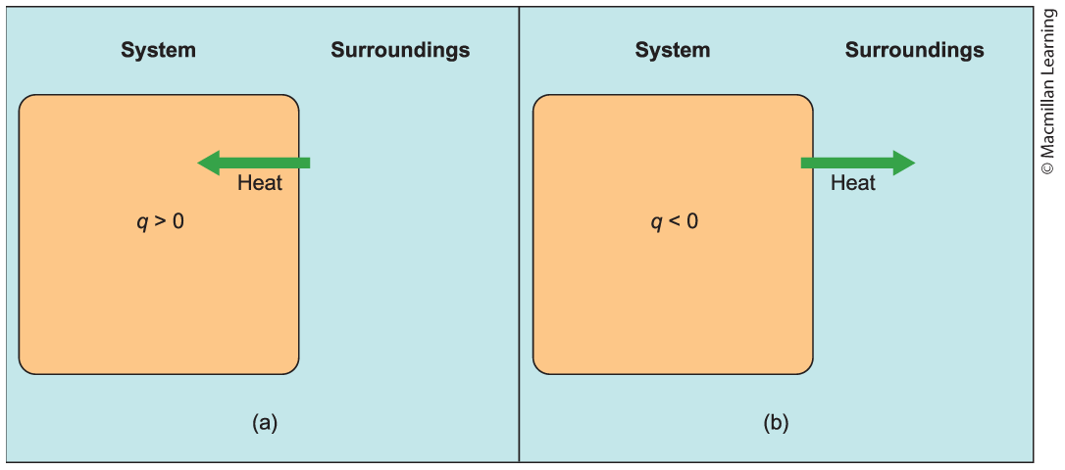
Sign conventions for energy
All relative to the system. If the system absorb energy (E > 0), then energy is positive. If the system release energy (E < 0), then energy is negative.

Slide 14
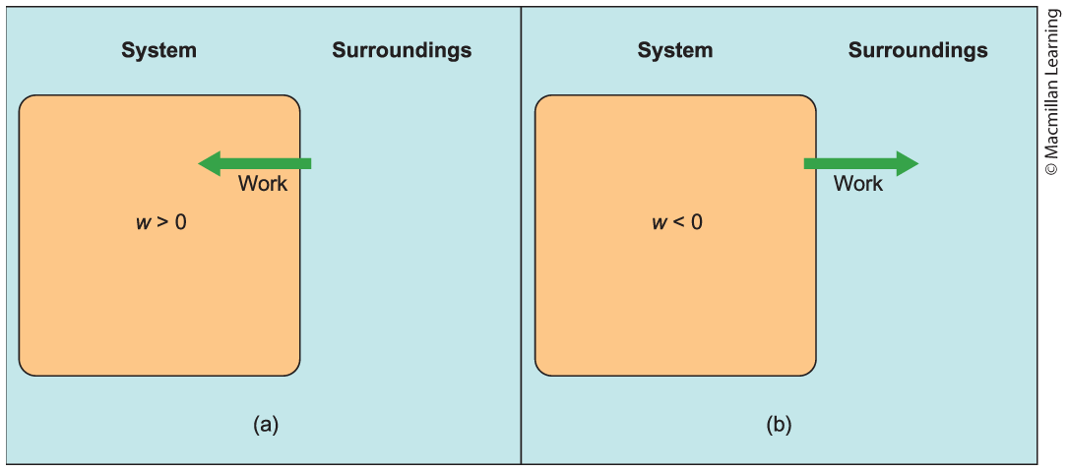
Sign conventions for energy
All relative to the system. If the system absorb energy (E > 0), then energy is positive. If the system release energy (E < 0), then energy is negative.

Slide 15
Examples: Sign conventions
Determine whether w or q is positive or negative in each of the following scenarios:
Rolling a bowling ball across the floor where the bowling ball is the system
A crane lifting a steel beam, where the steel beam is defined as the system
Steam condenses on a cool mirror, where the mirror is defined as the system
Ice pack placed on a person's sore back, where the ice pack is defined as the system

Slide 16
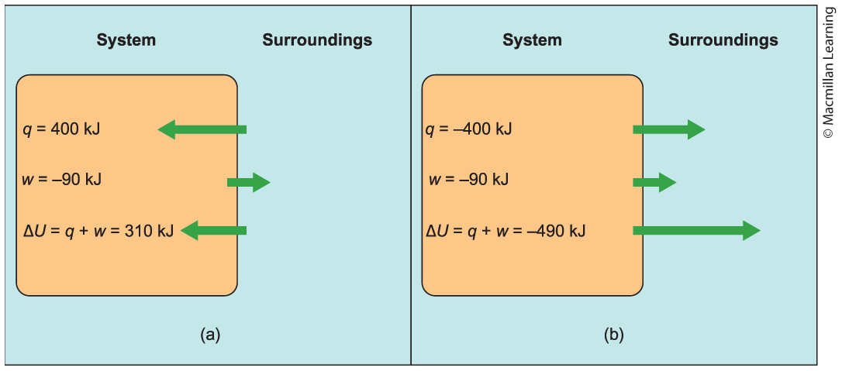
Internal Energy (ΔU)
ΔU = q + w
q = heat
w = work
Internal energy – the potential do perform work

Slide 17
Sign conventions q, W, and ΔU
Parameter | Sign | Meaning
q | + | System gains heat
q | - | System loses heat
w | + | Work done on system
w | - | Work done by system
ΔU | + | Gains internal energy
ΔU | - | Loses internal energy

Slide 18
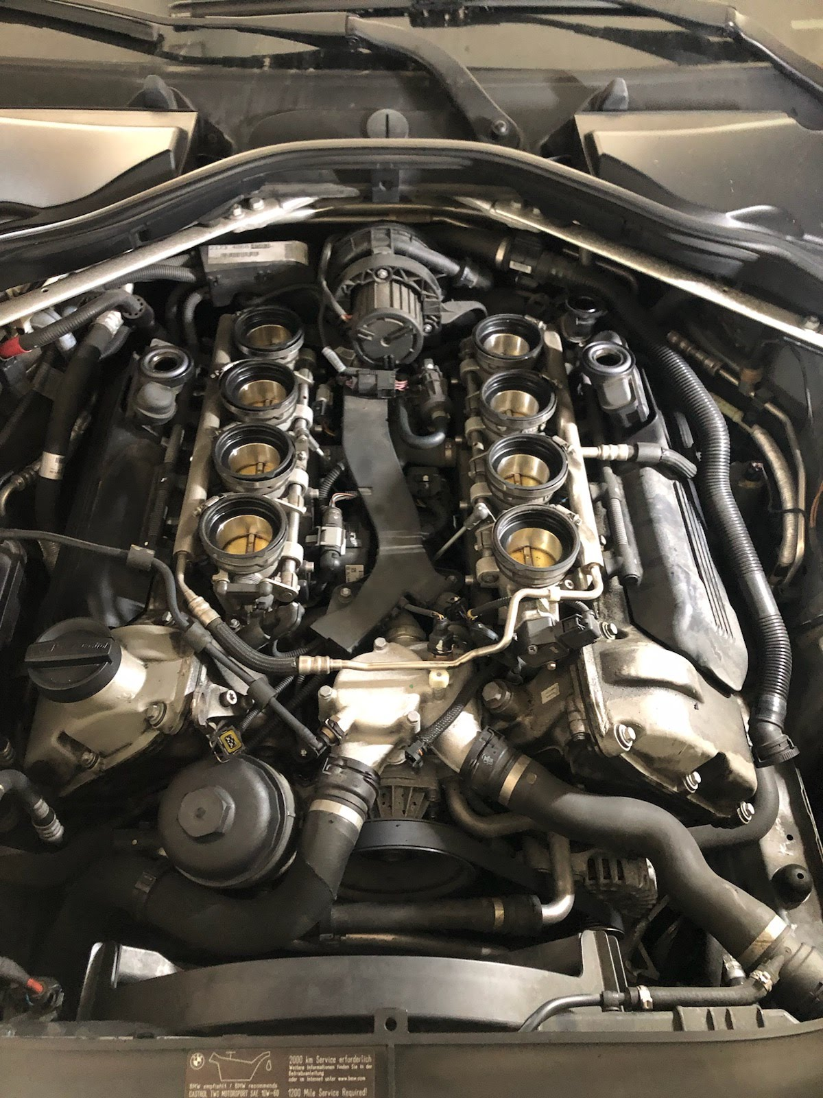
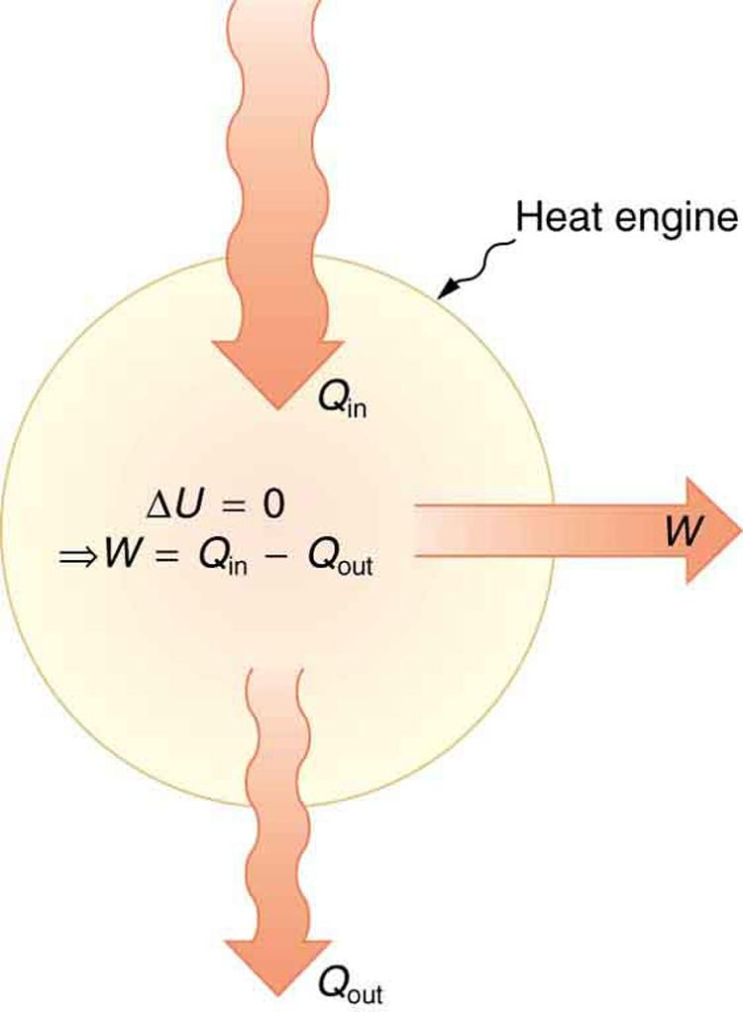
first law of thermodynamics
Energy is neither created nor destroyed. Energy of the universe is constant.

Slide 19
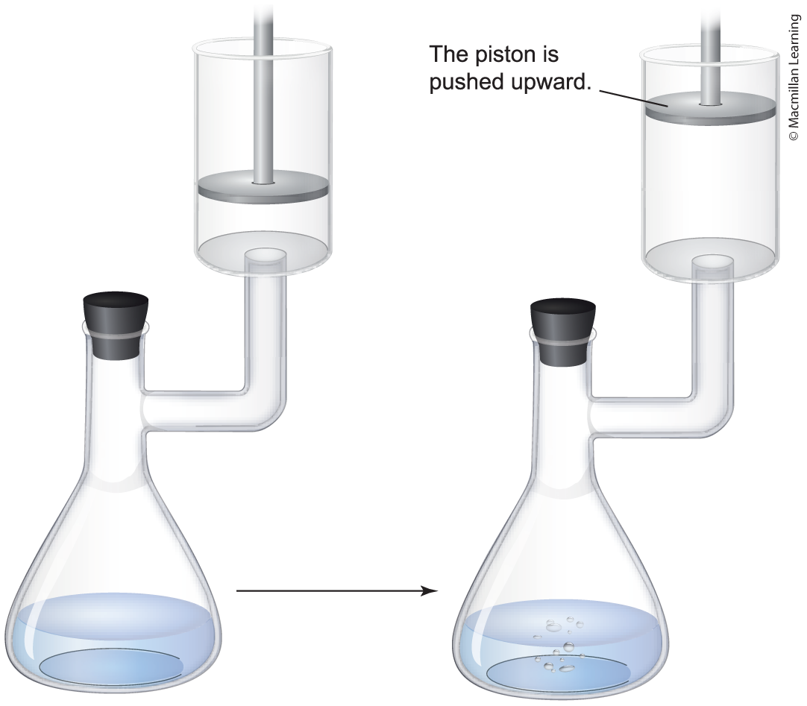
Example: internal energy
A closed chemical reaction is performed in a flask attached to a piston. The reaction releases 890 J of heat to the surroundings and the gas produced performs 450 J of work on the surroundings by pushing the piston upward. Determine ΔU.
Game plan: ΔU = q + w
What are the sign conventions for q and w?
ΔU = q + w = -890 J – 450 J = - 1340 J

Slide 20
Your turn: internal energy
Same setup as in the prior slide, a closed chemical reaction of two gases forms a solid that consumes 550 J of heat from the surroundings and the surroundings performs 210 J of work on the system. Determine ΔU.

Slide 21
Outline
Announcements
Grading...
Ch. 6 & 18: Thermodynamics
Concept of Energy (Kinetic v. Potential) and Units for Energy
Energy, Heat, and Work
0th and 1st Law of Thermodynamics
Energy as a State Function

Slide 22
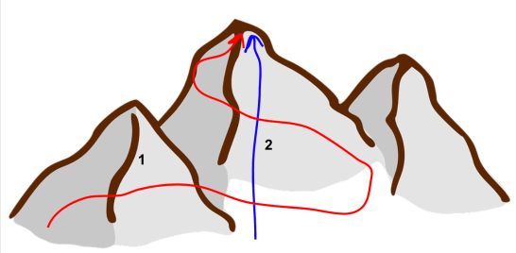
Define: state function
State of system that is independent of the path taken

Slide 23

Define: state function
Mount Baldy hike (4000 ft elevation) – Two routes: Ski Hut trail (4 miles) or Devil's backbone (7 miles)
State of system that is independent of the path taken

Slide 24
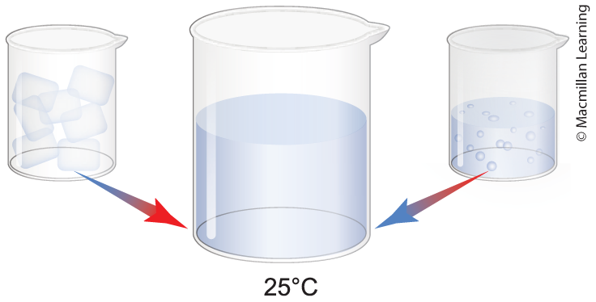
Define: state function
Ethanol
State of system that is independent of the path taken
Internal energy (U) is a state function
Work and heat are not state functions (Path dependent)

Slide 25
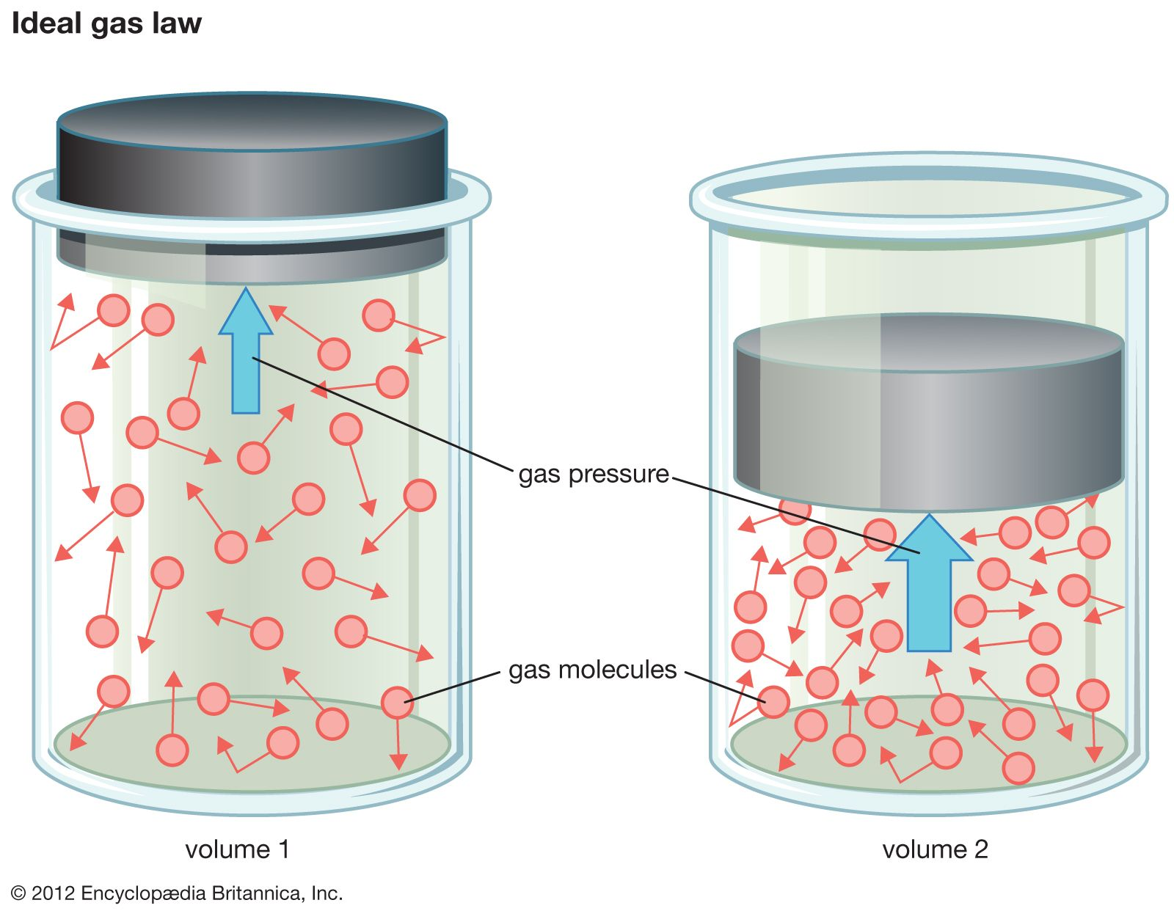
Calculating Work: Pressure-volume work
Pressure (P) – the force (F) acting over a surface area (P = F/A)

Slide 26
Calculating work: Pressure-Volume Work
w = - PΔV
P = external pressure
ΔV = change in volume
= V_{final} - V_{initial}
1 L atm = 101.325 J
Example: A chemical reaction initially at 0.550 L contracts to 0.375 L with the external pressure of 1.00 atm. Find the work done.
ΔV = 0.375 L – 0.550 L = - 0.175 L
w = -1.00(-0.175 L) = 0.175 L atm = 17.7 J

Slide 27
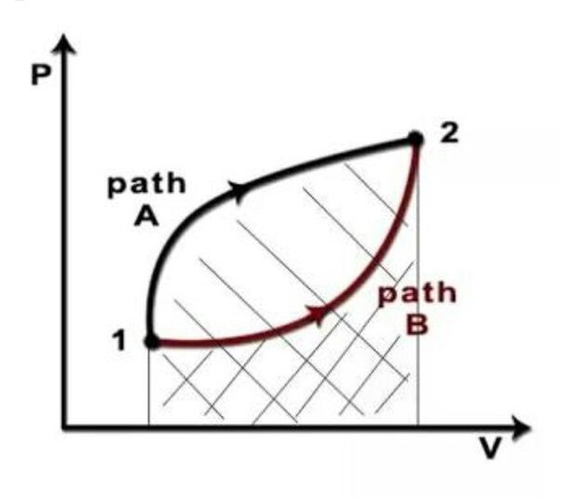
Work is not a state function
w = - PΔV
P = external pressure
ΔV = change in volume
= V_{final} - V_{initial}
Work is the area under the curve

