Slide 1
Lecture 13: Hess's law
California State University, Fullerton
2023 Fall Semester – Chem 123

Slide 2
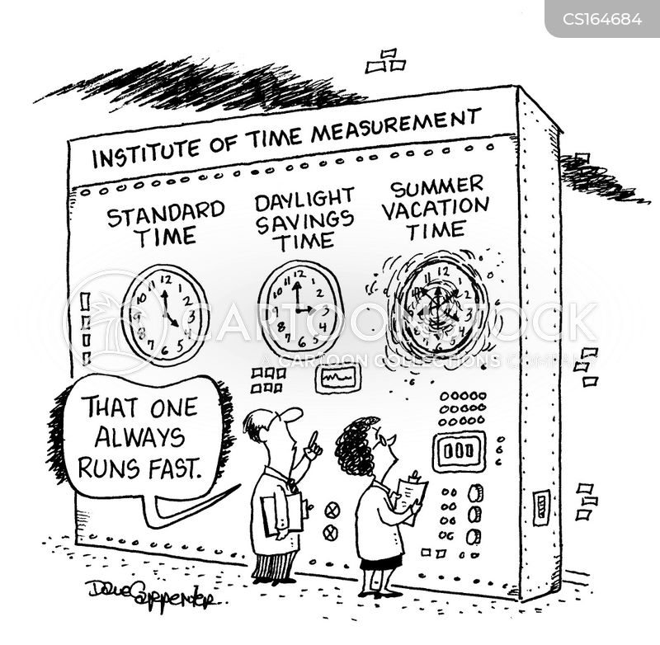
QUESTIONS, COMMENTS, AND CONCERNS?

Slide 3
Outline
Announcements
Ch. 6 & 18: Thermodynamics
Highlights of prior lecture
Hess's Law

Slide 4
announcements
Reminder: Ch 6 homework to Oct 12th at 11:59 pm
In-Class: Heat worksheet this Weds, Oct 11 and 1 pt EC offered for students who present
Exam 2 will cover Chs. 5 – 7
5-6 questions all free response
Practice! Practice! Practice!

Slide 5
Outline
Announcements
Ch. 6 & 18: Thermodynamics
Highlights of prior lecture
Hess's Law

Slide 6
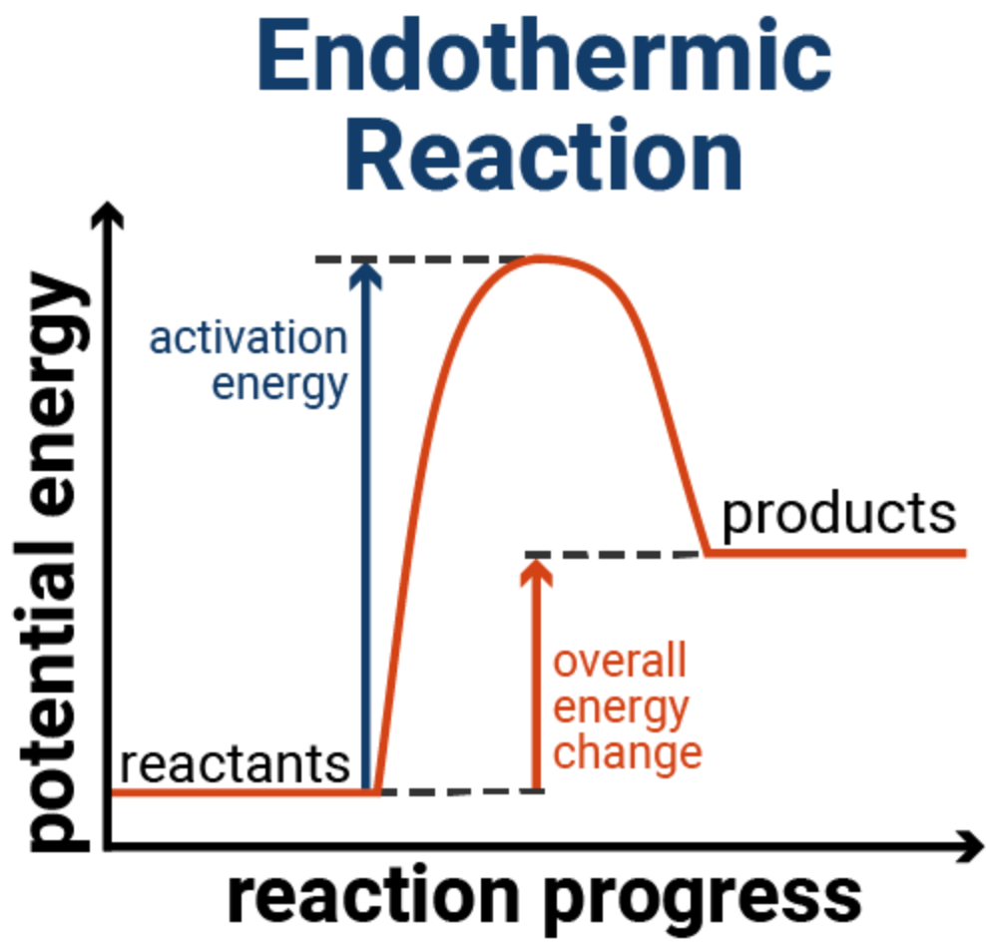
Endothermic processes
Generic reaction:
A + B --> C + D
Endothermic reaction – overall reaction results in positive change in energy (ΔE = E_{products} – E_{reactants})
Activation energy (E_{a}) – minimum amount of energy to start reaction

Slide 7
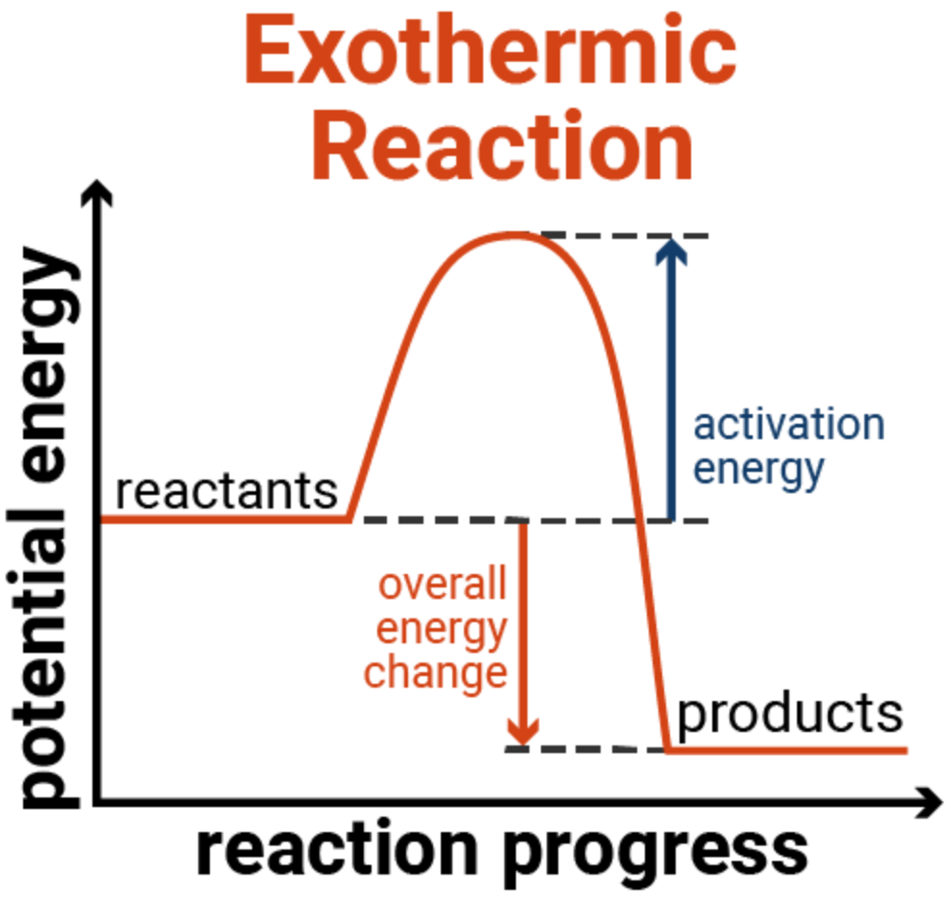
Exothermic processes
Generic reaction:
A + B --> C + D
Exothermic reaction – overall reaction results in negative change in energy (ΔE = E_{products} – E_{reactants})
Activation energy (E_{a}) – minimum amount of energy to start reaction

Slide 8
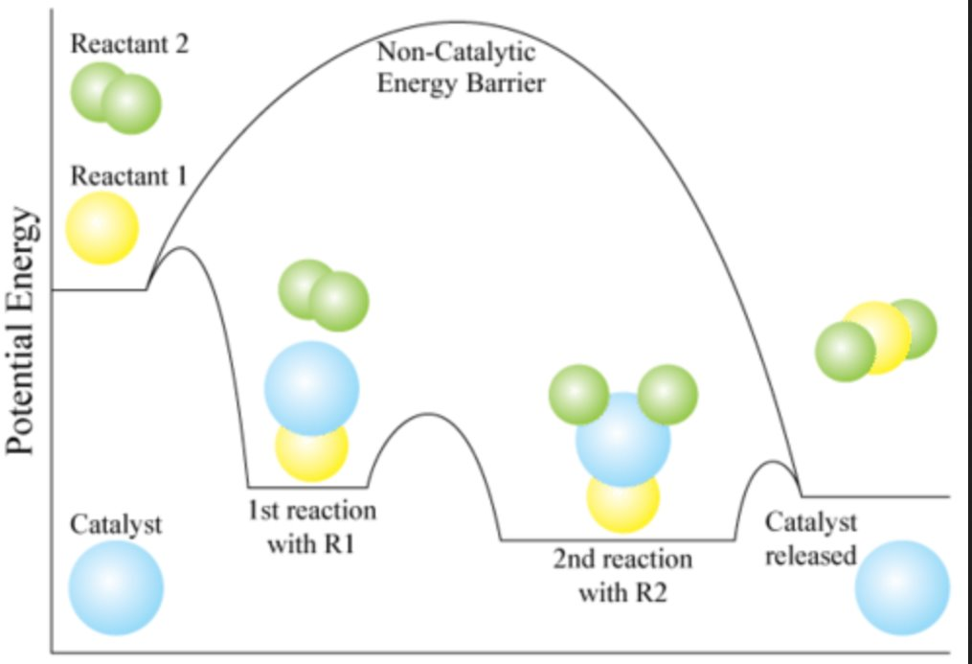
Q: How catalyst affects chemical reaction
Activation Energy (E_{a}) determines the rate of the reaction
Catalyst speeds up the reaction by lowering E_{a}

Slide 9
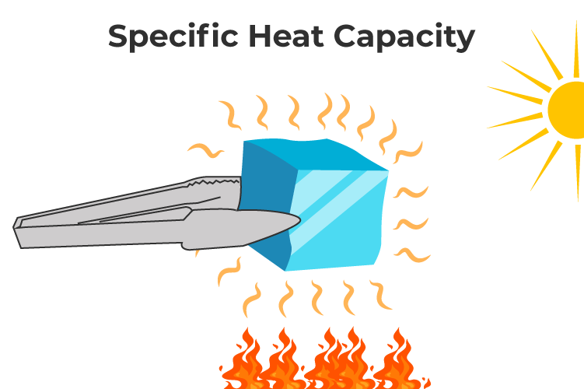
Quantifying heat
q = mcΔT
m is the mass of the material (grams)
c is the specific heat capacity (J/(g °C)) - amount of heat to heat a substance by 1 gram per 1 °C
ΔT is the change in temperature (°C)
ΔT = T_{final} - T_{initial}

Slide 10
Enthalpy change in chemical reaction
A + B --> C + D
ΔH > 0, endothermic
ΔH < 0, exothermic
Understanding Enthalpy Change (ΔH)
Units are in kJ/mol reaction
2 H₂(g) + O₂(g) --> 2 H₂O(l) ΔH = -286 kJ/mol
Q: How much heat is released for 4 mols of H₂(g)? What about 3 mols O₂(g)?

Slide 11
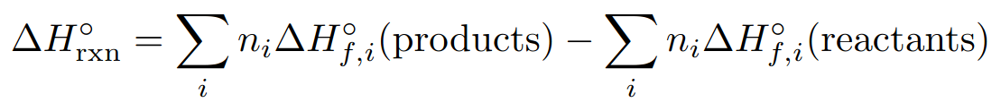
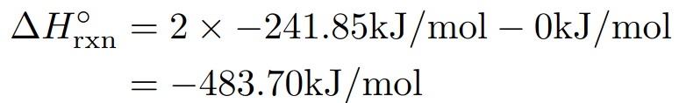
Formula to compute enthalpy of chemical reactions
n is the mols for each compound obtained from the chemical equation
ΔH_{f} is the enthalpy of formation – energy to form said compound
Enthalpy of formation for elements are zero
Example: 2 H₂(g) + O₂(g) --> 2 H₂O(g); enthalpy formation of water is –241.8 kJ/mol

Slide 12
Outline
Announcements
Ch. 6 & 18: Thermodynamics
Highlights of prior lecture
Hess's Law

Slide 13
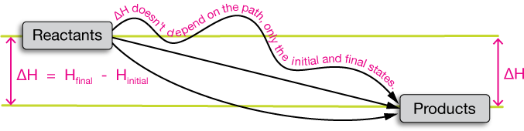
Hess's law
States that regardless of the multiple stages or steps of a reaction, the total enthalpy change (ΔH) for the reaction is the sum of all changes
ΔH is a state function!

Slide 14
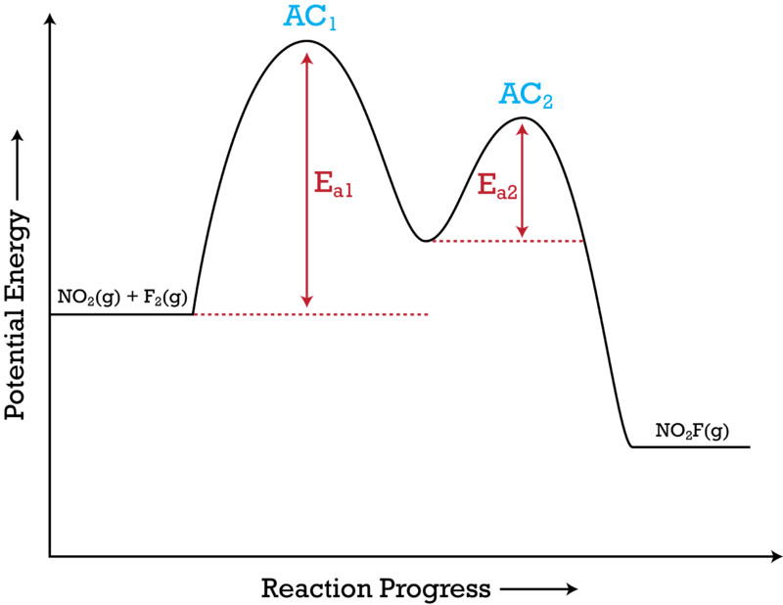
Hess's law
States that regardless of the multiple stages or steps of a reaction, the total enthalpy change (ΔH) for the reaction is the sum of all changes
ΔH is a state function!
2 NO₂(g) + F₂(g) → 2 NO₂F(g)
Mechanism involves two steps:
AC1: NO₂(g) + F₂(g) → NO₂F(g) + F(g) (Slow)
AC2: NO₂(g) + F(g) → NO₂F(g) (Fast)
AC = activated complex (intermediate/transition states)

Slide 15
Rules for hess's law
Generic Chemical Equation: A + B --> C + D +ΔH₁
Flip the chemical equation, the enthalpy of reaction (ΔH) changes signs
C + D --> A + B - ΔH₁
Multiply the chemical by a number, the ΔH is raised by the scalar multiple
2 A + 2 B --> 2 C + 2 D 2 ΔH₁
Summing two or more chemical equations, overall ΔH is the sum of the ΔH of the individual equations
A + B --> C + D +ΔH₁
2C --> E + F -ΔH₂
Overall: A + B + C --> D + E + F ΔH₁-ΔH₂

Slide 16
Hess's law example
Compute the overall ΔH for the reaction:
2 NO₂(g) + F₂(g) → 2 NO₂F(g)
Mechanism involves two steps:
AC1: NO₂(g) + F₂(g) → NO₂F(g) + F(g) ΔH₁ = -69.49 kJ/mol
AC2: NO₂(g) + F(g) → NO₂F(g) ΔH₂ = -224.44 kJ/mol
AC = activated complex (intermediate/transition states)
2 NO₂(g) + F₂(g) → 2 NO₂F(g)
ΔH_{overall} = ΔH₁ + ΔH₂ = -293.93 kJ/mol

Slide 17
Hess's Law example
Determine the overall ΔH for the following chemical equation:
C(s) + ½ O2(g) --> CO(g)
Use the following reactions:
C(s) + O₂(g) --> CO₂(g) ΔH₁ = -393 kJ/mol
CO(g) + ½ O₂(g) --> CO₂(g) ΔH₂ = -283 kJ/mol
Game plan: How to combine the reactions to obtain overall chemical equation

