Slide 1
Lecture 14: ideal gas law
California State University, Fullerton
2023 Fall Semester – Chem 123

Slide 2

QUESTIONS, COMMENTS, AND CONCERNS?

Slide 3
Outline
Announcements
Highlights of prior lecture: Hess's Law
Ch. 7: Gases
Real World Connection and Ideal Gas Simulator
Boyle's Law
Charles's Law
Avogadro's Law
Ideal Gas Law

Slide 4
announcements
No exceptions for late In-Class worksheets
Gas law worksheet posted for extra practice
Achieve McMillan exam_2_study_materials posted
Posting exam 2 study guide and heat worksheet answer key
Online Ch 7 Hw is posted Due Oct 26 at 11:59pm
Weds, Oct 18 – Exam 2 will cover Chs. 5 – 7
5-6 questions all free response
Practice! Practice! Practice!

Slide 5
Outline
Announcements
Highlights of prior lecture: Hess's Law
Ch. 7: Gases
Real World Connection and Ideal Gas Simulator
Boyle's Law
Charles's Law
Avogadro's Law
Ideal Gas Law

Slide 6
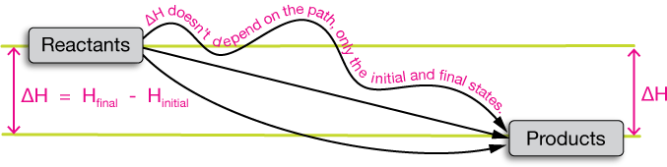
Hess's law
States that regardless of the multiple stages or steps of a reaction, the total enthalpy change (ΔH) for the reaction is the sum of all changes
ΔH is a state function!

Slide 7
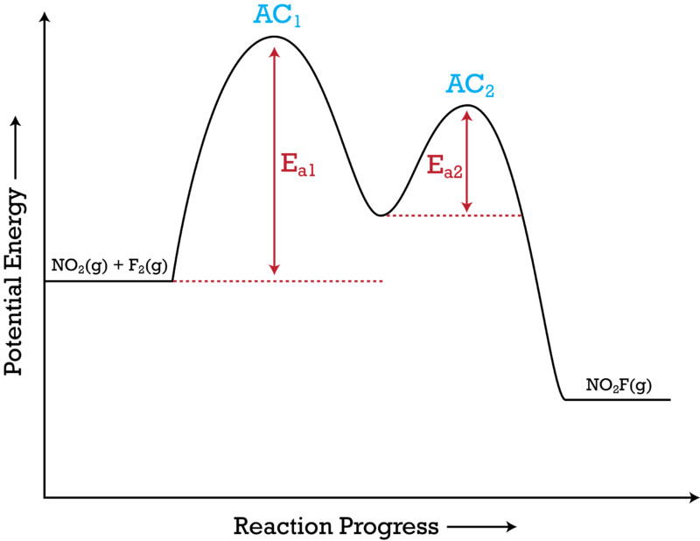
Hess's law
States that regardless of the multiple stages or steps of a reaction, the total enthalpy change (ΔH) for the reaction is the sum of all changes
ΔH is a state function!
2 NO₂(g) + F₂(g) → 2 NO₂F(g)
Mechanism involves two steps:
AC1: NO₂(g) + F₂(g) → NO₂F(g) + F(g) (Slow)
AC2: NO₂(g) + F(g) → NO₂F(g) (Fast)
AC = activated complex (intermediate/transition states)

Slide 8
Rules for hess's law
Generic Chemical Equation: A + B --> C + D +ΔH₁
Flip the chemical equation, the enthalpy of reaction (ΔH) changes signs
C + D --> A + B - ΔH₁
Multiply the chemical by a number, the ΔH is raised by the scalar multiple
2 A + 2 B --> 2 C + 2 D 2 ΔH₁
Summing two or more chemical equations, overall ΔH is the sum of the ΔH of the individual equations
A + B --> C + D +ΔH₁
2C --> E + F -ΔH₂
Overall: A + B + C --> D + E + F ΔH₁-ΔH₂

Slide 9
Hess's law example
Compute the overall ΔH for the reaction:
2 NO₂(g) + F₂(g) → 2 NO₂F(g)
Mechanism involves two steps:
AC1: NO₂(g) + F₂(g) → NO₂F(g) + F(g) ΔH₁ = -69.49 kJ/mol
AC2: NO₂(g) + F(g) → NO₂F(g) ΔH₂ = -224.44 kJ/mol
AC = activated complex (intermediate/transition states)
2 NO₂(g) + F₂(g) → 2 NO₂F(g)
ΔH_{overall} = ΔH₁ + ΔH₂ = -293.93 kJ/mol

Slide 10
Outline
Announcements
Highlights of prior lecture: Hess's Law
Ch. 7: Gases
Real World Connection and Ideal Gas Simulator
Boyle's Law
Charles's Law
Avogadro's Law
Ideal Gas Law

Slide 11
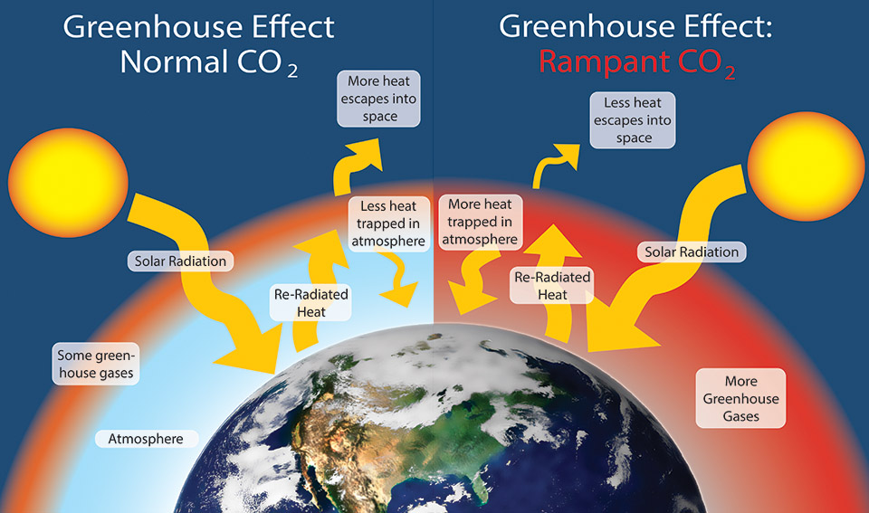
Connection to real world

Slide 12
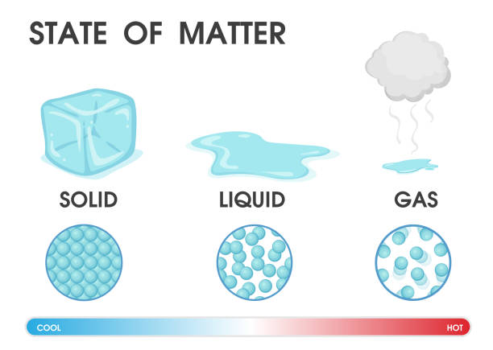
Q: What are the differences between solid, liquid, and gas?

Slide 13
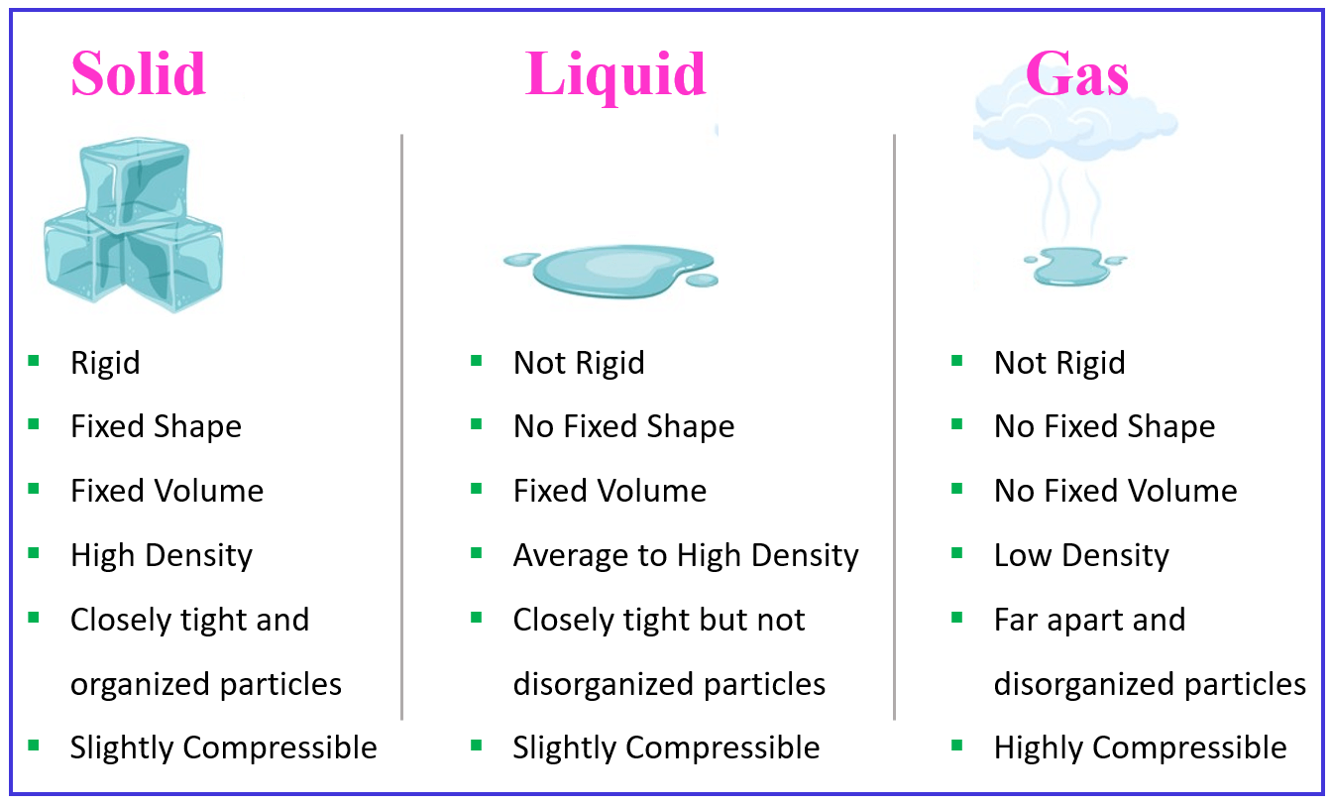
Difference between solid, liquid, and gas

Slide 14
Gas behavior simulator
Use the simulator to understand the behavior of gases: https://phet.colorado.edu/sims/html/gas-properties/latest/gas-properties_all.html

Slide 15
Outline
Announcements
Highlights of prior lecture: Hess's Law
Ch. 7: Gases
Real World Connection and Ideal Gas Simulator
Boyle's Law
Charles's Law
Avogadro's Law
Ideal Gas Law

Slide 16
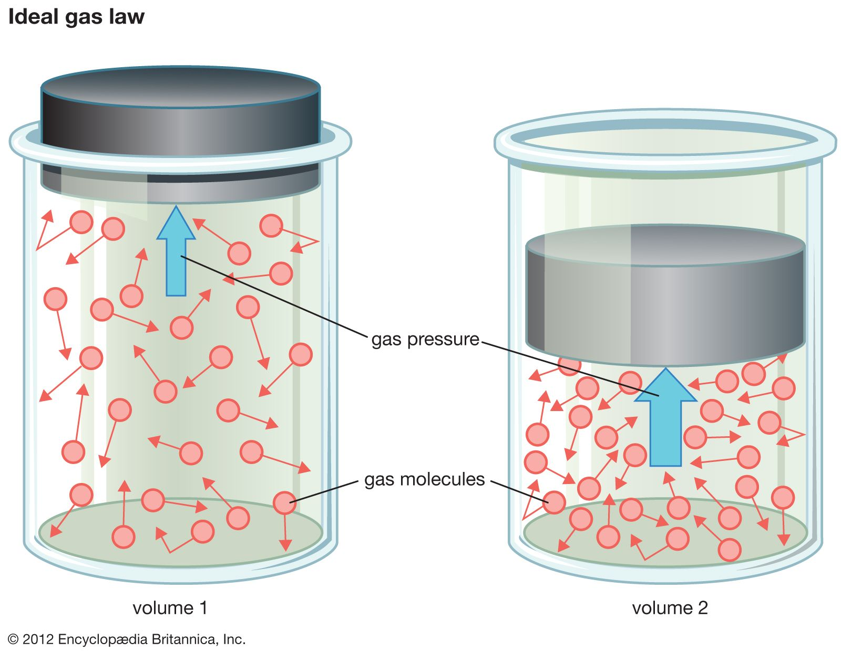
Gas pressure
Pressure is the ratio of force (F) over area (A)
P = F/A
Smaller the volume or surface area, the greater the pressure

Slide 17
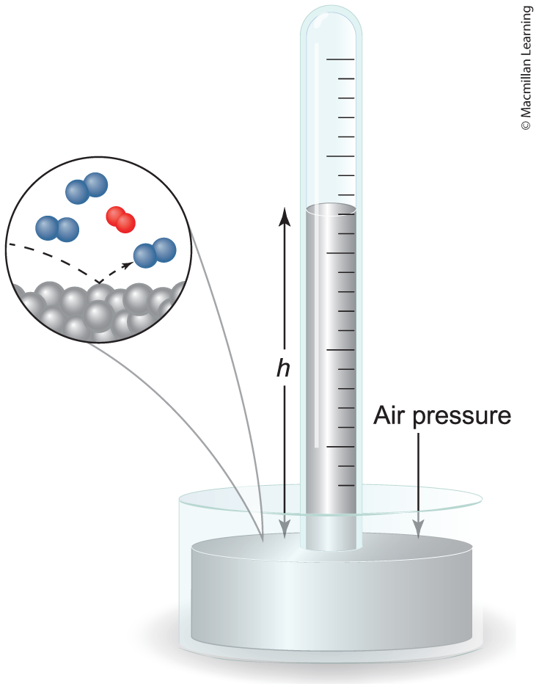
Measuring Gas pressure
Pressure is the ratio of force (F) over area (A)
P = F/A
Units for pressure are atmosphere (atm), Pascal (Pa), mm Hg, or Torr
1 atm = 101,325 Pa
= 760 mm Hg = 760 Torr

Slide 18
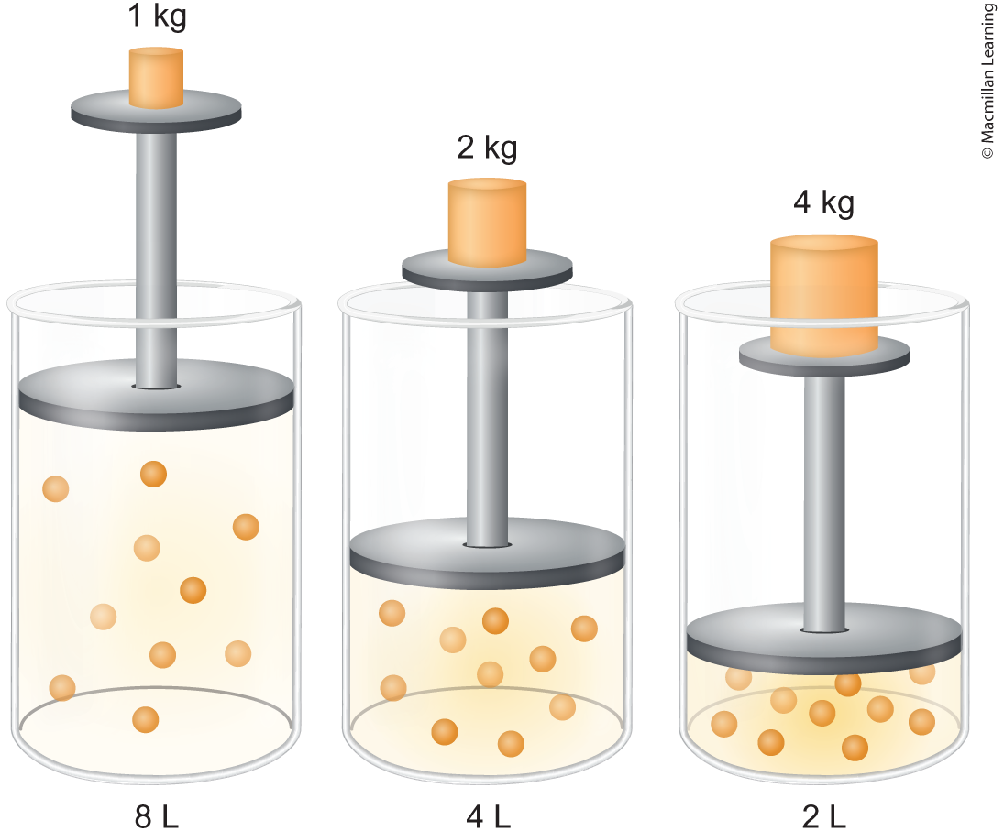
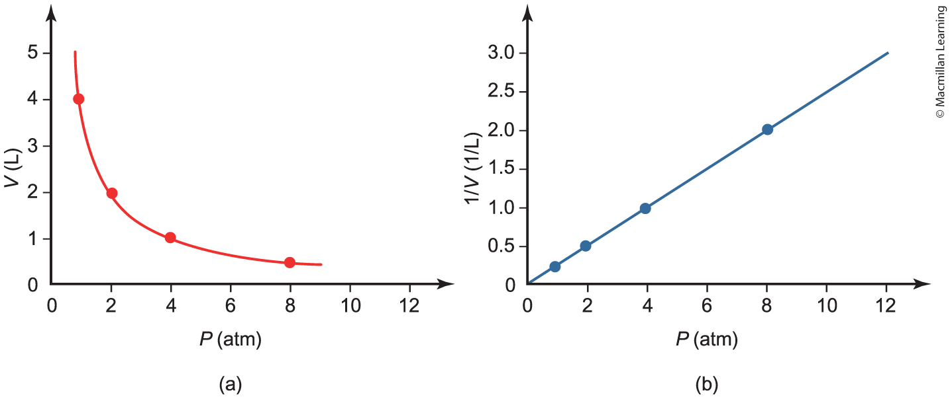
Boyle's law
Q: At const. temp, what happens to the gas pressure with increasing weight?

Slide 19
Boyle's law
At const. temp, pressure is inversely proportional to volume P ∝ 1/V;
PV = constant; P₁V₁ = P₂V₂
As the pressure increases, the volume decreases

Slide 20
example: Boyle's law
3.00 L sample of hydrogen gas (H₂) has at pressure of 0.800 atm. What is the volume if its pressure is increased to 2.00 atm at constant temperature?
Game plan: Determine equation and what the question is asking for.
P₁V₁ = P₂V₂
(0.800 atm)(3.00 L) = (2.00 atm)V₂
V₂ = 1.20 L

Slide 21
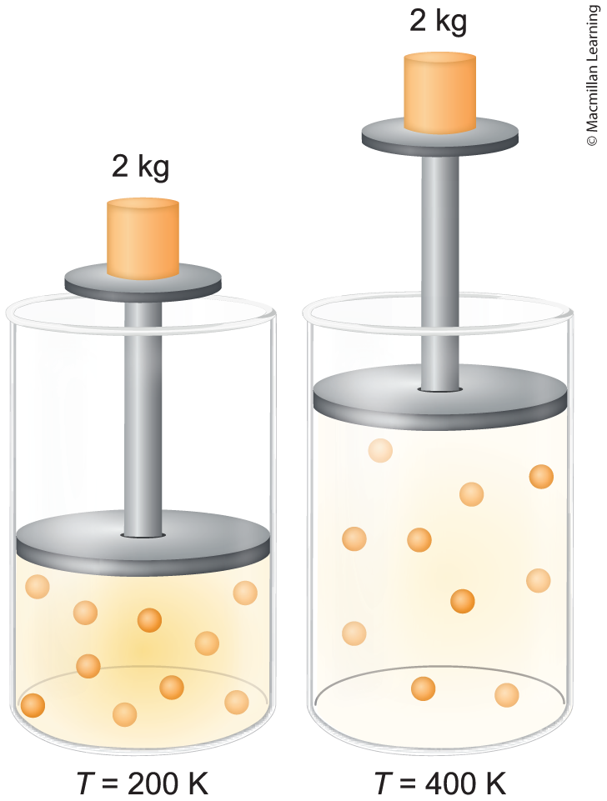
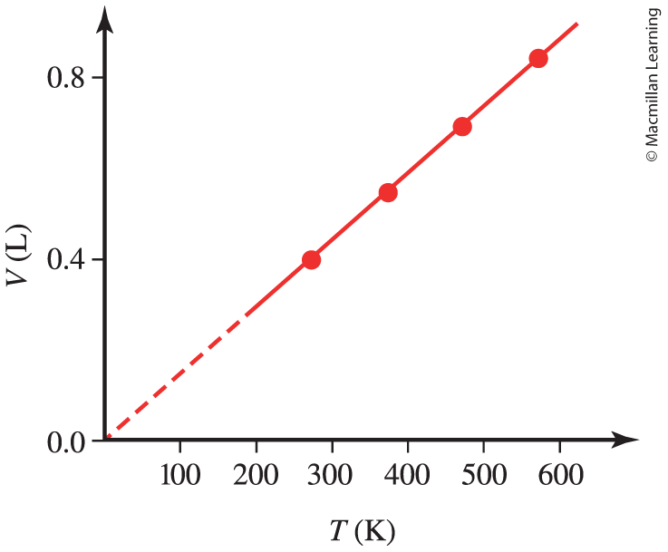
Charles's law
At constant pressure, temperature is directly proportional volume T ∝ V;
V₁/T₁ = V₂/T₂ = constant

Slide 22
Example: Charles's Law
550. mL sample of argon gas is expanded at constant pressure to 2.00 L at 55.0 °C. What was the original temperature of the gas in °C?
Game plan: Determine equation and what the question is asking. Convert all temperature to Kelvin.
V₁/T₁ = V₂/T₂
T₁ = (V₁)(T₂)/V₂ = (550 mL)(1 L/1000 mL)(55.0 + 273.15 K)/2.00 L
T₂ = 90.2|4125 K – 273.15 = -182|.908 °C = -183 °C

Slide 23
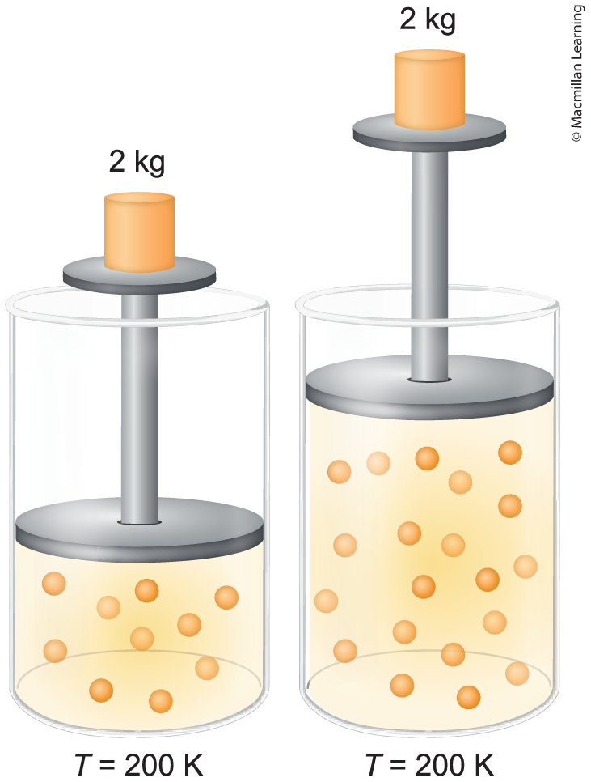
Avogadro's law
At const. P and T, the volume is directly proportional to mols V ∝ n;
V₁/n₁ = V₂/n₂

Slide 24
Example: Avogadro's law
A sample of 22.0g CO₂(g) occupies a volume of 15.3 L. What will the new volume be if an additional 15.0g CO₂(g) are added at constant temperature and pressure?
Game plan: Determine the equation and what the question is asking.
V1/n1 = V2/n2
V2 = (V1)(n2)/n1 = (15.3 L)(37.0g)(1 mol/44.01g)/(22.0g (1 mol/44.01g))
= 25.7|318 L = 25.7 L

Slide 25
Outline
Announcements
Highlights of prior lecture: Hess's Law
Ch. 7: Gases
Real World Connection and Ideal Gas Simulator
Boyle's Law
Charle's Law
Avogadro's Law
Ideal Gas Law

Slide 26
Assumptions of ideal gas law
Constantly moving
Have negligible volume, or gas particles are small relative to the container
Have negligible intermolecular forces, or interactions between gas molecules
Undergo perfectly elastic collisions implying energy is not lost
Average kinetic energy proportional to the ideal gas's absolute temperature KE ∝ T

Slide 27
Ideal gas law
PV = nRT
P is pressure
V is volume
n is mols
T is temperature
R is the gas constant (pay attention to the correct units!)
R = 8.3145 J/(mol K) = 0.08205 (L atm)/(mol K) = 8.3145 (L kPa)/(mol K)

Slide 28
Example: derive boyle's law from ideal gas law

Slide 29
your turn: derive the charles's law and avogadro's law from the ideal gas law

