Slide 1
Lecture 15: gases
California State University, Fullerton
2023 Fall Semester – Chem 123

Slide 2

QUESTIONS, COMMENTS, AND CONCERNS?

Slide 3
Outline
Announcements
Review Ideal Gas Law
Ch. 7: Gases
Dalton's Law of Partial Pressures
Molar Mass and Density in Gas Law
Stoichiometry with Gas Law
Diffusion and Effusion
Behavior of Real Gases

Slide 4
announcements
Gas worksheet Weds, Oct 25th
Online Ch 7 Hw is posted Due Oct 26 at 11:59pm
Recovering from a cold, delay grading exam 2
Schedule for the remaining semester

Slide 5
Outline
Announcements
Review Ideal Gas Law
Ch. 7: Gases
Dalton's Law of Partial Pressures
Molar Mass and Density in Gas Law
Stoichiometry with Gas Law
Diffusion and Effusion
Behavior of Real Gases

Slide 6
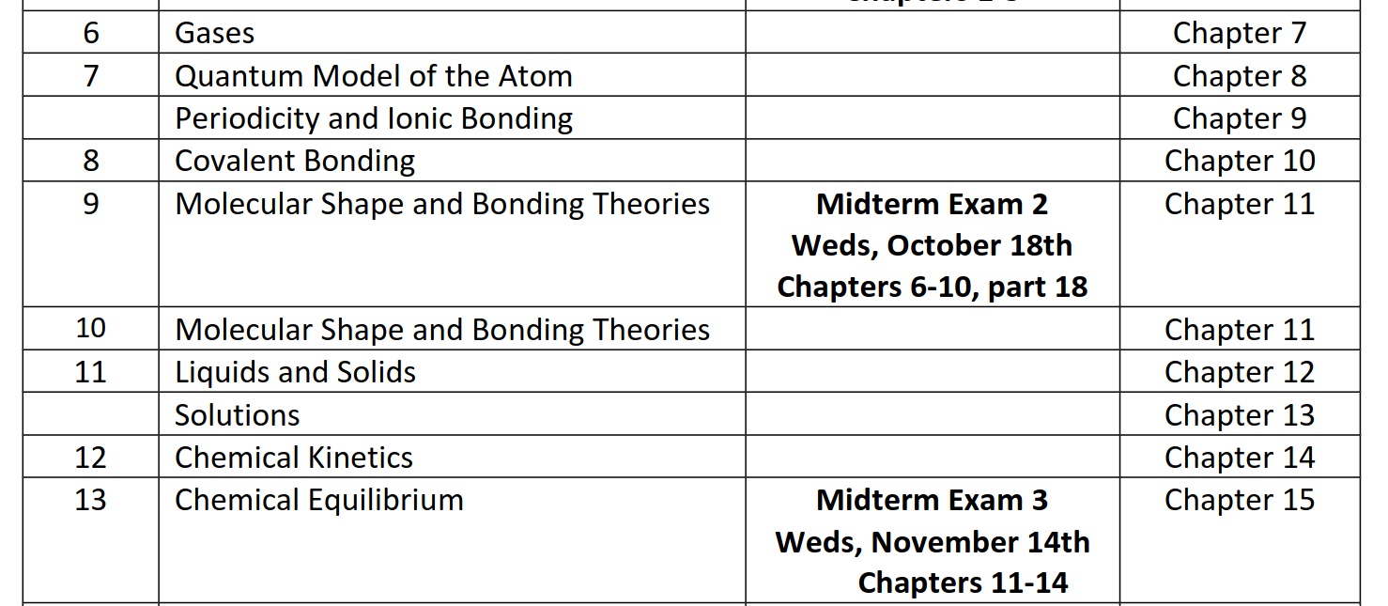
announcements

Slide 7
Outline
Announcements
Review Ideal Gas Law
Ch. 7: Gases
Dalton's Law of Partial Pressures
Molar Mass and Density in Gas Law
Stoichiometry with Gas Law
Diffusion and Effusion
Behavior of Real Gases

Slide 8
Ideal gas law
PV = nRT
P is pressure
V is volume
n is mols
T is temperature in Kelvin
R is the gas constant (pay attention to the correct units!)
R = 8.3145 J/(mol K) = 0.08205 (L atm)/(mol K) = 8.3145 (L kPa)/(mol K)

Slide 9
Kinetic Molecular Theory of gases
Constantly moving
Have negligible volume, or gas particles are small relative to the container
Have negligible intermolecular forces, or interactions between gas molecules
Undergo perfectly elastic collisions implying energy is not lost
Average kinetic energy proportional to the ideal gas's absolute temperature KE ∝ T

Slide 10
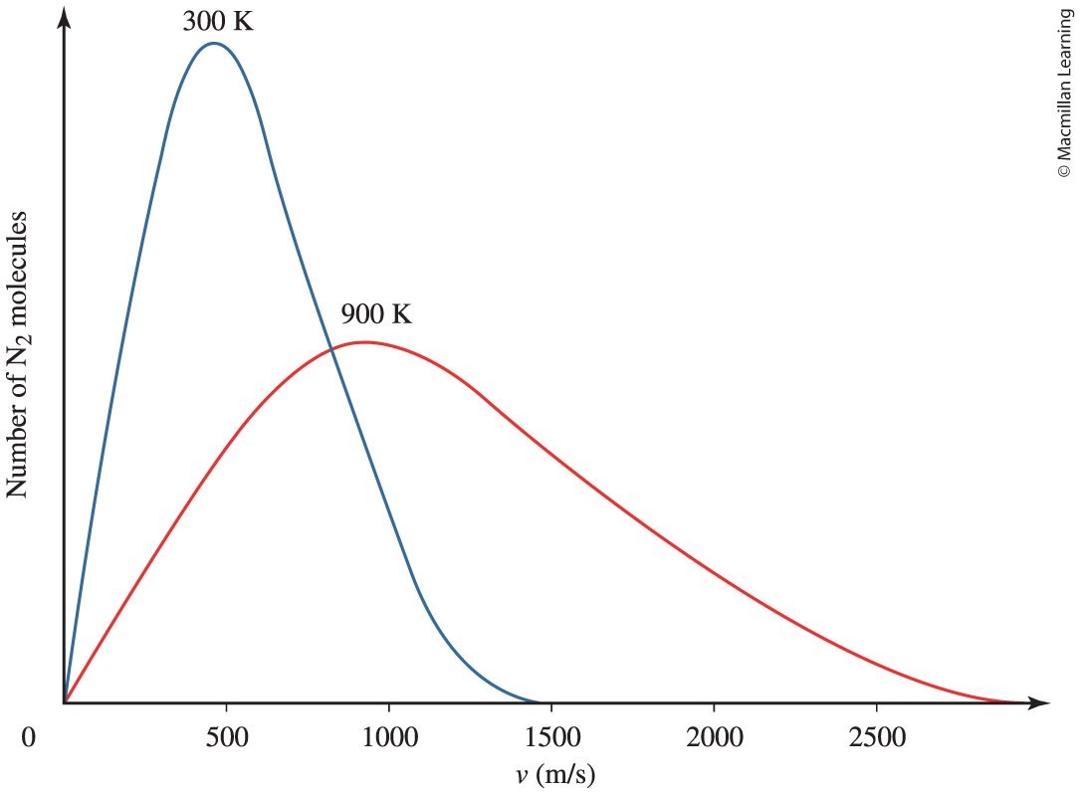
Movement of gas particles

Slide 11
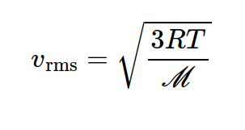
Q: between a light and heavy gas molecule, which one would be faster at a given temperature?
R is the gas constant (8.3145 J/(K mol))
T is the temperature in Kelvin
M is the molar mass

Slide 12
Outline
Announcements
Review Ideal Gas Law
Ch. 7: Gases
Dalton's Law of Partial Pressures
Molar Mass and Density in Gas Law
Stoichiometry with Gas Law
Diffusion and Effusion
Behavior of Real Gases

Slide 13
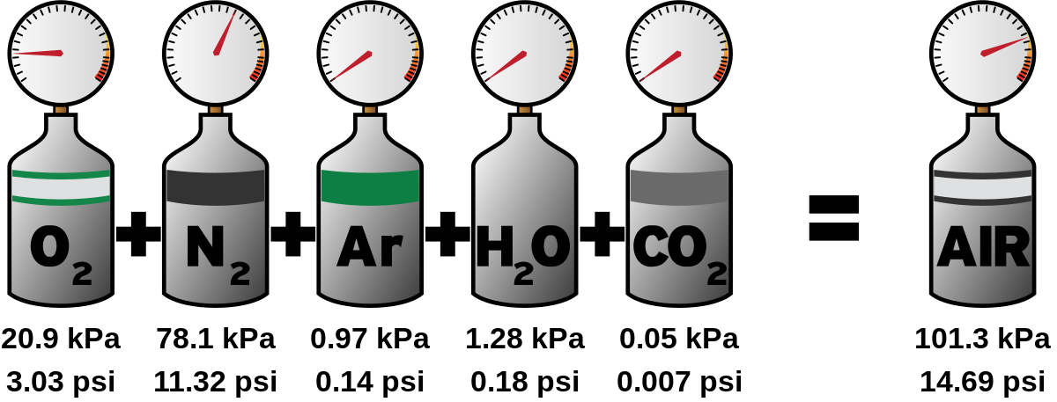

Dalton's law of partial pressures
Since gases are not interacting with one another, we can think of them as independent particles exerting their own pressures (partial pressures)
P₁, P₂, …, P_{n} are partial pressures

Slide 14


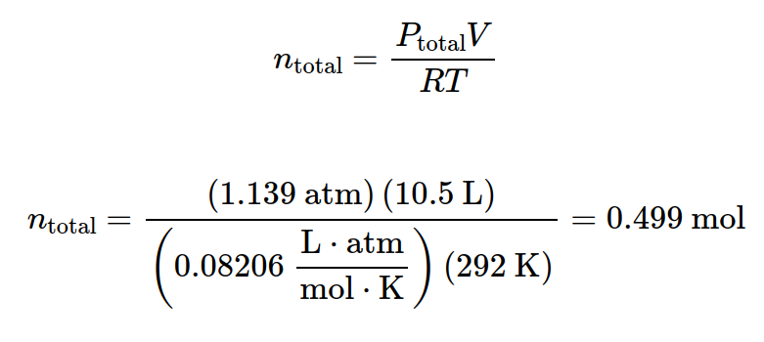
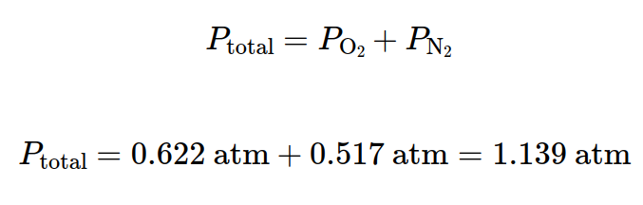
Determining the partial pressure of a gas
P_{total} is the total pressure and P_{i} is the partial pressure
Example: A 10.5 L sample of gas at 292 K contains O₂ at 0.622 atm and N₂ at 0.517 atm. What is the total moles?

Slide 15
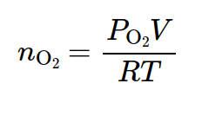
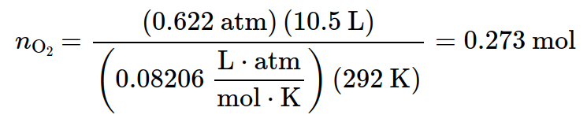
Determining the partial pressure of a gas
P_{total} is the total pressure and P_{i} is the partial pressure
Example: A 10.5 L sample of gas at 292 K contains O₂ at 0.622 atm and N₂ at 0.517 atm. What is the moles of O₂?

Slide 16
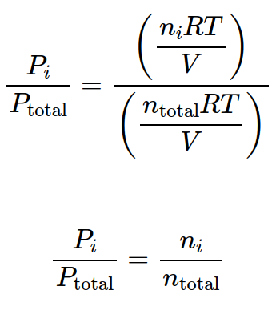
Determining the partial pressure of a gas
P_{total} is the total pressure and P_{i} is the partial pressure
Take the ratio P_{total} and P_{i}, obtain partial pressure P_{i}
n_{i}/n_{total} ratio is the called the mole fraction

Slide 17
significance of the mole fraction?
n_{i}/n_{total} ratio is the called the mole fraction
Composition of atmosphere is 78% nitrogen and 21% oxygen

Slide 18
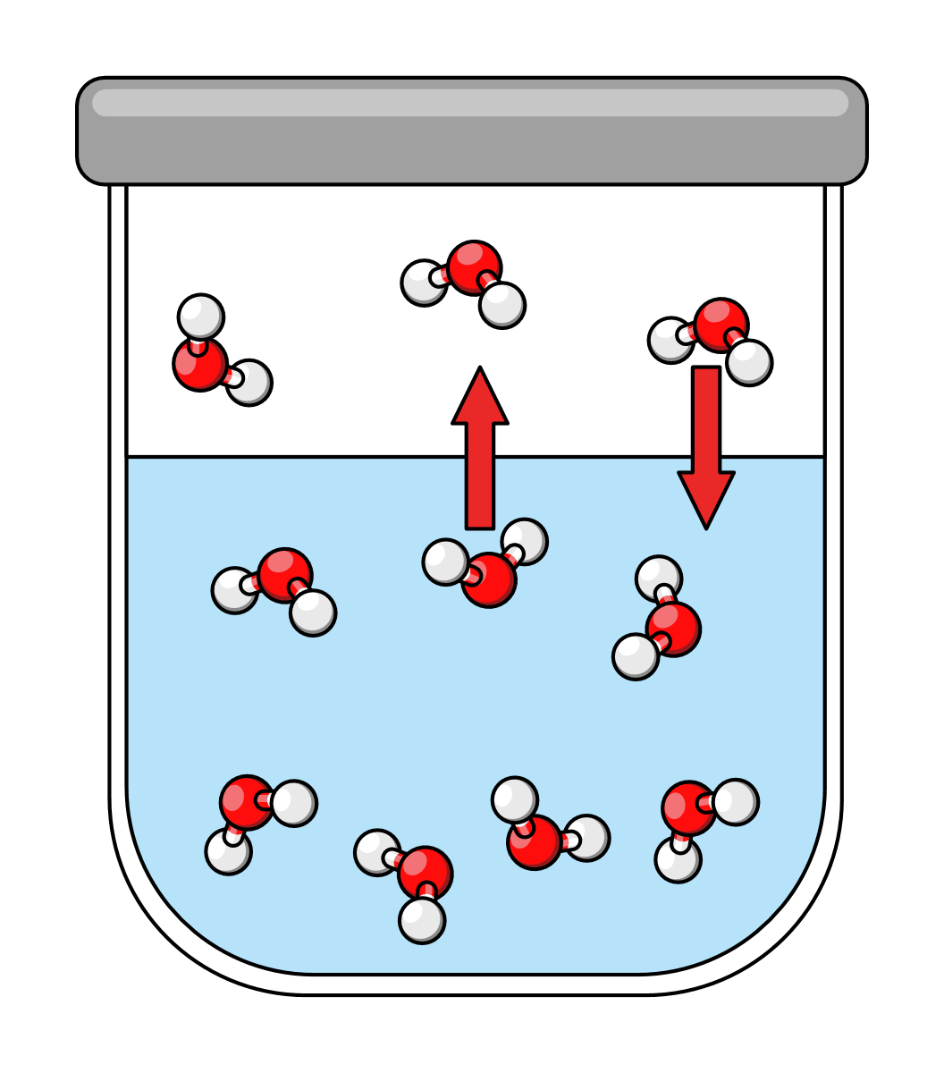
Vapor pressure
Pressure of vapor in contact with liquid or solid
Example of water in a "dynamic equilibrium"
Vapor pressure of water increases as temperature increases

Slide 19
Vapor pressure related to boiling
Vapor pressure of water increases as temperature increases
Water boils when the vapor pressure is greater than the atmospheric pressure (1 atm = 760 torr)
Applicable to all liquids

Slide 20
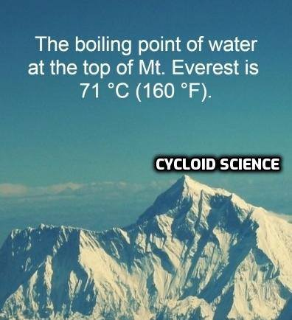
Q: At high altitudes, Why does water boil at a lower temperature?

Slide 21
Outline
Announcements
Review Ideal Gas Law
Ch. 7: Gases
Dalton's Law of Partial Pressures
Molar Mass and Density in Gas Law
Stoichiometry with Gas Law
Diffusion and Effusion
Behavior of Real Gases

Slide 22
Molar mass and density in gas law
Keep track of the units! Recall Ideal gas law:
PV = nRT
Molar mass (g/mol) - obtain moles from the ideal gas law and the mass of the sample is given in the problem
Density (g/L) - perform algebra to obtain n/V and multiply both sides by the molar mass (M)
Mn/V = PM/RT

Slide 23
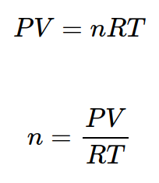
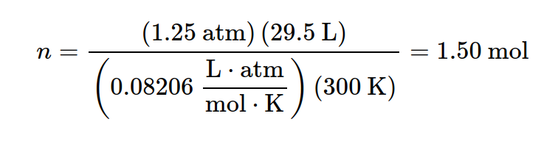
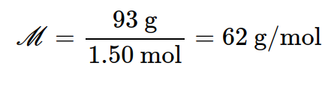
Example: molar mass with ideal gas
93 g sample of a pure gaseous substance occupies 29.5 L at 27°C and 1.25 atm. What is the molar mass of the gas?
Game plan: Keep in mind units for molar mass (g/mol). Find the moles of the gas.

Slide 24
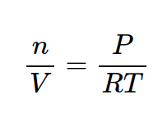
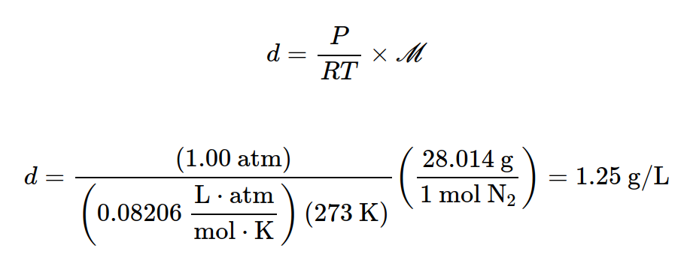
Example: density with molar mass
Find the density of N₂ at 0°C and 1.00 atm pressure.
Game plan: Keep in mind units for density (g/L). Setup the ideal gas
(PV = nRT) and multiply both sides by the molar mass.

Slide 25
Outline
Announcements
Review Ideal Gas Law
Ch. 7: Gases
Dalton's Law of Partial Pressures
Molar Mass and Density in Gas Law
Stoichiometry with Gas Law
Diffusion and Effusion
Behavior of Real Gases

Slide 26
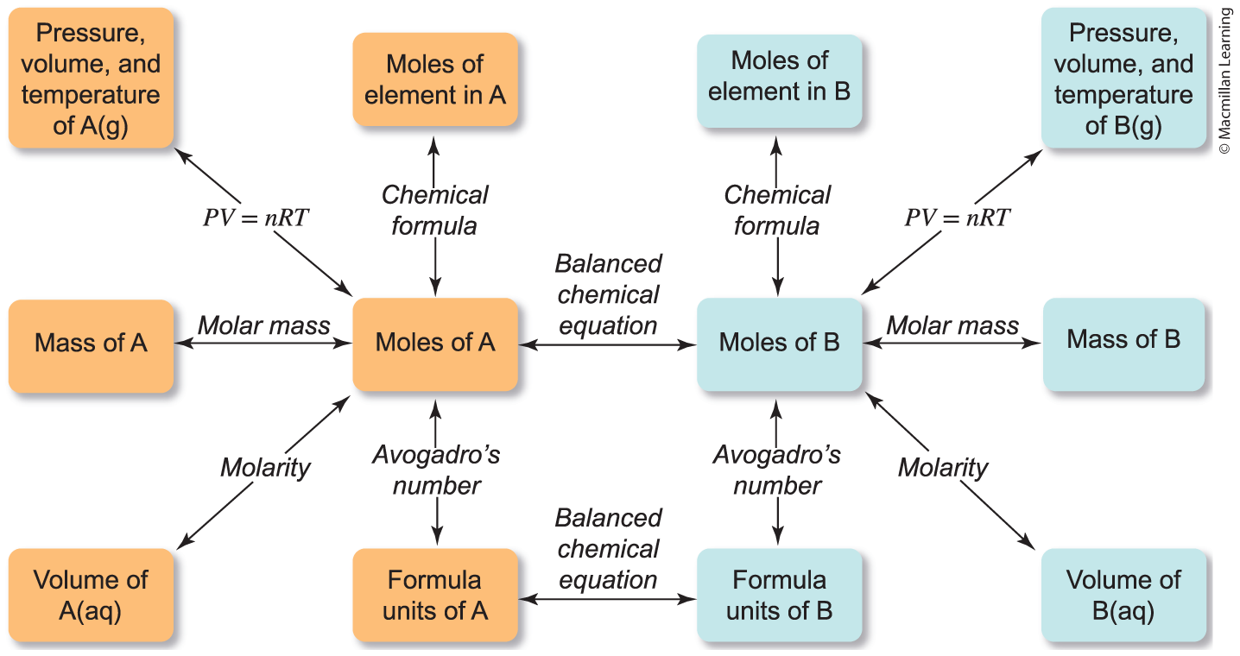
Extra layer to stoichiometry

Slide 27
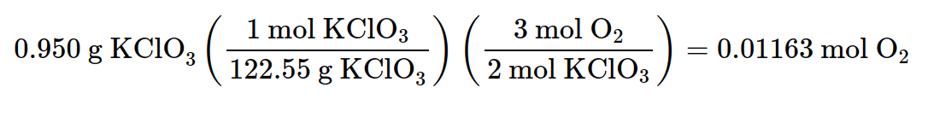
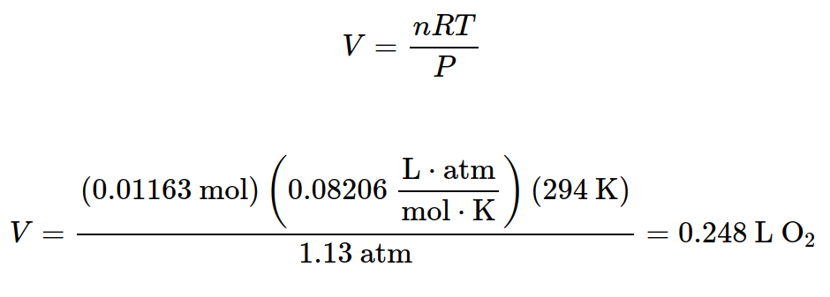
Example: Stoichiometry with gas law
How many liters of O₂(g) at 21°C and 1.13 atm can be prepared by the thermal decomposition of 0.950g KClO₃(s)?
2 KClO₃(s) ---> 2 KCl(s) + 3 O₂(g)
Game plan: Stoichiometry (determine mols O₂) feed into ideal gas law

Slide 28
Your turn: Stoichiometry with gas law
How many grams of Hg₂O is needed to decompose releasing O₂ at a pressure of 0.95 atm and a volume 0.375 L at 22°C.
2 Hg₂O ---> 4 Hg(l) + O₂(g)

Slide 29
Outline
Announcements
Review Ideal Gas Law
Ch. 7: Gases
Dalton's Law of Partial Pressures
Molar Mass and Density in Gas Law
Stoichiometry with Gas Law
Diffusion and Effusion
Behavior of Real Gases

Slide 30

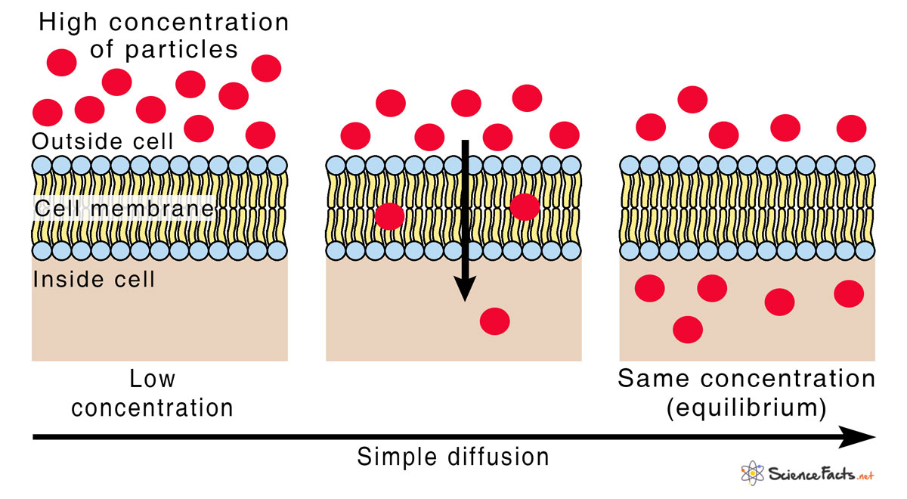
Diffusion and effusion
Diffusion - the movement of molecules from a region of higher concentration to a region of lower concentration down the concentration gradient.

Slide 31
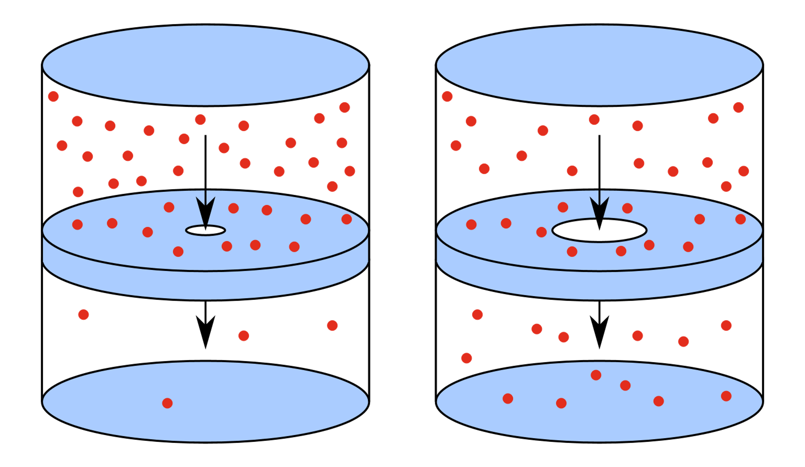
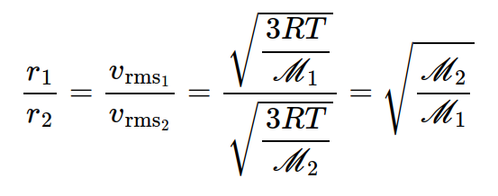
Diffusion and effusion
Effusion - the movement of molecules through a tiny hole into a region of lower pressure
Grahm's Law of Effusion

Slide 32
Grahm's Law of Effusion
r₁, r₂ are effusion rates and M₂, M₁ are molar masses
Smaller the molar mass will have a higher effusion rate

Slide 33
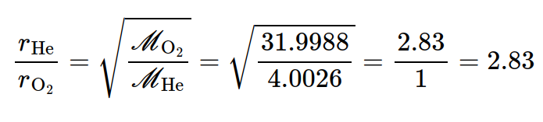
Example: effusion rates
Calculate the relative effusion rates of helium and oxygen gases.

Slide 34
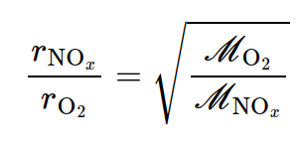
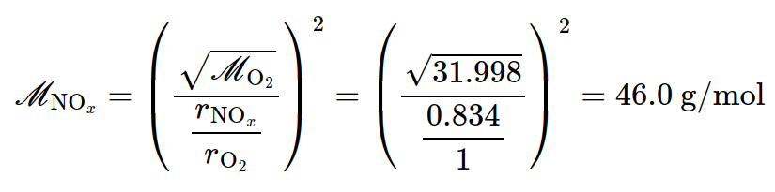
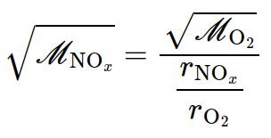
Example: effusion rates
NO_{x} was found to effuse at a rate that is 0.834 times the rate of effusion of oxygen. Determine the molar mass of NO_{x}
Game plan: Write out Grahm's effusion formula and solve for molar mass NO_{x}

