Slide 1
Lecture 16: Real gases
California State University, Fullerton
2023 Fall Semester – Chem 123

Slide 2

QUESTIONS, COMMENTS, AND CONCERNS?

Slide 3
Outline
Announcements
Highlights of the prior lecture
Ch. 7: Gases
Behavior of Real Gases
Gas worksheet

Slide 4
announcements
Gas worksheet due tonight at 11:59pm, 1 hour grace period (hard deadline 1:00am
Online Ch 7 Hw is posted Due Oct 26 at 11:59pm
Grading exam 2 in progress

Slide 5
Outline
Announcements
Highlights of the prior lecture
Ch. 7: Gases
Behavior of Real Gases
Gas worksheet

Slide 6
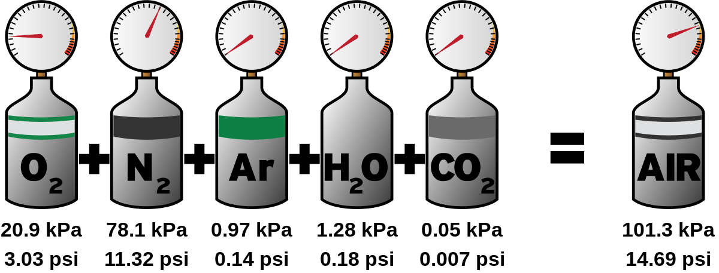

Dalton's law of partial pressures
Since gases are not interacting with one another, we can think of them as independent particles exerting their own pressures (partial pressures)
P₁, P₂, …, P_{n} are partial pressures

Slide 7
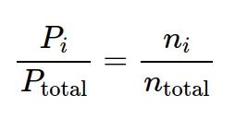
significance of the mole fraction?
n_{i}/n_{total} ratio is the called the mole fraction
Composition of atmosphere is 78% nitrogen and 21% oxygen

Slide 8
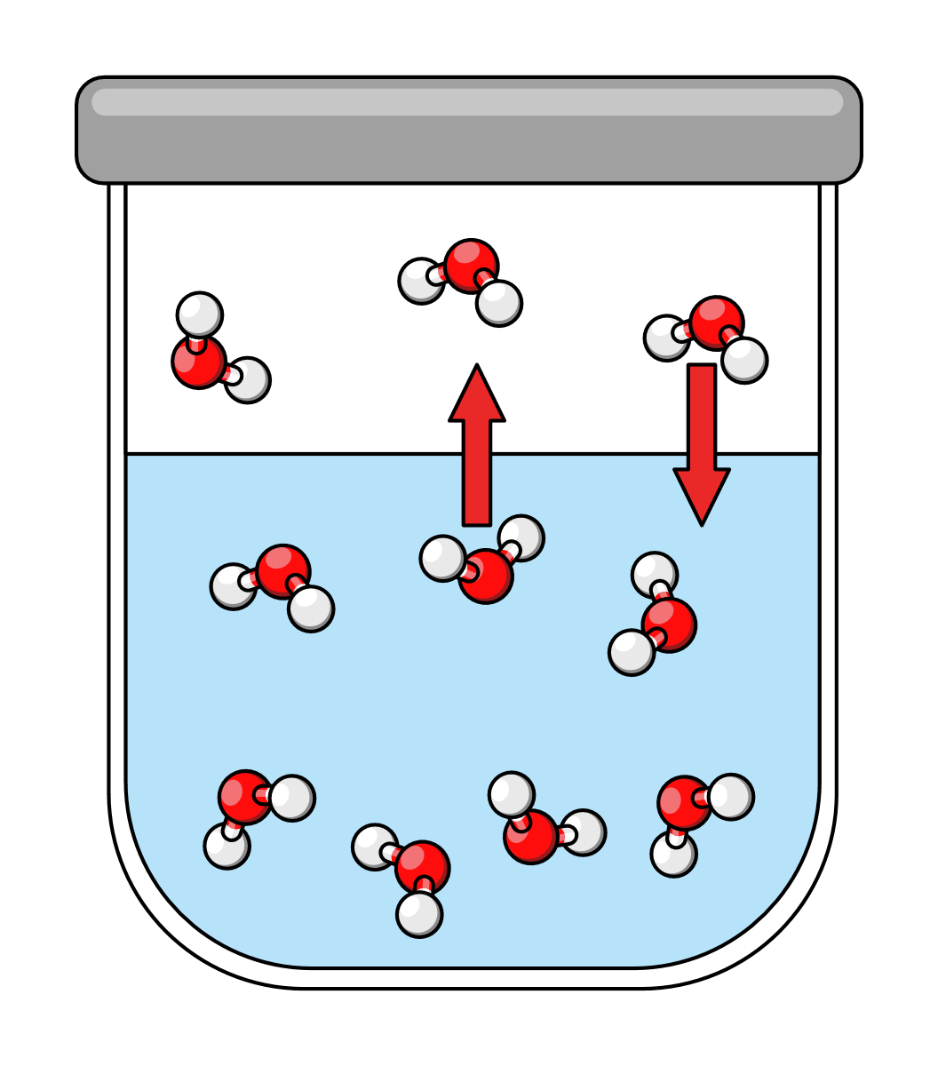
Vapor pressure related to boiling
Vapor pressure of water increases as temperature increases
Water boils when the vapor pressure is greater than the atmospheric pressure (1 atm = 760 torr)
Applicable to all liquids

Slide 9
Molar mass and density in gas law
Keep track of the units! Recall Ideal gas law:
PV = nRT
Molar mass (g/mol) - obtain moles from the ideal gas law and the mass of the sample is given in the problem
Density (g/L) - perform algebra to obtain n/V and multiply both sides by the molar mass (M)
Mn/V = PM/RT

Slide 10
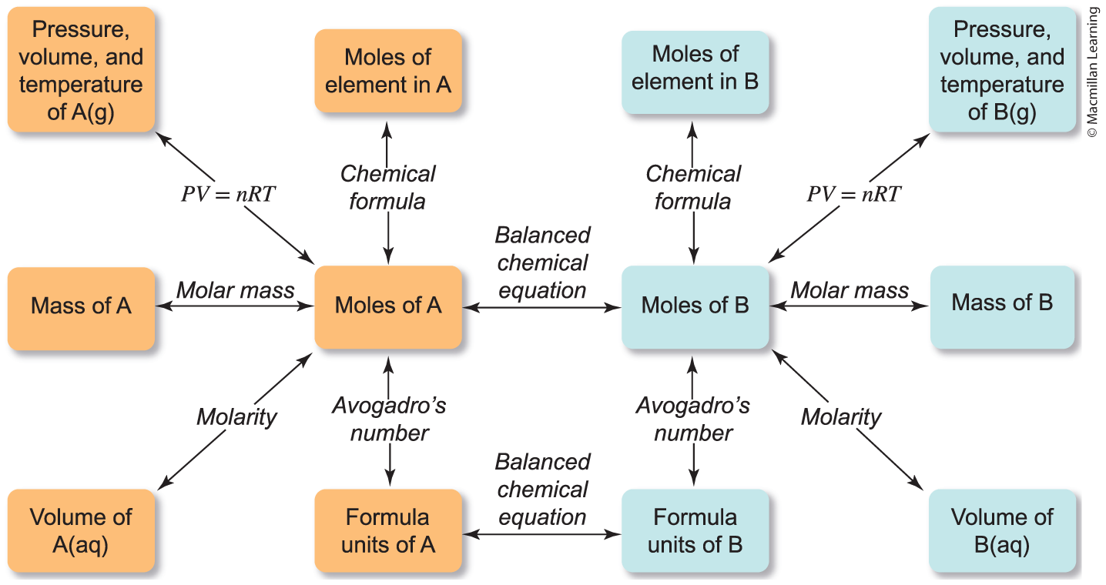
Extra layer to stoichiometry

Slide 11

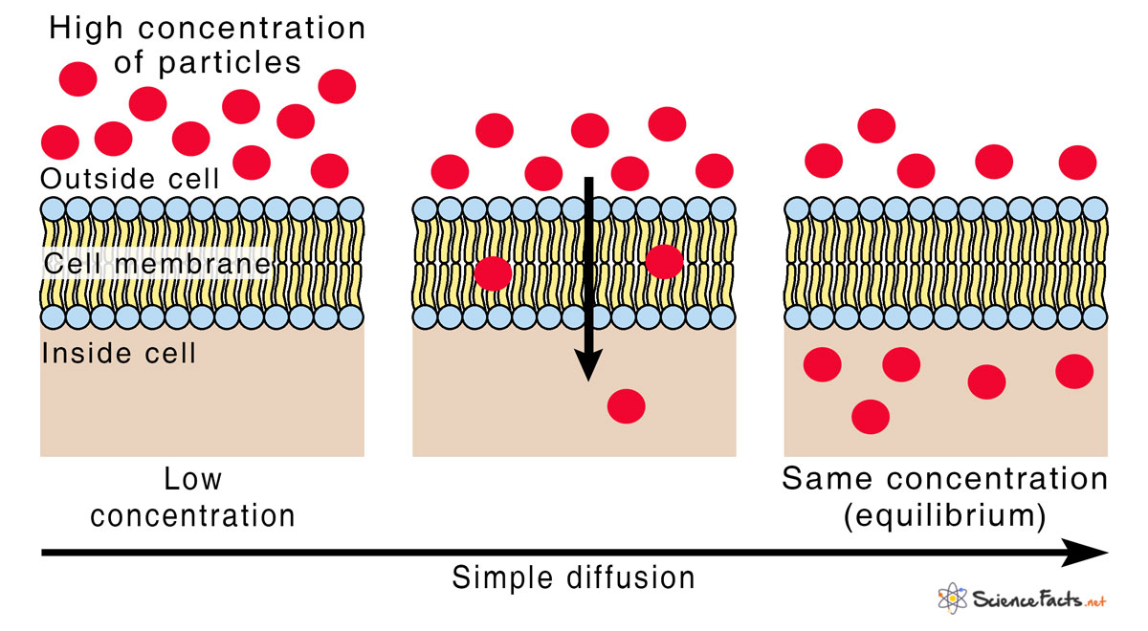
Diffusion and effusion
Diffusion - the movement of molecules from a region of higher concentration to a region of lower concentration down the concentration gradient.

Slide 12
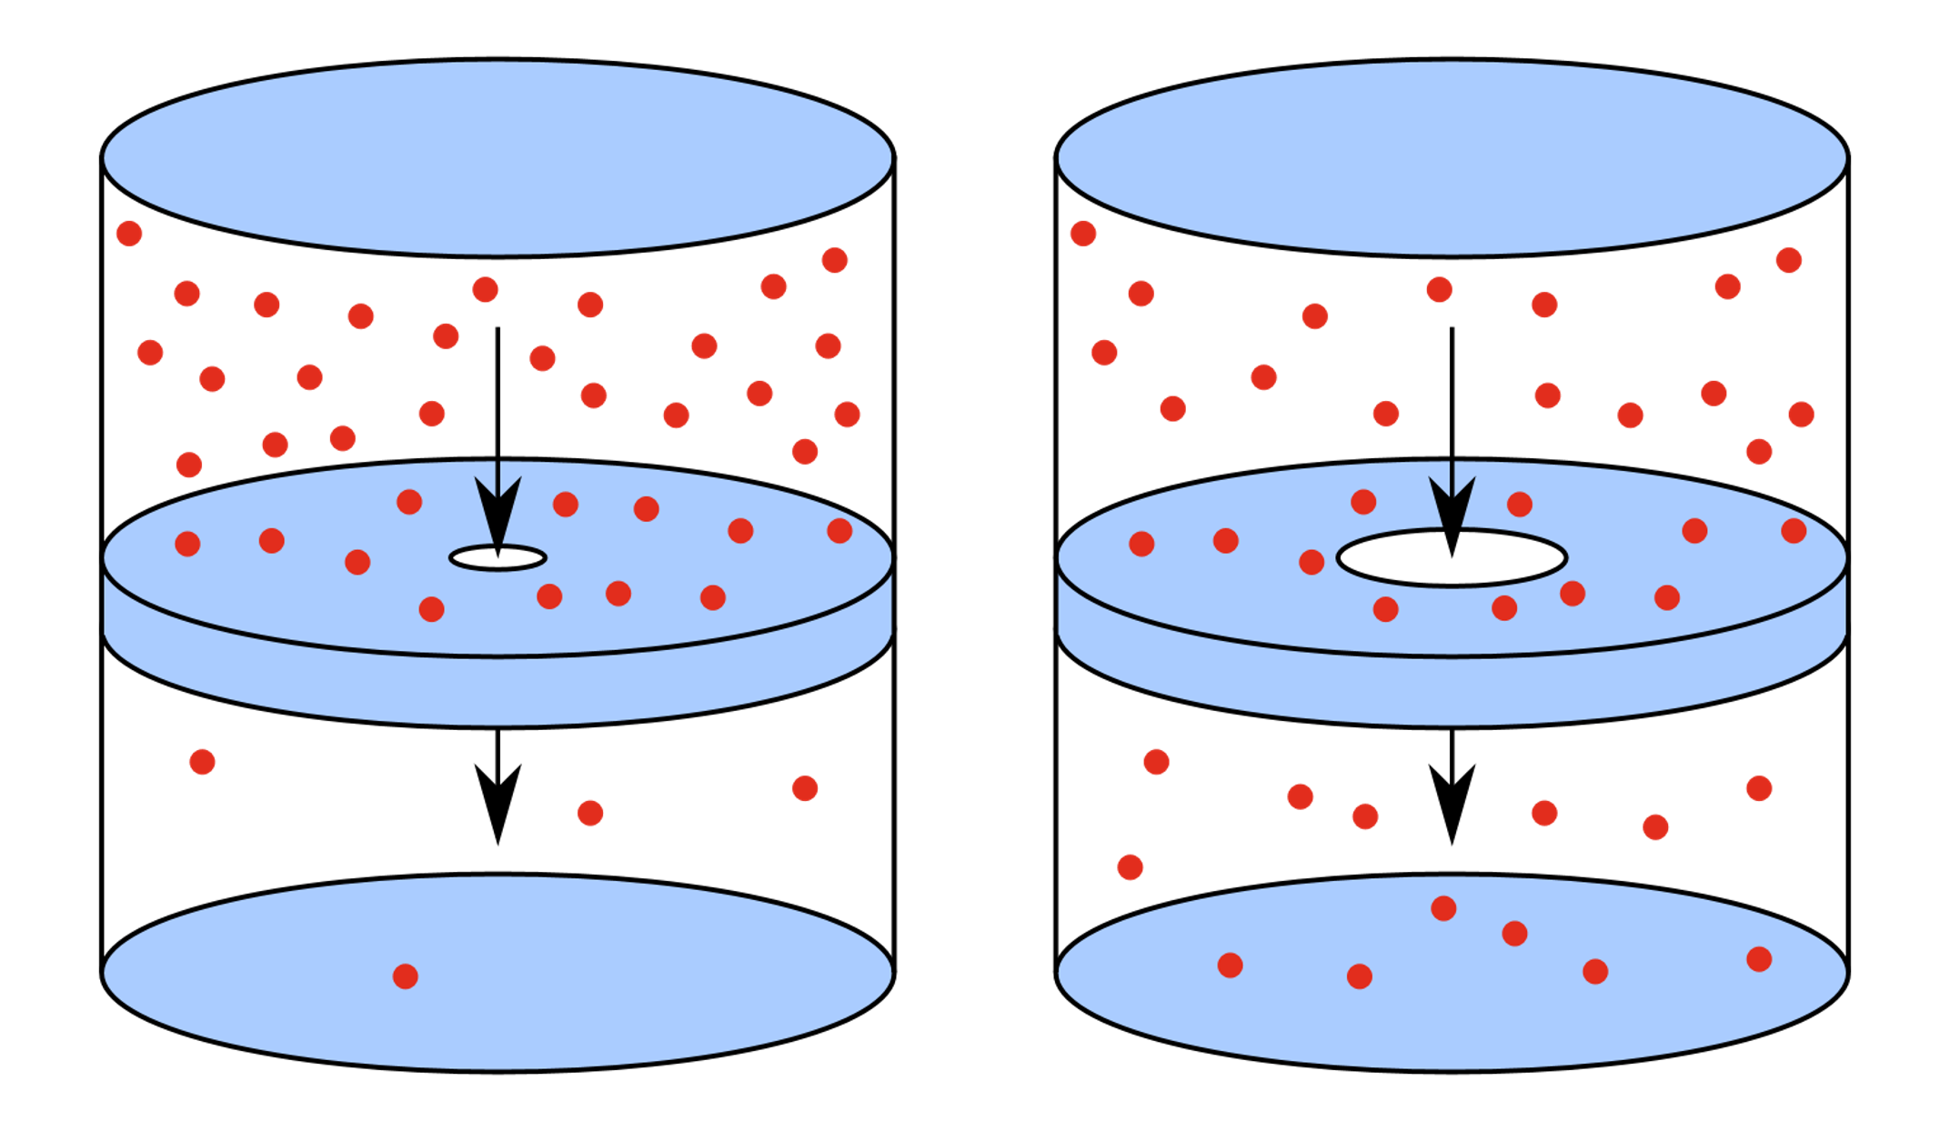
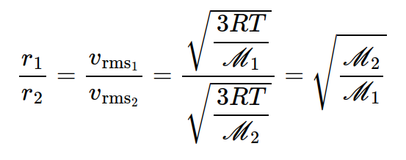
Diffusion and effusion
Effusion - the movement of molecules through a tiny hole into a region of lower pressure
Grahm's Law of Effusion

Slide 13
Outline
Announcements
Highlights of the prior lecture
Ch. 7: Gases
Behavior of Real Gases
Gas worksheet

Slide 14
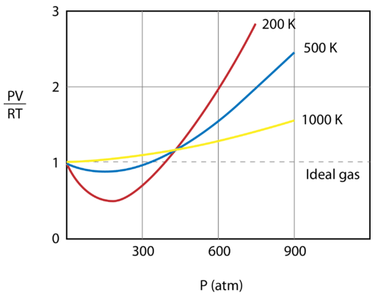
Real gases
Does not behave based on two assumptions of Ideal Gases
Volume of gas particles are negligible
No interactions between gas particles (both attractive and repulsive)

Slide 15
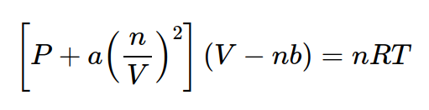
Real gases
Volume bigger than from ideal at high pressures
Pressure is less than from ideal at small volume
Addition of parameters "a" (attractive force) and "b" (repulsive force) incorporated into the ideal gas law
Empirically determined values

Slide 16
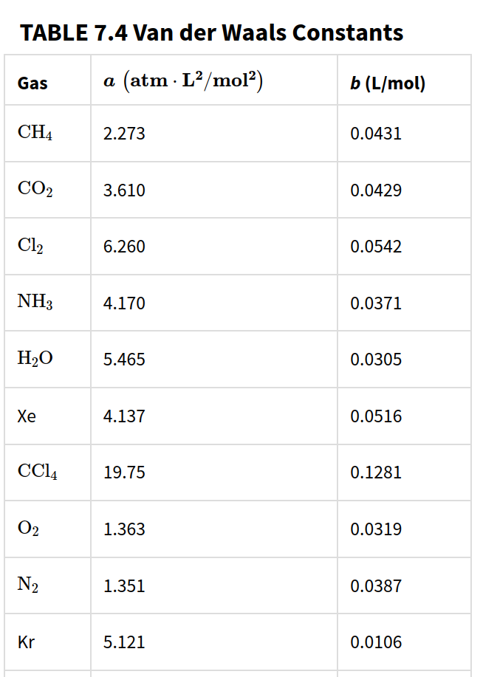
Constants "a" and "b"

Slide 17
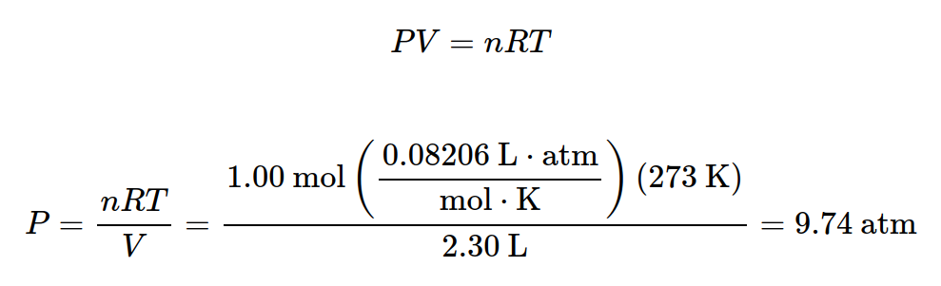
Example: real gas
Calculate the pressure of 1.00 mol Ar(g) at 2.30 L and 273K at ideal gas condition.

Slide 18
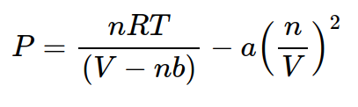
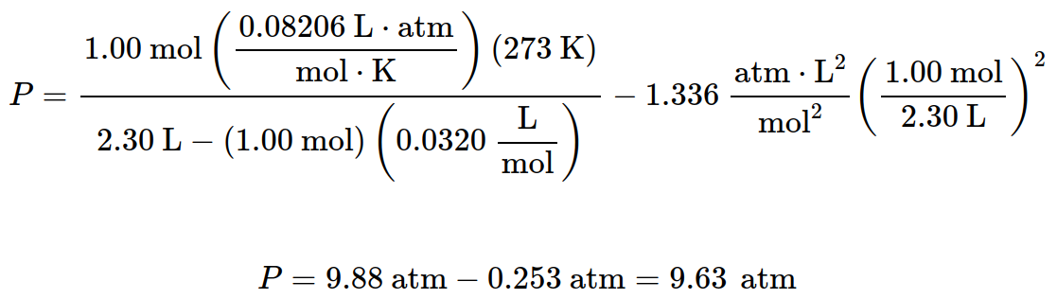
Example: real gas
Calculate the pressure of 1.00 mol Ar(g) at 2.30 L and 273K at real gas condition. (a = 1.336 and b = 0.0320)

