Slide 1
Lecture 10: acid/base titration
California State University, Fullerton
2023 Fall Semester – Chem 123

Slide 2

QUESTIONS, COMMENTS, AND CONCERNS?

Slide 3
Outline
Announcements
Exam 1 Redo
In-class worksheet on Monday, Oct 2nd
Ch. 5: Stoichiometry
Molarity
Acid/Base Titration

Slide 4
announcement
Exam redo for half the points – 33 points out of 66 total points
On a separate document/paper, redo all problems with the correct answers for half the points
Submit the corrections online as well as your exam
Due Mon, Oct 2nd at 11:59pm
Attend Monday, Oct 2nd – in-class worksheets
Submit in-class worksheets onto canvas graded base on completion and effort
2 Pts EC Opportunity: Present all problems on the white board

Slide 5
Outline
Announcements
Exam 1 Redo
In-class worksheet on Monday, Oct 2nd
Ch. 5: Stoichiometry
Molarity
Acid/Base Titration

Slide 6
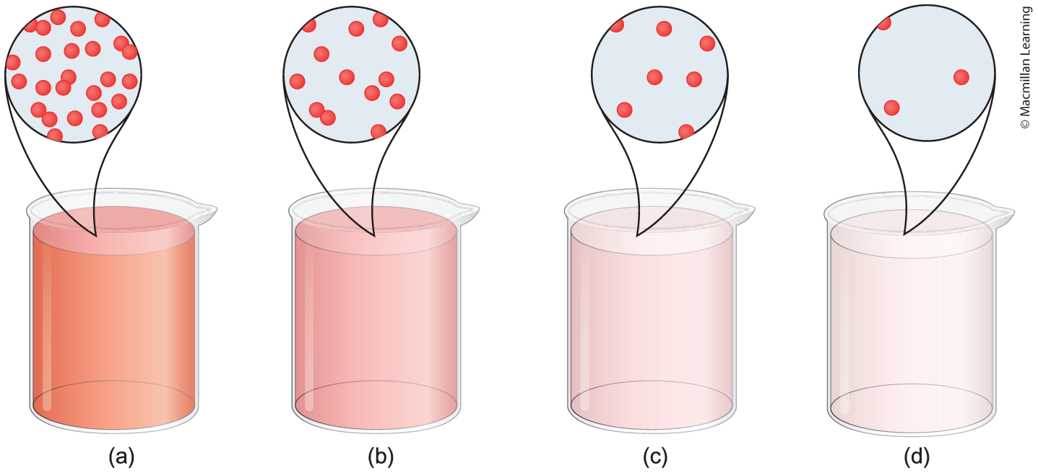
Concentrated and diluted solutions
(a) - supersaturated solution: dissolves more solute than the solution has the capacity to at a given temperature
(b) - saturated solution: at full capacity to dissolve solute
(c)+(d) - unsaturated solution: solvent can dissolve more solute

Slide 7
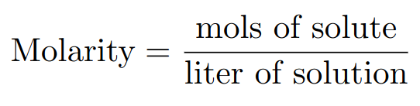
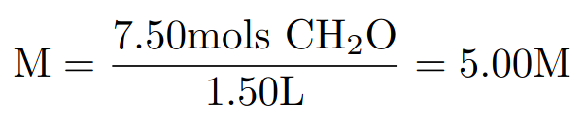
quantifying concentration of solutions
Molarity (M): The ratio of moles solute and liter solution
Example: Calculate the molarity of a solution containing 7.50 mol formaldehyde (CH₂O) in water to form 1.50 L of solution.

Slide 8
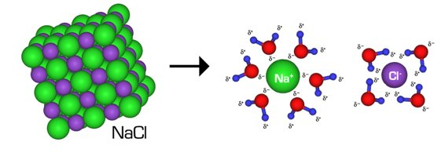
electrolyte revisited
Electrolyte: substance that conducts electric current because of a dissociation into positively and negatively ions
1.50M Cl⁻(aq)
1.50M NaCl(aq)
1.50M Na⁺(aq)

Slide 9
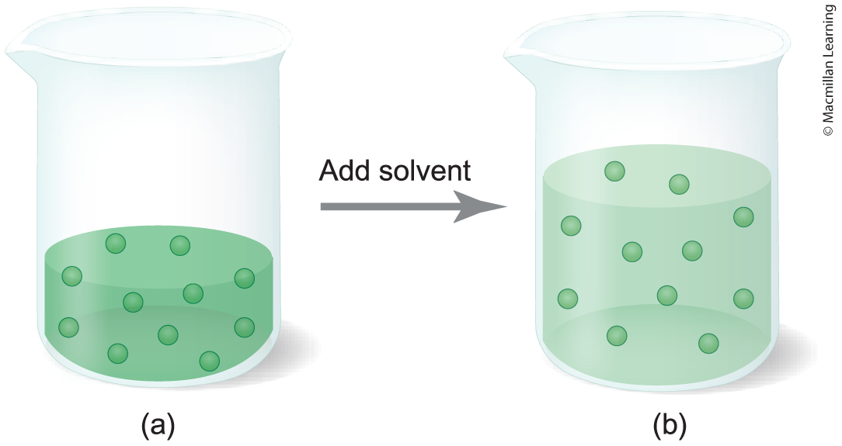


What is dilution?
M₁ is the initial molarity
M₂ is the final molarity
V₁ is the initial volume
V₂ is the final volume
n₁ is the initial mols of solute
n₂ is the final mols of solute

Slide 10
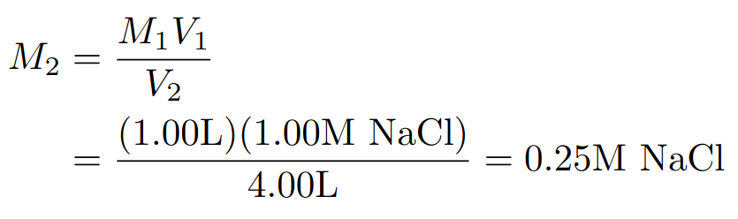
Example: Dilution problems
Example: Calculate the final concentration of NaCl(aq) after 1.00L of 1.00M NaCl(aq) diluted by the addition of 3.00L of water.

Slide 11
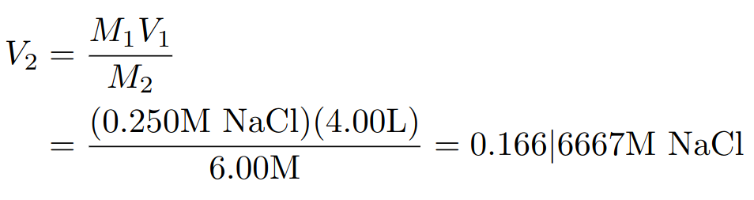
Example: Making solutions
Example: A scientist must prepare 4.00L of 0.500M NaCl(aq) solution from 6.00M NaCl(aq) solution. What volume should the scientist dilute to?
Note: Read the question carefully

Slide 12
Outline
Announcements
Exam 1 Redo
In-class worksheet on Monday, Oct 2nd
Ch. 5: Stoichiometry
Molarity
Acid/Base Titration

Slide 13
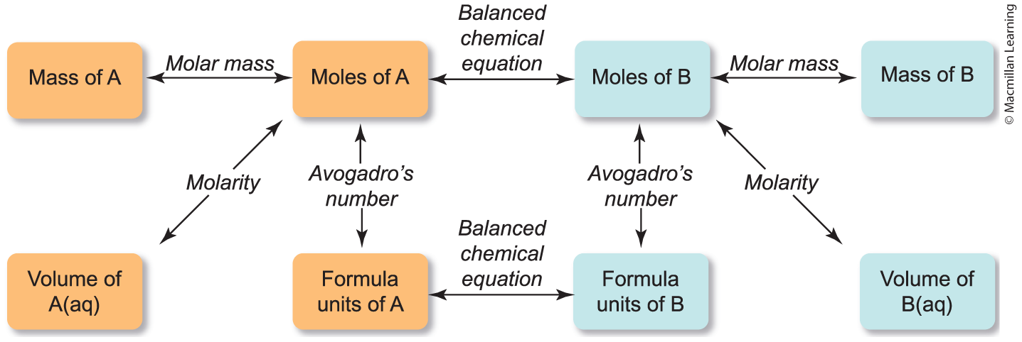
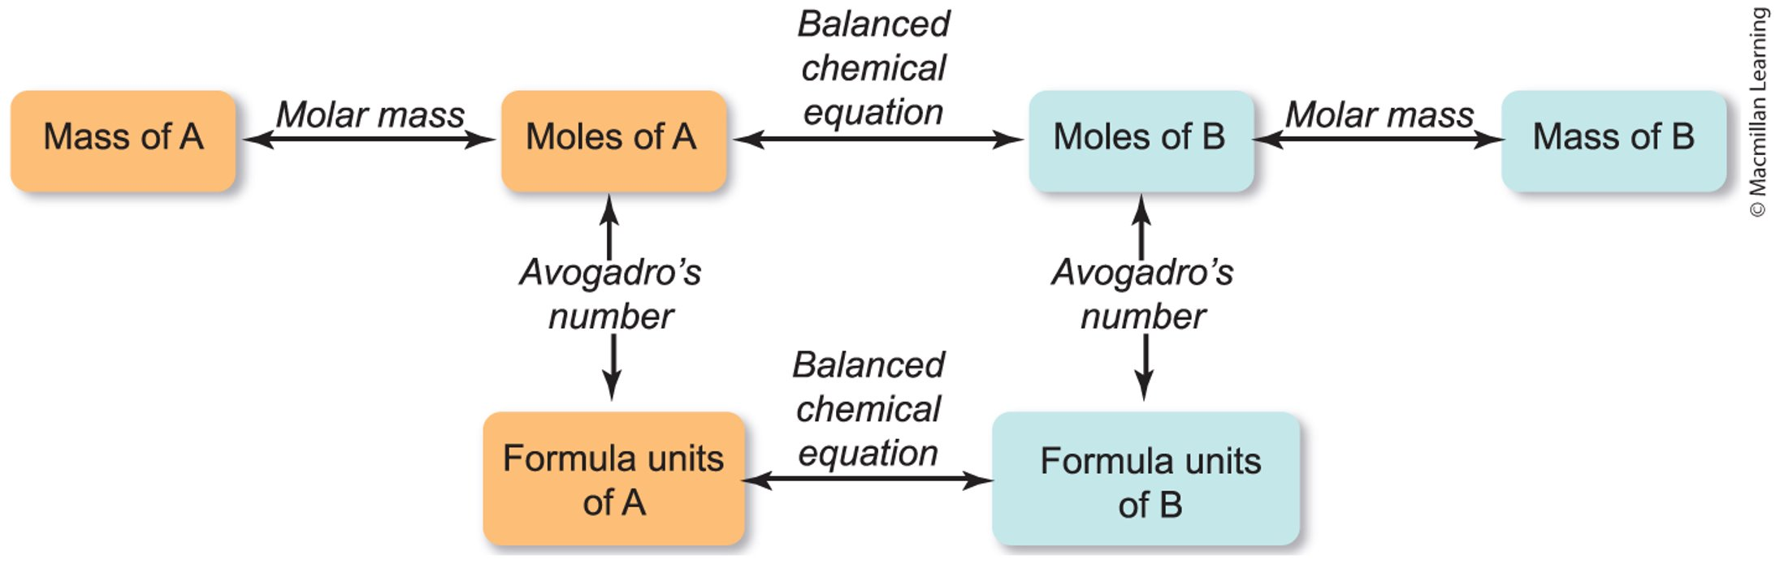
Molarity Stoichiometry – ACID/Base

Slide 14
Example: Acid/base titration
HCl(aq) reacts with NaOH(aq) to yield NaCl(aq) and H2O(l):
HCl(aq) + NaOH(aq) ---> NaCl(aq) + H₂O(l)
Find the volume in L of 1.50M HCl(aq) is needed to react with 35.0mL of 2.45M NaOH(aq).
Game plan:
Recognize all units
For the chemical equation, what unit should we work in?

Slide 15
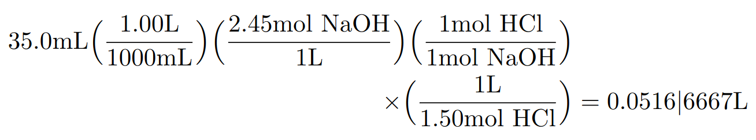
Example: Acid/base titration
HCl(aq) reacts with NaOH(aq) to yield NaCl(aq) and H2O(l):
HCl(aq) + NaOH(aq) ---> NaCl(aq) + H₂O(l)
Find the volume in L of 1.50M HCl(aq) is needed to react with 35.0mL of 2.45M NaOH(aq).

Slide 16
In-class worksheets
Attend Monday, Oct 2nd – in-class worksheets
Submit in-class worksheets onto canvas graded base on completion and effort
2 Pts EC Opportunity: Present all problems on the white board

