Slide 1
Lecture 5: Nomenclature, Moles
California State University, Fullerton
2023 Fall Semester – Chem 123

Slide 2
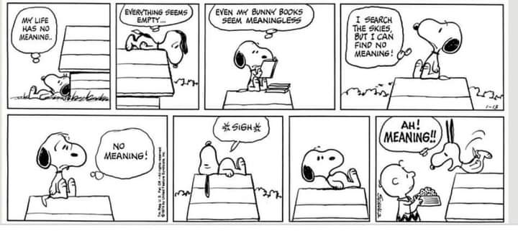
QUESTIONS, COMMENTS, AND CONCERNS?

Slide 3
Outline
Announcements
Ch. 3: Compounds and the Mole
  Naming ionic and binary covalent compounds, and acids
  Mole concept and molar mass
  % composition, molecular formula, and empirical formula
In-Class: Nomenclature worksheet

Slide 4
Annoucements
Picking up the pace – Ch 3, 4, & 5 are the harder to grasp conceptually
Do practice problems at the end of the textbook
First exam week 5 on Weds, Sept 20th – covering Ch 1-4; 5-6 free response questions

Slide 5
Outline
Announcements
Ch. 3: Compounds and the Mole
  Naming ionic and binary covalent compounds, and acids
  Mole concept and molar mass
  % composition, molecular formula, and empirical formula
In-Class: Nomenclature worksheet

Slide 6
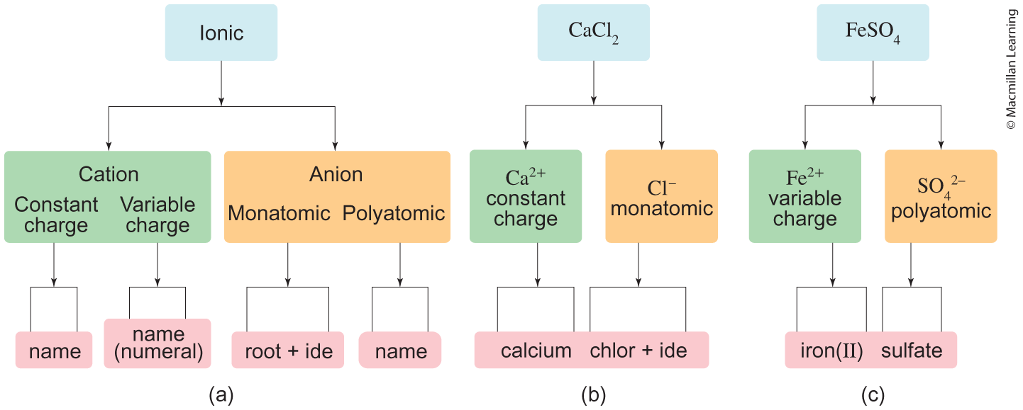
Naming ionic compounds

Slide 7
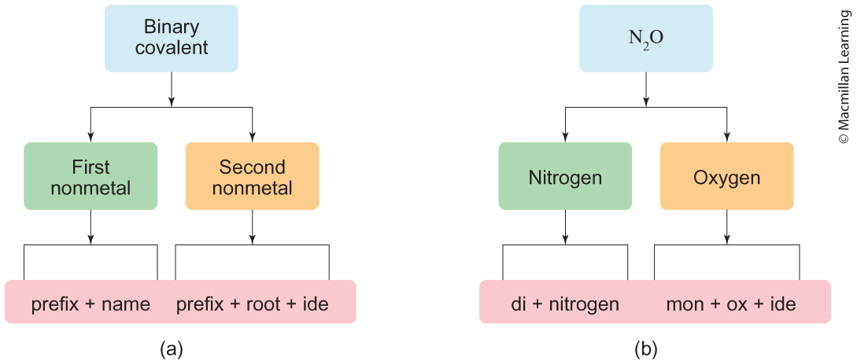
Binary covalent compounds

Slide 8
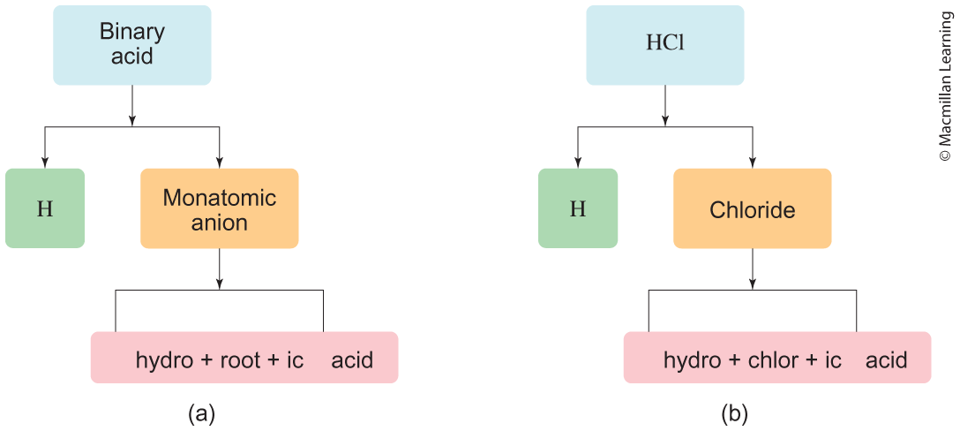
Naming acids
Arrhenius acid (most familiar) – release of proton (H⁺ ion) in solution
Binary acid – H atom(s) bonded to monatomic anion

Slide 9
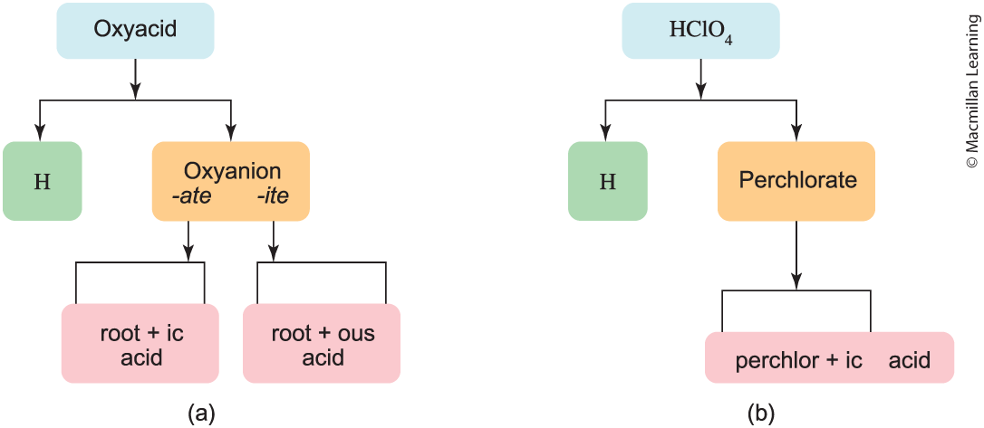
Naming acids
Oxyacid – H atom(s) bonded to oxyanion (ClO₄¹⁻, SO₄²⁻, PO₄³⁻)

Slide 10
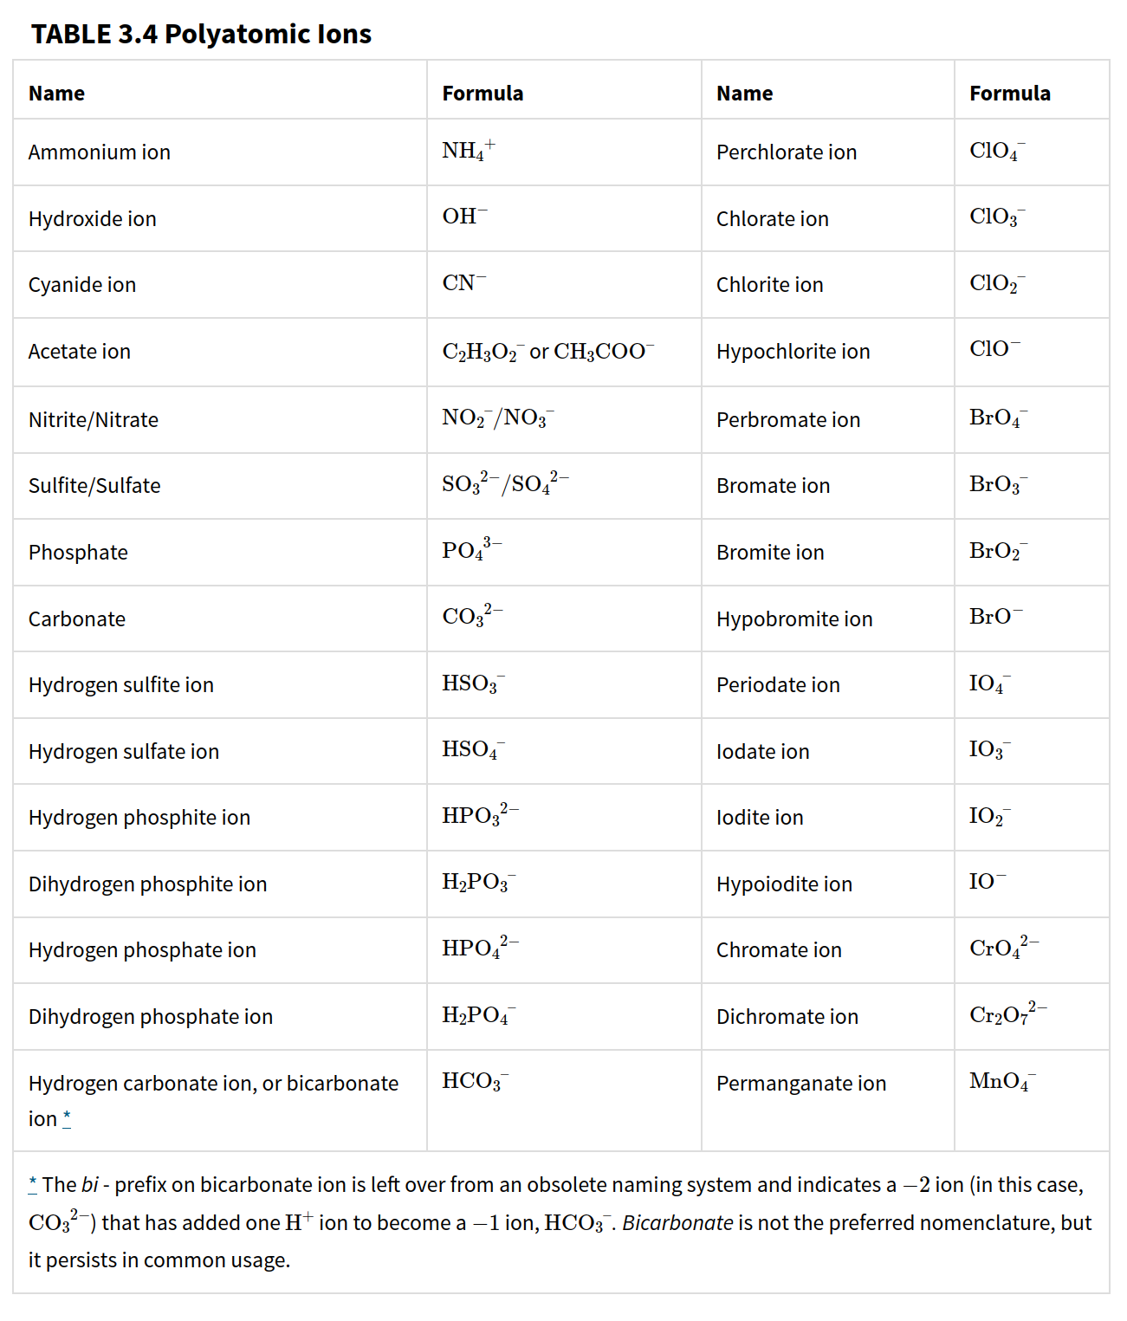
Practice: Naming the acids
H₃PO₄
H₂SO₄
HF
Hydrochloric acid
Bromous acid
HNO₃

Slide 11
Outline
Announcements
Ch. 3: Compounds and the Mole
  Naming ionic and binary covalent compounds, and acids
  Mole concept and molar mass
  % composition, molecular formula, and empirical formula
In-Class: Nomenclature worksheet

Slide 12
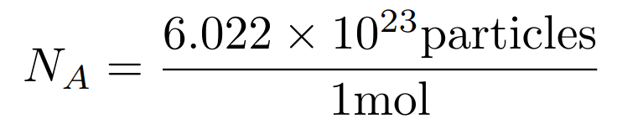
the mole and avogadro's number
Analogy to ratios e.g. 1 dozen eggs is 12 eggs
Avogadro's number (N_{A}) relates to the mole and the number of "particles" (atoms, molecules, or photons – light particles)
Example: How many moles of H₂O are in a drop of water that contains
1.67 x 10²¹ H₂O molecules?

Slide 13
Power of the Mole: atoms in a compound
Sucrose (C₁₂H₂₂O₁₁) is a single molecule made of 12 C atoms, 22 H atoms, and 11 O atoms
Alternative perspective: 1 mol Sucrose – 12 mols C, 22 mols H, and 11 mols O
Indicated by the subscripts!
Examples: Determine the amount of mols per atom within the compound.
1 mol CCl₄
4 mol CCl₄
0.5 mol H₃PO₄

Slide 14
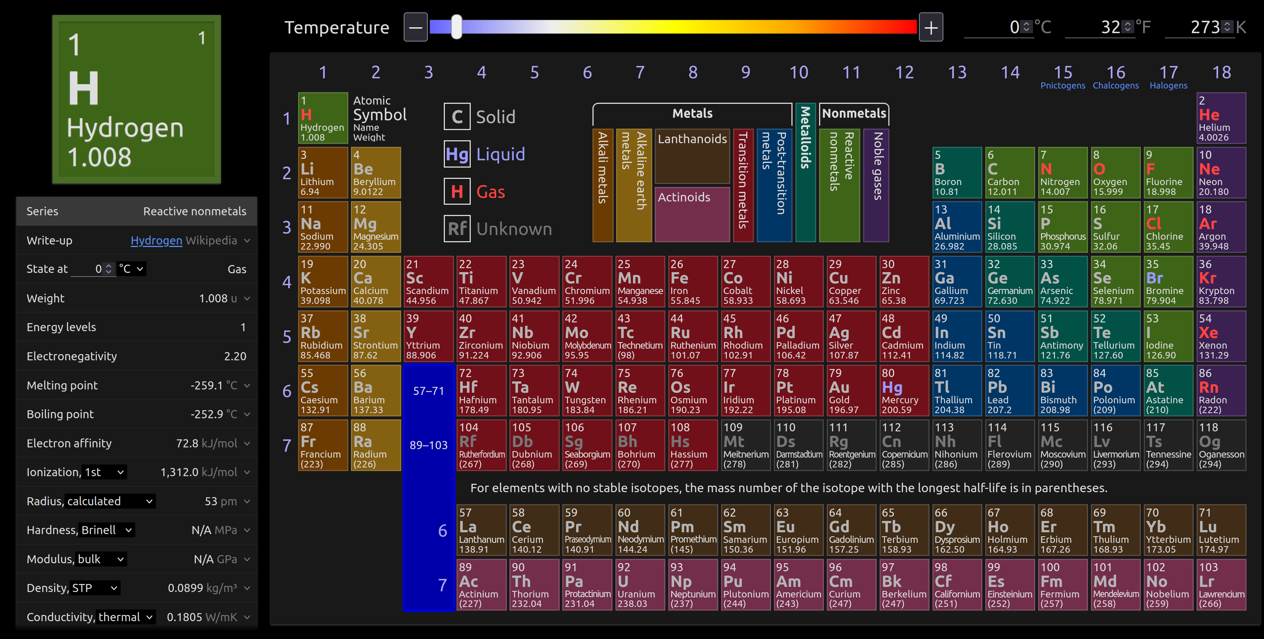
Calculating molar masses

Slide 15
Calculating molar masses
1 atomic mass unit (amu) is equivalent to 1.661 x 10⁻²⁷ kg
Claim: 1.008 amu H is 1.008 g/mol H. Prove that. Hint: Use Avogadro's number (6.022 x 10²³ atoms/mol)

Slide 16
Calculating molar masses

Slide 17
Molar masses of compounds
Calculating the molar mass of compounds is summing the molar masses of the atoms
Examples: Determine the molar masses for each compound.
CCl₄
H₃PO₄

Slide 18
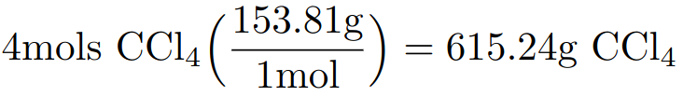
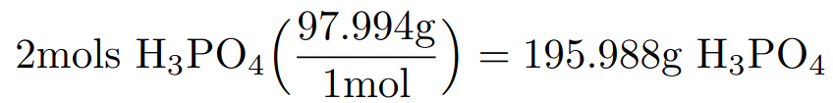
Meaning of molar mass
Analogy to density (g/mL) converting from one unit to another
Molar mass conversion between grams (g) and moles (mol)
Examples: Convert to grams for the following compounds.
4 mols CCl₄
2 mols H₃PO₄

Slide 19
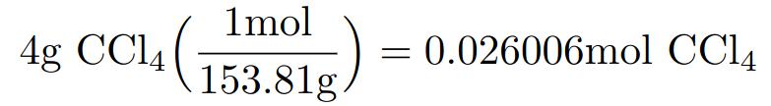
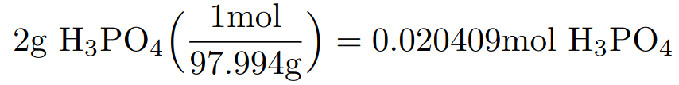
Meaning of molar mass
Analogy to density (g/mL) converting from one unit to another
Molar mass conversion between grams (g) and moles (mol)
Examples: Convert to moles for the following compounds.
4 grams CCl₄
2 grams H₃PO₄

Slide 20
Outline
Announcements
Ch. 3: Compounds and the Mole
  Naming ionic and binary covalent compounds, and acids
  Mole concept and molar mass
  % composition, molecular formula, and empirical formula
In-Class: Nomenclature worksheet

Slide 21
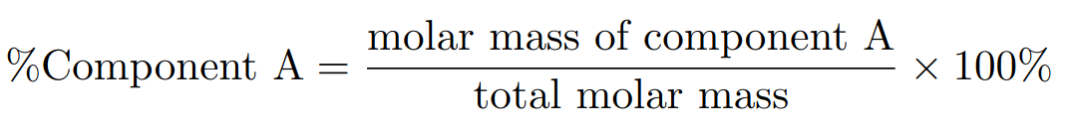
% Composition
Finding the % composition of the atom within a compound
Examples: Calculate the % composition for CCl₄

Slide 22
% Composition
Finding the % composition of the atom within a compound
Your Turn: Calculate the % composition for CaF₂

Slide 23
Molecular and empirical formula
Empirical formula – smallest ratio of elements within a compound e.g. CH₂O
Molecular formula – scalar multiple of the empirical formula e.g. C₆H₁₂O₆
Note: molar mass of molecular formula is a scalar multiple of the empirical formula
Helpful to determine the molecular formula of the unknown compound

Slide 24
Steps to Finding the empirical formula
Given the mass or % composition of each element. Out of 100% or 100g, convert each element to masses e.g. 25% C, 50% O, 25% H --> 25 g C, 50 g O, 25 g H
Convert all units to moles (Why?)
Divide by the smallest amount of moles. If the ratio is 0.333 or 0.667, then multiply all ratios by 3. If the ratio is 0.5, then multiply ratios by 2.
Round each ratio to whole numbers.

Slide 25
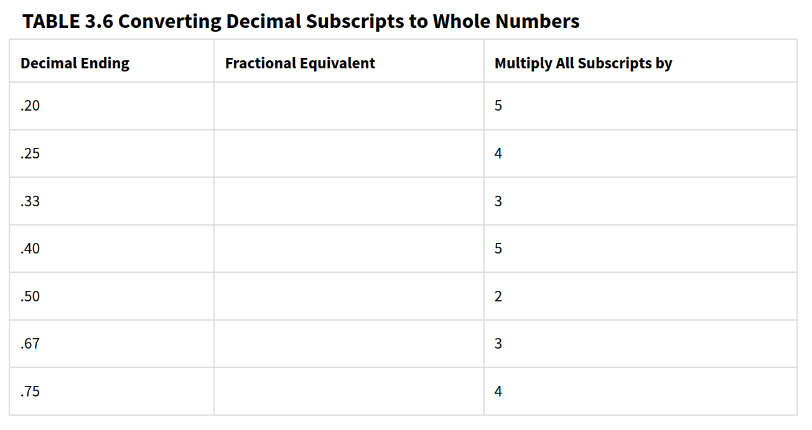
Converting Decimal subscripts to whole numbers

Slide 26
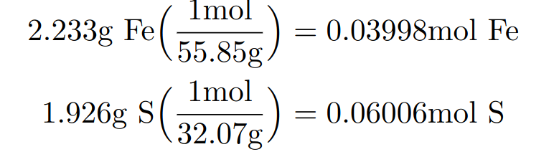
Example: finding empirical formula
A sulfide of iron was formed by combining 1.926g of sulfur(S) with 2.233g of iron (Fe). What is the compound’s empirical formula?
Fe:Fe – 1.000
S:Fe – 1.502
Note: Since S:Fe ends in 0.5, multiple all ratios by 2. Empirical formula Fe₂S₃

Slide 27
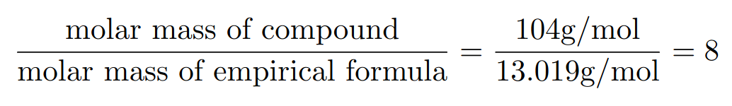
Finding molecular formula
After finding the empirical formula, the molar mass of compound is given experimentally
Divide the experimentally determined molar mass by molar mass of empirical formula; multiple the ratio for each element in empirical formula
Example: Polystyrene has an empirical formula of CH. A scientist synthesized polystyrene that was determined to have a molar mass of 104 g/mol. Determine the molecular formula.
C₈H₈

Slide 28
Your turn: determine empirical and molecular formula
A major textile dye manufacturer developed a new yellow dye. The dye has a percent composition of 75.95% C, 17.72% N, and 6.33% H by mass with a molar mass of about 240 g/mol. Determine the molecular formula of the dye.

Slide 29
In-class: complete nomenclature worksheet
For the remaining time of lecture, work with classmates on nomenclature worksheet
Each student submit on canvas the worksheet by today at 11:59 pm
Graded based on completion and effort

